Slide 1
MapReduce: Simplified Data Processing on Large Clusters
Jeffrey Dean and Sanjay Ghemawat
Presented by : Young-Chan Choi

Slide 2
Index
Introduction
Programming Model
Implementation
Performance
Conclusion

Slide 3
Introduction
Motivation
Hundreds of special-purpose computations that process large amount of raw data.
Most computations are straightforward… BUT…
Problems
input data is large
Computations have to be distributed across hundreds/thousands of machines
Junior Developer

Slide 4
Introduction
Restricted Programming model
Most of the parallel processing systems have only been implemented in smaller scales and leave details of handling machine failures to the programmer
Bulk Synchronous Programming / some MPI primitives
provides higher-level abstraction
active disk: computation is pushed into processing elements that are close to local disk → locality optimization
Junior Developer

Slide 5
Introduction
Restricted Programming model
River
Non-uniformities introduced by heterogeneous hardware or system perturbations
Provide good average case performance by careful scheduling of disk and network transfers
BAD-FS
Targeted to the execution of jobs across a wide-area network
Fundamental similarities
Use redundant execution to recover from data loss caused by failures
Locality aware scheduling
Junior Developer

Slide 6
Introduction
MapReduce
New abstraction that hides messy details of parallelization, fault-tolerance, data distribution and load balancing
Simple and powerful interface that enables automatic parallelization and distribution of large-scale compuation
Writing code for every computations
Using MapReduce

Slide 7
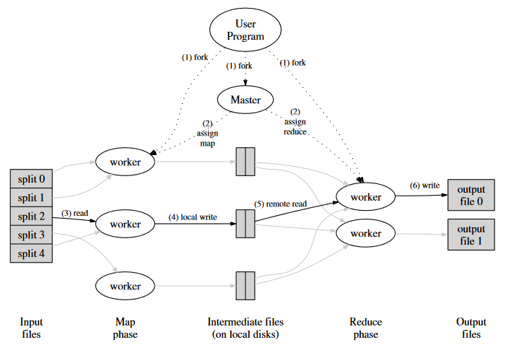
Programming model
Map, Reduce
Map
Reduce
Input
Key/value
map
Intermediate
Key/value
Intermediate
Key/value
merge
Smaller
Values
0 or 1 output file

Slide 8
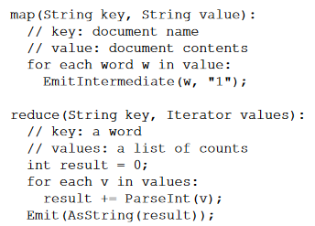
Programming model
Example
Word count
Map output
Key | Value
AAA | 1
BBB | 1
AAA | 1
CCC | 1
Key | Value
BBB | 1
BBB | 1
CCC | 1
CCC | 1
Reduce output
Key | Value
AAA | 2
Key | Value
BBB | 3
Key | Value
CCC | 3

Slide 9
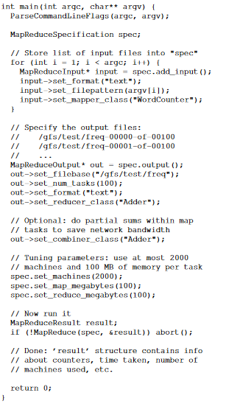
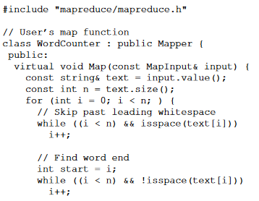
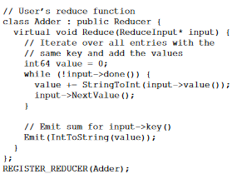
Programming model
Example
Word count(Full Code)

Slide 10
Implementation
Environment
Dual-processor x86 system with 2~4GB RAM
100mb/s ~ 1gb/s ethernet
Hudreds/thousands of machines → machine failure is common
Distributed file system(GFS) use replication to provide availability and reliability
Users submit jobs to a scheduling system

Slide 11
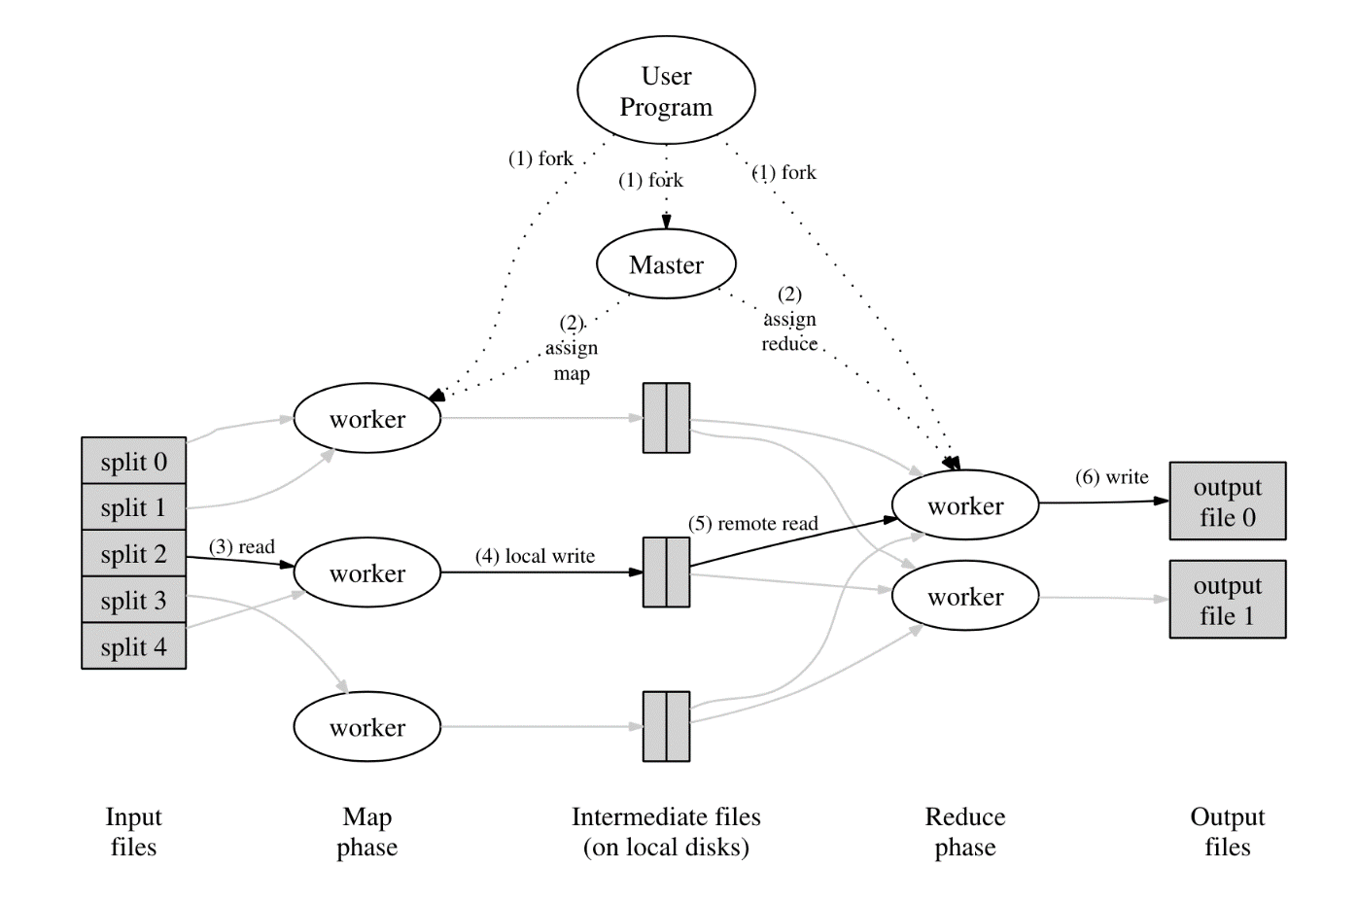
Implementation
Execution Overview
Step1
split input files into M pieces
each piece is about 16~64MB
start copies of program on a cluster of machines

Slide 12
Implementation
Execution Overview
Step2
One of the copies of program is master
Rest are workers
M map tasks, R reduce tasks
Master assigns map tasks and reduce tasks

Slide 13
Implementation
Execution Overview
Step3
Map task workers read the content of the corresponding input split
Parses key/value pairs out of input data
Intermediate key/value pairs produced by user-defined Map function are buffered in memory

Slide 14
Implementation
Execution Overview
Step4
Buffered intermediate key/value is written to local disk, partitioned into R regions
Location of data are passed back to the master
Send location of data

Slide 15
Implementation
Execution Overview
Step5
Reduce worker read buffered data from the local disk of map workers
Sort intermediate data by intermediate keys all occurrences of the same key are grouped together
If intermediate data is too large, external sort is used

Slide 16
Implementation
Execution Overview
Step6
Reduce worker iterates over the sorted intermediate data, passes key and corresponding intermediate values to user’s reduce function
Output of reduce function is appended to a final output file

Slide 17
Implementation
Execution Overview
Step7
Mater wakes up the user program when all map tasks and reduce tasks have been completed
Final Output
R output files
No need to combine

Slide 18
Implementation
Master Data Structures
Step7
Mater wakes up the user program when all map tasks and reduce tasks have been completed
Final Output
R output files
No need to combine

Slide 19
Implementation
Fault Tolerance
Worker Failure
no response is received from a worker in a certain amount of time → worker failed
Master Failure
Write checkpoints of the master data structures
If master task dies, restart from checkpoint state
Worker
Worker
Job 1
Job 2
Job 3 – failure happened
Job 4
Job 1
Job 2
Job 3
Job 4
Master
Reassign Job

Slide 20
Implementation
Locality
Network bandwidth is relatively scarce resource
Input data is stored on the local disks
Master schedule a map task on a machine that contains a replica of corresponding input data
Worker
Worker
Worker
Worker
Worker
Worker
data1
data1
Assign
job
Network Disconnect
Master

Slide 21
Implementation
Task Granualarity
Map: M pieces Choose M that makes individual task is roughly 16~64MB
Reduce: R pieces R is constrained by users because output file depends on R
M, R is larger than number of workers – improves dynamic load balancing, speeds up recovery when failure happens
Master make O(M+R) scheduling decisions, keeps O(M*R) state in memory
M=20000, R=5000 when using 2000 worker machines

Slide 22
Implementation
Backup Tasks
straggler
Machine that takes long time to complete one task
Ex) machine with bad disk
When MapReduce is close to completion, master schedules backup execution of the remaining in-progress tasks
Task is completed when primary or backup execution completes
Job 1
Job 2
Job 3 – failure happened
Job 4
Worker
(straggler)
Worker
(straggler)
Master
Worker
Worker
Master
Worker
Worker
fin
fin

Slide 23
Performance
Tasks
Task1(Grep)
Find particular pattern of data on about 1TB of data
Extracts a small amount of interesting data from large data set
Task2(Sort)
Sort 1TB of data
Shuffles data from one representation to another
Cluster Configuration
1800 machines
2GHz Intel Xeon processor with Hyper Threading enabled
4GB memory (2.5~3GB available)
160GB HDD
2-level 3-shaped switched network aggregated bandwidth: 100~200Gbps

Slide 24
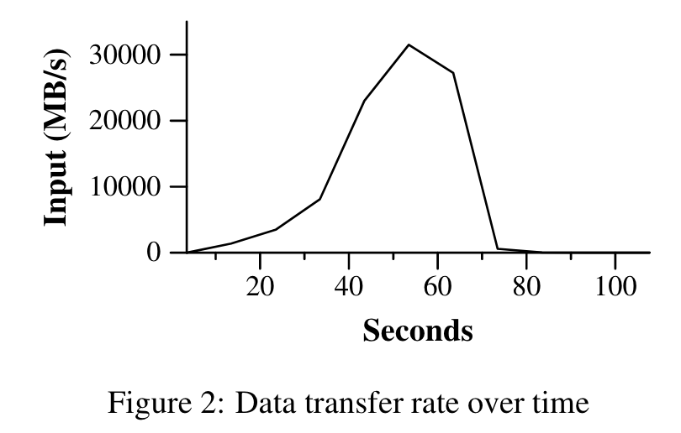
Performance
Task: Grep
Task
Scans 10^10 100-byte records, search for rare three-character pattern (92,337 occurred)
M=150,000 R=1
1764 workers
Rate increases as more machines are assigned to MapReduce computation
Takes 150 secs (including startup overhead)

Slide 25
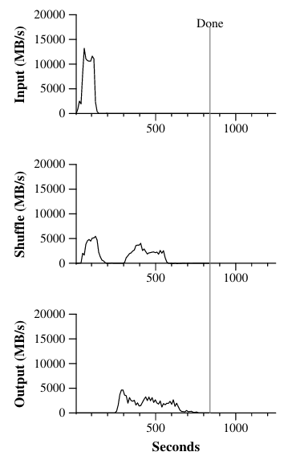
Performance
Task: Sort
Task
Sort 10^10 100-byte records
Map key: sorting key value: original text line
Reduce identity function
M=150,000 R=4,000
Takes 891sec (including startup overhead)
NOTE
Input rate is higher because of locality optimization
Shuffle rate is higher than output rate because writes two copies of sorted data

Slide 26
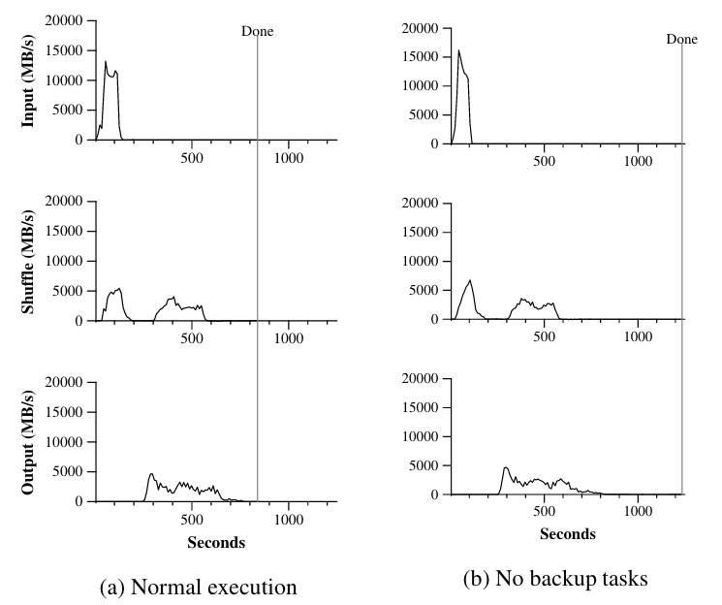
Performance
Effect of backup tasks
5 reduce tasks don’t finish until 300 seconds after when other tasks are finished
With no backup tasks, computation takes 1283 seconds

Slide 27
Performance
Machine failures
Killed 200 out of 1746 workers (only the processes were killed)
computation takes 933 seconds (5% increase)

Slide 28
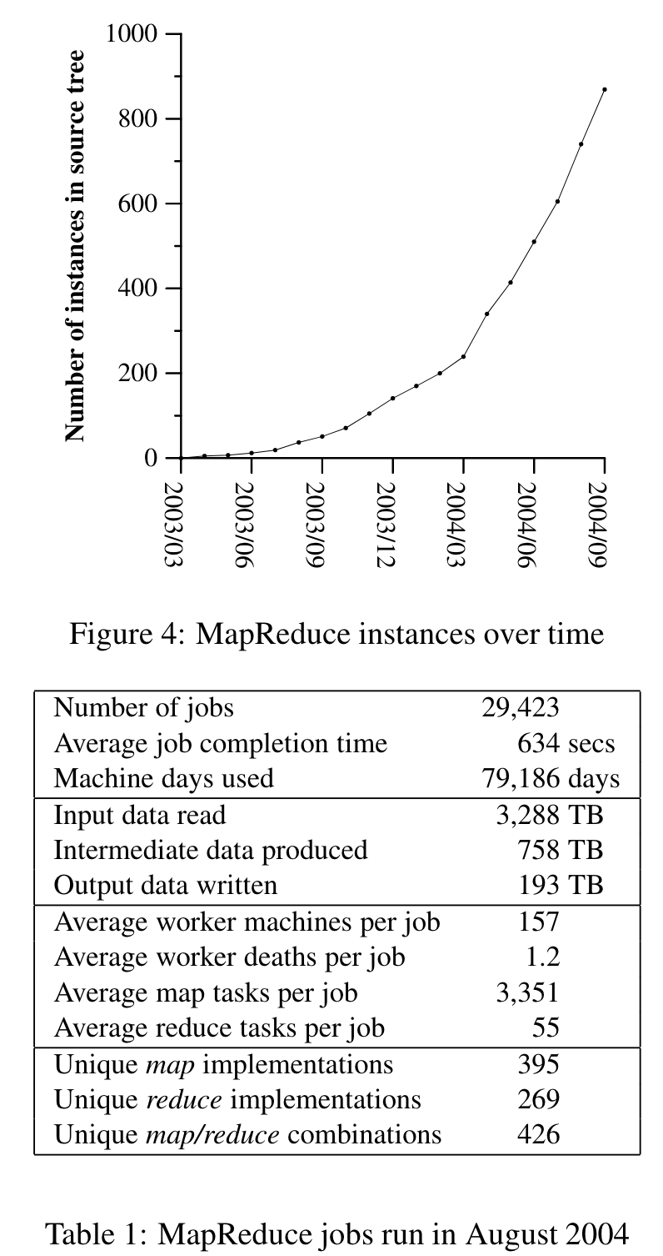
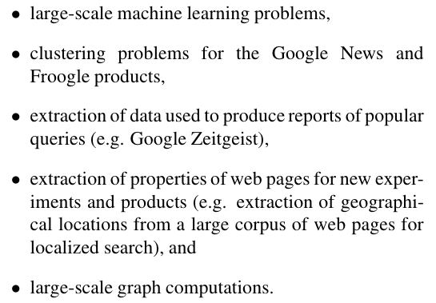
Conclusion
Experience
Domains

Slide 29
Conclusion
Conclusion
MapReduce programming model
Easy to use
Large variety of problems are easily expressible as MapReduce computation
Developed an implementation of MapReduce that scales to large clusters of machines
Lessons
Restricting programming model makes it easy to parallelize and distribute computation and to make such computation fault-tolerant
Network bandwidth is a scarce resource
Redundant execution can be used to reduce the impact of slow machines, and to handle machine failure and data loss

Slide 30
Reference
https://yeomko.tistory.com/31
https://12bme.tistory.com/154
https://velog.io/@spdlqjfire/%ED%95%98%EB%91%A1-%ED%94%84%EB%A1%9C%EA%B7%B8%EB%9E%98%EB%B0%8D-MapReduce

Slide 31
Q&A

Slide 32
Thank You

