Slide 1
자율형 블록체인 융합연구소
PipeDream Generalized Pipeline
Parallelism for DNN Training
Deepak Narayanan‡ ∗, Aaron Harlap† ∗, Amar Phanishayee⋆,Vivek Seshadri⋆,
Nikhil R. Devanur⋆, Gregory R. Ganger†, Phillip B. Gibbons†, Matei Zaharia‡
⋆Microsoft Research †Carnegie Mellon University ‡Stanford University
2023.10.24
Presented by Hernandez Santiago Luis Eduardo
luislalo3100@gmail.com

Slide 2
INDEX
01.
Introduction
02.
Data Paralelism
03.
Model Paralelism
04. PipeLining
05. CHL 1: Work Partitioning
06. CHL 2: Work Scheduling
07. CHL 3: Effective Learning
08. Implementation
09. Evaluation
10. Conclusion
11. Improvements

Slide 3
01
Introduction

Slide 4
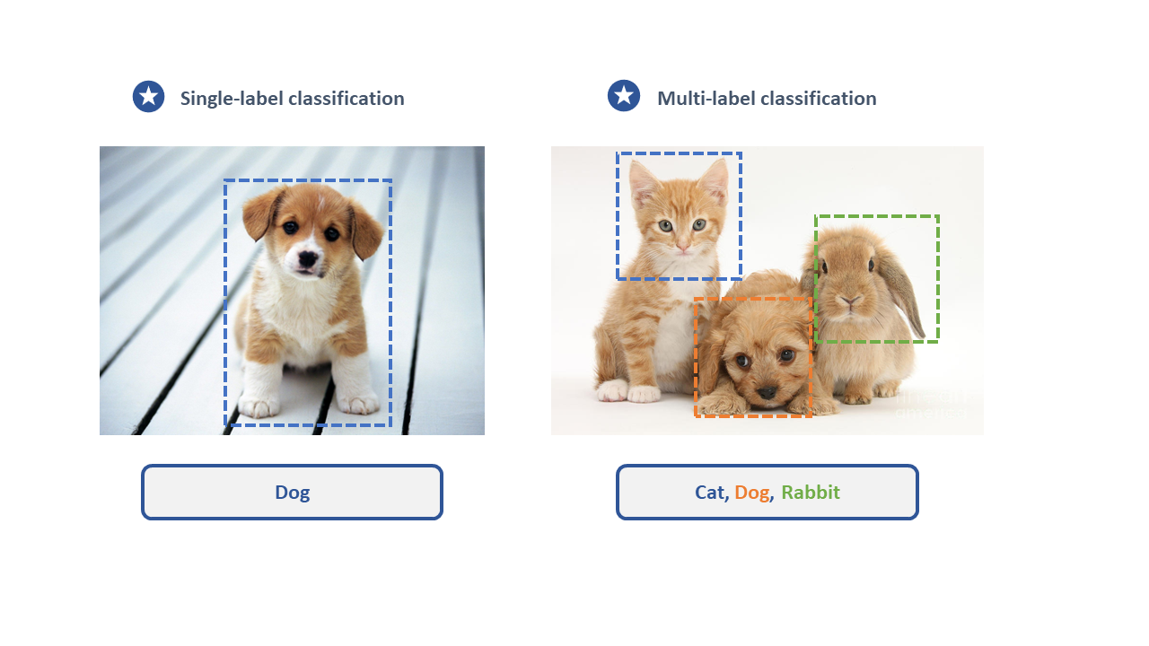
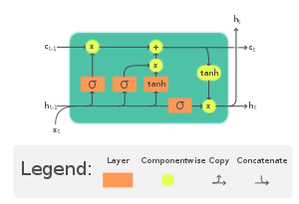
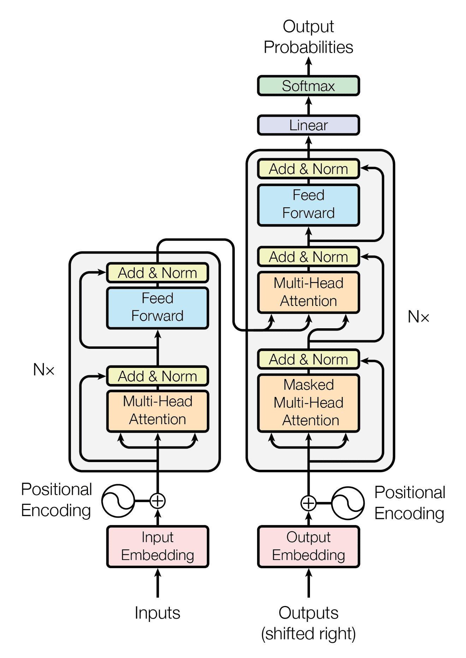
01
Introduction
Deep Neural Networks has reached state of the art results across a range of applications

Slide 5
01
Introduction
Models need to be trained
Ŷ_{i}=lion
x_{i}=
y_{i} = cat
W optimized using standard iteratice optimization procedures:
W = W -n ·∇W

Slide 6
Model training is time and compute intensive ?

Slide 7
02
Data Parallelism

Slide 8
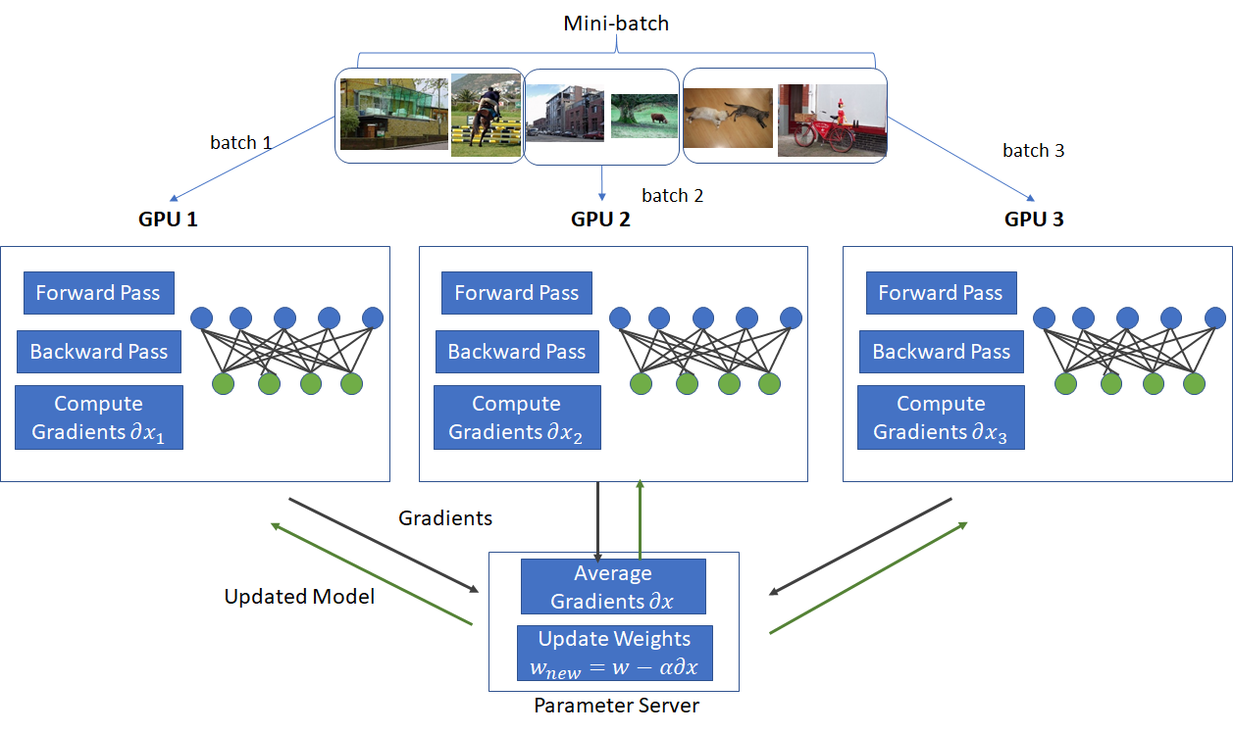
02
Data Parallelism: Paralelize DNN training
Inputs divided across multiple workers(GPU)
∇W ¹
∇W ²
∇W ³
Gradient aggregation

Slide 9
02
Data Parallelism: Paralelizing DNN training
Disadvantages of data parallesim
Figure 1: Communication overhead of data-parallel training using diferent multi-GPU server instances using PyTorch 1.1, NCCL [3], and fp32 precision. We use the largest per-GPU minibatch size that fts in GPU memory, and keep the per-GPU minibatch size constant as the number of GPUs are scaled up (weak scaling).

Slide 10
03
Model Paralelism

Slide 11
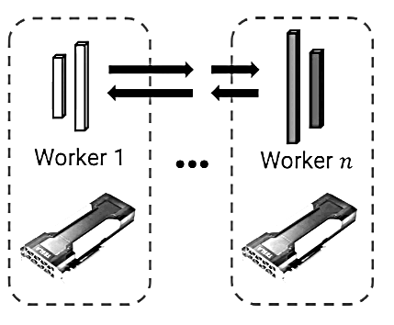
03
Model Parallelism: An alternative to data parallelism
-Operators in a DNN model(Layers) are partitioned across the available workers
- A single version of weights split over workers
-Each worker evaluating and performing updates for only a subset of the model’s parameters for all inputs
- Activations and gradients send between workers

Slide 12
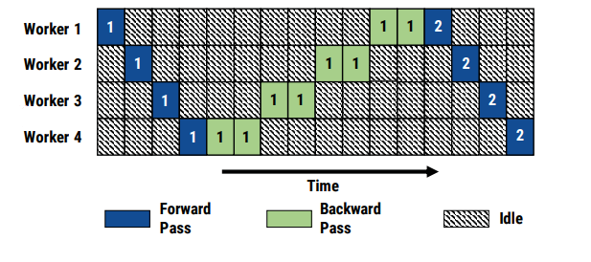
03
Model Parallelism: An alternative to data parallelism
However
Model Paralelism Suffers from:
- Under utilization of computer resources.
- The burden of partitioning a model across multiple GPUs is left to the programmer.

Slide 13
04
Pipelining

Slide 14
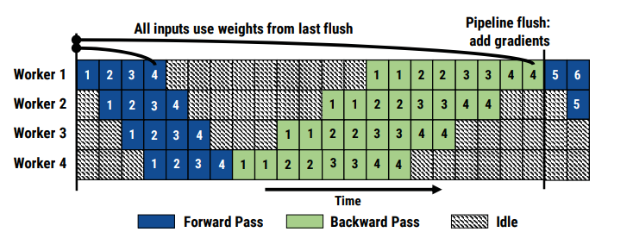
Intrabatching Parallelism
04
Pipelining: Pipelining in DNN training is not equal to traditional pipelining
microbatch
1. How should weight and activation versions be managed?
-- Backward passs operators depend on internal state aka (W, activations)
-- Backward pass for inputs should use the same weight version as corresponding forward pass
2. What is pipelining
- Pipelining--> Injecting multiple inputs into the system
- Every worker has a different input to process, improving utilization

Slide 15
04
Pipelining: Pipelining in DNN training is not equal to traditional pipelining
- GPipe--> Interbatching Parallelism
Pipelining in the context of model-parallel training for very large models
Minibatch ---> microbatches
performs forward passes followed by backward passes for these m microbatch
GPipe’s Objective --> Training a large model AmoebaNet, GPipe optimizes for memory efficiency; it uses existing techniques such as weight gradient aggregation

Slide 16
04
Pipelining: Pipelining in DNN training is not equal to traditional pipelining
Downsides
-Trades computation for memory by discarding activation stashes between the
forward and the backward pass, instead opting to re-compute them
when needed in the backward pass .
-It can suffer from reduced hardware efficiency due to re-computation overheads
and frequent pipeline flushes if m is small

Slide 17
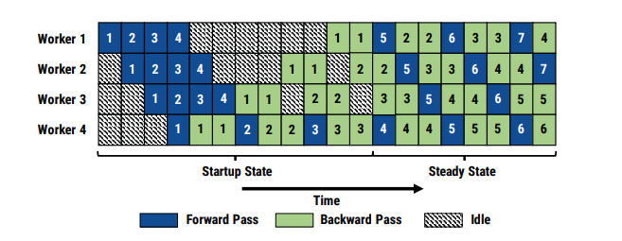
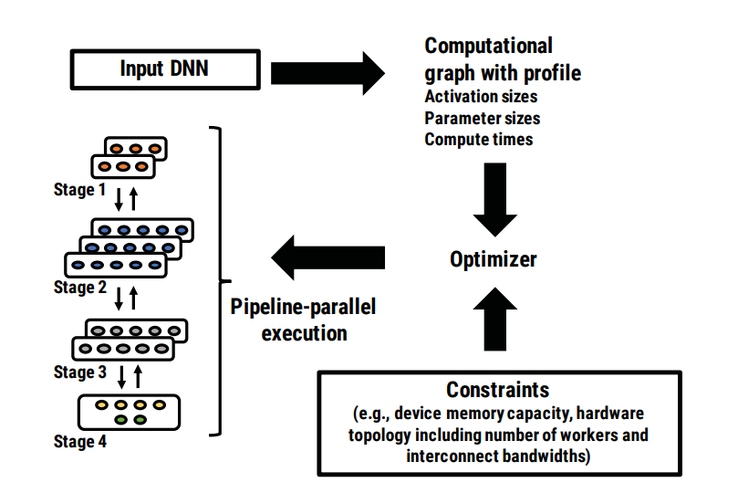
04
Pipelining: PipeDream Pipeline Parallelism
PipeDream
-Combines intra-batch parallelism with inter-batch parallelism
-Partitioning the layers of a DNN model into multiple stages
-Each stage consists of a consecutive set of layers in the model
-Each stage is mapped to a separate GPU that performs the forward pass (and backward pass) for all layers in that stage.

Slide 18
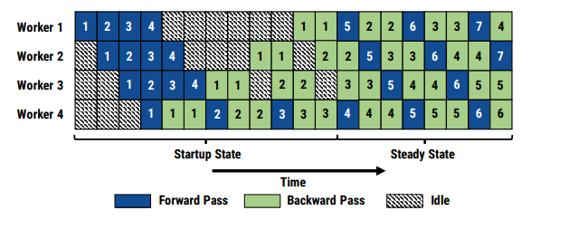
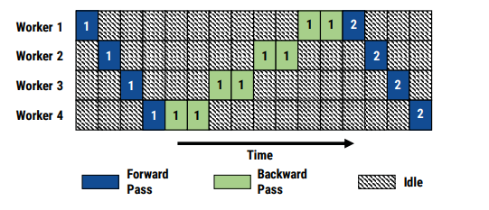
04
Pipelining: PipeDream Pipeline Parallelism
II. Multiple minibatches
I. Ideal Scenario
I. One minibatch active
II.
Simple Case
I)-Simplest case, only one minibatch is active in the system, as in traditional model-parallel training
II)-In this setup, at most one GPU is active at a time.
Best case
I)-Ideally, we would like all GPUs to be active.
II)-So, we inject multiple minibatches into the pipeline one after the other

Slide 19
04
Pipelining: PipeDream Pipeline Parallelism
IV.
VI.
V.
III.
III-On completing its forward pass for a minibatch, each stage asynchronously sends the output activations to the next stage
IV-While simultaneously starting to process another minibatch.
V-The last stage starts the backward pass on a minibatch immediately after the forward pass completes
VI-On completing its backward pass, each stage asynchronously sends the gradient to the previous stage while starting computation for the next minibatch

Slide 20
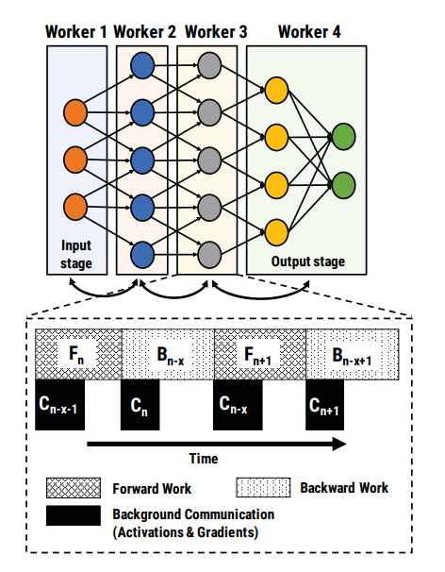
00
Advantages of PipeDream
Pipelining communicates less
Pipelining overlaps computation and communication.

Slide 21
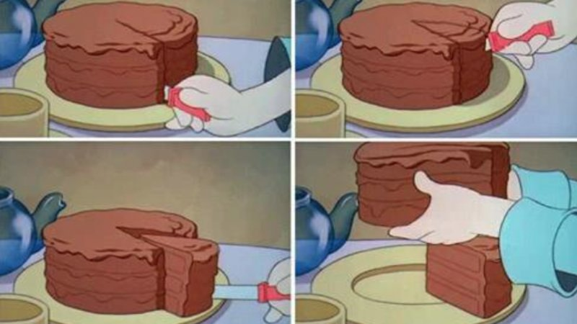
05
CHL1: Work Partitioning

Slide 22
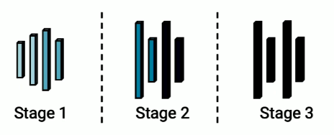
06
Challenge 2:
How should the DNN operators be partitioned into pipeline stages?
-Each operator(layer) has a different computation time
- Activations and gradients need to be communicated across stages
Best case scenario:
t_{1,}t_{2,}t₃ are as close to each other as possible
Computer resources seldom idle --> better hardware efficiency of the pipeline
Communication time between t_{1-->}t_{2 and} t_{2-->}t₃ is small as possible
Less communication --> better hardware efficiency
comm comm
t₁
t_{1-->}t₂
t₂
t_{2-->}t₃
t₃

Slide 23
05
Challenge 1: Stage process minibatches at vastly different throughputs can lead to bubbles in the pipeline
- The steady state throughput of the resulting pipeline is the throughput of the slowest stage
“even if other stages in the pipeline are faster, the system as a whole cannot process data faster than the slowest stage can handle”--> the performance of a pipelined system is often dictated by its slowest component.
-Like in delivery line you depend of the speed of the people or the machine who place the sticker in the box to put the box inside the truck
Notes:
Bubbles --> refers to stages in a pipeline where no useful work is being done. Like a wasted cicle n the pipeline

Slide 24
05
Challenge 1: Stage process minibatches at vastly different throughputs can lead to bubbles in the pipeline
-Having each stage process minibatches at vastly different throughputs can lead to bubbles in the pipeline, starving faster stages of minibatches to work on and resulting in resource under-utilization
Notes:
Bubbles --> refers to stages in a pipeline where no useful work is being done. Like a wasted cicle n the pipeline

Slide 25
05
Challenge 1: Stage process minibatches at vastly different throughputs can lead to bubbles in the pipeline
Solution:
Optimizer
Profiler
Partitioning Algorithm

Slide 26
05
Challenge 1: Stage process minibatches at vastly different throughputs can lead to bubbles in the pipeline
Partitioning Algorithm
2-level hardware topology. Solid green boxes represent GPUs. Each server (dashed yellow boxes) has 4 GPUs connected internally by links of bandwidth B1; each server is connected by links of bandwidth B2. In real systems, B1 > B2

Slide 27
06
CHL2: Work Scheduling

Slide 28
05
Challenge 2: Work Scheduling
Each active minibatch in the pipeline may be in a different stage, either in the forward pass or backward pass.
In the startup phase, the input stage admits enough minibatches to keep the pipeline full in steady state
one-forward-one-backward (1F1B) schedule.
Notes:
NOAM number of Active Monibatches

Slide 29
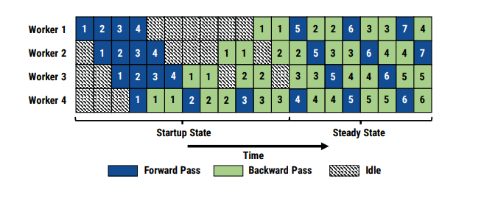
05
Challenge 2: Work Scheduling
1. In the startup phase, the input stage admits exactly four minibatches that propagate their way to the output stage.
2. As soon as the output stage completes its forward pass for the frst minibatch, it performs its
backward pass for the same minibatch,
3. then starts alternating between forward and backward passes for subsequent minibatches

Slide 30
05
Challenge 2: Work Scheduling
4. As the backward pass starts propagating to earlier stages in the pipeline, every stage starts alternating between its forward and
backward passes for diferent minibatches. As shown in the fgure,
every worker is performing either a forward or backward pass for
some minibatch in steady state

Slide 31
07
CHL3: Effective Learning

Slide 32
05
Challenge 3: Effective Learning--> Pipelining leads to weight version mismatches
Naïve Pipelining leads to mismatch in weight versions
X_{n} --> W_{n} ---> Y_{n}
Forward pass
W_{n+1}
X_{n} --> W_{n+p} ---> Y_{n}
Backward pass
Input n sees updates in backward pass not seen in the forward pass, leading to incorrect gradients

Slide 33
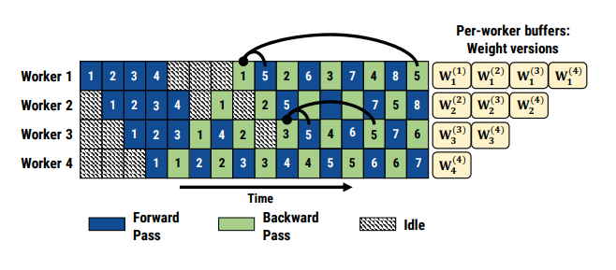
Challenge 3: Effective Learning--> Pipelining leads to weight version mismatches
05
Weight stashing: A solution to version mismatches
Naïve Pipelining leads to mismatch in weight versions
Store multiple <weight,activation> versions
Ensures same weight versions used in both forward and backwars pass
X_{n} --> W_{n} ---> Y_{n}
Forward pass
Worst case memory footprint similar to data parallelism
W_{n+1}
W_{n}
W_{n+1}
W_{n2}
Stashed weights
X_{n} --> W_{n} ---> Y_{n}
Backward pass

Slide 34
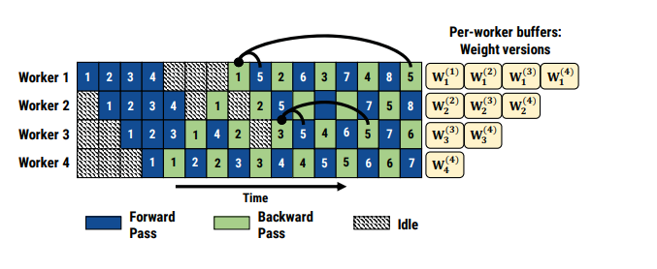
05
Challenge 3: Effective Learning--> Pipelining leads to weight version mismatches
Weight stashing: A solution to version mismatches

Slide 35
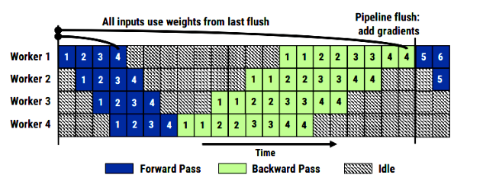
05
Going back to GPipe
>> Single weight version
>> Periodic pipeline flushes update weight version across workers

Slide 36
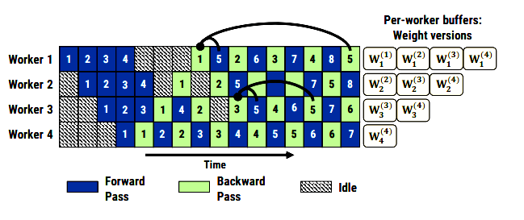
05
GPipe and PipeDream make different tradeoffs
GPipe
2018
Pipeline flushes--> expensive
PipeDream
2019
-->Hihg memory footprint from weight versions (Expensive costs on RAM memory)

Slide 37
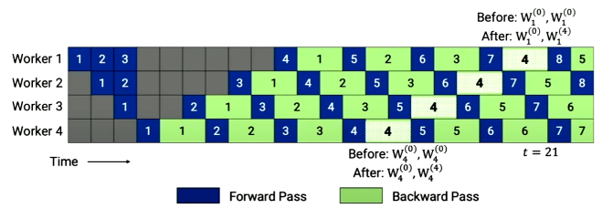
05
Solution: Double-Buffered weight updates
Memory-Efficient Pipeline-Parallel DNN Training
2020
Double-buffered weight updates:
High throughput and low memory footprint
How are the weight and activation versions managed?
>> Two weight versions(shadow version and main version)
--updates dont need to be appliied as soon are generated
--weight updates can be generated into single larger weight updates
Weight updates from inputs 1 to 4 accumulated and applied as a single weight update to generate a new weight version w_{i}⁽⁴⁾

Slide 38
00
Double-buffered weight updates: weight semantics
-Assuming a per-GPU microbatch size og b, minibatch size B = b · d , where d is the depth of the pipeline
-Weight update semantics of data parallelism:
Weight update semantics with 2BW almost unchanged(note additional delay term of 1 in gradient computation)
Semantics similar with replicated stages or gradient aggregation(minibatch size B multiplied by appropriate scale factor)

Slide 39
08
Implementation

Slide 40
01
Setup
How should the DNN operators be partitioned into pipeline stages?
-Integrated PipeDream with Pytorch in ~3000 lines of Python code
- Integrated with Pytorch’s communucation librart
NCCL backend for Data Paralelism baselines
Gloo backend for PipeDream
-Experiments run on three different server types

Slide 41
09
Evaluation

Slide 42
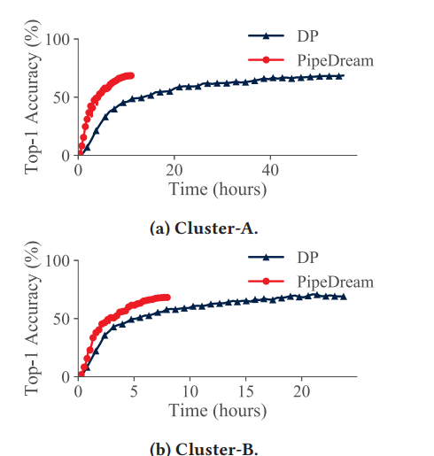
09
PIPEDREAM > DATA PARALLELISM
The goal is to train a model with high accuracy as fast as possible. VGG60 image classification model
5.3 times faster on cluster A
2.5 times faster on cluster -B

Slide 43
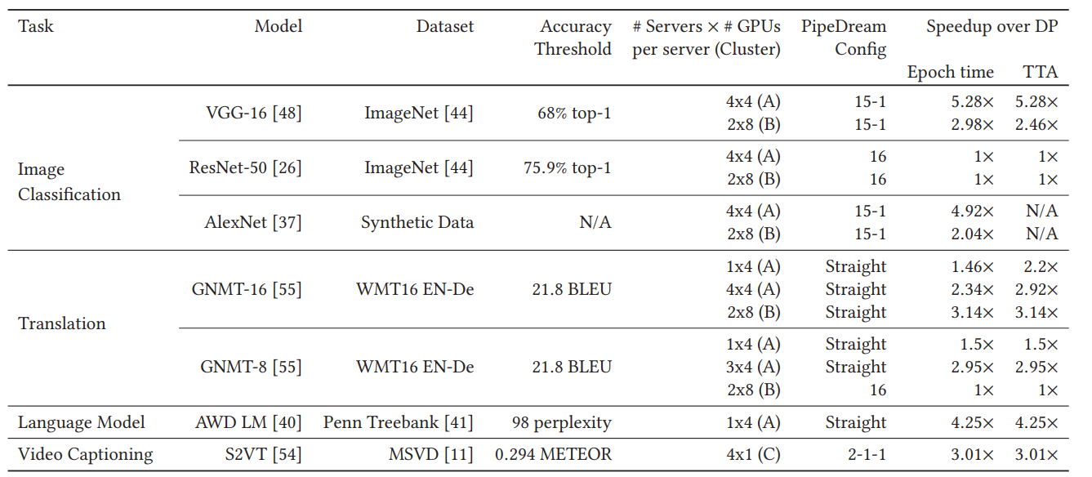
09
PIPEDREAM > DATA PARALLELISM
4 different tasks--> image classification, translation, language modeling, video captioning
sa

Slide 44
09
PIPEDREAM > DATA PARALLELISM
With the same number of GPUs, PipeDream is up to 5.3 faster than Data Paralelism
sa

Slide 45
10
Conclusion

Slide 46
10
Conclusion and Takeaways
Model and data parallelism often suffer from high communication overhead and low resource utilization for certain models and deployments
PipeDream shows pipelining can be used to accelerate distributed training for models that fit on a single worker.
Pipelining when combined with data and model parallelism in a principled way, achieves end to end speedups of up to 5.3x compared to data parallelism, with similar worst-case memory footprint

Slide 47
11
References
Insert Title: Paper: https://www.pdl.cmu.edu/PDL-FTP/BigLearning/sosp19-final271.pdf
Simpler explanation by microsoft:
https://www.microsoft.com/en-us/research/blog/pipedream-a-more-effective-way-to-train-deep-neural-networks-using-pipeline-parallelism
Language Models are Few-Shot Learners: https://arxiv.org/abs/2005.14165
GNPP PRESENTATION: https://www.youtube.com/watch?v=ILBPCi6Il1U
Gpipe https://www.youtube.com/watch?v=9s2cum25Kkc
Efficient Large Scale https://www.youtube.com/watch?v=MO_CESBOXgo&t=22s

Slide 48
Q&A

Slide 49
Thank you
End Of Document

