Slide 1
CHIPMUNK: Investigating Crash-Consistency in Persistent-Memory File Systems
Hayley Le Blanc, Shankara Pailoor, Om Saran K R E, Isil Dillig, James Bornholt, Vijay Chidambaram
University of Texas as Austin
Presented by : Young-Chan Choi

Slide 2
Index
Introduction / Background
CHIPMUNK
Testing PM File Systems
Bug Analysis
Conclusion

Slide 3
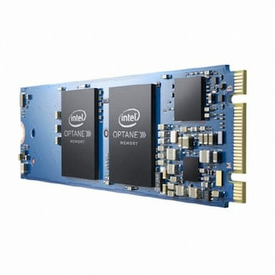
Introduction / Background
Persistent Memory
Byte-addressable, connected to memory bus like DRAM
Persistent like traditional storage media
Extremely low-latency persistent memory
Fine-grained access to storage over the memory bus
Accessed via processor load/store instructions
Persistent after cache line flush instruction
Bypass cache with non-temporal stores
Data is flushed
= cache is written in PM or written using non-temporal stores
In-flight write
Write that has not yet been flushed
Intel Optane
But.. Intel Optane has failed in commercial market

Slide 4
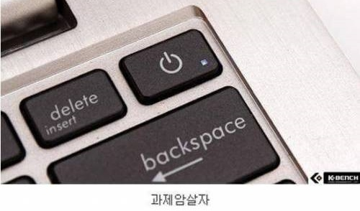
Introduction / Background
Crash Consistency
Crash consistent if file system maintains a set of guarantees about its data and meta data after a crash
Process should not remain incomplete when crash occurs file system should recover from failure without data loss
Ex) rename must be atomic
Need to save our project from sudden blackout

Slide 5
Introduction / Background
Persistent Memory File System
Difference from traditional file systems
Synchronously write some updates directly to storage media
Perform I/O directly using memory loads and stores without an extra software layer
Do not require use of fsync-related system calls to ensure that data becomes durable

Slide 6
Introduction / Background
Persistent Memory File System
Why current tools are not enough
Prior works cannot record writes to PM prior works rely on kernel block layer, which PM file system do not use
Current tools do not check all necessary crash states they insert crashes after fsync-related system call, not during system call
Tools for testing PM files do not scale well
Prior work cannot test high-level crash-consistency properties of files systems they focus on programming errors

Slide 7
Introduction / Background
Contributions
CHIPMUNK
framework for testing the crash consistency of any PM file system that implements the POSIX interface
detect both low-level PM programming errors and high-level logic bugs
Analysis of 23 BUGS!
Largest published corpus of PM file-system crash-consistency bugs
Analyze bugs to distill useful insights for PM file-system design and efficient crash-consistency testing of PM file systems

Slide 8
Introduction / Background
Challenges with testing PM file systems
Intercepting writes to the storage media PM file system writes directly to media using processor store instructions
Prior works inject crashes only after fsync-related system calls injecting crashes in the middle of file system calls is crucial for new and complex PM file systems

Slide 9
Introduction / Background
짤방저장소
Intel Optane

Slide 10
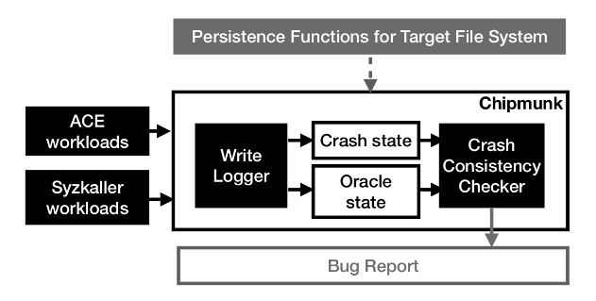
CHIPMUNK
Overview
Runs given workload
Records the writes made by the file system
Replays recorded writes to create crash images
Mount the target file system on the crash image
Recover
Checks whether it has recovered to a consistent state
Junior Developer

Slide 11
CHIPMUNK
Overview
Runs given workload
Records the writes made by the file system
Replays recorded writes to create crash images
Mount the target file system on the crash image
Recover
Checks whether it has recovered to a consistent state
Junior Developer

Slide 12
CHIPMUNK
Challenges
How to intercept writes
How to deal with new crash-consistency semantics
How to deal with very large sets of crash states
Junior Developer

Slide 13
CHIPMUNK
Challenges
How to intercept writes
How to deal with new crash-consistency semantics
How to deal with very large sets of crash states
Prior works: black-box approach based on the Linux kernel’s block layer → PM file system do not use this layer
Gray-box function-level instrumentation
Junior Developer
PM file system uses Centralized persistence function to perform I/O
CHIPMUNK requires the name of centralized persistence functions use runtime Kprobes and Uprobes to debug by instrumenting name of centralized persistence functions

Slide 14
CHIPMUNK
Challenges
How to intercept writes
How to deal with new crash-consistency semantics
How to deal with very large sets of crash states
CHIPMUNK must inject crashes during system calls to test novel ,complex, and un-tested crash-consistency mechanisms of PM files systems
CHIPMUINK coalesce logically-related non-temporal stores → flushes → replay logically-related non-temporal stores in different combination
Junior Developer

Slide 15
CHIPMUNK
Challenges
How to intercept writes
How to deal with new crash-consistency semantics
How to deal with very large sets of crash states
Strong crash consistency make fine-grained writes
Store fence
Number of possible crash states to check explode to an intractable number
Store fence
Small number of small writes to PM
+
Frequent store fences
Junior Developer
(3~10 in-flight writes)
Lots of in-flight writes
Lots of in-flight writes

Slide 16
CHIPMUNK
Challenges
How to intercept writes
How to deal with new crash-consistency semantics
How to deal with very large sets of crash states
Checking every possible crash state is unlikely to expose new bugs
Checks only a small subset of states with missing data
Junior Developer

Slide 17
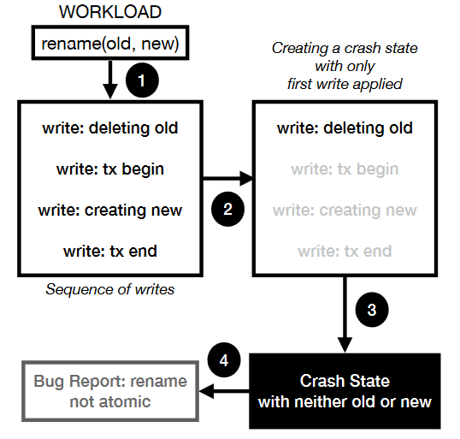
CHIPMUNK
Architecture
Run workload, log write
Construct crash state
Check each crash state
Generate bug report if required

Slide 18
CHIPMUNK
Architecture
Logging Writes
Use dynamic debugging and tracing tool Kprobes, Uprobes
Make copy of probed instruction
Replace first byte with breakpoint instruction
Breakpoint hit → control is passed to handler
Handlers record probed operation and its arguments
User-space test harness insert markers to log to record the start and end of each system call

Slide 19
CHIPMUNK
Architecture
Constructing crash states
CHIPMUNK selects crash point based on the crash consistency guarantees of the file system and simulates crashes ext4-DAX, XFS-DAX: crash point placed after fsync, sync, fdatasync others: crash point injected after each store fence

Slide 20
CHIPMUNK
Architecture
Constructing crash states
CHIPMUNK replays workload by walking through logs of flushes, non-temporal stores, fences
Encounters cache line flush / non-temporal store → adds structure to in-flight vector
Encounters store fence → contructs → checks crash states → flushes contents
Type, content, destination address

Slide 21
CHIPMUNK
Architecture
Constructing crash states
n
Crash state is constructed by replaying a subset of the contents of the in-flight vector
n is small(3~10)
Even a cap of 2 writes can reveal many bugs
O/X
O/X
O/X
n=3
7 crash states to check

Slide 22
CHIPMUNK
Architecture
Testing crash states
n
Mounts target file system on each crash state
Compares the file-system state vs oracle(post crash state)
Oracle runs the original workload on fresh file system
crash
state
Oracle
(post crash state)
Encounters beginning of new system call → records current oracle state of files that will be modified → execute
Compare
File system: contents
Directory: directory entries
Ideal state(crash not occurred)

Slide 23
CHIPMUNK
Architecture
Testing crash states
Crash injected in the middle of system call
Oracle
(previous)
execution
compare
execution
crash
state
Oracle
(current)

Slide 24
CHIPMUNK
Architecture
Testing crash states
Crash injected after the system call
Check system call is synchronous(crash state = current oracle state)
Oracle
(previous)
execution
execution
crash
state
compare
Oracle
(current)

Slide 25
CHIPMUNK
Architecture
Testing crash states
Validate file system is in a usable state
Creates files in all directories, then deletes all files
Outputs bug report if any of these checks or operations fail

Slide 26
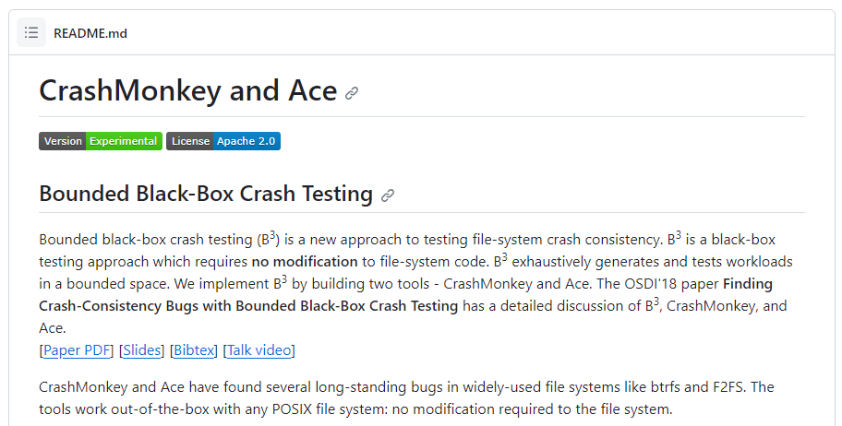
CHIPMUNK
Workload Generation
Automatic Crash Explorer
Exhaustively generate workloads of a pre-defined structure
Generate workloads with n core file system operations
Ext4-DAX, XFS-DAX: insert at least 1 fsync-family operation
Test
seq-1, seq-2
seq-3: contain only pwrite, link, unlink, rename
ㄴopen, close, fsync, fdatasync, sync

Slide 27
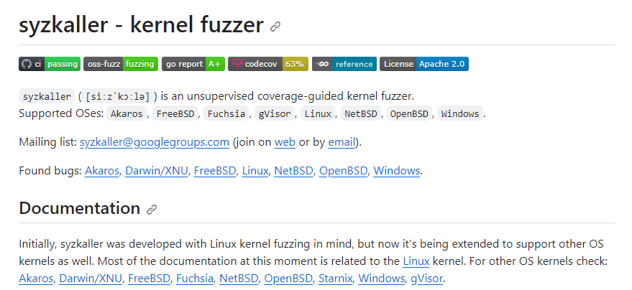
CHIPMUNK
Workload Generation
Syzkaller
Fuzzer starts with an initial set of test cases
Use genetic programming to generate new tests
If workload covered new parts of the kernel, fuzzer adds new parts to seeds and generate new workloads from it

Slide 28
CHIPMUNK
Workload Generation
Syzkaller
Adaptation
Restrict Syzkaller to only generate workloads that contain file-system operations
Replace workload executor with custom workload invokes CHIPMUNK on each workload, records code coverage before the crash and during recovery
Add crash points between each system call and in the middle of final non-failing system call
Add sync at the end of each workload
Use GCC’s sanitizer coverage instrumentation to collect code coverage
Use simple triaging procedure that clusters bug reports by lexical similarity

Slide 29
CHIPMUNK
Discussion
Limitations
CHIPMUNK cannot test every workload does not test all possible crash states for each workload
CHIPMUNK assumes that PM file system has centralized persistent functions
CHIPMUNK does not currently support checking concurrent workloads

Slide 30
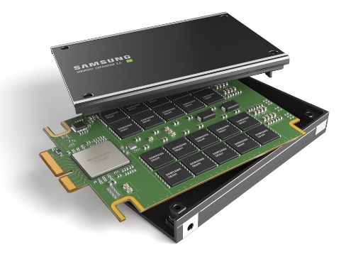
CHIPMUNK
Discussion
Persistent model
Available on Intel’s Optane DC Persistent Memory Module (Optane project has cancelled)
CHIPMUNK is not tied to any persistent model
CHIPMUNK would be a valuable tool for testing file systems built for variety of persistent models
Optane
CLX
Samsung CLX
Worst case

Slide 31
Testing PM File Systems
Methodology
File systems
7 open-source PM file systems
NOVA
NOVA-Fortis
PMFS
WineFS
SplitFS
Ext4-DAX
XFS-DAX
Strong crash-consistency guarantee
Weak crash-consistency guarantee
→ Only inserts crash points after fsync-related system calls

Slide 32
Testing PM File Systems
Methodology
System calls
10 key operations create, mkdir, fallocate, write, link, unlink, remove, rename, truncate, rmidr
Ext4-DAX, XFS-DAX: inlcude setxattr, removexattr, use at least one of fsync, fadatasync, sync

Slide 33
Testing PM File Systems
Experimental setup
QEMU/KVM virtual machine
1CPU, 8GB RAM, 2x128MB PM devices
ACE generated workload
Run on Amazon EC2
96 vCPUs, 384GB memory, 900GB NVME SSDs
Evaluate CHIPMUNK with Syzkaller
7 chameleon cloud 2 Xeon Gold 6240R CPUs, 192GB RAM, 480GB storage

Slide 34
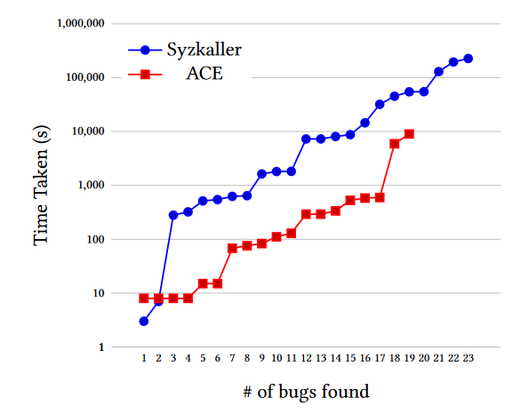
Testing PM File Systems
Evaluation
CHIPMUNK found 19 bugs using ACE tests across 5 of the tested systems
Syzkaller checked over 40 million crash states, find 23 unique bugs
ACE
Syzkaller
Find only 19/23 bugs
ACE misses 4 bugs because
They do not conform to the patterns
Takes 20x more CPU time
Takes 47 hours to find 4 bugs

Slide 35
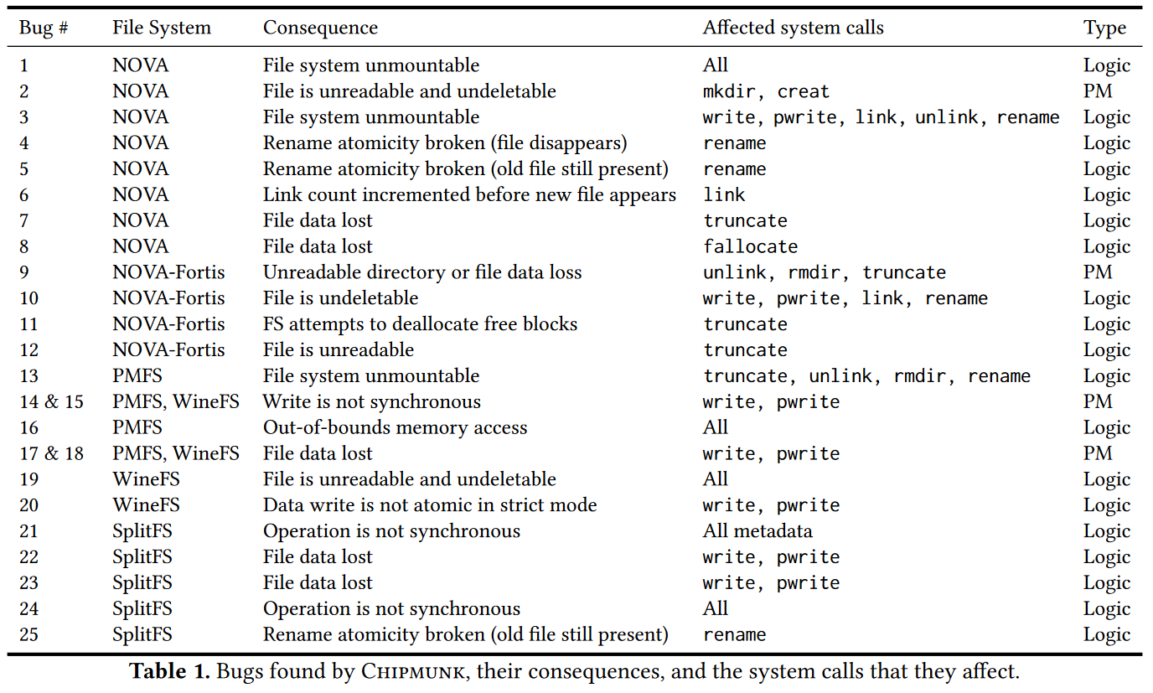
Testing PM File Systems
Results
Crash consistency bugs
Many of these bugs have serious consequences
Did not find any bugs in ext4-DAX, XFS-DAX most code is shared with their non-DAX version

Slide 36
Testing PM File Systems
Results
Non-crash consistency bugs
Found 8 non-crash consistency bugs
Able to find because they cause KASAN errors, segmentation faults, incorrect behavior

Slide 37
Bug Analysis
Observations
Observation 1: Most of the observed bugs are logical issues rather than PM programming errors
Majority of bugs found are due to higher-level logic bugs
Observation 2: In-place update optimizations are a common source of crash consistency bugs
Most of the systems use journal for crash-consistency, but have performance optimizations to bypass the journal in certain circumstances
These optimizations are particularly error prone (6/23)
In some cases, journaling can even be better than in-place updates
Fixed version of rename
25% slower
Real-world meta-data Intensive
benchmark: <1% overhead
Fix for bug6
7% faster

Slide 38
Bug Analysis
Observations
Observation 3: Rebuilding volatile state during crash recovery is error-prone
PM file systems often keep metadata like free page lists in DRAM and rebuild them at mount
Rebuilding code is subtle because it must account for potential inconsistencies or partial states after a crash
9/23 bugs were in rebuilding code

Slide 39
Bug Analysis
Observations
Observation 4: Resilience mechanisms to recover from media failures can introduce new crash-consistency bugs
NOVA-Fortis: NOVA + fault detection, tolerance for media errors
NOVA-Fortis has all the same crash-consistency bugs found in the original version of NOVA
4 new bugs caused by complexity of maintaining redundant state and checksums

Slide 40
Bug Analysis
Observations
Observation 5: Many observed bugs require simulating crashes during system calls
Current crash-consistency testing tools for traditional file system insert crashes only after fsync-related system calls
11/23 bugs require a crash to occur during a system call.

Slide 41
Bug Analysis
Observations
Observation 6: Short workloads suffice to expose many crash-consistency bugs
ACE: empirical study that showed that most bugs could be reproduced with at most 3 core operations
19/23 bugs can be found using ACE
4 bugs found using Syzkaller were found on short workloads ACE missed them because of complexities

Slide 42
Bug Analysis
Observations
Observation 7: Most of the observed buggy crash states involve few writes to PM
Most bugs found by CHIPMUNK involve crash states that include small subsets of the in-flight writes
10 bugs can be exposed by a crash state that replays only a single write onto the last known-persistent state
1 bug requires two writes
Cap of two for number of write is enough to find all bugs presented in this paper
Cap of five is sufficient to check all crash states for most system calls

Slide 43
Conclusion
Lessons
Synchronous crash consistency on PM file systems simplifies the user experience but complicates implementing and testing
Diverse testing mechanisms and checkers help validate assumption about crash-consistency patterns
Most assumptions about file-system crash consistency do not carry across to PM
Lightweight testing offers a scalable approach to detecting many crash-consistency bugs

Slide 44
Conclusion
CHIPMUNK new record-and-replay framework for testing the crash consistency of PM file system
Use ACE workload generator, Syzkaller gray-box fuzzer and find 23 unique bugs
Provide insights into how crash-consistency bugs arise in PM file systems and what types of tools are needed to test these systems

Slide 45
Reference
https://github.com/utsaslab/crashmonkey
https://github.com/google/syzkaller/
https://news.samsung.com/global/samsung-electronics-introduces-industrys-first-512gb-cxl-memory-module

Slide 46
Q&A

Slide 47
Thank You

