Slide 1
ROLEX: A Scalable RDMA-oriented Learned Key-Value Store for Disaggregated Memory Systems
Li, P., Hua, Y., Zuo, P., Chen, Z., & Sheng, J. FAST 23
2023. 10. 31
Presented by GuangXun Zhao
guangxun0621@gmail.com

Slide 2
Introduction
Background & Motivation
Design
Evaluation
Conclusion

Slide 3
Introduction

Slide 4
Introduction
Disaggregated Memory Systems(DMS)
DMS is widely used, such as databases and in-memory key-value stores
Compute node & memory node
RDMA
NIC
Memory Pool
Compute Pool

Slide 5
Background & Motivation

Slide 6
Background
Disaggregated Memory Systems(DMS)
Two widely used structures for the ordered KVS
Trees-based
Learned index
B+tree
Model
(e.g., NN, LR)
Memory Pool
Notes:
KVS에서 2가지 방식

Slide 7
Background
Tree-based in DMS – Two sided
Round Trip Time(RTT)
Get（K）
Put (K,V）
Limit computing resource
B+tree
RTT
RPC
Memory Pool
Compute Pool

Slide 8
Background
Tree-based in DMS – One sided
Round Trip Time(RTT)
Get（K）
Get（K）
Put (K,V）
B+tree
RTT
RDMA
Cache
Memory Pool
Compute Pool

Slide 9
Background
Tree-based in DMS – One sided
Round Trip Time(RTT)
Get（K）
Put (K,V）
B+tree
RTT
RDMA
Cache
Memory Pool
Compute Pool
Limit local cache
Notes:
因为内部节点消耗了太多内存空间，也很难被完全缓存
总结:
B+ tree 的查找操作需要多次遍历，每次都可能涉及网络通信，从而导致多次 RTT。
而 learned index 则通过模型预测直接定位到数据的位置，通常只需要一次网络通信，从而只有一次 RTT。

Slide 10
Background
Learned index in DMS
XStore: OSDI’20
Fully cached
Get（K）
Once
Model
(e.g., NN, LR)
RTT
Cache
Memory Pool
Compute Pool
Notes:
FULL CAHCHE

Slide 11
Background
Learned index in DMS
Put（K,V）
RTT
Model
(e.g., NN, LR)
Cache
Memory Pool
Compute Pool
Notes:
Write 같은 동적 workload에는 여전히 해결해야하는 3가지 챌린지 존재

Slide 12
Challenge 1
Limited computing resources on memory nodes
Memory nodes are used to store large amounts of data, and compute nodes are used to process data.
RDMA
NIC
Memory Pool
Compute Pool

Slide 13
Challenge 1
Limited computing resources on memory nodes
Computing-intensive operation: insert, update, delete etc.
Computing-intensive
operations
Memory Pool
Compute Pool

Slide 14
Challenge 1
Limited computing resources on memory nodes
Computing-intensive
operations
Memory Pool
Compute Pool

Slide 15
Challenge 2
Overloaded bandwidth for data transferring
Full bandwidth
Memory Pool
Compute Pool

Slide 16
Challenge 3
Inconsistency issue among different nodes
Atomic granularity of an RDMA operation is 8B
Update
RDMA
NIC
Memory Pool
Compute Pool
Insert

Slide 17
Design

Slide 18
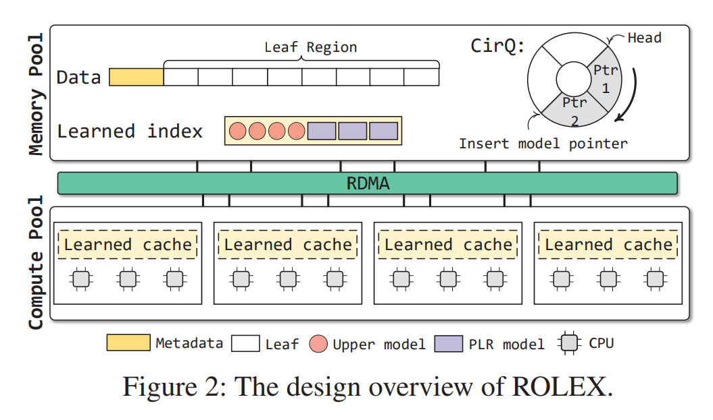
Rolex
Asynchronous retraining
Fixed-size arrays(Leaf Region)
Retraining-decoupled Learned Indexes
One-sided Index Operations

Slide 19
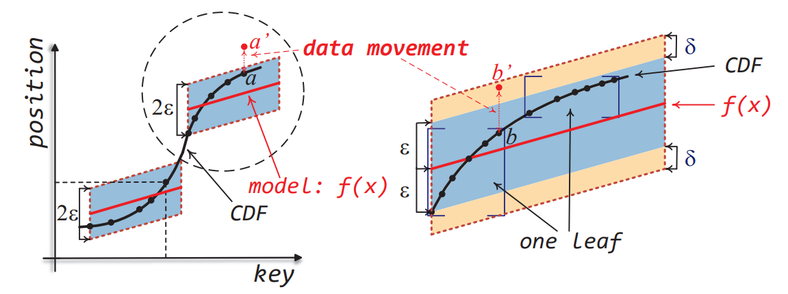
Retraining-decoupled Learned Indexes
The challenges of coalescing the learned indexes on dynamic workloads
Come from the high overheads of keeping all data sorted and avoiding data loss
Red line is linear regression model
that is trained on the black points
prediction range:
Blue block : pred − ε, pred + ε
ε is the predefined maximum model error
Notes:
dynamic workloads에서 모든 데이터의 순서 유지하고 삽입 시 learnd model에서의 데이터 손실을 방지하는 높은 오버헤드를 줍니다.
come from the high overheads of keeping all data sorted and avoiding data loss
데이터 손실이 발생하는 이유는 모델이 훈련 후 훈련된 데이터의 위치를 ​​기록하지만, 대량의 새로운 데이터를 삽입한 후에는 retraining 하지 않으면 새 위치를 찾을 수 없기 때문입니다.
빨간 선은 모델이고 검은 점(즉, 훈련된 데이터)에서 학습된 선형 회귀 모델을 나타냅니다.
동그라미 a가 a’로 이동하면 다시 트레이닝 필요하는데 이러면 training 끝날때까지 latency가 올라가고 시스템의 성능이 내려간다.
하지만 학습된 인덱스가 learning 하지 않은 모델이 모든 데이터를 찾을 수 있으면 빈번한 retraining이 필요하지 않다고 합니다.

Slide 20
Retraining-decoupled Learned Indexes
The challenges of coalescing the learned indexes on dynamic workloads
Come from the high overheads of keeping all data sorted and avoiding data loss
Red line is linear regression model
that is trained on the black points
prediction range:
Blue block : pred − ε, pred + ε
ε is the predefined maximum model error

Slide 21
Retraining-decoupled Learned Indexes
Training Algorithm
Use an improved OptimalPLR algorithm to train the piecewise linear regression (PLR) models
OptimalPLR: O(N)
Bias : represented as δ

Slide 22
Retraining-decoupled Learned Indexes
Position prediction changes to leaf prediction
Data-movement constraints
Moving data within fixed-size leaves
Each leaf contains at most δ data
Synonym-leaf sharing
Allows multiple data values with the same key to share one "Synonym Leaf"
OptimalPLR: O(N)
Bias : represented as δ

Slide 23
Memory pool stores data
Fixed-size arrays(Leaf Region)
alloc_num(8B) : The number of leaves that have been allocated
alloc_num+1 : Atomically allocate leaves via FAA(Fetch and Add)
Notes:
나머지 리프 영역은 많은 리프를 저장하며 각 리프는 δ 개의 키-값 쌍을 포함

Slide 24
One-sided Index Operations
In-order to solve the problem of Challenge3
Leaf-atomic shift scheme
Update
RDMA
NIC
Memory Pool
Compute Pool
Insert

Slide 25
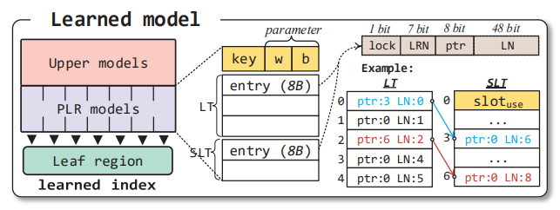
Leaf table (LT) and synonym leaf table (SLT)
The size of LT is determined in the training phase
SLT is fixed to $2^{8}$ slots
Leaf region max is $2^{48}$(δ)leaves.
Synonym leaves is ($2^{8}$-1)=255
alloc_num(8B) & FAA
1bit: Lock
7bit: Leaf-region number
8bit: Pointer to SLT
48bit: Leaf number

Slide 26
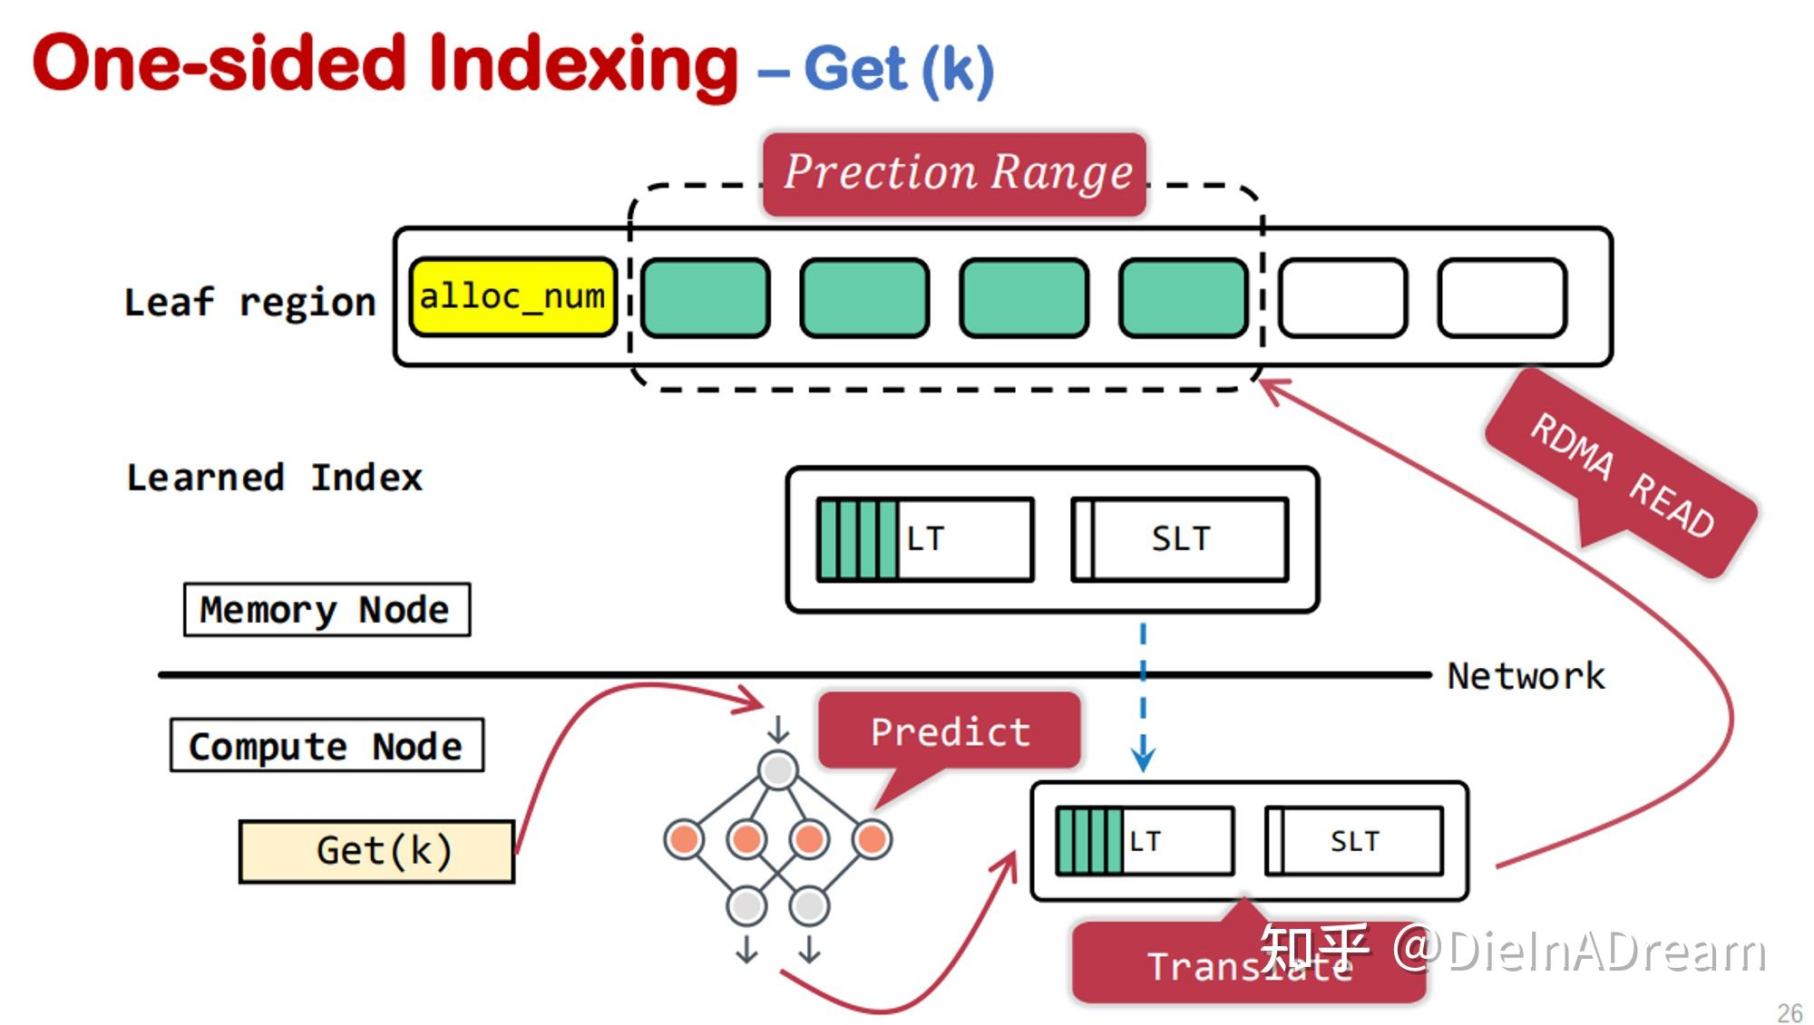
Point query operation
Calculate the $L_{range}$
Looking up LT and SLT
Read leaves with RDMA doorbell batching according to the physical addresses
Search for the captured value, and then further read the value based on the value pointer
Leaf number
Leaf size
Address of the first leaf in the leaf region
1
3
2
Translate

Slide 27
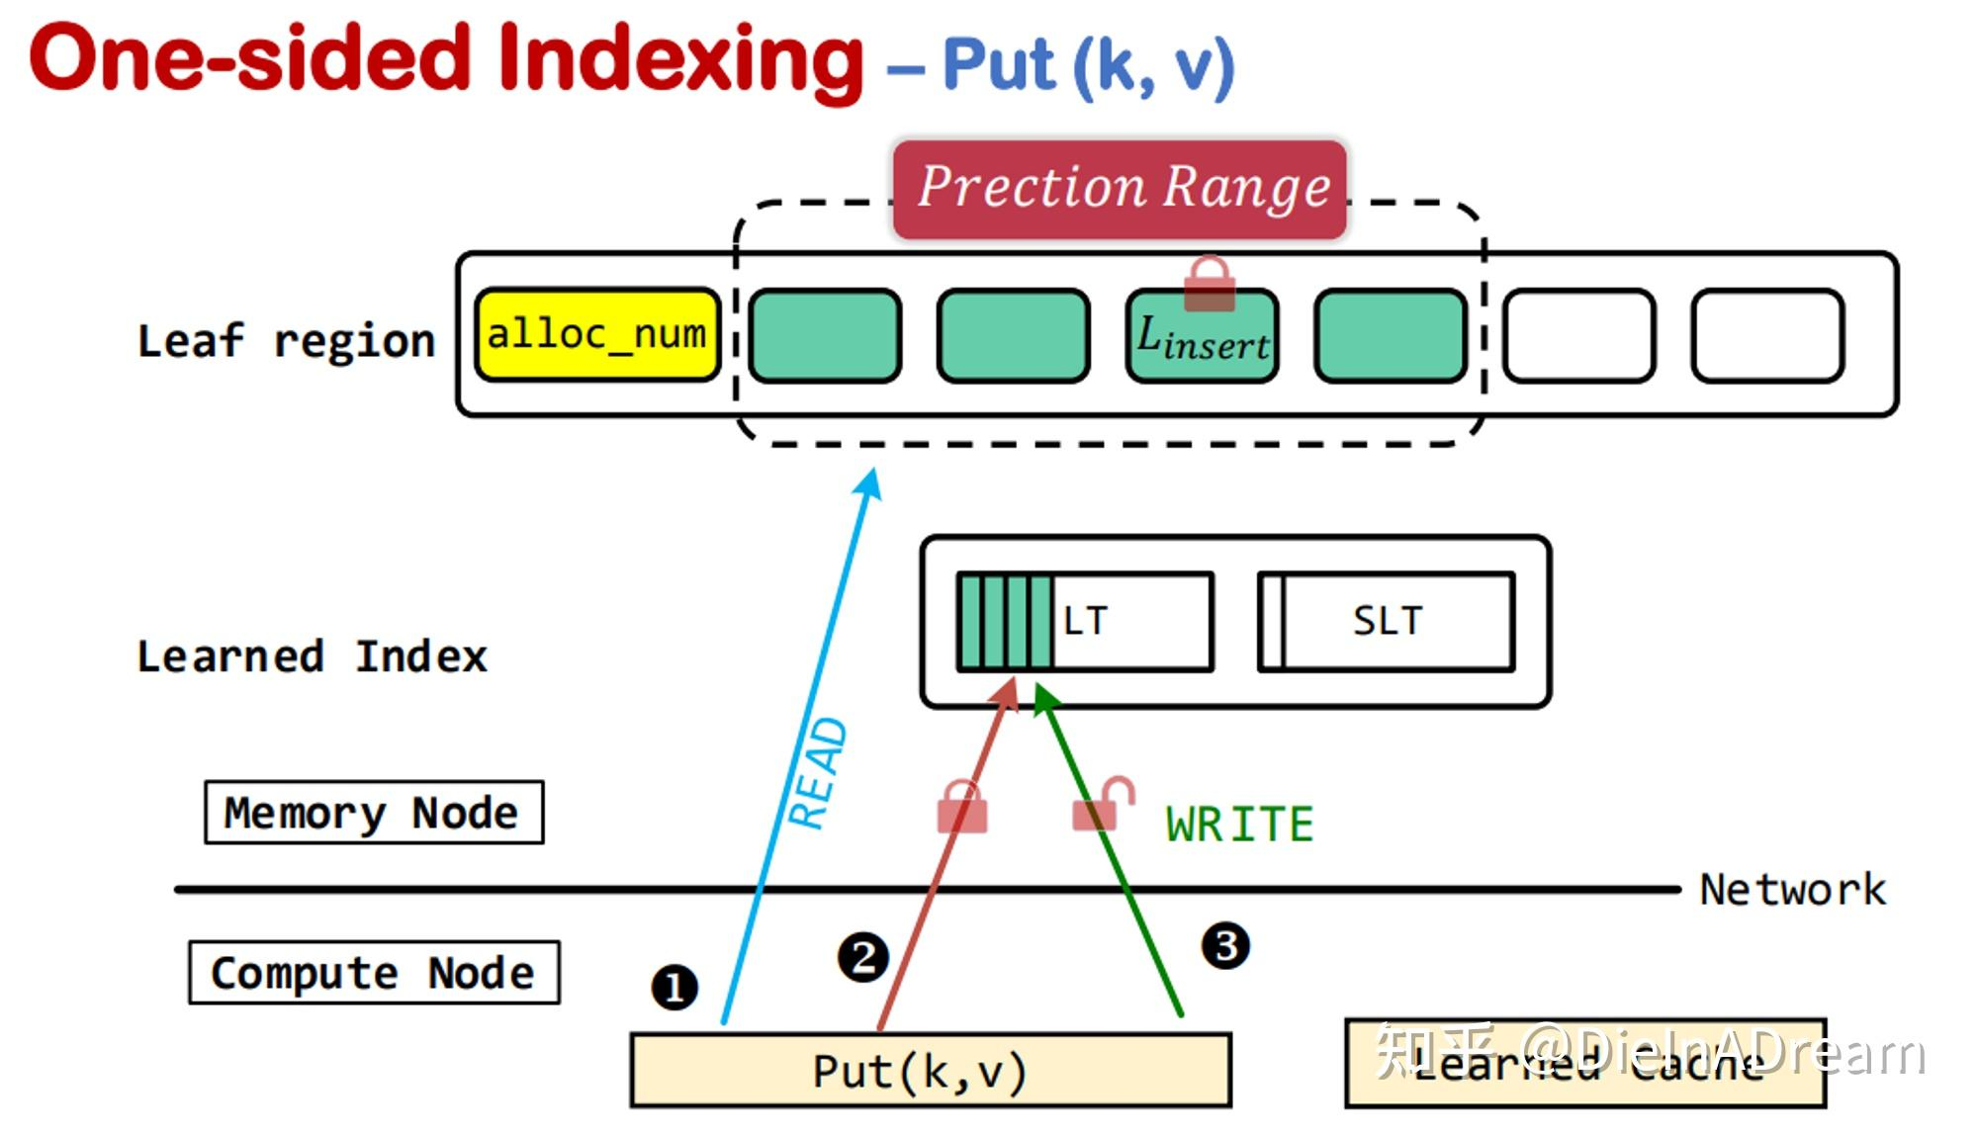
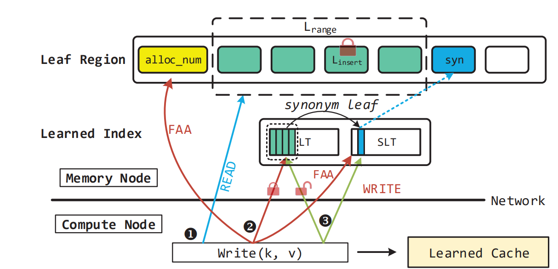
Write operation
Fetching: Compute node fetches the remote leaves like point query($L_{insert}$ )
Fine-grained locking: Locking the $L_{insert}$ via compare-and-swap (CAS)
Writing and unlocking: Write and Unlock via CAS
Learned Cache

Slide 28
Asynchronous Retraining
CirQ to identify models waiting for retraining, and then uses the shadow redirection scheme to retrain concurrently without blocking the system
Asynchronous retraining
Notes:
重新训练的开销来自数据重新排序和重新训练算法[37, 46]。一个直观的解决方案是在计算节点上进行重新训练，但这会消耗大量可用的网络带宽
内存结点周期地检查 CirQ 的头部以进行重训练，在后台进行并构建一个新的 LT 来合并老的 LT 和 SLT，同时计算节点还可以并发访问老的模型。

Slide 29
Asynchronous Retraining - Consistency guarantee
alloc_num
L3
L5
L8
…
LT
SLT
Retraining
LT
SLT
Old model
New model
Asynchronous retraining
Notes:
当重训练以后使用新的模型替换老的模型以后，ROLEX 加锁老的模型，并把 L8 插入到新的 SLT

Slide 30
Evaluation

Slide 31
Evaluation step
CPU | 2XIntel(R) Xeon(R) Gold 6320R
DRAM | 188GB
RNIC | Mellanox ConnectX-5
Workload | Weblogs & DocID: 100 million items
XStore-D | OSDI’20
EMT-D(eRPC + Masstree) | NSDI’19
Sherman(B-ink Tree) | SIGMOD’22
FG(Fine-grained B-ink Tree) | SIGMOD’19
100Gb RNIC
Memory Pool
Compute Pool

Slide 32
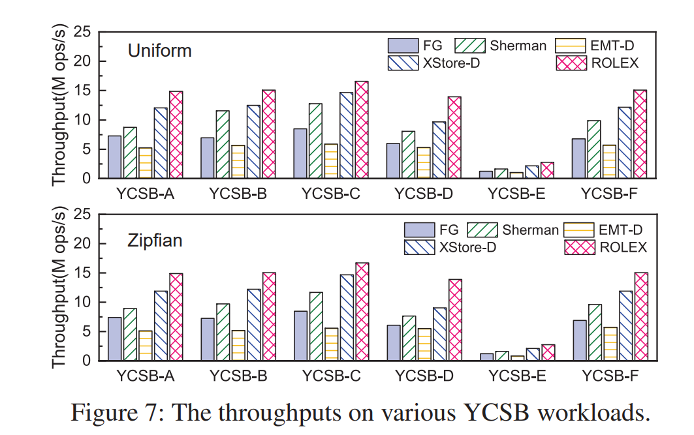
YCSB
100 million items
FG 2.1x
Sherman 1.7x
EMT-D 2.8x
XStore-D 1.3x
ROLEX improves the performance by 67% over other schemes

Slide 33
Various scenarios
FG 2.1x
Sherman 1.8x
EMT-D 4.5x
XStore-D 4.3x
XStore-D sends most of the data requests to the remote side as write requests increase.

Slide 34
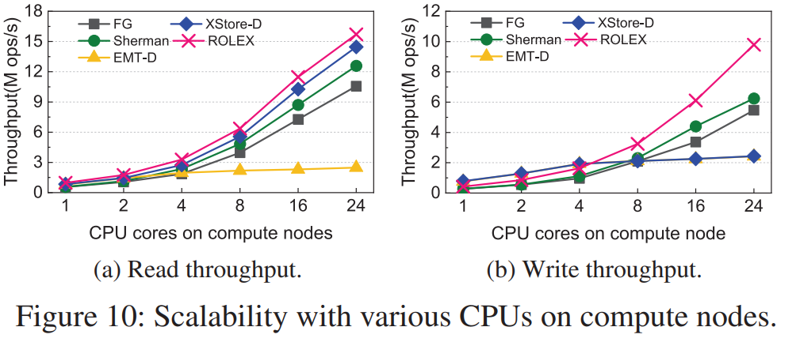
Scalability Performance
Write performance of XStore-D fails to scale out
The performance of EMT-D doesn’t increase

Slide 35
In-depth analysis
Maximum prediction error (ε) : (a) &(c)
leaf size (δ) : (b)
128 leaves consume about 300μs

Slide 36
Conclusion

Slide 37
Conclusion
This paper proposes ROLEX, a RDMA-oriented KVS using Learned index in DMS. ROLEX decouples the insertion and retraining operations, which enables the compute nodes to directly modify the remote data without retraining models.
ROLEX achieves high performance on both static and dynamic workloads in the context of the disaggregated memory systems
ROLEX is open-source for public use in GitHub

Slide 38
Thank you
2023. 10. 31
Presented by GuangXun Zhao
guangxun0621@gmail.com

