Slide 1
DiLOS: Do Not Trade Compatibility for Performance in Memory Disaggregation
W. Yoon et al.
Eurosys’23
2023. 11. 07
Presented by SeongHyeon Lee
leesh0812@dankook.ac.kr

Slide 2
Outline
Outline
Introduction & Motivation
DiLOS
Page Fault Handler
Prefetcher
Page Manager
Implementation
Evaluation
Conclusion

Slide 3
Introduction & Motivation
Memory disaggregation
RDMA network
(Understanding Memory Resource Management in VMware ESX 4.1, ESX Vmware)

Slide 4
Introduction & Motivation

Slide 5
Introduction & Motivation

Slide 8
Process 1

Slide 9
Process 1

Slide 10
Process 2

Slide 11
Process 2

Slide 12
Big Process

Slide 13
Big Process

Slide 14
Big Process

Slide 15
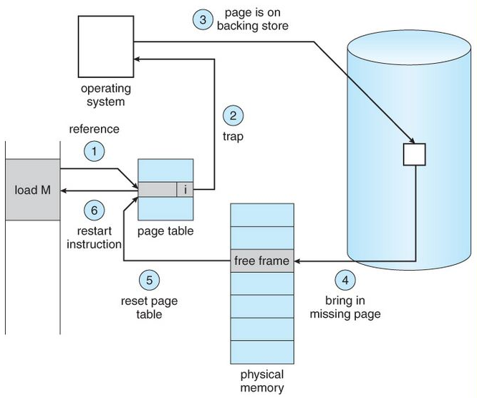
Introduction & Motivation
Page fault
(Source: A. Silberschatz, “Operating system Concept”)

Slide 16
Introduction & Motivation
Cost of Handling Page Faults
Notes:
\

Slide 17
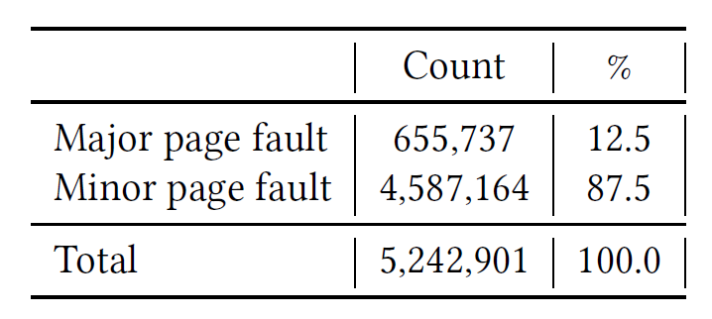
Introduction & Motivation
Cost of Prefetching

Slide 18
Introduction & Motivation
User level system
First, some user-level systems require application modifications
Second, user-level systems is supporting only a limited number of programming languages.
Compatibility
Performance

Slide 19
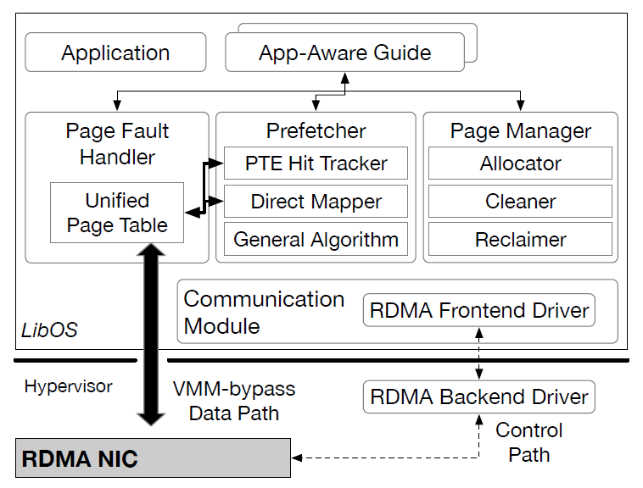
DiLOS
DiLOS

Slide 20
DiLOS
DiLOS

Slide 21
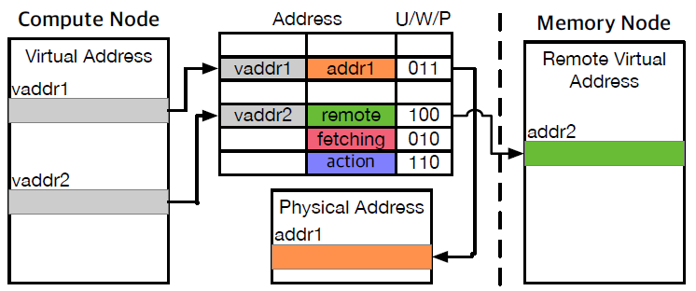
DiLOS
Unified Page Table
The core of the DiLOS paging subsystem is centered around the UPT
swap system or swap cache X
DiLOS tags: local, remote, fetching, and action.

Slide 22
DiLOS
Unified Page Table
The core of the DiLOS paging subsystem is centered around the UPT
swap system or swap cache X
DiLOS tags: local, remote, fetching, and action.

Slide 23
DiLOS
Unified Page Table
The core of the DiLOS paging subsystem is centered around the UPT
swap system or swap cache X
DiLOS tags: local, remote, fetching, and action.

Slide 24
DiLOS
Page Fault Handler
Reduce the latency of page fault processing.
Reduces the operations involved with various structures, such as allocation, tracking, and updating.

Slide 25
DiLOS
DiLOS

Slide 26
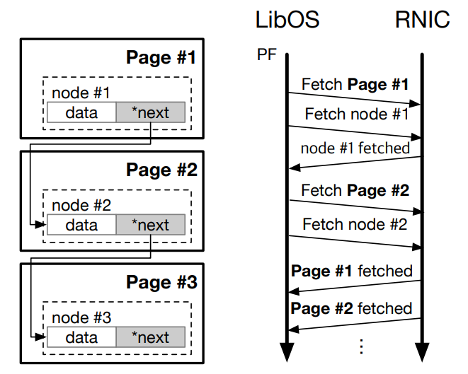
DiLOS
Page Prefetcher
DiLOS page fault handler is to reduce the latency of page fault processing
PTE Hit Tracker
Accessed bit
Direct Mapper
General Algorithm

Slide 27
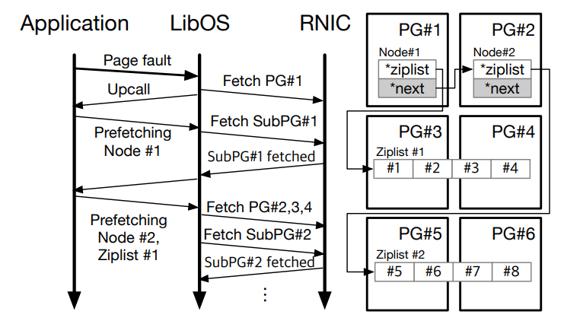
DiLOS
Page Prefetcher
DiLOS page fault handler is to reduce the latency of page fault processing
PTE Hit Tracker
Accessed bit
Direct Mapper
General Algorithm

Slide 28
DiLOS
LibOS

Slide 29
DiLOS
Page Manager
Allocator finds and assigns available pages, updating this information in the page table
Cleaner identifies pages marked as 'Dirty' and rewrites or updates them to the remote memory node(background and eager eviction)
When the local DRAM is full, the reclaimer performs page reclamation to free up pages

Slide 30
DiLOS
Implementation
To avoid unnecessary data copying and VM exits resulting from the use of a virtualized RDMA driver, a VMM-bypass data path is utilized.
The control path communicates with the hypervisor's backend driver via virtio.
DiLOS’ driver uses RDMA’s protection key mechanism(isolate data-path among VMs)
The base OSv does not support the write-combining buffer used by BlueFlame, necessitating modifications to provide support.

Slide 31
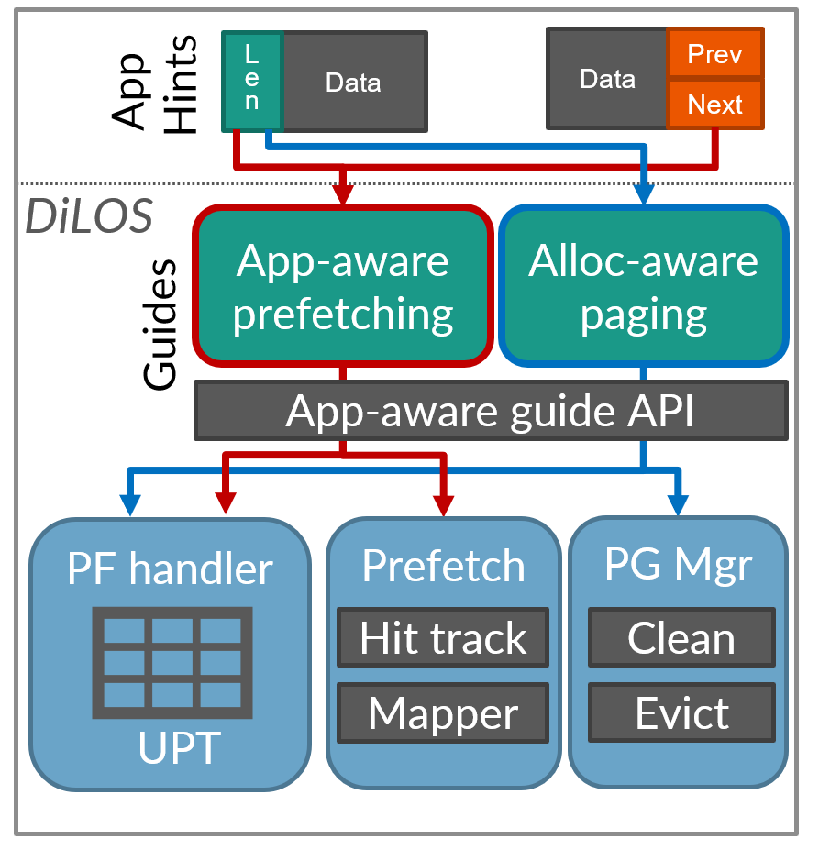
DiLOS

Slide 32
Evaluation
Setup
Compute node: Xeon E5-2670v3 2.3GHz
Memory node: DDR4
Connect: X-5 100GbE RoCEv2 RDMA
QEMU 4.2.1 and Mellanox OFED 5.0

Slide 33
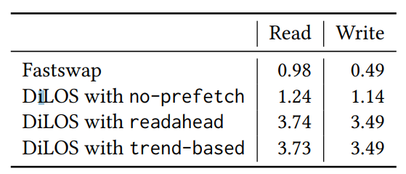
Evaluation
Throughputs of sequential read and write

Slide 34
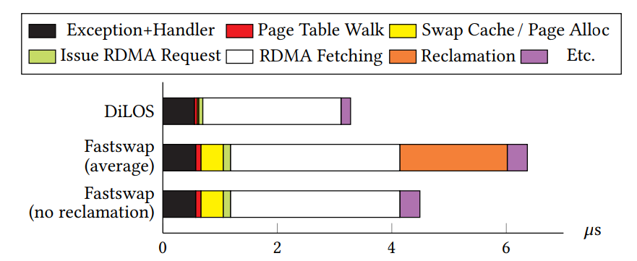
Evaluation
Latency breakdown of DiLOS and Fastswap during sequential read

Slide 35
Evaluation
Number of page faults during sequential read

Slide 36
Evaluation
Completion time of simple benchmarks

Slide 37
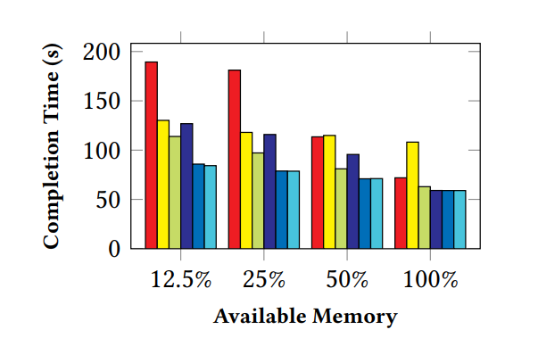
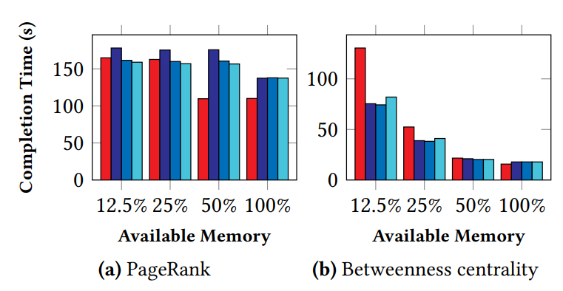
Evaluation
NYC taxi workload on DataFrame & GAPBS processing time

Slide 38
Evaluation
Redis’s request handling throughput(GET, LRANGE)

Slide 39
Conclusion
DiLOS, LibOS-based memory disaggregation system
Retains compatibility by using POSIX and paging’
Paging supports unmodified applications
LibOS simple design eliminates all unnecessary costs in paging
Adds performance by lightweight and allocation/app-aware paging
New prefetcher design minimizes page faults
Specialization guides allow low-cost domain hints integration
App-aware prefetching hides remote memory latency

Slide 40
Q&A
Q&A

