Slide 1
SHADE: Enable Fundamental Cacheability for Distributed Deep Learning Training
Redwan Ibne Seraj Khan, Ahmad Hossein Yazdani, Yuqi Fu, Arnab K. Paul, Bo Ji, Xun Jian, Yue Cheng, Ali R.Butt
Virginia Tech
Presented by : Young-Chan Choi

Slide 2
Index
Introduction / Background
Motivation
SHADE
Evaluation
Limitation

Slide 3
Introduction / Background
Deep Learning Training Process
For each epoch
load each batch
transfer data to GPU(VRAM)
forward-pass with minibatch data
calculate loss
back propagation using calculated loss
weight update
get train accuracy / test accuracy
Randomly select n data samples
repeat

Slide 4
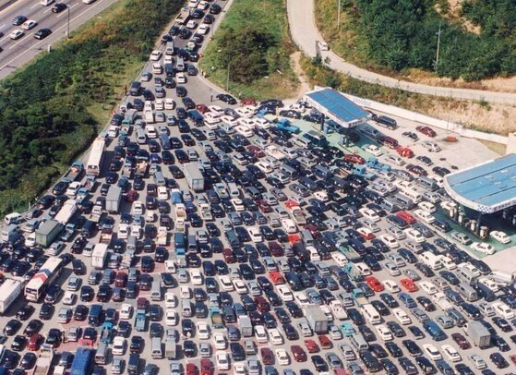
Introduction / Background
Distributed Deep Learning Training Process
Communication-intensive
Data parallel training
Update every model
+SGD
GPU
weight
Model parallel training
Replica of model
Pipeline parallelism
GPU
weight
Average
weight
Replica of model
GPU
DATA
weight
DATA
Replica of model
DATA
Minibatch consisting of
randomly selected samples
Computation-intensive
I/O intensive

Slide 5
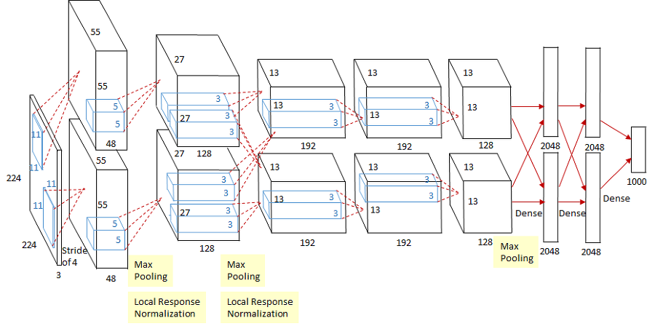
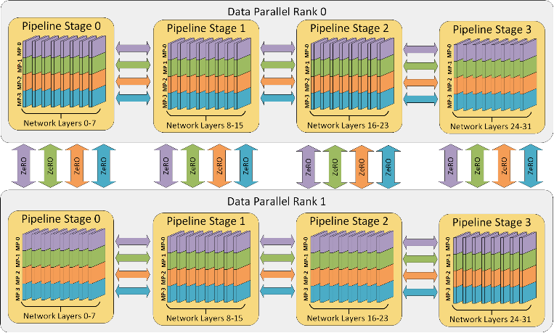
Introduction / Background
Distributed Deep Learning Training Process
Data parallel training
+SGD
Model parallel training
Pipeline parallelism

Slide 6
Introduction / Background
Distributed Deep Learning Training Process
Communication-intensive
Data parallel training
Update every model
+SGD
GPU
weight
Model parallel training
Replica of model
Pipeline parallelism
GPU
weight
Average
weight
Replica of model
GPU
DATA
weight
DATA
Replica of model
DATA
Minibatch consisting of
randomly selected samples
Computation-intensive
I/O intensive

Slide 7
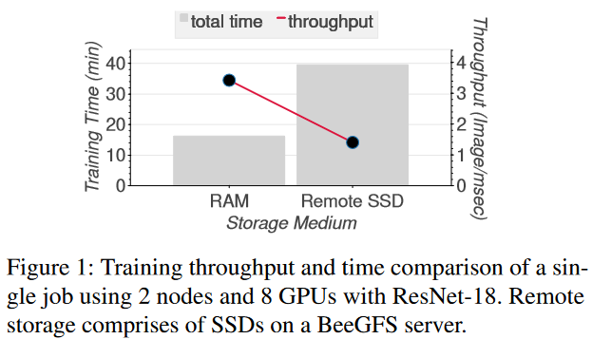
Introduction / Background
Distributed Deep Learning Training Process
I/O Characteristic of Data-Parallel DL Training
Highly-concurrent
Read-only
Repetitive
Totally random I/O access
Improving I/O efficiency can improve training speed
→ using GPU Spot VMs does not have enough RAM

Slide 8
Introduction / Background
Importance Sampling
Specific set of training samples tend to generate little-to-no impact on the model quality
Prioritizing training using samples with relatively higher importance can achieve improvement in both training time and test errors
Feed forward loss is often used to measure the importance of each data sample as an alternative of gradients
Mini batch 0
weight
Forward / back propagation
update
Mini batch 0
weight
Forward / back propagation
update
Mini batch 0
weight
Contribution of each batch is different
Forward / back propagation
update

Slide 9
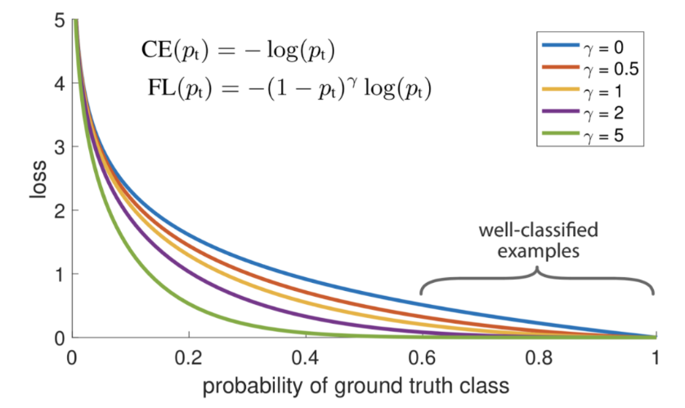
Introduction / Background
Focal Loss
Background: easy problem
Foreground: hard problem
To address class imbalance
Focus training with hard negative example
P: model’s estimated probability for the class with label y=1

Slide 10
Motivation
Sample Access Pattern of Importance Sampling
Analyze importance sampling
26.5%, 26.6%, and 26.2% of the samples are accessed more than once in epochs 1, 20, and 89
9.6% of the samples are accessed 3 times or more in epoch 89

Slide 11
Motivation
Data Importance Distribution
Not all samples contribute equally to model training
In particular, in epoch 20, around 49.91% of samples have a normalized importance score greater than 30%
→the importance information could be exploited by a priority caching policy to optimize the I/O efficiency of DL training.

Slide 12
Motivation
Impact of Importance Sampling on Training
importance sampling incurs negligible impact on the model accuracy for the CIFAR-10 (a), (b)
importance sampling does not have a drastic loss degradation (c)
importance sampling can achieve better accuracy in under 20 epochs than the accuracy achieved by normal baseline random sampling in 100 epochs (d)

Slide 13
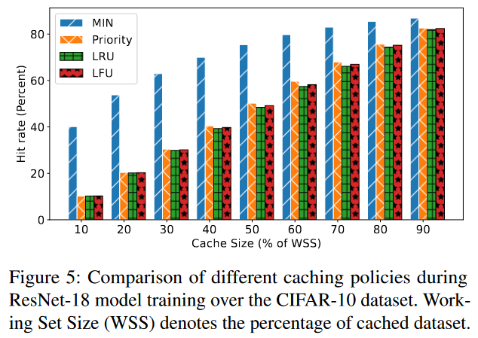
SHADE
Challenge
Belady’s MIN cache replacement policy achieves an optimal read hit ratio assuming perfect future knowledge (replaces the item that will be accessed furthest in the future)
Key Insight
DLT treats different training samples differently
I/O accesses are inherently predictable
→ exposing interesting exploitation opportunities to fundamentally improve the I/O efficiency

Slide 14
SHADE
Challenge
Default importance sampling assigns per-minibatch scores coarse-grained, inaccurate want an importance score that precisely tells us the relative importance that each sample carries within a minibatch
aggressively feeding the DL model with repetitive samples might make training model biased
importance scores are constantly changing and may get stale quickly capture most up-to-date importance score

Slide 15
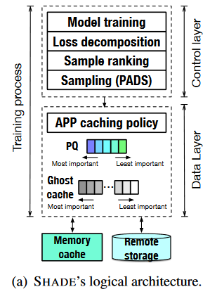
SHADE
Overview
Control Layer
provides the data layer with the list of samples needed for training
Data Layer
1st iteration
Fetch samples from a remote storage and populates the cache
During Training
Finds importance (loss decomposition + ranking)
Update importance, priority queue, ghost cache
During Training
checks whether it is beneficial to cache a newer item instead of evicting a cached prior sample

Slide 16
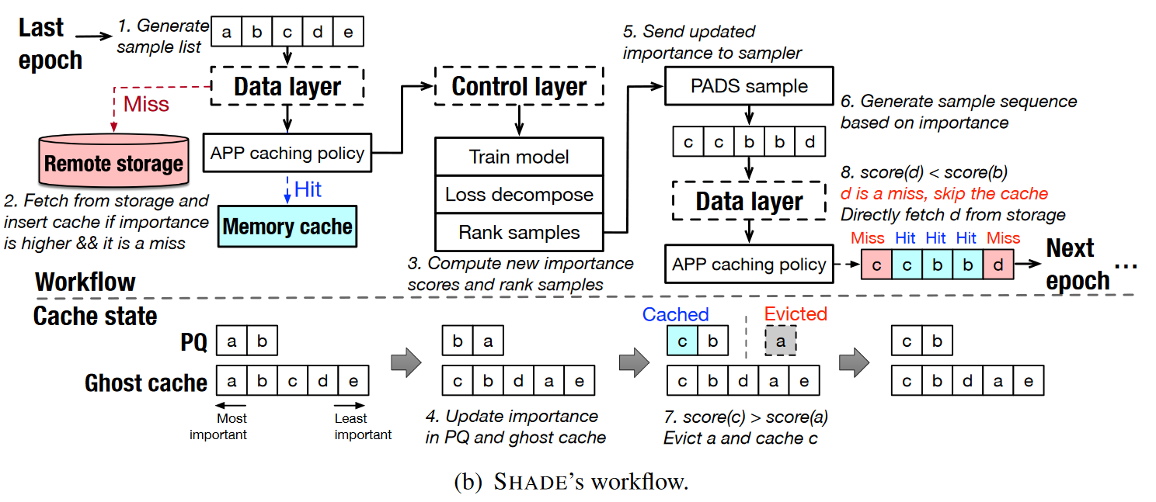
SHADE
Overview

Slide 17
SHADE
Control Layer
Calculates importance score
Samples the data from different training processes
Loss Decomposition
Default calculate forward pass forward loss = importance score
SHADE use sample-level and minibatch-level cross entropy loss
S data samples
Calculate categorical-cross entropy for each sample
T-class
SOFTMAX

Slide 18
SHADE
Control Layer
Loss Decomposition
Calculate minibatch importance
$E_{sample_{k}}$: categorical cross-entropy
T-class
Entropy
High model generates multiple predictions for a single sample out
Low model can generate a single prediction for it with high enough accuracy → not highly important in increasing accuracy of model in later epochs
xS data samples

Slide 19
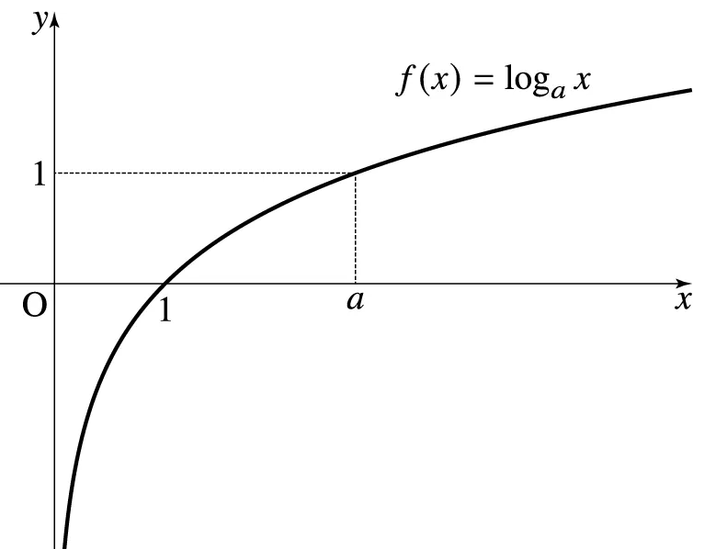
SHADE
Control Layer
Rank-based Importance Score
rank
Calculate relative rankings of a sample in a minibatch
Find number of samples that has lower entropy
+ $b_{0}$
Log
Relative scores are desirable for three reasons
Different samples from different minibatches would share the same rank in our method if they contributed the same proportion in improving the accuracy
Training against harder-to-learn samples may help mitigate the high volatility of the accuracy rate
Easy to choose top x% important data
Entropy score

Slide 20
SHADE
Control Layer
Priority-based Adaptive Data Sampling(PADS)
prioritizes the samples that contributed the most to the accuracy of the model by constructing a multinomial probability distribution of the data samples
sampler builds a list of important samples for shuffling and sharding across different DLT processes
The sampler provides the data layer with a list of repetitive samples
While training
Steep decline in the loss convergence curve
Stagnant accuracy curve
intentionally shuffles the important samples
Examples
PADS create samples list with repetitions based on importance (3, 5, 2 is important)
Belady’s MIN
4
7
3
5
3
5
2
2
1
10
4
5
5
1
10
Selected by PADS cache 3,5→ 80%
Sample list provided by random sampler cache 5 first (need twice) + any number → 60%

Slide 21
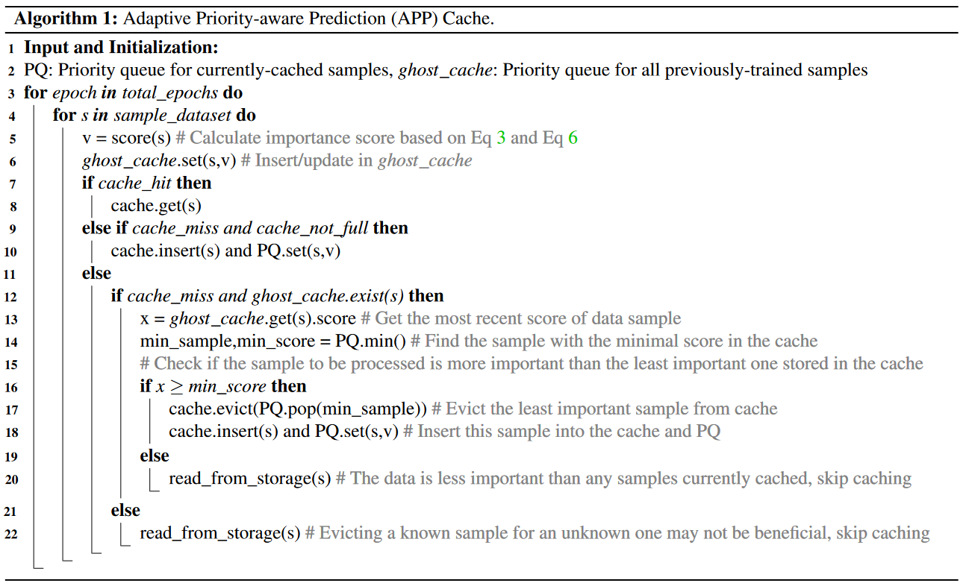
SHADE
Data Layer
Importance scores are constantly changing
Adaptive Priority-Aware Prediction(APP)
Updates the importance score of a data sample as soon as the importance score changes
Priority Queue(PQ)
Keeps track of metadata state of currently cached samples in the cache
Ghost Cache
Tracks all metadata state of the samples that have been cached (including evicted ones)
helps decide whether a previously-evicted sample could be brought back into the cache

Slide 22
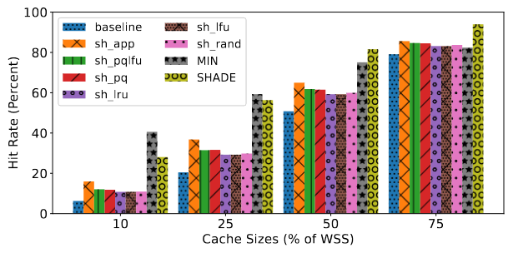
Evaluation
Experimental Setup
SHADE
LRU + pytorch
x8 P100 GPUs
Spread across 4 nodes
Connected via 10Gbps interconnect
Cache Hit Ratio
Priority-based LFU batch-forward loss ➔ sample access frequency
Priority-based policy forward loss = importance score
LRU based on recency of item
LFU evicts least frequent items
Random
APP does not use loss decomposition, rank-based importance score, PADS sampling
SHADE
MIN

Slide 23
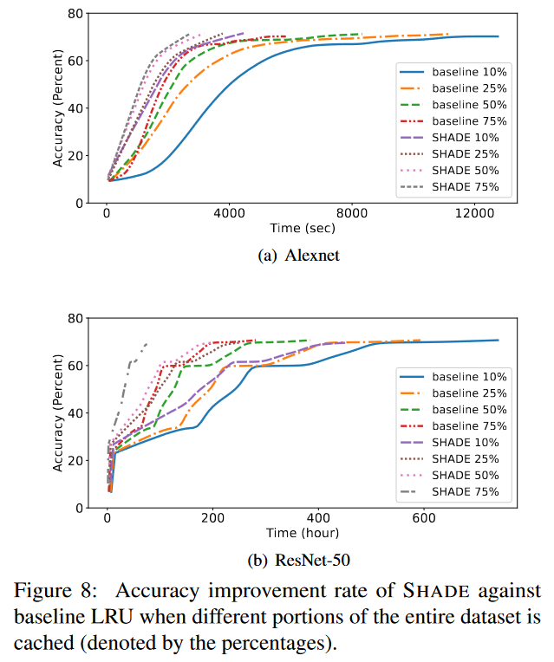
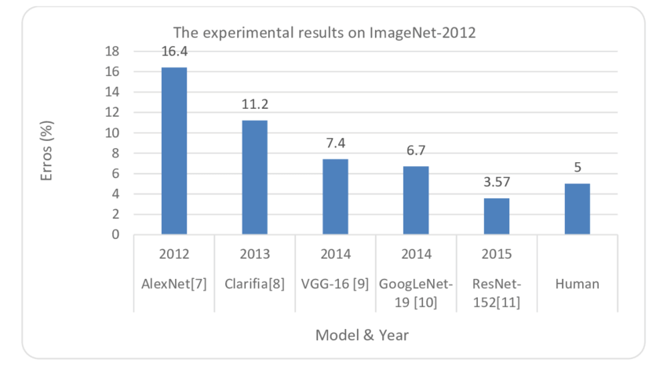
Evaluation
Accuracy vs Time
How quickly accuracy reaches 75%
even if a larger portion of the dataset is cached, naively caching data items without proper techniques to exploit data locality can not guarantee improved performance
Notes:
75%까지 학습 빨라지는거 확인해서 뭐 어쩌나…
나중에 학습이 최종적으로 잘 되는지 그걸 봐야하지 않을까?
Top 1 AlexNet: 58.3%, ResNet50: 76~78%
Top 5 AlexNet: 80.2%, ResNet50: 92~94%

Slide 24
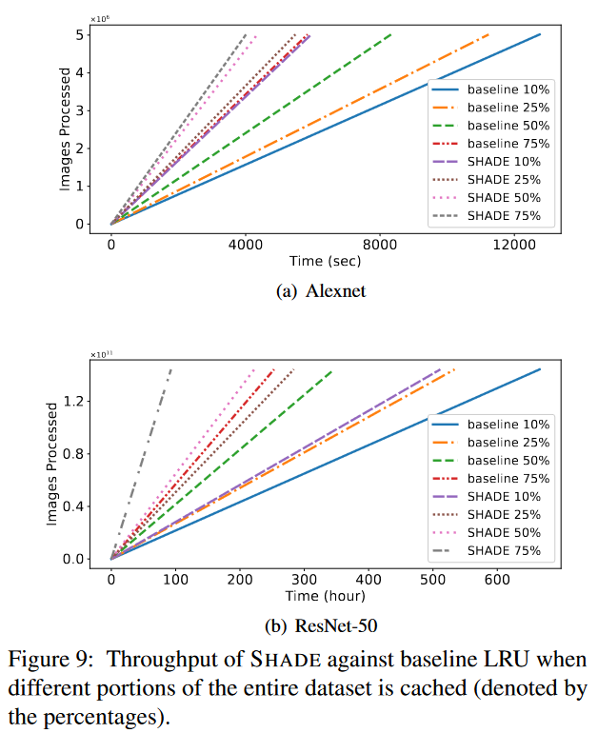
Evaluation
Throughput
SHADE while caching just 10% of the dataset has around 2.3× better throughput
The improvement in the ability to process more images is due to the ability of SHADE to exploit data locality with APP cache policy
SHADE can exploit data locality and has techniques to train on important samples which ensures a better accuracy improvement rate
Notes:
Throughput은 보통 inference에 쓰지 않나?

Slide 25
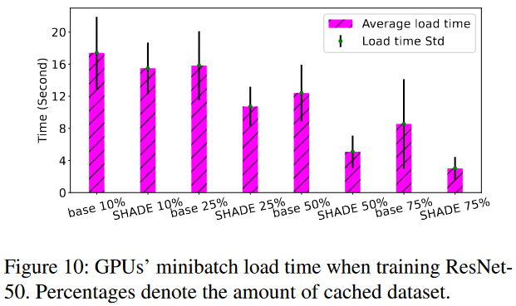
Evaluation
Minibatch Load Time
SHADE can achieve a lower mean load time
SHADE can maintain a small standard deviation in minibatch load time
In case for baseline, standard deviation increases as it caches larger portions of the dataset

Slide 26
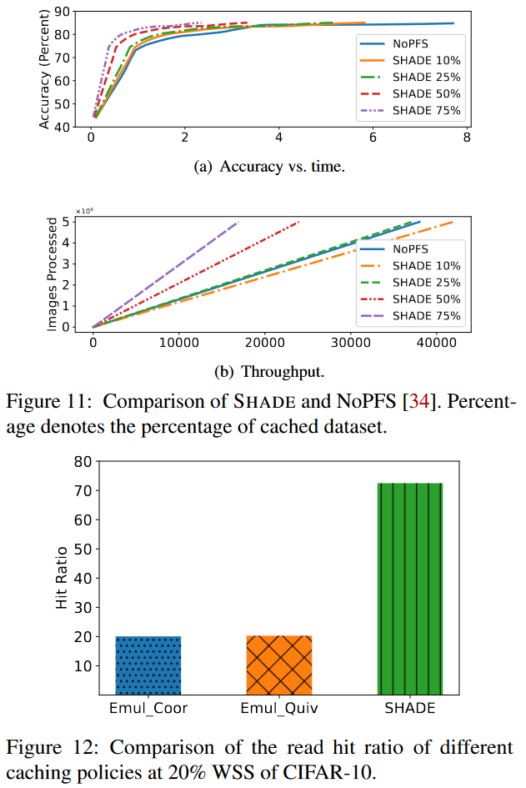
Evaluation
End-to-End System Comparison
Comparison with NoPFS
NoPFS: SOTA system for improving I/Os of DLT exploits the seeds, random sampling use Clairvoyance to approximate future distance of Belady’s MIN
NoPFS incurs a 4.5× and 2.4× increase in training time to reach accuracy
SHADE has 2.2× and 1.6× better throughput
SHADE can manipulate the sampling process (PADS policy) and keep repeated samples in the cache, it can achieve a higher hit ratio (72.5%) and thus outperforms both Emul_Quiv and Emul_Coor by 3.6×.

Slide 27
Limitations
Too old deep learning architecture (AlexNet, ResNet)
CIFAR 10 may not be appropriate for large deep learning experiments
Using random sampling is to maximize model generalization + prevent model from learning sequence of samples → repetitive sampling may result in low generalization of model
Better use focal loss methods or need comparison with proposed method
How about separating papers into two 1. importance sampling 2. caching system
Does not present final accuracy of trained model

Slide 28
Reference
https://unerue.github.io/computer-vision/classifier-alexnet.html
https://www.deepspeed.ai/tutorials/pipeline/
https://sanghyukchun.github.io/69/
https://www.researchgate.net/figure/Accuracy-for-ImageNet-challenge-with-different-DL-models_fig1_323570864
https://arxiv.org/abs/1708.02002

Slide 29
Q&A

Slide 30
Thank You

