Slide 1
자율형 블록체인 융합연구소
EnvPipe: Performance-preserving DNN
Training Framework for Saving Energy
Sangjin Choi and Inhoe Koo, KAIST; Jeongseob Ahn, Ajou University;
Myeongjae Jeon, UNIST; Youngjin Kwon, KAIST
2023.11.28
Presented by Hernandez Santiago Luis Eduardo
luislalo3100@gmail.com

Slide 2
INDEX
01.
Introduction
02.
Background
03.
Challenges
04. EnvPipe
05. Evaluation
06. Conclusion
07. Q&A

Slide 3
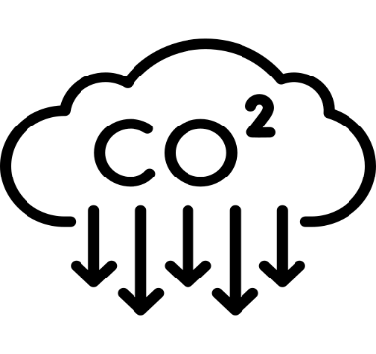
01
Introduction
Eco AI, Sustainable AI?
Are we the bad guys?
- GPT-3 --> 14.8 days, 1,287MWh
- Enough energy to power 44,183 US households for one day

Slide 4
02
Background

Slide 5
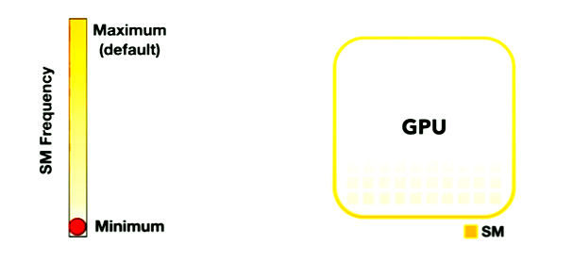
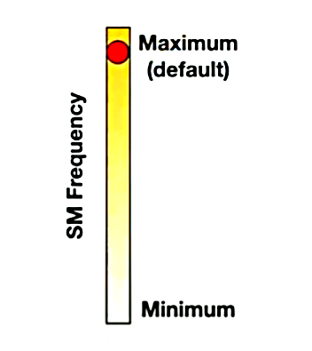
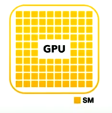
02
Background
GPU DVFS (Dynamic Voltage and Frequency Scaling)
Finding optimal streaming multiprocessor(SM) or memory clock frequency
SM--> small processing unit reponsible for executing thousands of threads in parallel in the GPu

Slide 6
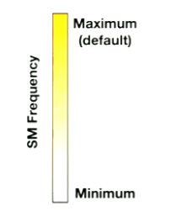
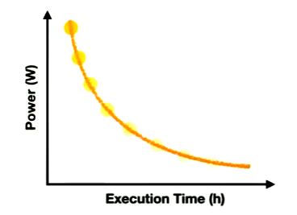
02
Background
GPU DVFS (Dynamic Voltage and Frequency Scaling)
Finding optimal streaming multiprocessor(SM) or memory clock frequency
Reducing SM frequency saves energy but degrades performance

Slide 7
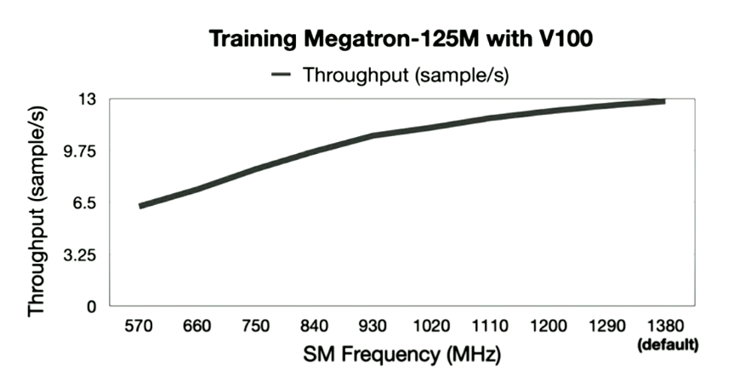
02
Background
GPU DVFS
Energy Scaling Valley Trend

Slide 8
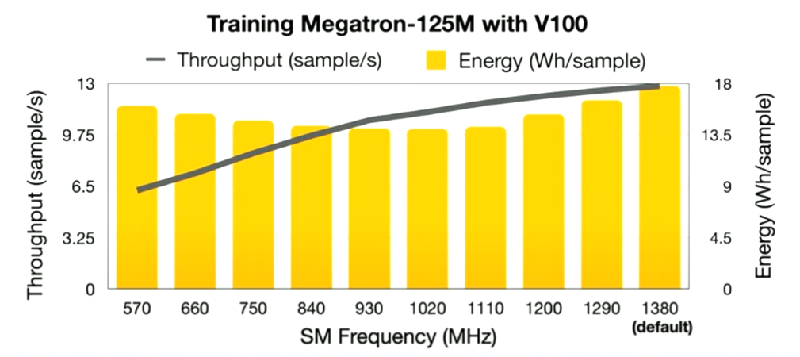
02
Background
Previosly on Sustainable AI
Energy Scaling Valley Trend
~20% slowdown
Navigating the energy-performance trade-off

Slide 9
02
Background
GPU DVFS
Energy Scaling Valley Trend with other models
Reducing SM frequency saves energy but degrades performance

Slide 10
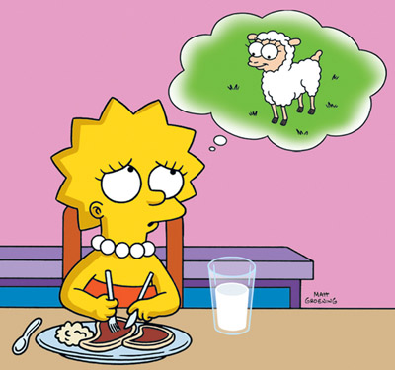
02
Background
Trade-off Dilema
Drawbacks: Hard to sacrifice perf. or accuracy in ML
Performance: How much slowdown is acceptable for long-running jobs?
10% slowdown for 1 month training is 3 days
Accuracy: the training goal for ML
Importance to save energy without degrading any performance or accuracy
Time is gold

Slide 11
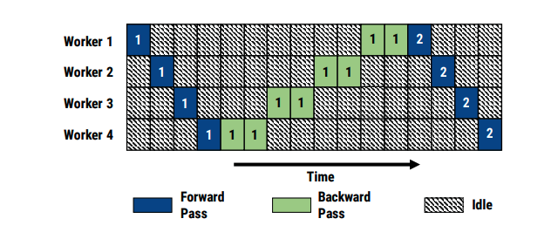
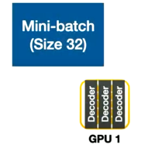
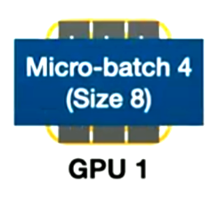
02
Background
Opportunity: Bubbles in Pipeline Parallelism
-Model vertically partitioned to each GPU
-Splits input mini-batch into multiple micro-batches and pipeline executions

Slide 12
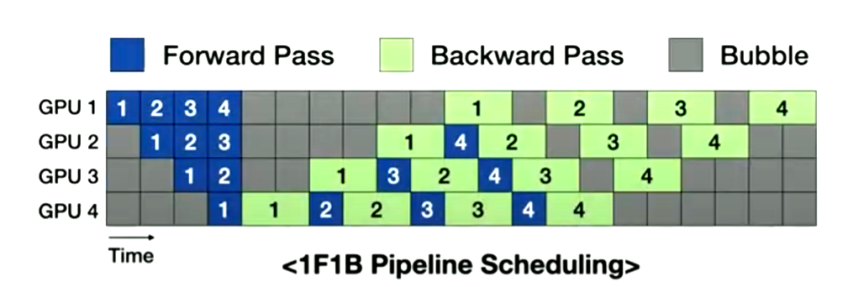
02
Background
Opportunity: Bubbles in Pipeline Parallelism
Forward Pass(FP)
Backward Pass(BP)
Bubble(B)
Weight Update

Slide 13
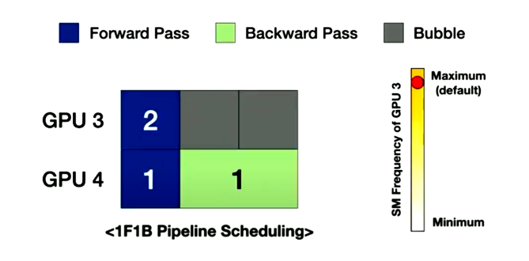
02
Background
Opportunity: Bubbles in Pipeline Parallelism
What happens when we decrease the SM frequency of GPU3?

Slide 14
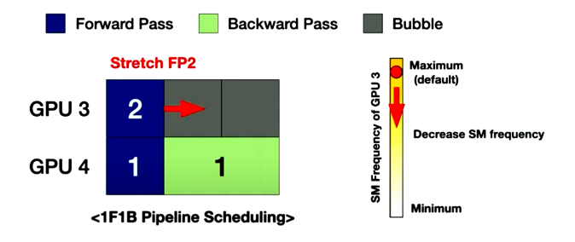
02
Background
Opportunity: Bubbles in Pipeline Parallelism
What happens when we decreased the SM frequency of GPU3?
The forward pipeline unit 2 will stretch an thus energy consumption of gpu3 will decrease with no overall performance degradation

Slide 15
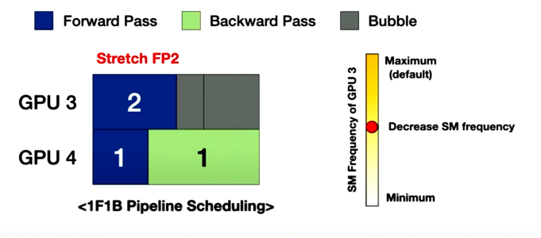
02
Background
Opportunity: Bubbles in Pipeline Parallelism
Leverage pipeline bubbles to save energy without performance degradation

Slide 16
02
Background
Opportunity: Bubbles in Pipeline Parallelism
A bigger picture of how take advantage of Bubbles on 1F1B Scheduling

Slide 17
03
Challenges

Slide 18
03
Challenges
Challenge I
Not All Bubbles are Usable
GPipe Scheduling Method
Unlike 1F1B scheduling method GPipe first schedules all the forward pass and later schedules all the backward pass.

Slide 19
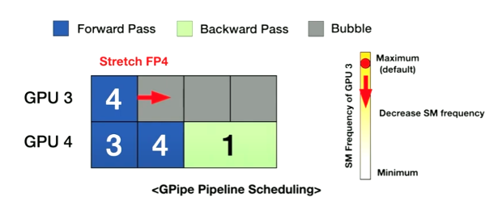
03
Challenges
Challenge I
Not All Bubbles are Usable
GPipe Scheduling Method
What happens when we decrese the SM frequency of GPU3 while using the GPipe Scheduling?

Slide 20
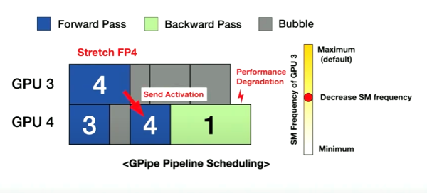
03
Challenges
Challenge I
Not All Bubbles are Usable
GPipe Scheduling Method
What happens when we decrese the SM frequency of GPU3 while using the GPipe Scheduling?
FP4 on GPU3 will stretch -->
FP4 unit should send the activation to the next GPU -->
The start time of FP4 on GPU4 delays --->
Performance Degradation

Slide 21
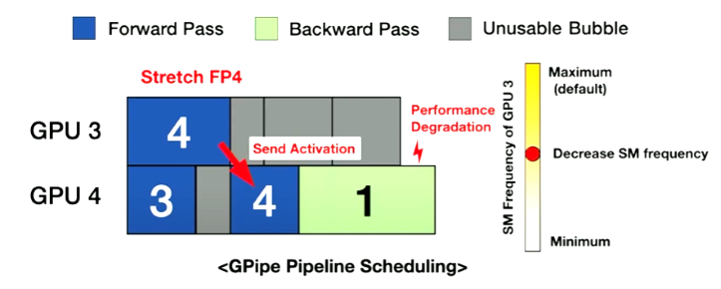
03
Challenges
Challenge I
Not All Bubbles are Usable
GPipe Scheduling Method
-Bubbles on GPipe Scheduling are unusable
-There is a necesity to Identidy Unusable and Usable bubbles

Slide 22
03
Challenges
Challenge II
Not Enough Usable Bubbles
-Too much stretching can degrade performance
-Leveraging just the right amount of bubbles would avoid performance degradation

Slide 23
04
EnvPipe

Slide 24
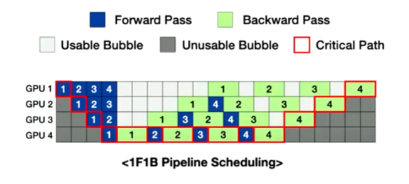
04
EnvPipe
RecaII
In Challenge II: Not Enough Usable Bubbles
Envelope + Pipeline Paralelism
The critical path represented as red boxes determines the end to end execution time of the pipeline and it should be preserved

Slide 25
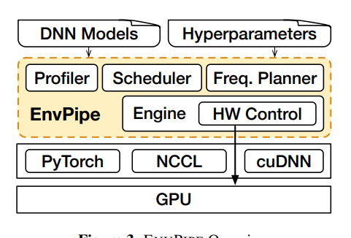
04
EnvPipe
EnvPipe Goals
Maximize Energy Saving --> Leveraging as many pipeline bubbles as possible
No Accuracy Degradation --> Not modify user-provided hyperparameters
Minimize Perf. Degradation --> Keep performance degradation near zero
1. Profiler
Portrays performance-energy tend for each stage
2. Scheduler
Schedules pipeline units to maximize energy saving
3. Freq. Planner
Reconfigures to minimize performance Degradation

Slide 26
04
EnvPipe
Profiler
Portrays performance-energy trend for each stage
-Valley trend according to SM frequency on Energy Consumption
Depends on hardware, batch_size, and partitioned model
-Online profiler portrays each pipeline stage to obtain the performance energy trend
~20% stretch maximum

Slide 27
04
EnvPipe
Scheduler
Determines the amounts of usable bubbles
How to effectively identify usable bubbles?
How to maximize Utilization of usable bubbles for energy saving

Slide 28
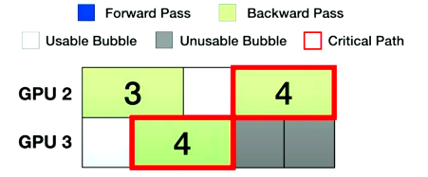
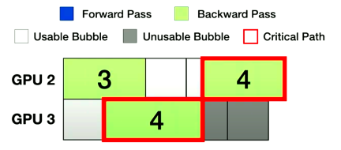
04
EnvPipe
Scheduler
How to effectively identify usable bubbles?
Stretch BP4 in GPU3 to use the bubbles after it(gray).
Critical path delays --> Performance Degradation ---> Critical path Bubbles are unusable
*The pipeline units on the critical path determines the end-to-end execution time of the pipeline.

Slide 29
04
EnvPipe
Scheduler
How to effectively identify usable bubbles?
Stretch BP4 in GPU3 to use the bubbles after it(gray).
Critical path delays --> Performance Degradation:
-Bubbles after Critical path Bubbles are unusable
-Bubbles after non-performance critical path are usable
*The pipeline units on the critical path determines the end-to-end execution time of the pipeline.

Slide 30
04
EnvPipe
Scheduler
How to effectively identify usable bubbles?
Stretch pipeline units on the non performance critical path

Slide 31
04
EnvPipe
Scheduler
How to maximize Utilization of usable bubbles ?
Conclusion: Stretch the pipeline units on the non-performance critical paths
--> Stretch all units inside the outer envelope with just the critical path

Slide 32
04
EnvPipe
Scheduler
How to maximize Utilization of usable bubbles ?
Save energy at no performance degradation.
Since data dependency is far there is enough slack time to stretch the micro batch

Slide 33
04
EnvPipe
Scheduler
How to maximize Utilization of usable bubbles ?
How about stretching the FP and BP units at the back inside by the envelope?

Slide 34
04
EnvPipe
Scheduler
How to maximize Utilization of usable bubbles ?
How about stretching the FP and BP units at the back inside by the envelope?
By stretching this units the critical path changes and it is now not the outer envelope

Slide 35
04
EnvPipe
Scheduler
How to maximize Utilization of usable bubbles ?
Reasons for the performance degradation
1. Immediate dependecy between GPU3 and GPU4
Solution: Change Immediate dependency to far dependency

Slide 36
04
EnvPipe
Scheduler
How to maximize Utilization of usable bubbles ?
Reasons for the performance degradation
2. Uneven distribution of usable bubbles
Lots of backward computation at the final stage but not enough usable bubbles
Too many wasted bubbles at the front
Solution--> Evenly distribute usable bubbles to maximize utilization

Slide 37
04
EnvPipe
Scheduler
Designed their own scheduler
Step1) Initialize with 1FB1 scheduling
Among existing pipeline scheduling methods 1F1B has the fewest units under performance critical path.
ENVPIPE moves FP units to upfront usable bubbles (e.g., FP4, FP5, and FP6 in GPU2 ◇)
Generating usable bubbles after backward units (e.g., BP3, BP4, and BP5 in GPU2 △).

Slide 38
04
EnvPipe
Scheduler
Designed their own scheduler
Step2) Reschedule FP units to the front
-Change the immediate dependency to far dependency and distributed usable bubbles to make best out of bubbles.
-All data with dependency is in the same order as before. Only the data dependency becomes farther

Slide 39
04
EnvPipe
Scheduler
Designed their own scheduler
Step3) Stretched all pipeline units inside the outer envelope to maximize energy saving
-Stretching all pipeline units inside the envelope degrades performance.
Conclusion
-Naively stretching all pipelines units inside the envelope decreases performance.

Slide 40
04
EnvPipe
Freq. Planner
-SM frequency should be reconfigured on some pipeline units to minimize performance degradation
From the maximum default frequency we stretched all pipeline units inside the envelope to the minimum point in the energy value curve

Slide 41
04
EnvPipe
Freq. Planner
-How much reconfiguration is needed?
Critical path should be the outer envelope to minimize performance degradation.
Increasing the SM too much will reduce energy saving
Reconfigure just the right amount.

Slide 42
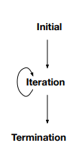
04
EnvPipe
Freq. Planner
Iterative Algorithm
Scheduling Algorithm --> Planner stretches the pipeline units inside the envelope by min SM frequency
1) Executes single pipeline step
2) Finds changed critical path
3) Reconfigures SM frequency on the critical path in small steps
Repeats the find and reconfigure steps iteratively to reconfigure the SM frequency
-The algorithm terminates when the critical path becomes the outer envelope.

Slide 43
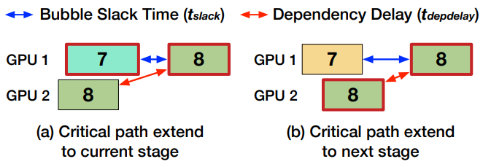
04
EnvPipe
Freq. Planner
Since the critical path decides the end to end execution time of the pipeline, the last unit BP8 on gpu1 will always be the last unit on the critical path

Slide 44
04
EnvPipe
Freq. Planner
Which pipeline unit is delaying the units on the critical path(8) ?
Which pipeline is delaying the start time of the last unit?
FP7 is delaying the start time of BP8, thus critical path extends to 7

Slide 45
04
EnvPipe
Freq. Planner
FP7 got reconfigured, stretch has shortened
Which pipeline unit is delaying the last unit?
BP8 on GP2 is delaying the start time of the last pipeline unit
The critical path extends to the next stage

Slide 46
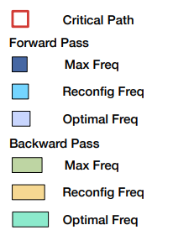
04
EnvPipe
Freq. Planner
Which pipeline unit is delaying the units on the critical path(8) ?
Which pipeline is delaying the start time of the last unit?
From the back of the pipeline the algorithm incrementally buil,ds a critical path

Slide 47
04
EnvPipe
Freq. Planner
Which pipeline unit is delaying the units on the critical path(8) ?
Which pipeline is delaying the start time of the last unit?
Since we found the critical path we reconfigure the pipeline units on the critical path and repeat the “find” and “reconfigure” steps

Slide 48
04
EnvPipe
Freq. Planner
Which pipeline unit is delaying the units on the critical path(8) ?
Which pipeline is delaying the start time of the last unit?
The Algorithm terminates when the critical path is outer envelope

Slide 49
05
Evaluation

Slide 50
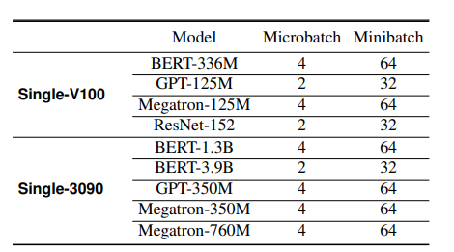
05
Evaluation
Single AWS P3.8xLarge with 4 V100 GPUs & Single AWS P3.8xLarge with 4 3090 GPUs
Baseline: run all GPUs with maximum frequency
~Maximize Energy Saving
~No Accuracy Degradation
~Minimize Perd. Degradation

Slide 51
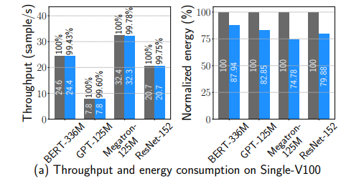
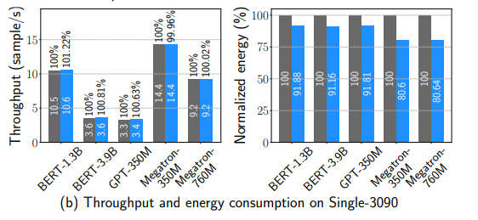
05
Evaluation
Single AWS P3.8xLarge with 4 V100 GPUs & Single AWS P3.8xLarge with 4 3090 GPUs
Baseline: run all GPUs with maximum frequency
~Performance degradation less than 1%
~Up to 25.2% energy saving on Single-V100

Slide 52
05
Evaluation
Multi-Node
Two AWS P3.16xLarge with 8 V100 GPUs
Connected with 25Gbps network
Performance degradation less than 1%
Up to 28.4% energy saving

Slide 53
06
Conclusion

Slide 54
01
Conclusion
ENV pipe is a DNN training framework that saves energy with no accuracy and performance degradation by leveraging bubbles in pipeline paralelismn. To achieve this goals we proposed a fine-grained online profiler. a scheduler to make best out of bubbles and frequency planner to minimize performance degradation. ENV pipe can save energy up to 28percent with less than one porcent of performance degradation

Slide 55
Q&A

