Slide 1
Constructing and Analyzing the LSM Compaction Design Space
Subhadeep Sarkar, Dimitris Staratzis, Zichen Zhu, Manos Athanassoulis
Boston University, MA, USA
Proceedings of the VLDB Endowment, 2021
2023. 12. 05
Presented by Charles D. Jaranilla
charlzdieljaranilla@gmail.com

Slide 2
Introduction
Background
The Compaction Design Space
Benchmarking and Evaluation
Conclusion

Slide 3
Introduction

Slide 4
LSM-based Key-Value Stores
Why LSM?
Fast writes
Competitive reads
Good space utilization
COMPACTION

Slide 5
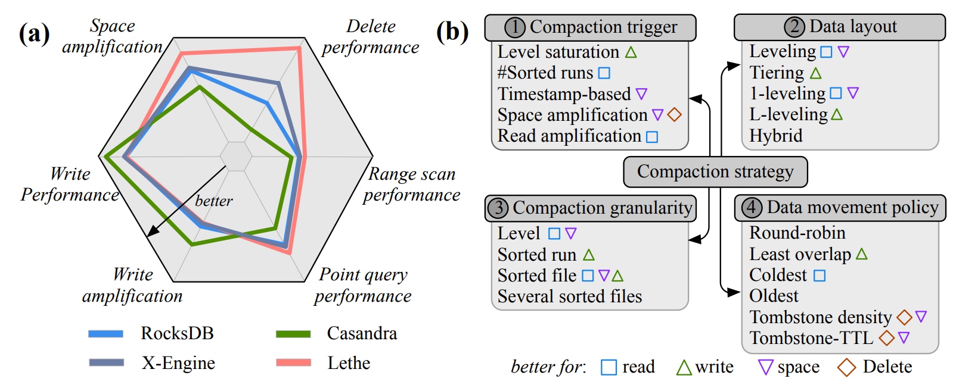
Compaction in LSM-Trees
Compaction

Slide 6
Goals
Provide a roadmap that helps to pick the correct compaction strategy based on performance requirement
Answer complex design questions about the LSM compaction design space

Slide 7
Contribution
Conceptual Contribution: Constructing the Compaction Design Space
Compaction Primitives
Trigger
Data Layout
Granularity
Data Movement Policy

Slide 8
Contribution
Experimental Contribution 1: Unifying the Experimental Infrastructure of Multiple Compaction Strategies
Experimental Contribution 2: Analyzing the Compaction Design Space
Performance Implications
Workload Influence on Compactions
Tuning Influence on Compactions
Answering Design Questions

Slide 9
This work defines the LSM compaction design space and
presents a thorough account of how the different primitives
affect the overall performance of a storage engine.

Slide 10
Background

Slide 11
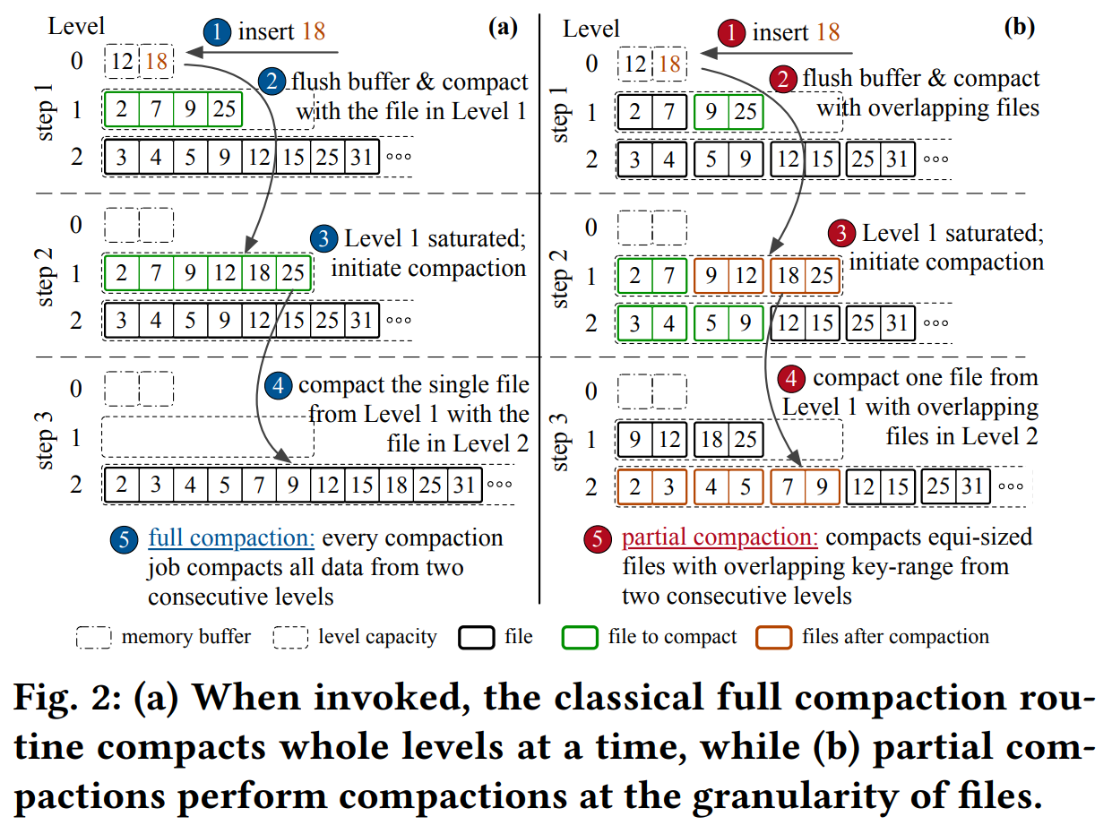
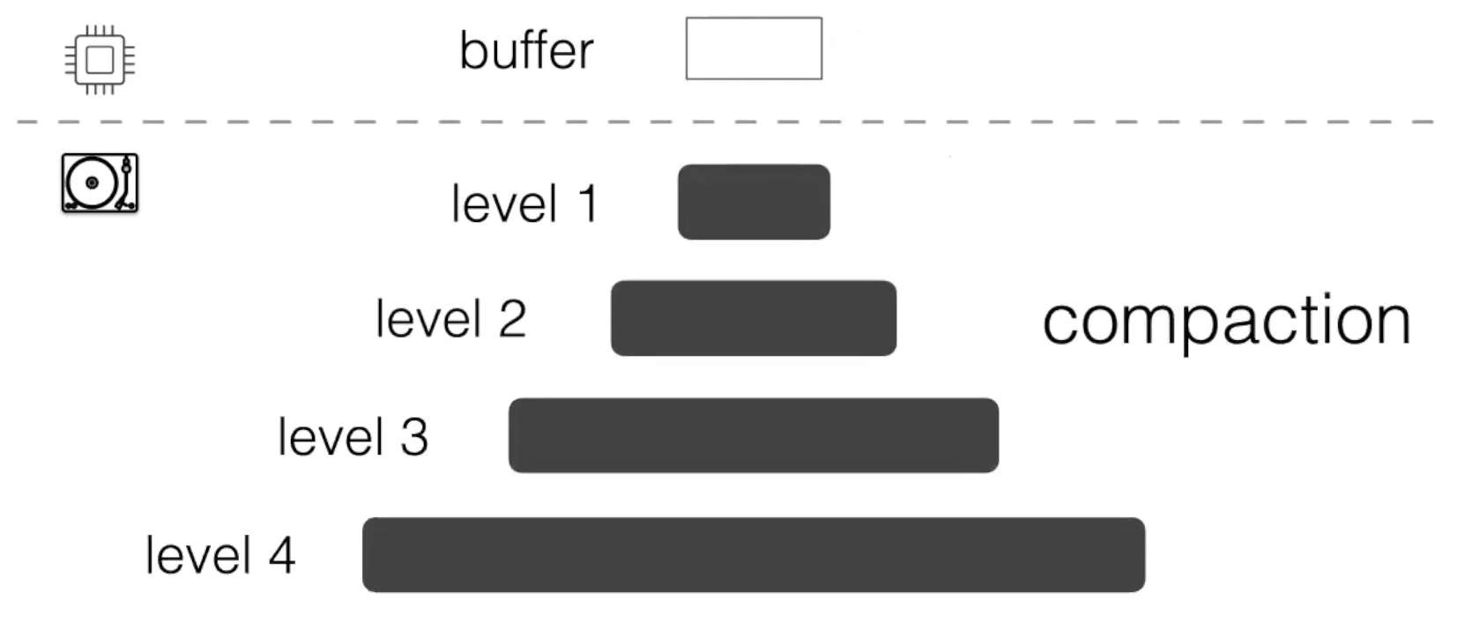
Background
LSM-Basics
LSM-Compactions

Slide 12
The Compaction Design Space

Slide 13
Compaction Primitives
An ensemble of design primitives that represents the fundamental decisions about the physical data layout and the data (re-)organization policy. Each primitive answers a fundamental design question.
Compaction trigger: When to re-organize the data layout?
Data layout: How to lay out the data physically on storage?
Compaction granularity: How much data to move at-a-time?
Data movement policy: Which block of data to be moved?

Slide 14
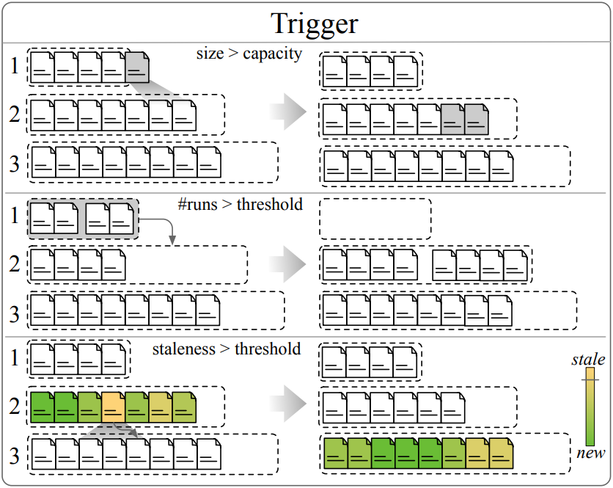
Compaction Trigger
Most common compaction triggers
Level saturation: level size goes beyond a nominal threshold
#Sorted runs: sorted run count for a level reaches a threshold
File staleness: a file lives in a level for too long
Space amplification (SA): overall SA surpasses a threshold
Tombstone-TTL: files have expired tombstone-TTL

Slide 15
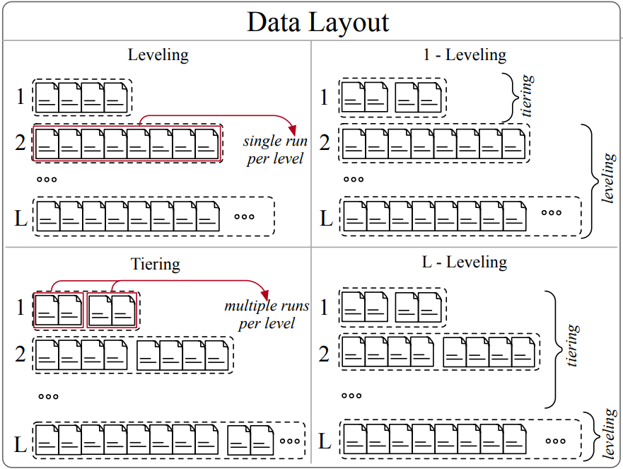
Data Layout
Most common options for data layout
Leveling: one sorted run per level
Tiering: multiple sorted runs per level
1-leveling: tiering for Level 1; leveling otherwise
L-leveling: leveling for last level; tiering otherwise
Hybrid: a level can be tiering or leveling independently

Slide 16
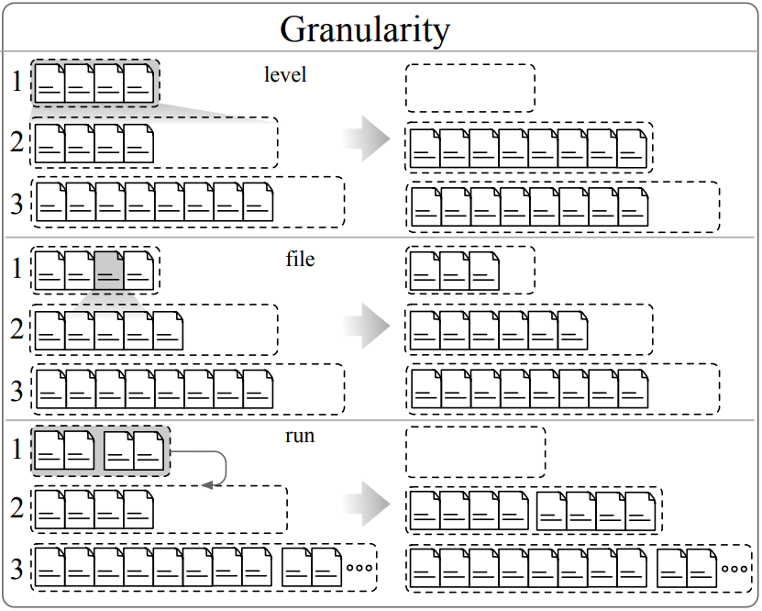
Compaction Granularity
Most common compaction granularity options
Level: all data in two consecutive levels
Sorted runs: all sorted runs in a level
File: one sorted file at a time
Multiple files: several sorted files at a time

Slide 17
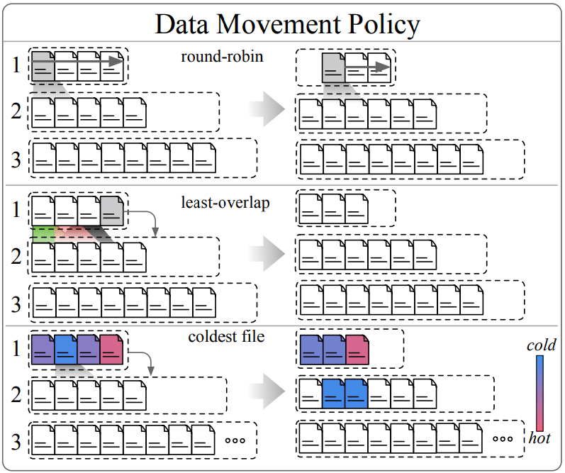
Data Movement Policy
Most common data movement policies
Round-robin: chooses files in a round-robin manner
Least overlapping parent: file with least overlap with “parent”
Least overlapping grandparent: as above with “grandparent”
Coldest: the least recently accessed file
Oldest: the oldest file in a level
Tombstone density: file with #tombstones above a threshold
Tombstone-TTL: file with expired tombstones-TTLs

Slide 18
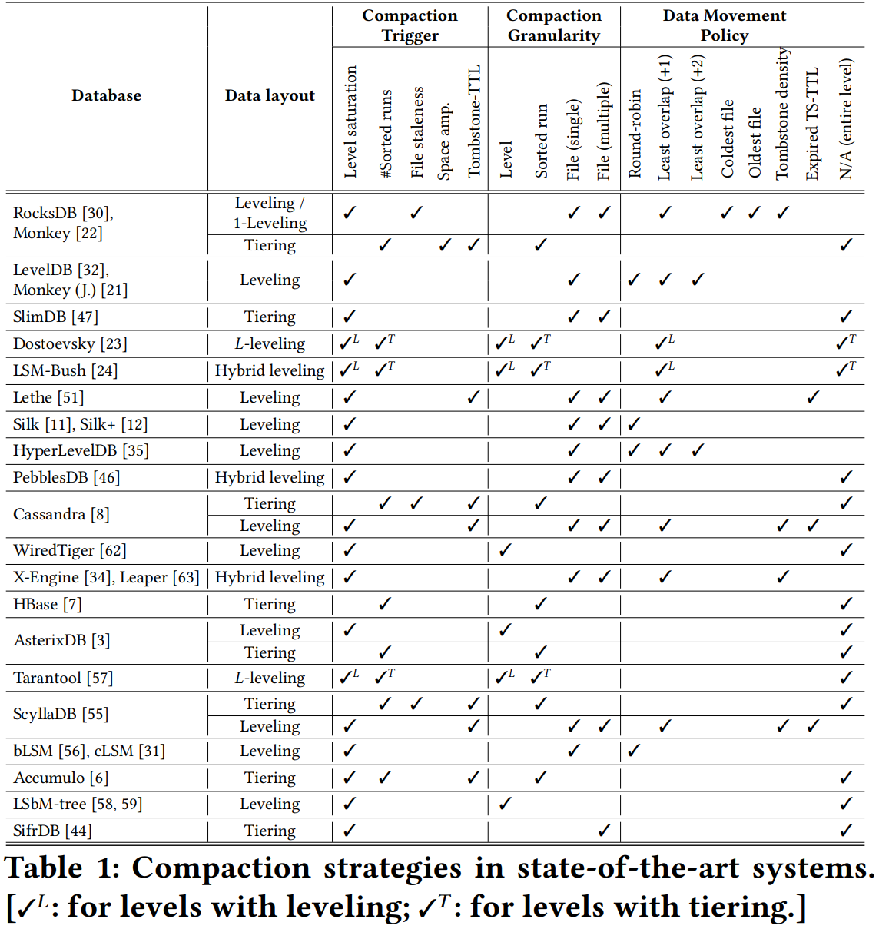
Compaction Design Space Cardinality

Slide 19
Compactions Analyzed

Slide 20
Benchmarking and Evaluation

Slide 21
Goal of the study
Answer the following questions:
Performance implications: How do compactions affect the overall performance of LSM-engines?
Compaction Latency
Write Amplification
Write Latency
Read Amplification
Point Lookup Latency
Range Lookup Latency
Space Amplification
Delete Performance
Workload influence: How do workload distribution and composition influence compactions, and thereby, performance?
What is the interplay between LSM compactions and tuning?

Slide 22
Experimental Setup
AWS EC2 server with t2.2xlarge instances (virtualization: hardware virtual machine)
Each virtual machine:
8 Intel Scalable Processors (vCPUs) at 3.0GHz
32GB of DIMM RAM
45MB of L3 cache
Ubuntu 20.04 LTS
Storage:
40 / 500 GB SSD volume with 4000 provisioned IOPS
RocksDB v6.11.4
Workloads: K-V-Workload-Generator

Slide 23
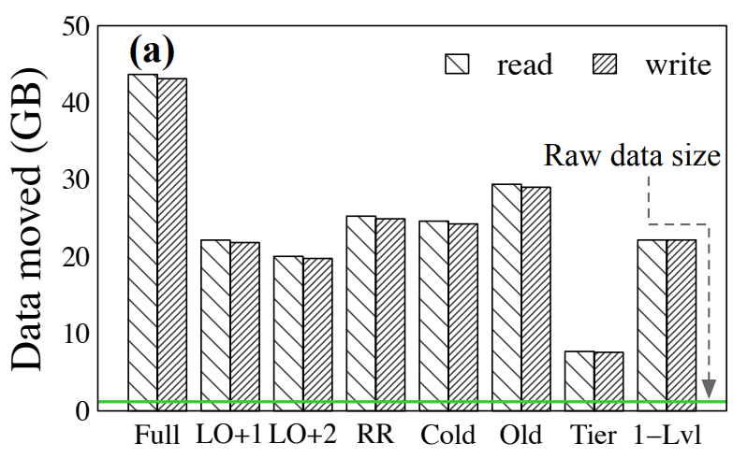
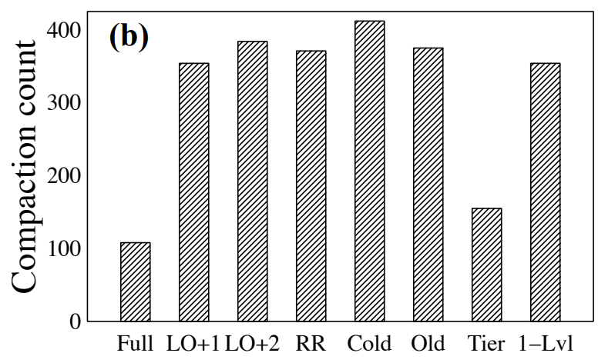
Key Observations
Observation 1: Compactions Cause High Data Movement
Observation 2: Partial Compaction Reduces Data Movement at the Expense of Increased Compaction Count
45%
75%
Takeaway: Larger compaction granularity leads to fewer but larger compactions

Slide 24
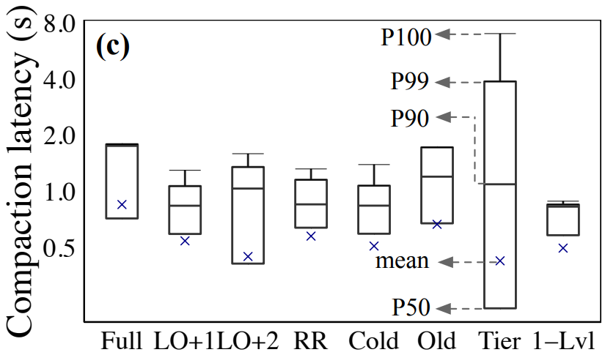
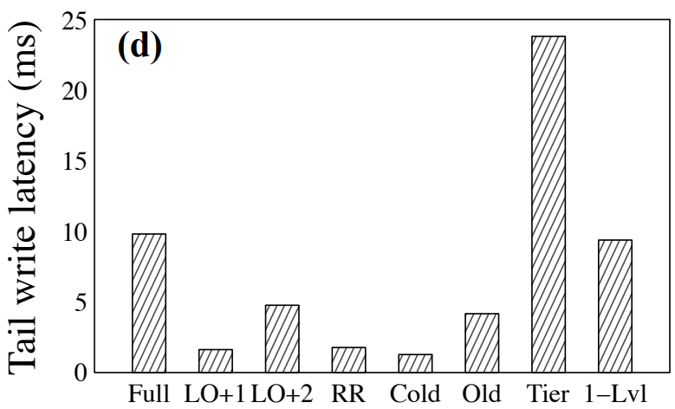
Key Observations
Observation 3: Full Leveling has the Highest Mean Compaction Latency
The Tail Write Latency is Highest for Tiering
5x
Takeaway: Tier may cause prolonged write stalls.

Slide 25
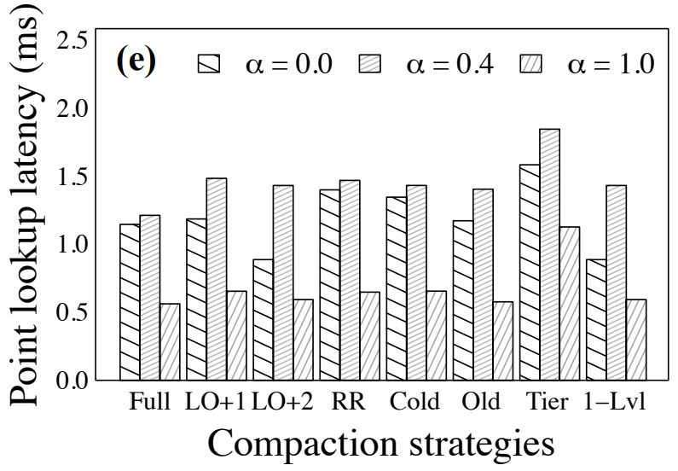
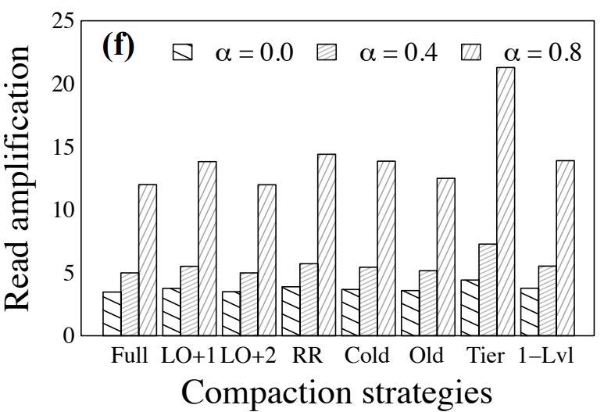
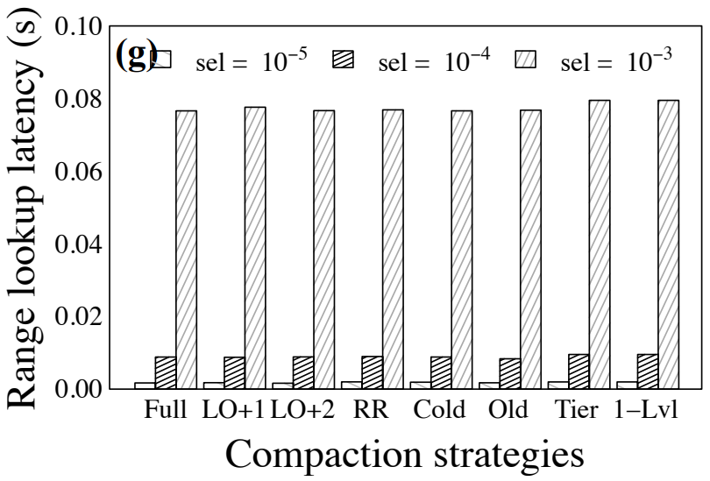
Key Observations
Observation 4: The Point Lookup Latency is Highest for Tiering and Lowest for Full-Level Compaction
Observation 5: Read Amplification is Influenced by the Block Cache Size and File Structure and is Highest for Tiering
The Effect of Compactions on Range Scans is Marginal
Takeaway: The point lookup latency is largely unaffected by the data movement policy

Slide 26
Key Observations
Observation 6: Mixed Workloads have Higher Tail Write Latency
Interleaving Compactions and Point Queries Helps Keeping the Cache Warm
Takeaway: Compactions help lookups by warming up the caches

Slide 27
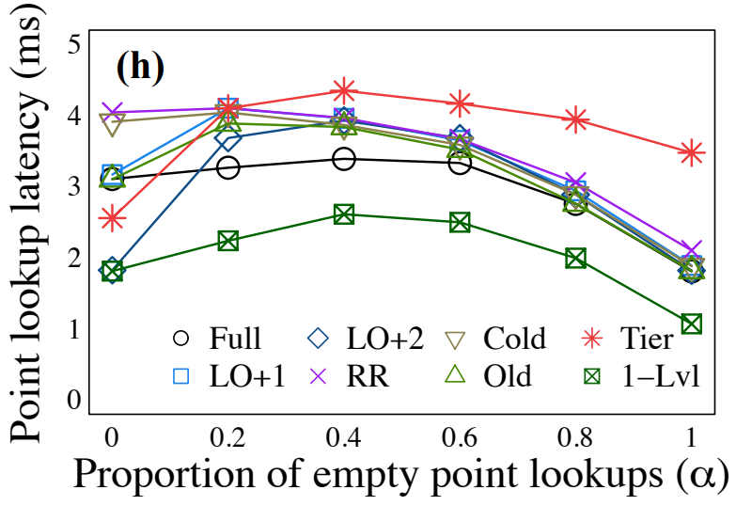
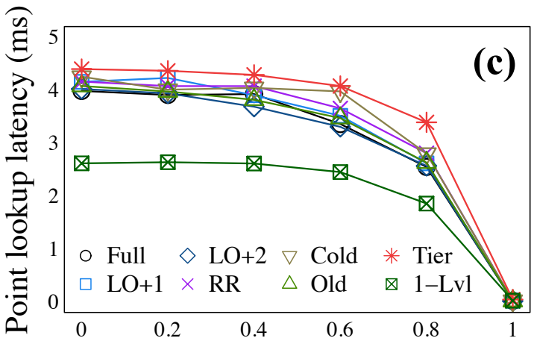
Key Observations
Observation 7: Insert Distribution Influences Point Queries
Uniform
Zipfian
1.5x
2x
Takeaway: For skewed ingestion/lookups, all compaction strategies behave similarly in terms of lookup performance

Slide 28
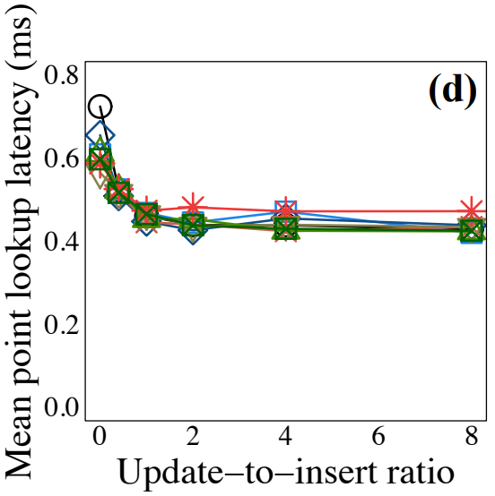
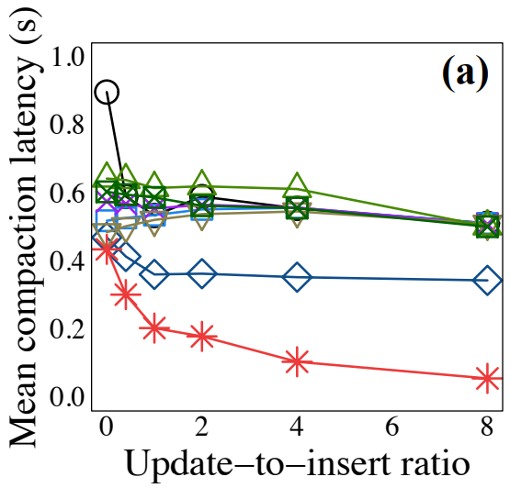
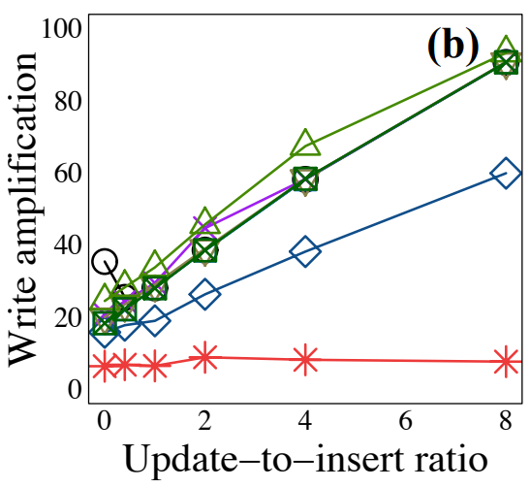
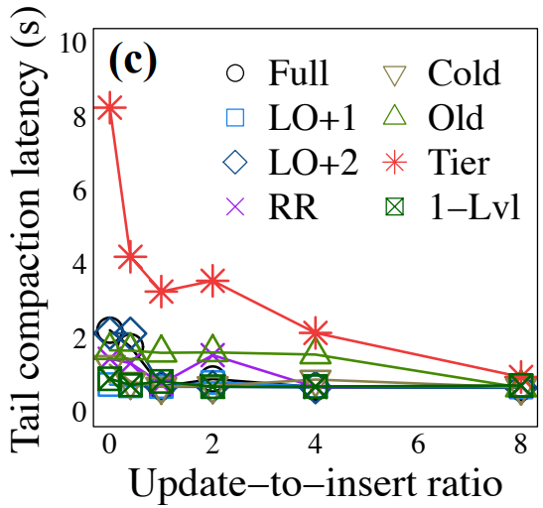
Key Observations
Observation 8: For Higher Update Ratio Compaction Latency for Tiering Drops; LO+2 Dominates the Leveling Strategies
The Point Lookup Latency Stabilizes with the Level Count
Takeaway: Tiering dominates the performance for update-intensive workloads

Slide 29
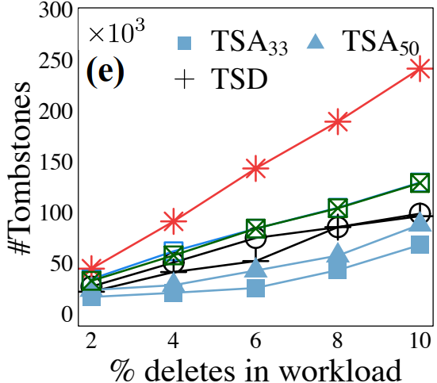
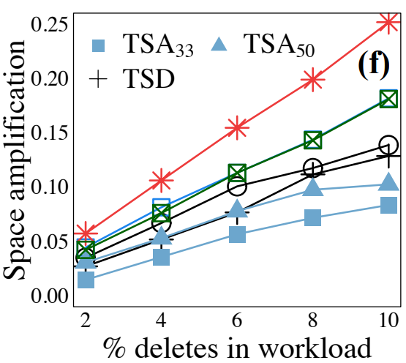
Key Observations
Observation 9: Optimizing for Deletes Comes at a (Write) Cost
TSD and TSA Offer Superior Delete Performance
Takeaway: TSD and TSA are tailored for deletes

Slide 30
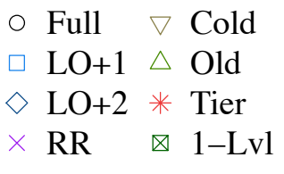
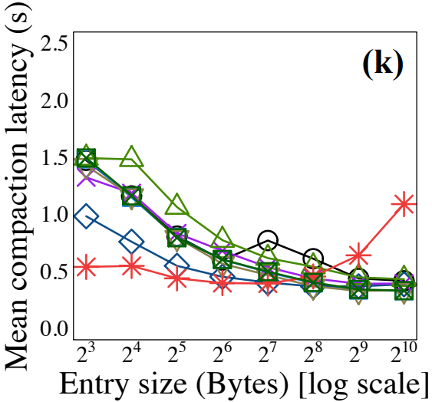
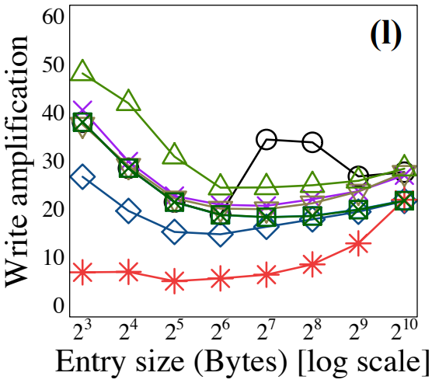
Key Observations
Observation 10: Tier Scales Poorly Compared to Leveled and Hybrid Strategies
Observation 11: For Smaller Entry Size, Leveling Compactions are More Expensive

Slide 31
Key Observations
Observation 12: Compactions with Tiering Scale Better with Buffer Size
Takeaway: The relative benefits of compaction strategies are marginally affected by LSM-tuning.

Slide 32
Conclusion
The LSM compaction design space that uses four primitives to define compactions: (i) compaction trigger, (ii) the data layout, (iii) compaction granularity, and (iv) the data movement policy.
Key Takeaways
There is no perfect compaction strategy
It is important to look into the compaction “black-box”
The right compaction strategy can significantly boost performance

Slide 33
Compactionary: A Dictionary for LSM Compactions
Subhadeep Sarkar, Kaijie Chen, Zichen Zhu, Manos Athanassoulis
Boston University, MA, USA
SIGMOD '22: Proceedings of the 2022 International Conference on Management of Data
June 2022

Slide 34
Compactionary
A demonstration framework that showcases side-by-side (A) the operational flow of different state-of-the-art compaction strategies and (B) how the different compaction strategies affect performance.
To understand the impact of the different factors on performance, users can:
customize the workload
configure the LSM tuning
switch between advanced compaction options
create custom hybrid compaction strategies
configure the settings separately for each strategy

Slide 35
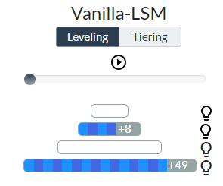
Goals
Visualize LSM compactions
understand when and how LSM engines perform compactions
Understand the impact of compactions along 14 performance metrics

Slide 36
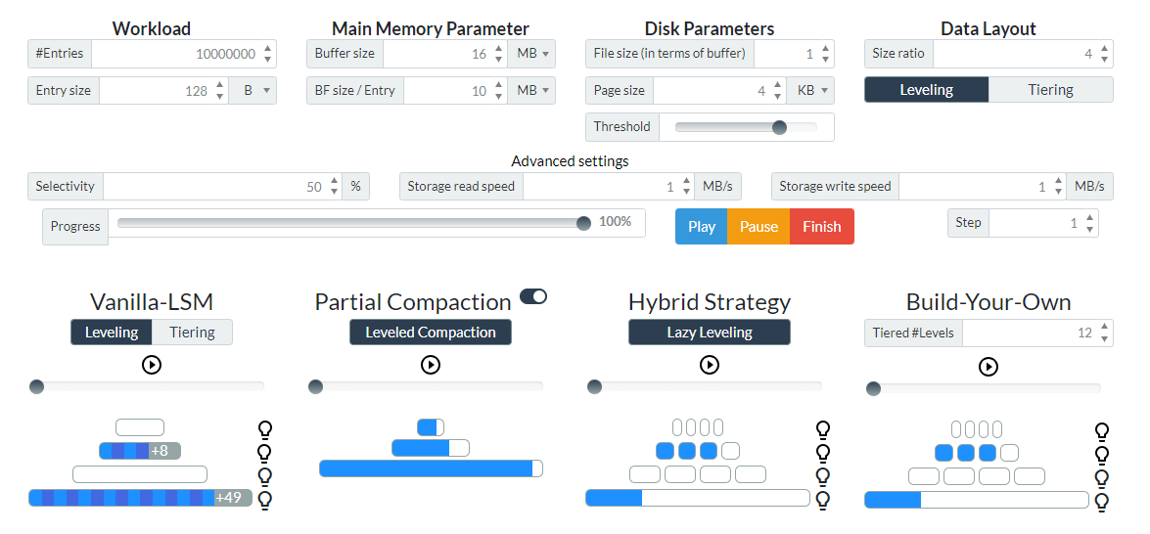
Web GUI – Configuration and LSM Tree

Slide 37
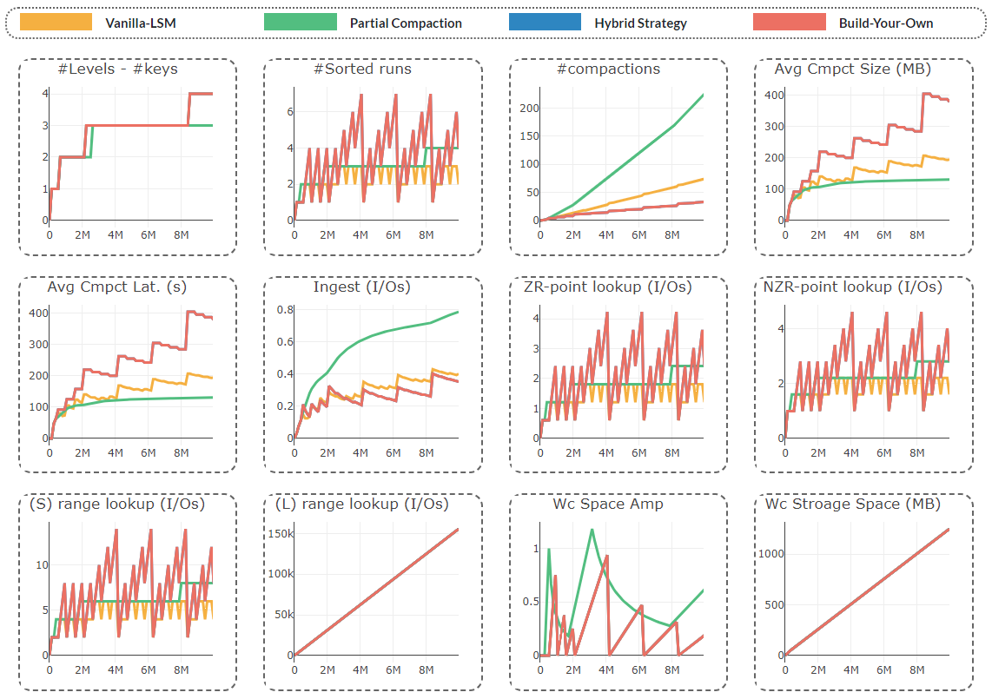
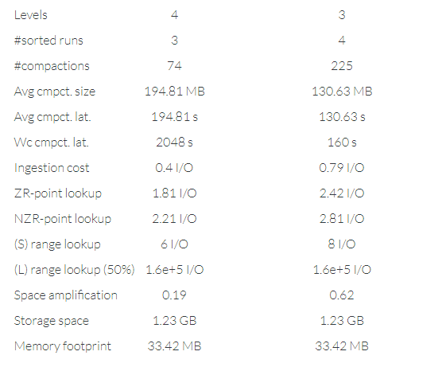
Web GUI – Stats and Plots

Slide 38
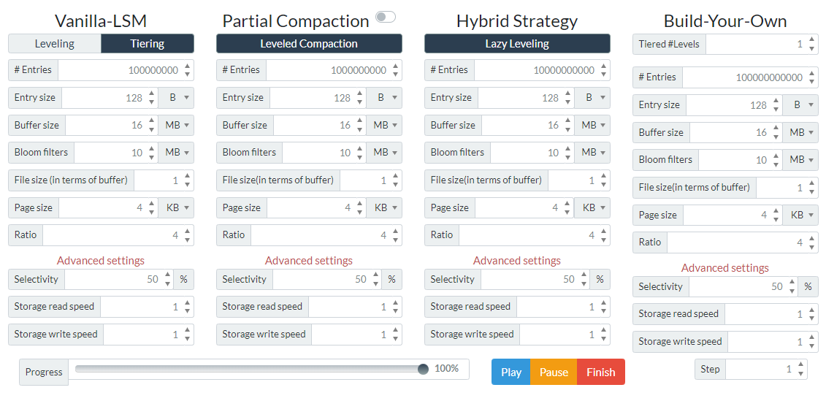
Web GUI – Individual Analysis

Slide 39
THANK YOU!

