Slide 1
On-demand Container Loading in AWS Lambda
Marc Brooker, Mike Danilov, Chris Greenwood, and Phil Piwonka, Amazon Web Services ATC’ 23
2023. 12. 5
Presented by Suhwan Shin
shshin@dankook.ac.kr

Slide 2
Content
Introduction
- Docker, Image, Container
Architecture
Block-Level Loading
Deduplication
- Limiting Blast Radius
- Garbage Collection (GC)
Tiered Cache
Conclusion

Slide 3
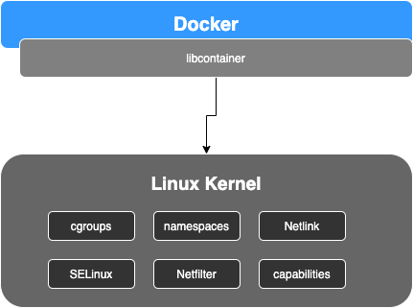
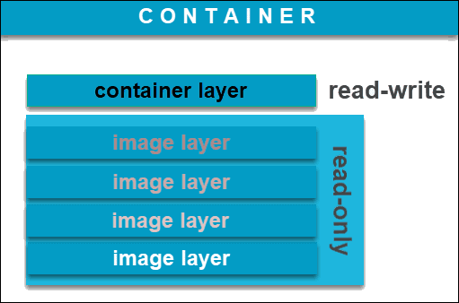
Introduction
Docker
A Platform as a Service
Creates an isolated virtualized environment for building, deploying, and testing applications
Docker Image
A bundle that includes server programs, source code, and libraries, compiled executable files necessary for service operation
Contains all the files and configuration values (environment) needed to create a container
https://ragin.medium.com/docker-what-it-is-how-images-are-structured-docker-vs-vm-and-some-tips-part-1-d9686303590f
https://phoenixnap.com/kb/docker-image-vs-container

Slide 4
Introduction
Docker
A Platform as a Service
Creates an isolated virtualized environment for building, deploying, and testing applications
Docker Image
A bundle that includes server programs, source code, and libraries, compiled executable files necessary for service operation
Contains all the files and configuration values (environment) needed to create a container
https://ragin.medium.com/docker-what-it-is-how-images-are-structured-docker-vs-vm-and-some-tips-part-1-d9686303590f
https://phoenixnap.com/kb/docker-image-vs-container

Slide 5
Introduction
Docker Container
A virtualized runtime environment that allows users to separate applications from the base system
An instance of an image in operation (a state of the image being executed)
It's a technology that packages or encapsulates the application along with its dependencies, running the process in an isolated space
https://ragin.medium.com/docker-what-it-is-how-images-are-structured-docker-vs-vm-and-some-tips-part-1-d9686303590f
https://phoenixnap.com/kb/docker-image-vs-container

Slide 6
Introduction
Docker Container
A virtualized runtime environment that allows users to separate applications from the base system
An instance of an image in operation (a state of the image being executed)
It's a technology that packages or encapsulates the application along with its dependencies, running the process in an isolated space
https://ragin.medium.com/docker-what-it-is-how-images-are-structured-docker-vs-vm-and-some-tips-part-1-d9686303590f
https://phoenixnap.com/kb/docker-image-vs-container

Slide 7
Introduction
AWS Lambda, one of such serverless services that runs user's code in response to events, supports container images: 250MB → 10GiB in size
How AWS Lambda efficiently loads and executes large container images
How AWS Lambda expands the convenience of serverless computing through this capability
Built a new storage and caching system
Scale up to 15,000 new containers per second
Handle millions of requests per second
Maintain a low start time of under 50ms
The system combines caching, deduplication, convergent encryption, erasure coding, and block-level demand loading

Slide 8
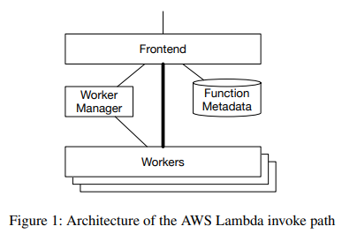
Architecture
Existing Architecture
Process
When a request to AWS Lambda is received, it undergoes authentication and is then forwarded to the Worker Manager through the frontend
The Worker Manager tracks the capacity to execute functions for all unique functions within the system
If there's enough capacity, forward it to a worker
If capacity is insufficient, request the start of a Sandbox on a worker with enough CPU and RAM to execute the function → Upon completion, notify the frontend to execute the function

Slide 9
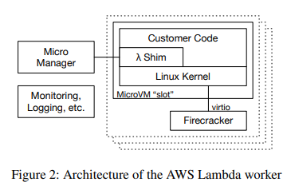
Architecture
Existing Architecture
Component
Micro Manager: Logging & Monitoring agent
Micro VM (slot)
Much exist
Single lambda function for per consumer
Minimized Linux guest kernel (As a small shim, it provides lambda's programming model and runtime (JVM, CoreCLR, etc.), user code, and libraries)
When a new MicroVM is created, the Worker downloads the function image from Amazon S3 and unpacks it onto the MicroVM's guest file system
Advantages: Simple and works well with small images
Disadvantages: The MicroVM must download and unpack the entire archive before it can begin work

Slide 10
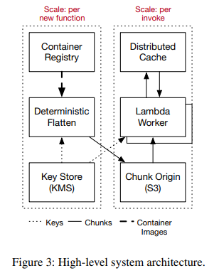
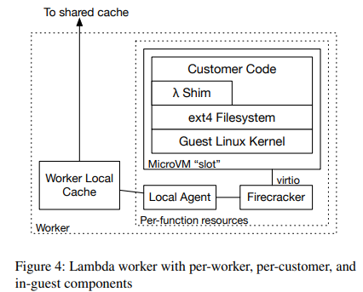
Block-Level Loading
To address the disadvantages of the existing architecture → Need to allow the system to load only the data necessary for the application

Slide 11
Block-Level Loading
To address the disadvantages of the existing architecture → Need to allow the system to load only the data necessary for the application

Slide 12
Deduplication
Most Lambda functions uploaded use similar base container images, so 80% of newly uploaded Lambda functions had zero unique chunks → Images re-uploading
But, When encrypting images, deduplication becomes difficult because encrypting the same content with different keys results in different outcomes
AWS calculates a SHA256 digest for each chunk during the flattening process to derive a key and uses AES-CTR to encrypt the block. AES-CTR guarantees that if the encrypted results are the same, then the plaintext is also the same
Deduplication has advantages in cost and performance, but it also presents risks
Access failure of a frequently used specific chunk affects the entire system
If there is corrupted data, it can be detected but not repaired.

Slide 13
Deduplication - Limiting Blast Radius
Deduplication has value in cost and cache performance, it also adds some risks
Some popular chunks have a significant impact on the entire system when problems occur with those chunks
partial (gray) failures of cache nodes
operational issues that cause unavailability of data
bugs in garbage collection
corruption of data in the cache hierarchy
Salt
Include a varying salt in the key derivation step of our convergent encryption scheme
This salt value can vary in time, with chunk popularity, and with infrastructure placement
Otherwise, identical chunks with different salt values will end up with different keys, and therefore difference ciphertexts, and will not deduplicate against each other
By controlling the frequency with which the salt is rotated, we can continuously trade off deduplication efficiency with blast radius

Slide 14
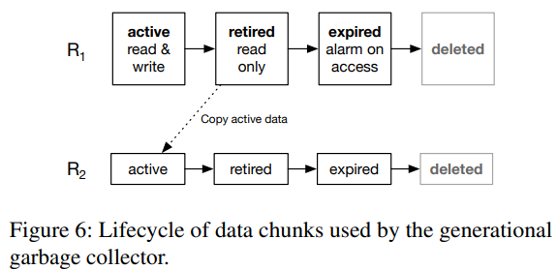
Deduplication - GC
Garbage collection approach is based on root concept
Create new roots periodically and retire old roots
Provides a valuable additional layer of protection against data loss
Having data in multiple roots does drive up storage costs
Additional cost is palatable for Lambda as customers often update their functions and a large majority of data is never migrated to a new root

Slide 15
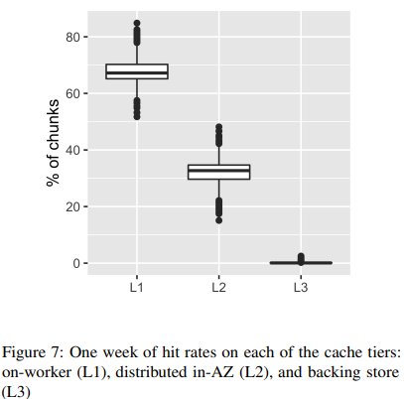
Tiered cache
AWS utilizes a hierarchical caching approach
Local cache → the remote AZ (Availability Zone) level shared cache → Amazon S3
Tail latency
A single slow cache server can cause a widespread impact
Hit rate drops
If an item is only located on a single server, server failure or deployment can cause a sharp decline in the hit rate
Throughput bounds
If an item is stored on a single server, it becomes bound by the bandwidth of that specific server

Slide 16
Tiered cache
AWS utilizes a hierarchical caching approach
Local cache → the remote AZ (Availability Zone) level shared cache → Amazon S3
Tail latency
A single slow cache server can cause a widespread impact
Hit rate drops
If an item is only located on a single server, server failure or deployment can cause a sharp decline in the hit rate
Throughput bounds
If an item is stored on a single server, it becomes bound by the bandwidth of that specific server

Slide 17
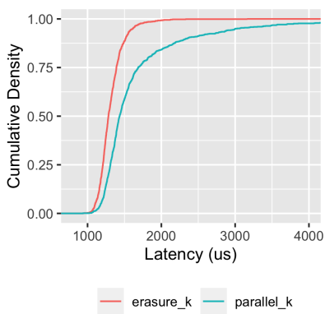
Tiered cache
Erasure Coding
When a worker experiences a cache miss, it fetches the chunk from the original source
The worker then uploads an erasure-coded chunk to the cache
Upon fetching a chunk, the worker requests more stripes than necessary for reconstruction
In current production, a 4 out of 5 code is used, resulting in a 25% storage overhead
This approach has significantly reduced tail latency
It effectively prevents a drop in hit rate during cache node failures or deployments

Slide 18
Tiered cache
Stability
A high cache hit rate can have hidden disadvantages
If the cache is empty, for reasons such as power loss or operational issues, or if there is a sudden reduction in the hit rate, possibly due to changes in user behavior, this can cause a sudden surge in traffic to downstream services
In the case of AWS, despite an end-to-end cache hit rate of 99.8%, the traffic to downstream services could potentially increase by up to 500 times more than usual
An increase in downstream latency can lead to a higher demand for concurrency, resulting in more lambda slots being used
Designing a system with a limit on concurrency can somewhat address this issue
When the number of concurrent tasks surpasses the set limit, any new containers that attempt to start are denied until an existing one completes

Slide 19
Tiered cache
Cache eviction and sizing
Traditional caching policies, such as LRU or FIFO, are straightforward and easy to implement. However, applying these in AWS presented some challenges
The issue was that entries from infrequently used functions, which were recently used, could replace the cache's hot entries, thus reducing the cache hit rate. This issue occurred repeatedly due to periodic cron job functions, which are numerous but each operates on a low scale, diminishing the cache's effectiveness
To reduce the impact of these periodic tasks on cache hit rates, the LRU-k eviction algorithm was implemented. LRU-k keeps track of the most recent k occurrences for items present in the cache

Slide 20
Conclusion
AWS Lambda now supports container images with a maximum size of 10GiB
It addresses challenges through techniques such as caching, deduplication, convergent encryption, erasuer coding, and block-level demand loading
The system is designed to scale with the capability to expand to a maximum of 15,000 new containers, process millions of requests per second, and maintain low startup times of under 50 milliseconds
It has handled trillions of Lambda function invocations and provides services to over a million AWS customers
Notes:
ZNS SSD에 F2FS LFS 모드를 사용하여 F2FS의 디스크 레이아웃을 식별하고,
높은 디스크 활용도에서의 과프로비저닝과 GC 성능 간의 트레이드오프를 탐구했습니다.
우리는 새로운 프리 세그먼트 finding 스킴을 사용하여 더 나은 저장 공간 활용을 위해 낮은 경험적 과프로비저닝 공간을 설정했습니다.
결과적으로 우리의 연구는 과프로비저닝 공간을 고려해야 하며, 특히 쓰기 중심 워크로드에 대한 ZNS 기반 시스템의 설계에 중요한 역할을 해야 함을 보여주었습니다.

Slide 21
On-demand Container Loading in AWS Lambda
Marc Brooker, Mike Danilov, Chris Greenwood, and Phil Piwonka, Amazon Web Services ATC’ 23
2023. 12. 5
Presented by Suhwan Shin
shshin@dankook.ac.kr
Thank You!

