Slide 1
고급 운영체제 (Advanced Operating Systems)
Dept. of Software
Dankook University
September 5, 2023
Jongmoo Choi
http://embedded.dankook.ac.kr/~choijm

Slide 2
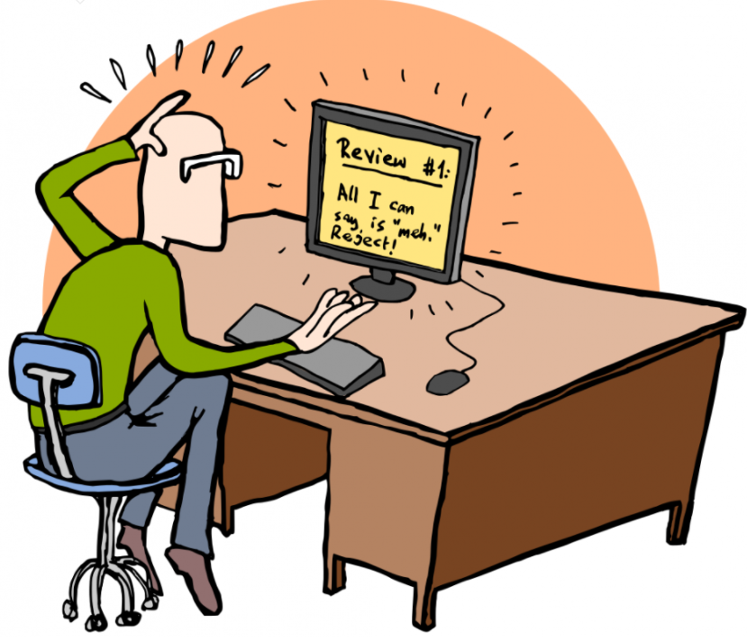
Course Objective
Understanding key concepts about advanced operating system
OS basic: scheduling, memory, file system, …
Bigdata platform, DNN framework, Key-value store, …
Disaggregation, Serverless, User level, …
Get accustomed to papers written in English
Grasp the general structure of a paper
How to review a paper?
Enhance presentation skill
Practice via actual presentations
How to discuss or argue?
Make our own paper
How to write a good paper?
Submit to a conference/journal (or mandatory?)
2

Slide 3
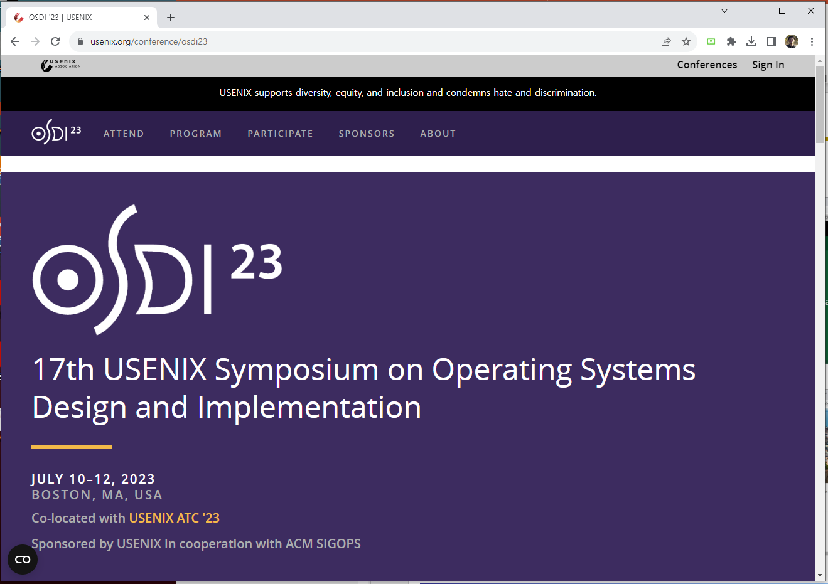
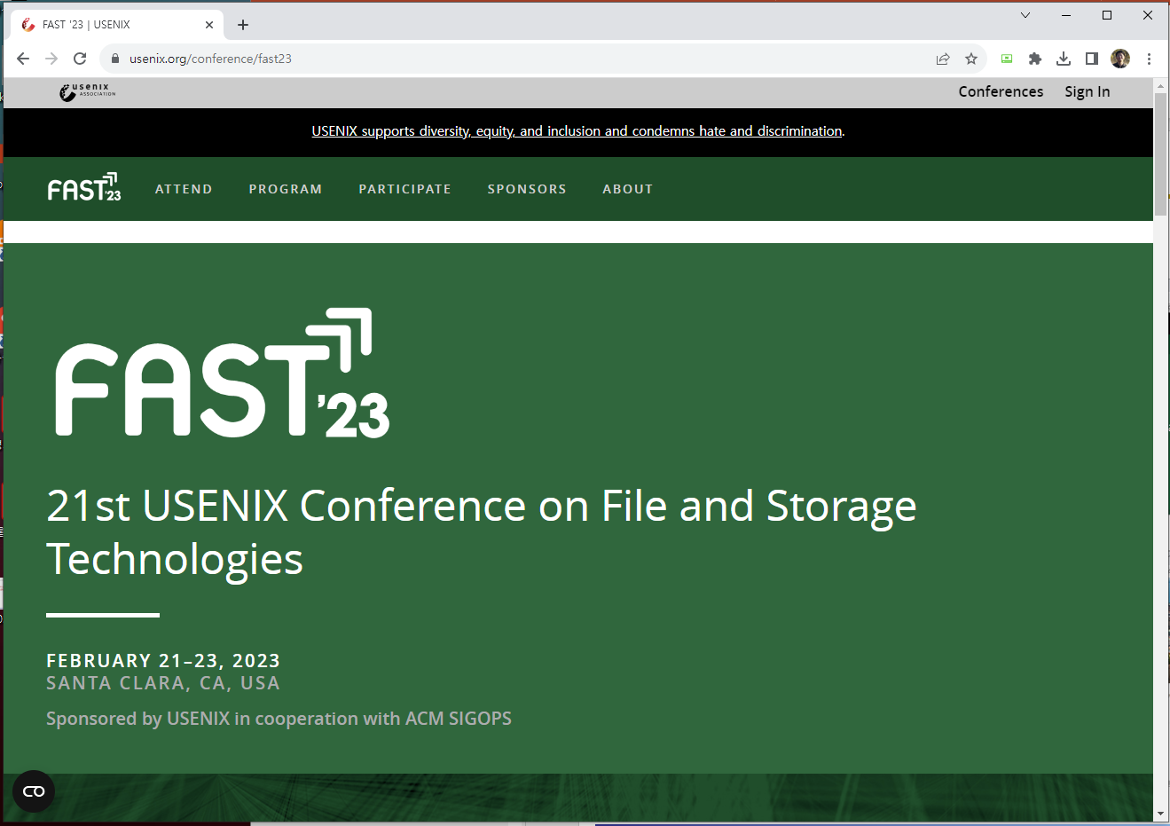
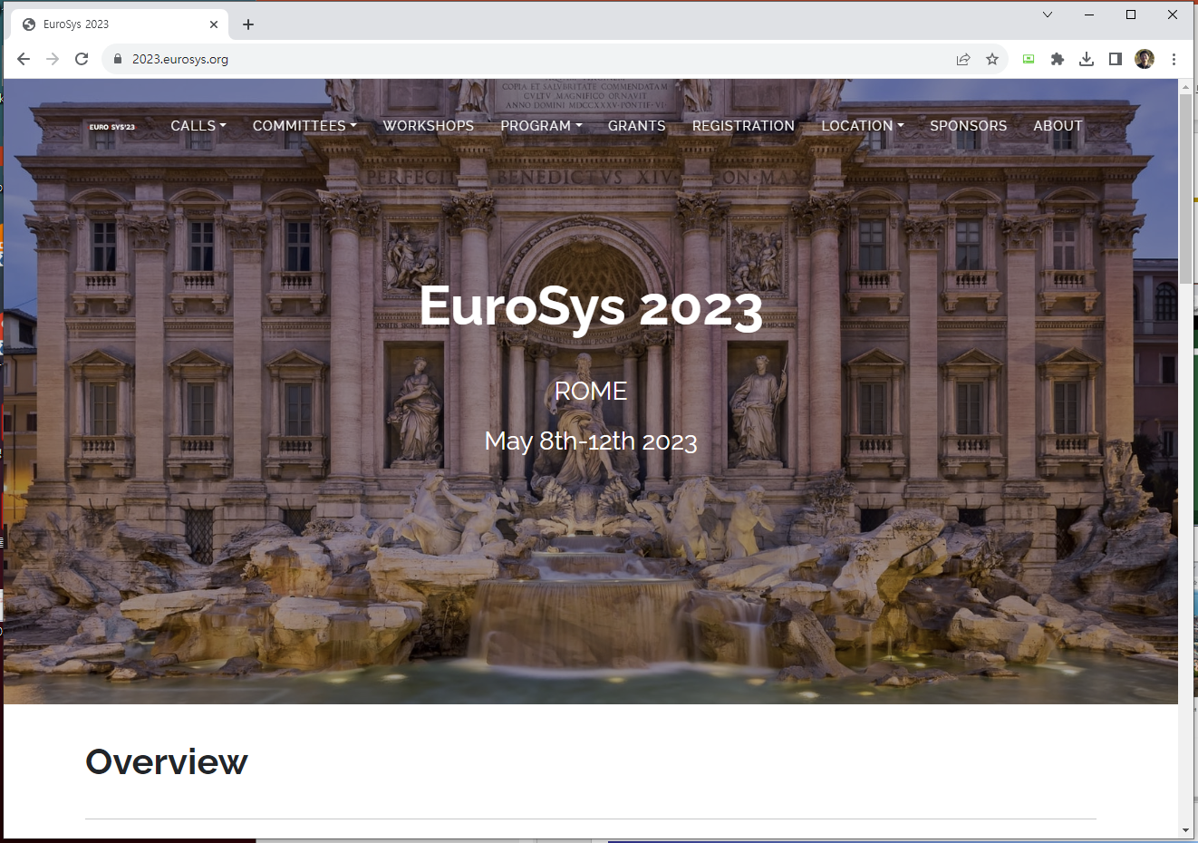
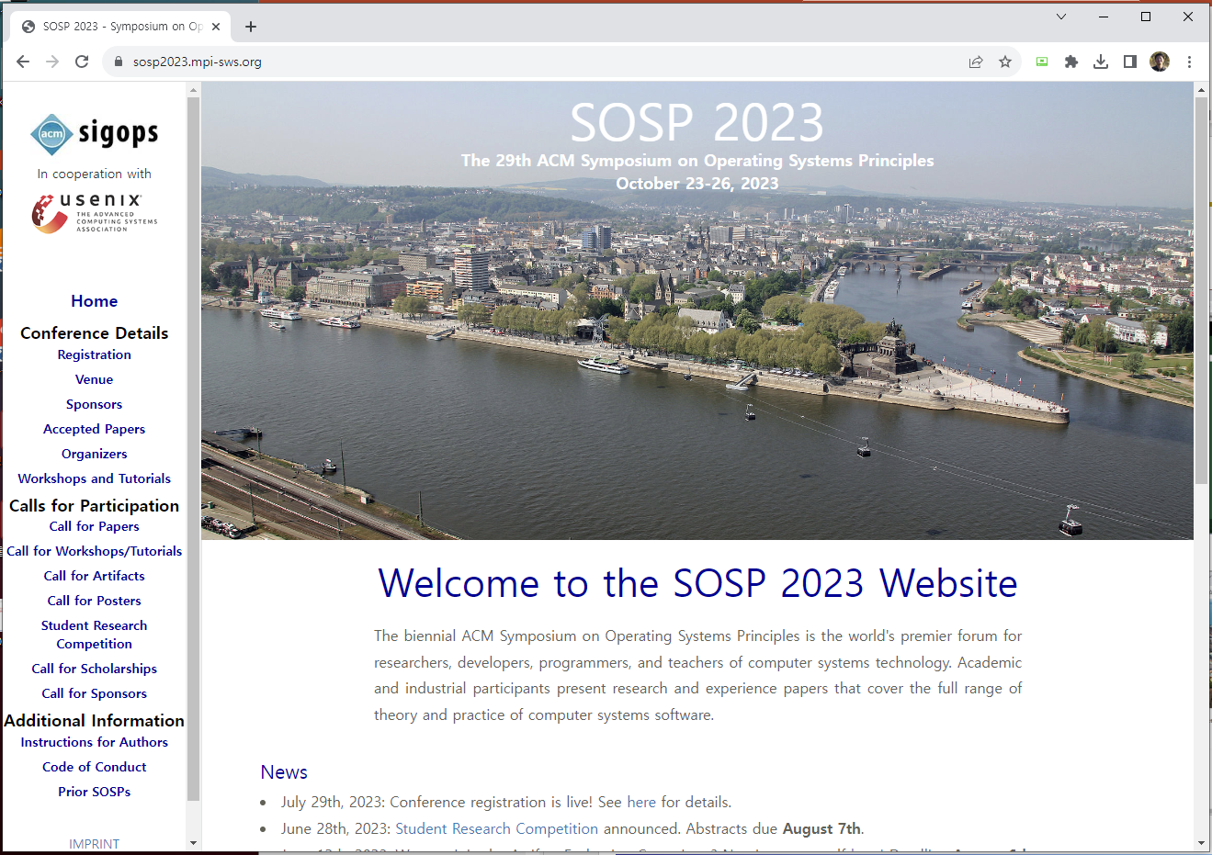
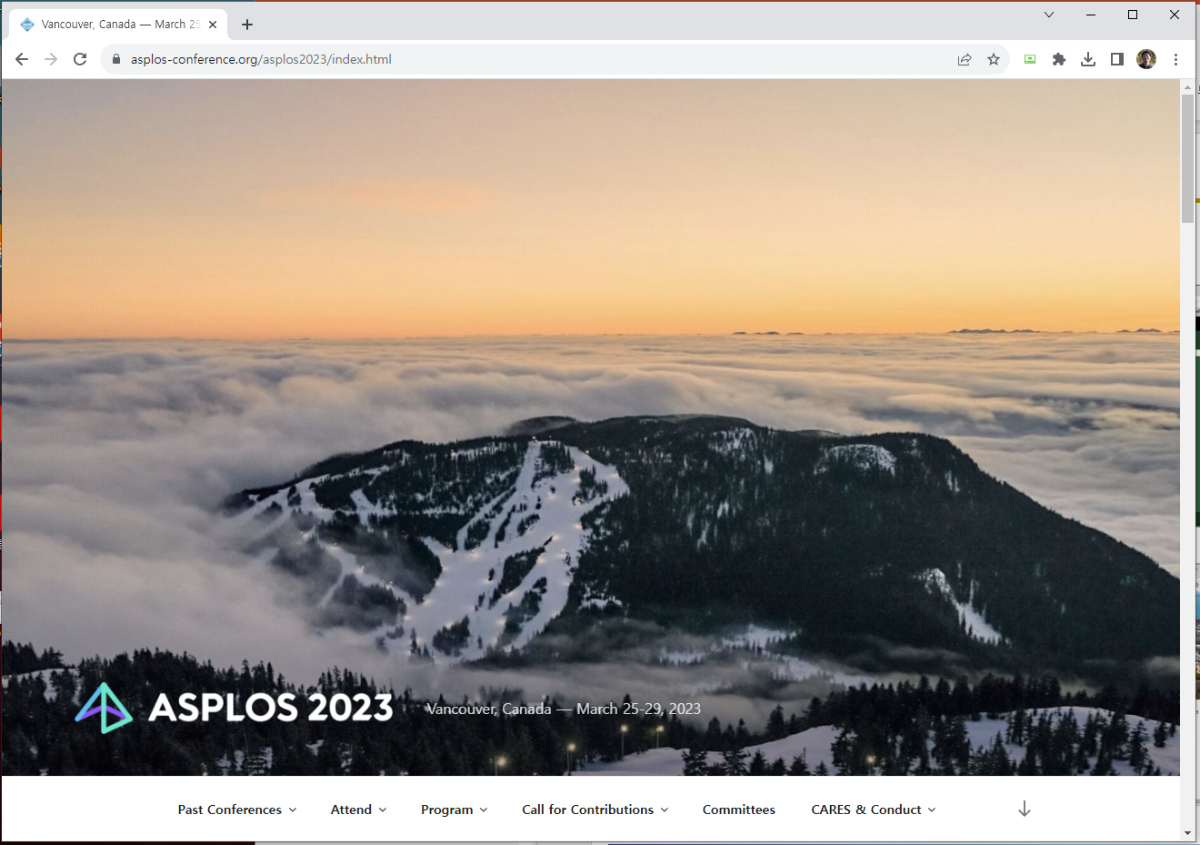
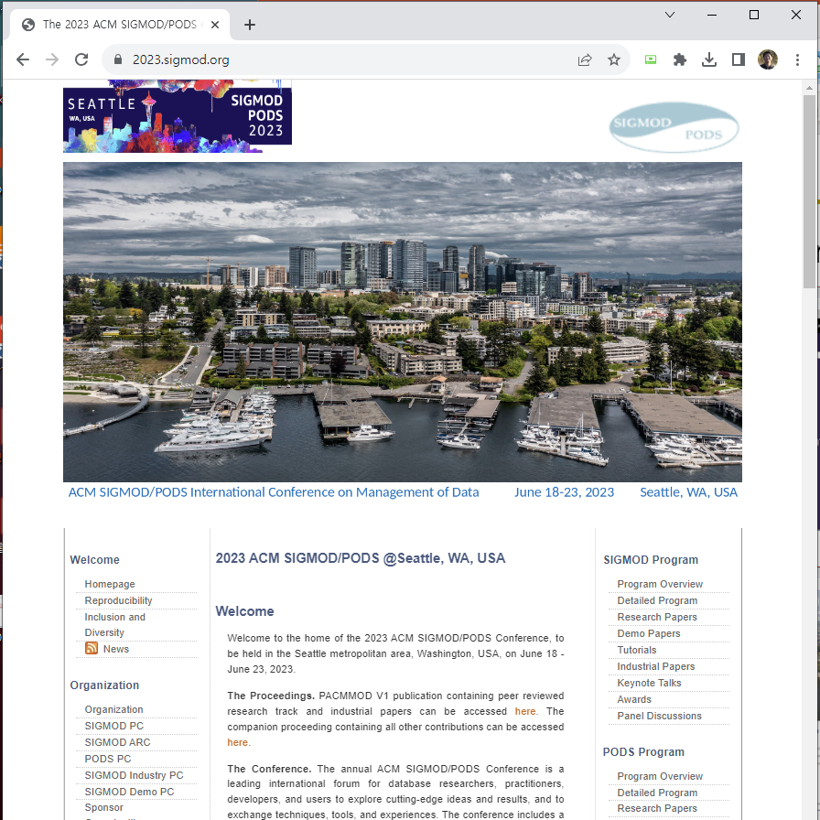
Course text
Where can you find papers?
<OSDI>
<FAST>
<Eurosys>
<SOSP>
<ASPLOS>
<SIGMOD>
3

Slide 4
Paper lists (Suggested)
1주. Introduction
강의 내용, 방법 소개 ➔ 논문 선택 (4개 선택, 그 중에 3개 발표)
2주. Scheduling
C. Waldspurger et al., "Lottery Scheduling: Flexible Proportional-Share Resource Management,” OSDI'94.
J. Lozi et al., “The Linux Scheduler: a Decade of Wasted Cores,” Eurosys’16.
3주. Memory Management
N. Megiddo et al., "ARC: A Self-Tuning, Low Overhead Replacement Cache,” FAST'03.
H. Park et al., "Regularities considered harmful: forcing randomness to memory accesses to reduce row buffer conflicts for multi-core, multi-bank systems", ASPLOS'13.
4주. File system
M. Rosenblum et al., “The Design and Implementation of a Log-Structured File System,” SOSP'91.
V. Chidambaram et al., "Optimistic Crash Consistency", SOSP’13.
5주. Personal presentation + Virtualization
P. Barham et al., “Xen and the Art of Virtualization,” SOSP'03.
C. Waldspurger, “Memory Resource Management in VMware ESX Server,” OSDI'02.
ICE break (자기 소개) + Idea (연구 주제 아이디어 발표)
4
Notes:
논문 배정: 2개씩: 12명 * 2개 = 24 = 2개*11주 + 1개*2주 + 0개*2주 (1주/15주)
논문 배정: 3개씩: 12명 * 3개 = 36 = 3개*11주 + 1개*2주 ➔ 한 학생은 2개가 되는군.

Slide 5
Paper lists (Suggested)
6주. Bigdata platform
J. Dean et al., "MapReduce: Simplified Data Processing on Large Clusters", OSDI'04.
S. A. Weil et al., "Ceph: A Scalable, High-Performance Distributed File System,” OSDI'06.
7주. DNN framework
D. Narayanan et al., “PipeDream: Generalized Pipeline Parallelism for DNN Training”, SOSP’19.
H. Zhao et al., "SiloD: A Co-design of Caching and Scheduling for Deep Learning Clusters", Eurosys'23.
8주. Disaggreagted and CXL
W. Yoon et al., "DiLOS: Do Not Trade Compatibility for Performance in Memory Disaggregation", Eurosys’23.
S. Yang et al., "Overcoming the Memory Wall with CXL-Enabled SSDs, ATC'23.
9주. PM
H. LeBlanc et al., "Chipmunk: Investigating Crash-Consistency in Persistent-Memory File Systems", Eurosys'23.
Li et al., "ROLEX: A Scalable RDMA-oriented Learned Key-Value Store for Disaggregated Memory Systems", FAST'23.
10주. Personal presentation + Cloud and Serverless
Lu et al., "Perseus: A Fail-Slow Detection Framework for Cloud Storage Systems", FAST’23.
M. Brooker et al., "On-demand Container Loading in AWS Lambda", ATC'23.
Related work (연구 주제에 대한 관련 연구) + Design (설계 내용)
5

Slide 6
Paper lists (Suggested)
11주. KVS
Yu et al., “ADOC: Automatically Harmonizing Dataflow Between Components in Log-Structured Key-Value Stores for Improved Performance”, FAST’23.
Mehdi et al., “ScaleDB: A Scalable, Asynchronous In-Memory Database”, OSDI'23.
12주. Cache
Khan et al., "SHADE: Enable Fundamental Cacheability for Distributed Deep Learning Training", FAST’23.
Cheng et al., “Take Out the TraChe: Maximizing (Tra)nsactional Ca(che) Hit Rate”, OSDI'23.
13주. User-level
Zhou et al., "Userspace Bypass: Accelerating Syscall-intensive Applications", OSDI’23.
A. Raza et al., "Unikernel Linux (UKL)", Eurosys'23.
14주. Performance
Berger et al., "Triangulating Python Performance Issues with SCALENE", OSDI’23.
B. Lepers et al., "OFence: Pairing Barriers to Find Concurrency Bugs in the Linux Kernel", Eurosys'23.
15주. Personal presentation
Evaluation (연구 주제에 대한 실험 내용) + Documentation (논문 형식. 예를 들어 정보과학회)
현재로는 시험 또는 과제 계획 없음 (논문 발표 및 개별 연구 발표에 집중)
6

Slide 7
Paper lists (Candidates)
Recommended for reading
How to do research
Butler W. Lampson, “Hints for Computer System Design,” SOSP’83.
Research papers
M. Abadi et al., “TensorFlow: A System for Large-Scale Machine Learning”, OSDI’16.
Y. Kwon et al., "Coordinated and Efficient Huge Page Management with Ingens", OSDI'16.
C. Lee et al., “F2FS: A New File System for Flash Storage,” FAST'15.
F. Manco et al., "My VM is Lighter (and Safer) than your Container, SOSP'17.
S. Ghemawat et al., “The Google File System,” SOSP'03.
S. Choi et al., "EnvPipe: Performance-preserving DNN Training Framework for Saving Energy", ATC’23.
S. R. Dulloor et al., “System Software for Persistent Memory”, Eurosys'14
C. Wang et al., "SEPH: Scalable, Efficient, and Predictable Hashing on Persistent Memory", OSDI'23.
Yang et al., "GL-Cache: Group-level learning for efficient and high-performance caching", FAST’23.
B. Kim et al., "Design Tradeoffs for SSD Reliability", FAST'19.
Zhong et al., "MadFS: Per-File Virtualization for Userspace Persistent Memory Filesystems", FAST'23.
M. Abdi et al. "Palette Load Balancing: Locality Hints for Serverless Functions", Eurosys'23.
O. Balmau et al, “SILK: Preventing Latency Spikes in Log-Structured Merge Key-Value Stores”, ATC'19.
Please let me know if you want to present other papers (major conf. & 2020 or later)
7

Slide 8
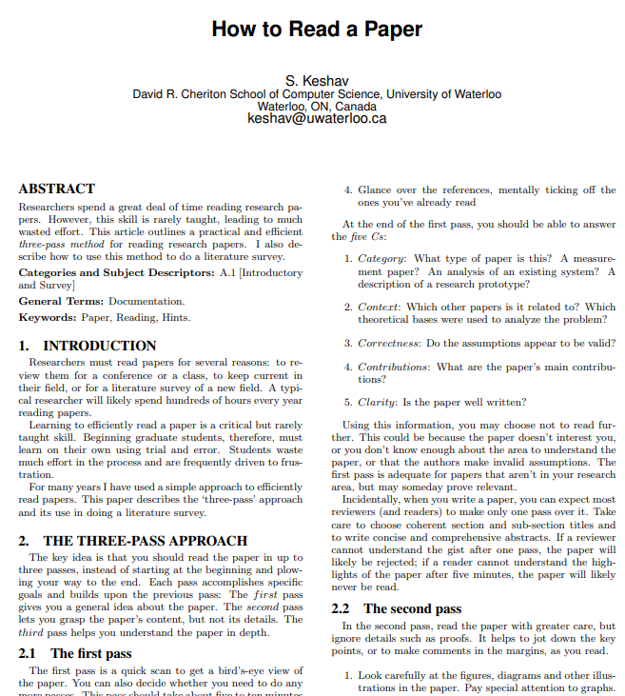
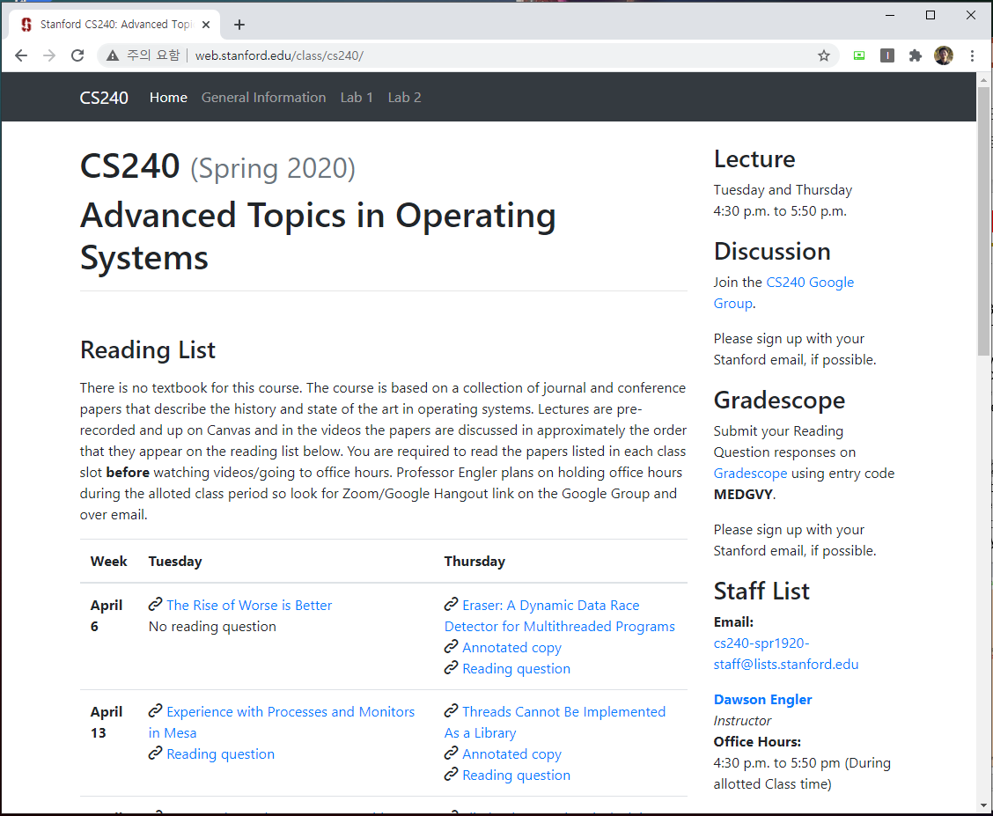
Papers about how to read/write a paper?
How to read a paper.
J. Eisner, “How to Read a Technical Paper”, https://www.cs.jhu.edu/~jason/advice/how-to-read-a-paper.html.
Roy Levin and David D. Redell, “How (and How Not) to Write a Good Systems Paper”, ACM Operating Systems Review, 1983.
J. Maletic, “How to Read and Evaluate Technical Papers”, http://www.cs.kent.edu/~jmaletic/howtoread.html.
S. Keshav, “How to read a paper”, https://web.stanford.edu/class/ee384m/Handouts/HowtoReadPaper.pdf.
Papers used in other universities
http://csl.snu.ac.kr/courses/4190.568/2019-1/#readings
http://web.stanford.edu/class/cs240/
https://www.seltzer.com/margo/teaching/CS508.19/syllabus.html
http://pages.cs.wisc.edu/~dusseau/Classes/CS736/CS736-F13/papers.html
https://www.cs.utexas.edu/~vijay/cs380l/schedule.htm
8

Slide 9
Lecture details
1. Presentation (roughly 3 times per person)
Less than 25 minutes
Q & A are quite important
2. Paper Review
3. Personal project
Write a paper
No examination
9

Slide 10
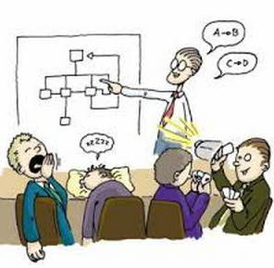
How to present
Presentation
Time
Presentation: 25 min, Q&A: 10 min
Slide
Less than 15 lines per each page
More than half pages must contain figures
Must include humor slides (if not, less points)
Must include references (if not, less points)
Each slide must be put in the lecture site (send it to choijm@dankook.ac.kr by Monday (previous day), 6pm)
Audience
Obligation of audience: at least one question per person a day
Without questions, you can not get a good grade.
Count the number of questions
10

Slide 11
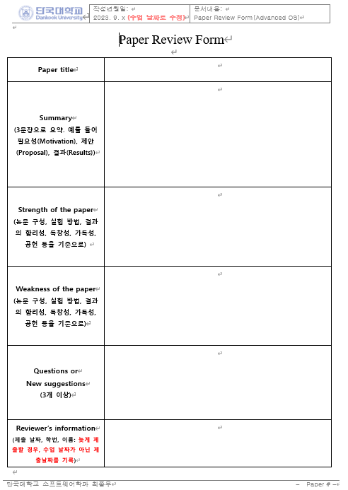
How to review a paper
Paper Review
All student must submit reviews about papers assigned to the corresponding week.
Format
Summary
3 sentences
Motivation, Proposal, Evaluation
Strength
What are positive things in this paper?
Weakness
What are the down sides of this paper?
Questions or Suggestions
At least 3
11

Slide 12
How to make a proposal
Personal project
1. Idea presentation (5 minutes)
Personnel introduction, Ice break
Research Idea (or Brainstorming)
2. Survey presentation and design (10 minutes)
Idea proposal
Related work (prepare references in advance)
Design: 1) why, 2) how, 3) what are expected results
3. Final presentation (15 minutes)
Idea, Related work, Design, Evaluation results
Apply the idea learnt from your presentation
1) presentation (ppt), 2) paper (tex, hwp, word)
I strongly recommend to submit KCC or KSC or any conferences/workshops
12

Slide 13
Evaluation
Evaluation
Presentation(30%)
Questions and Answers (20%)
Paper review (30%)
Final proposal (20%)
Choose papers in the suggested list and send your choices to me via email (choijm@dankook.ac.kr) until this Friday Monday (8th, September).
Need volunteers for next week (OS: scheduling papers).
13

Slide 14
Discussion

