Slide 1
Large-scale cluster management at Google with Borg
Abhishek Verma, Luis Pedrosa, Madhukar Korupolu, David Oppenheimer, Eric Tune, John Wilkes
EuroSys’ 15
Department of Computer Science, Dankook University
System Software Lab.
Suhwan Shin
09/24/2024

Slide 2
Contents
Introduction
Motivation
Borg
Borg Architecture
Borg from a User's Perspective
Resource Management
Availability & Reliability
Lessons
From Borg to Kubernetes
Conclusion

Slide 3
Introduction
What is Borg?
A large-scale cluster management system developed by Google
Purpose: Runs hundreds of thousands of jobs across thousands of machines
Scale: Manages clusters of up to tens of thousands of machines
Development: Started in the early 2000s, continuously evolved since then
Significance: Runs virtually all of Google's cluster workloads
Key Features:
Automated resource management and scheduling
High availability and reliability
Efficient resource utilization

Slide 4
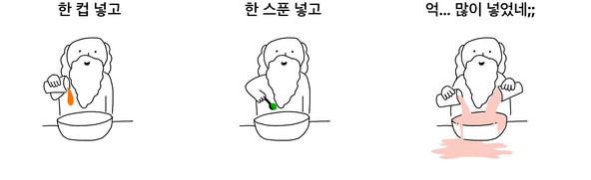
Motivation: Key Objectives of Borg
Resource Management and Scheduling
Efficiently allocate resources across diverse workloads
Balance between long-running services and batch jobs
High Availability and Reliability
Ensure continuous operation of critical services
Minimize downtime through fault-tolerant design
Scalability
Handle clusters with tens of thousands of machines
Manage hundreds of thousands of jobs simultaneously
Simplify Application Development
Abstract away infrastructure complexities
Provide consistent environment across different machines
Operational Efficiency
Reduce operational overhead for system administrators
Automate routine tasks and decision-making processes
Scability, High Availability, Reliability, Simplify Development, Operational Efficiency도 넣고..
Resource Management
Scheduling도
Google
Google
Google
Borg
Borg
Borg
When Google created Borg!

Slide 5
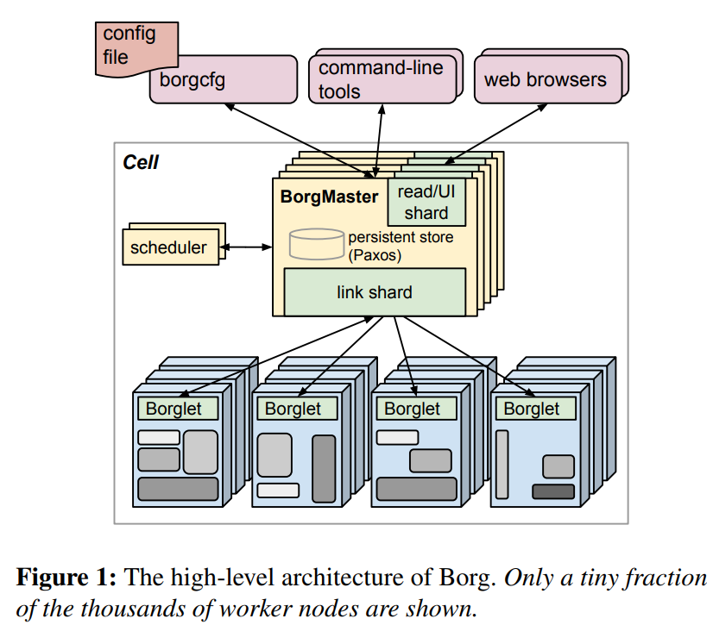
Borg: Architecture Overview
Key Components
Borgmaster: Central controller
Borglet: Agent on each machine
Scheduler: Task placement decision maker
Cluster Structure
Cell: Basic unit of a Borg cluster
Typically 10,000+ machines per cell
Multiple cells across different data centers
Communication Flow
Borgmaster communicates with Borglets
Users interact with Borgmaster via RPC
Scheduler interacts with Borgmaster for task placement

Slide 6
Borg: Architecture Overview
State Management
Borgmaster maintains cluster state
Uses Paxos-based store for high availability
Periodic checkpoints for recovery and debugging
Scalability Features
Separate scheduler process
Sharded Borgmaster functions
Optimized communication protocols

Slide 7
Borg: Borgmaster
Core Functions
Central controller for the entire cell (Manages the overall state of the cluster)
Handles client RPCs for state mutations and read-only access
Components
Main Borgmaster process & Separate scheduler process
Five replicas for high availability
State Management
In-memory copy of most cell state
Paxos-based store for persistence
Periodic checkpoints and change logs
Scalability Features
Link shards for Borglet communication
Asynchronous RPCs for read-only operations
Caching and aggregation of Borglet state updates

Slide 8
Borg: Borglet
Local Borg agent present on every machine in a cell
Key Responsibilities
Starting and stopping tasks
Restarting failed tasks
Managing local resources
Reporting machine state to Borgmaster
Resource Management
Manipulates Linux cgroups to enforce resource isolation
Dynamically adjusts resource caps for tasks
Handles out-of-memory events
Monitoring and Reporting
Aggregates machine-specific metrics (200 metrics per task)
Reports state to Borgmaster every few seconds
Fault Tolerance
Continues normal operation if Borgmaster connection is lost
Ensures running tasks and services stay up during Borgmaster failures

Slide 9
Borg: Scheduler
Assigns tasks to machines based on resource availability and constraints
Two-Phase Process
a) Feasibility Checking:
Finds machines that meet task's constraints
Considers available resources, including those from lower-priority tasks
b) Scoring:
Determines the "goodness" of each feasible machine
Considers user preferences and built-in criteria
Scoring Criteria
Minimizing number and priority of preempted tasks
Picking machines with task package copies
Spreading tasks across power and failure domains
Optimization Techniques
Score caching: Reduces repeated calculations
Equivalence classes: Groups tasks with identical requirements
Relaxed randomization: Examines a subset of machines

Slide 10
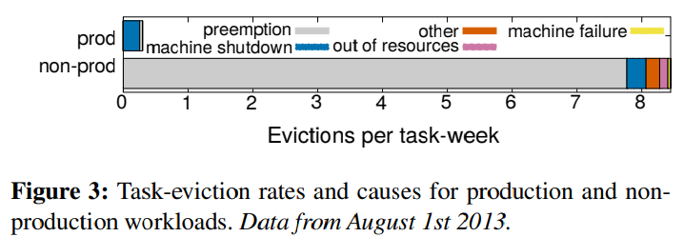
User’s Perspective: Workload Characteristics
Two Main Workload Types
a) Production (Prod) Jobs
Long-running services
User-facing applications (e.g., Gmail, Google Docs)
Critical infrastructure services (e.g., BigTable)
High priority, latency-sensitive
b) Non-Production (Non-Prod) Jobs
Batch jobs
Development and testing tasks
Lower priority, more tolerant to performance fluctuations (often use reclaimed resources)
Resource Usage Patterns
Prod jobs: Often reserve resources for peak loads
Non-prod jobs: More variable resource consumption

Slide 11
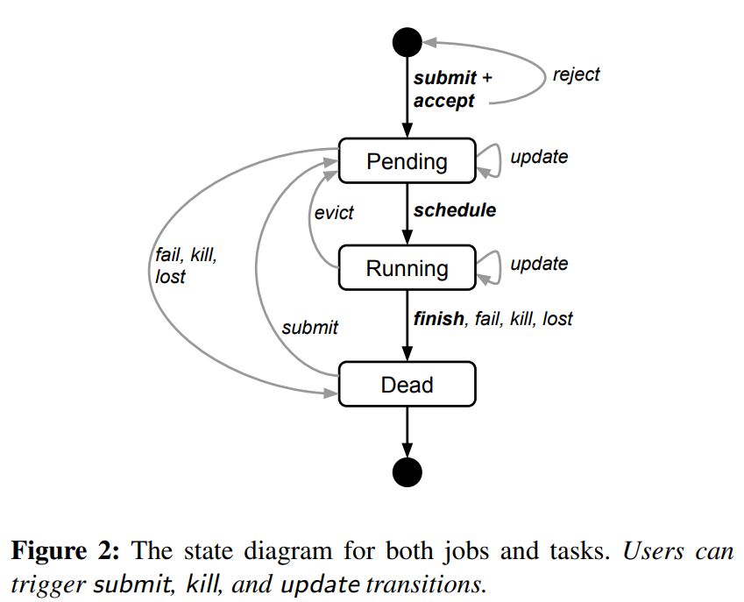
User’s Perspective: Jobs & Tasks
Jobs
Collection of related tasks
Defined by name, owner, and number of tasks
Can specify constraints for task placement
Tasks
Set of Linux processes running in a container
Have properties like resource requirements and task index
Typically run directly on the machine, not in VMs
Job Configurations
Written in BCL (Borg Configuration Language)
Can include lambda functions for dynamic adjustments
Task Lifecycle
Submit -> Schedule -> Run -> Finish/Fail/Kill

Slide 12
User’s Perspective: Priorities & quotas
Priorities
Small positive integer assigned to each job
Higher priority jobs can preempt lower priority ones
Priority bands: monitoring, production, batch, best effort
Quota
Vector of resource quantities (CPU, RAM, disk, etc.)
Expressed at a given priority for a period of time
Used for admission control, not scheduling
Quota Management
Higher-priority quota costs more
Production-priority quota limited to actual cell resources
Admission Control
Jobs only admitted if sufficient quota is available

Slide 13
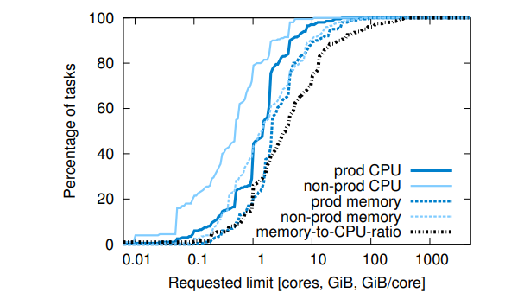
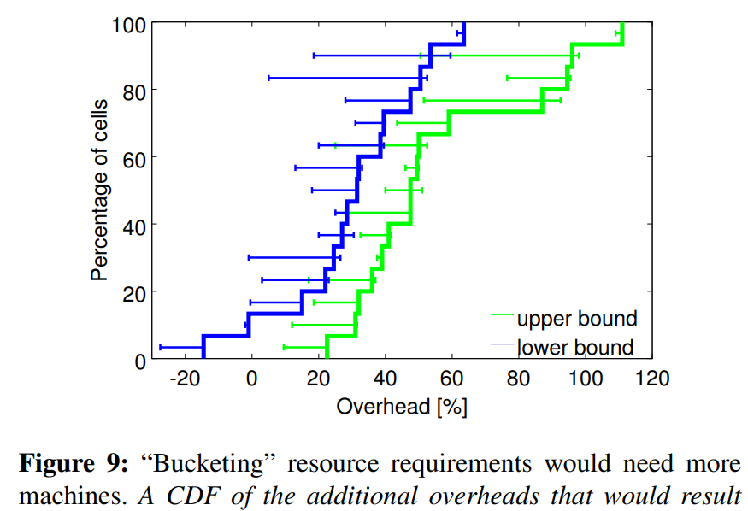
Resource Managment: Fine-grained Requests
Resource Units
CPU: Milli-cores, Memory & disk space: Bytes
Granularity Benefits
Allows precise resource allocation
Reduces waste from over-provisioning
Enables better cluster utilization
Request Patterns
No clear "sweet spots" in resource amounts
Wide range of CPU-to-memory ratios
Comparison to Fixed Sizes
More efficient than fixed-size VMs or containers (Avoids the need for predefined instance types)
Impact on Utilization
Helps in packing tasks more efficiently (better matching of resources to workload needs)

Slide 14
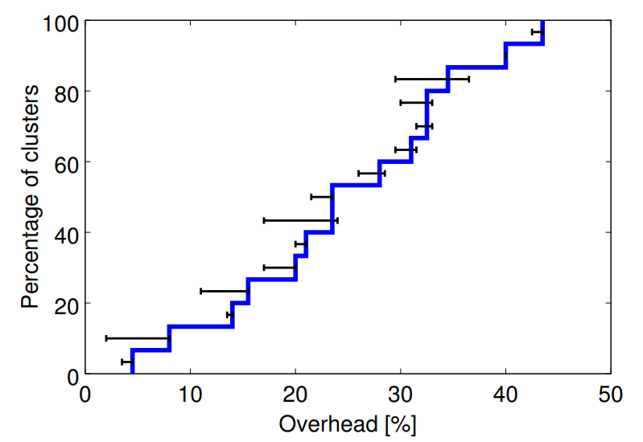
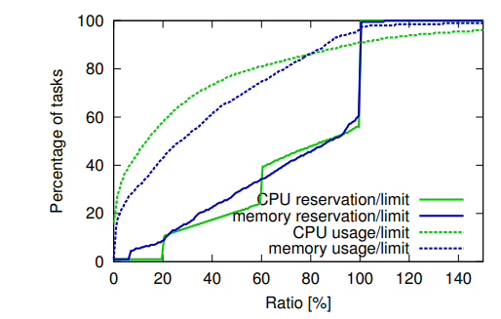
Resource Managment: Resource Reclamation
Concept
Using resources allocated but not currently consumed
Allows overcommitment of resources
Mechanism
Estimates task resource usage (reservation)
Reclaims unused resources for other tasks
Borgmaster calculates reservations every few seconds
Application
Production tasks use resource limits
Non-production tasks can use reclaimed resources
Benefits
Increases cluster utilization
Allows running more workload on the same hardware

Slide 15
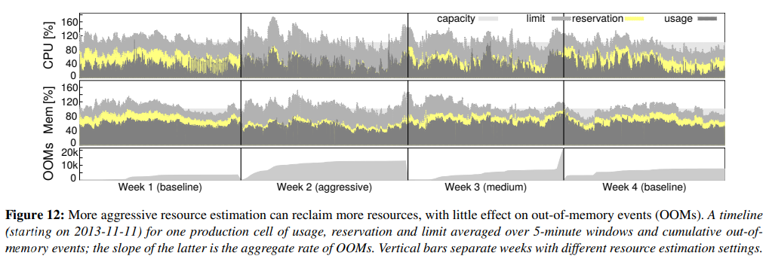
Resource Managment: Resource Reclamation

Slide 16
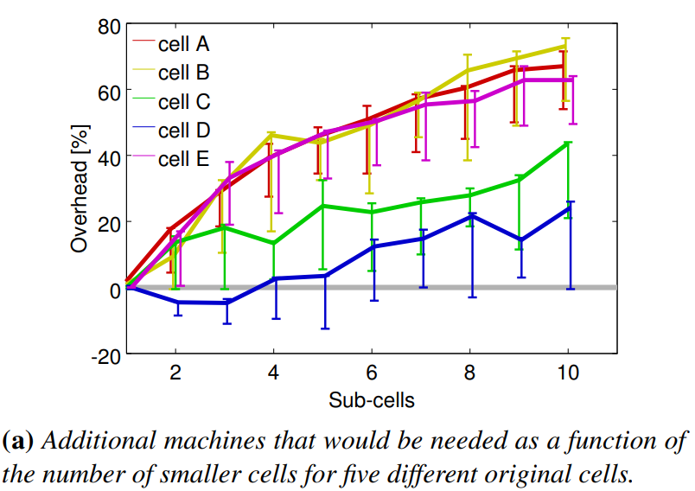
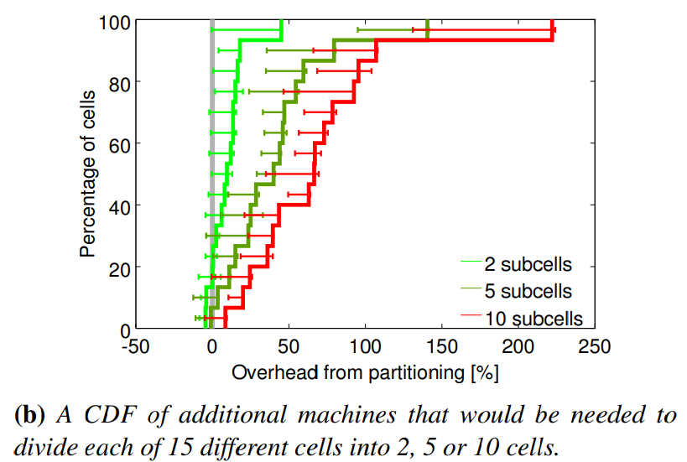
Resource Managment: Benefit of large cells
Cells often contain 10,000+ machines (Single management domain)
Key Benefits
Enables large computations
Reduces resource fragmentation
Improves bin-packing efficiency
Workload Management
Better handling of workload diversity (large or unusual tasks)
Resource Utilization
Higher overall resource utilization
More efficient sharing of resources across jobs
Operational Efficiency
Simplified cluster management → Reduced overhead in system administration

Slide 17
Availability & Reliability: Failure handling
Automatic Rescheduling
Reschedules evicted tasks (if necessary, Places tasks on new machines)
Failure Domain Spreading
Distributes tasks across machines, racks, and power domains → Reduces correlated failures
Maintenance Handling
Limits rate of task disruptions during upgrades
Controls simultaneous task downs per job
Robust Design
Uses declarative desired-state representations
Careful Recovery
Rate-limits task rescheduling after machine failures
Avoids cascading failures during network partitions

Slide 18
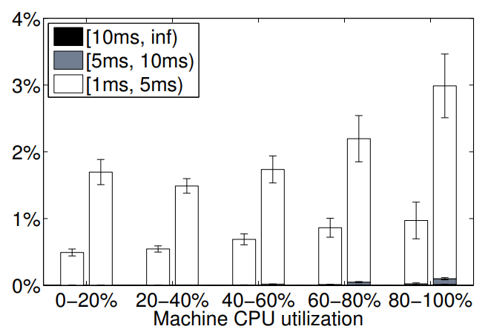
Availability & Reliability: Performance Isolation
Container Technology
Uses Linux cgroup-based resource containers
Resource Types
Compressible: CPU cycles, disk I/O bandwidth
Non-compressible: Memory, disk space
Application Classes
Latency-sensitive (LS) vs Batch tasks
Resource Management
Dynamic adjustment of resource caps
Throttling of greedy tasks
CPU Scheduling
Customized Linux CPU scheduler (CFS)

Slide 19
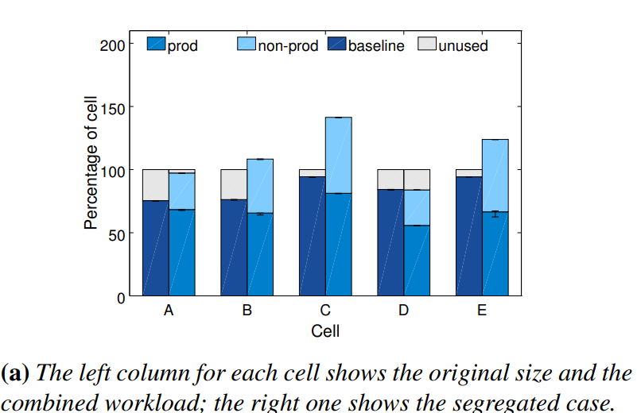
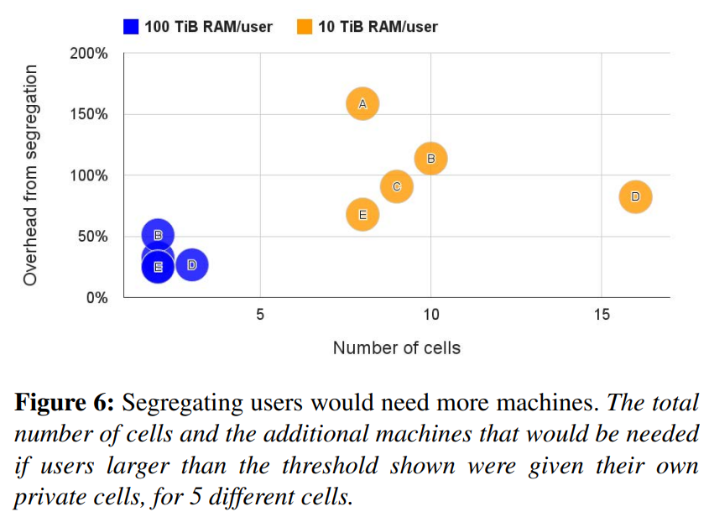
Benefits of Cluster Sharing
Mixed Workloads
Combines prod & non-prod jobs on same machines (98% of machines run both types)
Resource Efficiency
Higher overall cluster utilization
Better bin-packing of tasks
Cost Savings
Reduces need for separate clusters → Lowers total machine count required
Flexibility
Allows non-prod jobs to use resources reserved for prod spikes
Enables dynamic allocation based on current needs
Performance Impact
Minimal interference between different job types
Slight CPU performance decrease (about 3%) in shared cells

Slide 20
Lessons: The good & The bad
What worked well in Borg
Allocs are useful
Cluster management is more than task management
Introspection is vital
The master is the kernel of a distributed system
What worked bad in Borg
Jobs are restrictive as the only grouping mechanism for tasks
One IP address per machine complicates things
Optimizing for power users at the expense of casual ones

Slide 21
From Borg to Kubernetes
Kubernetes: Open-source system inspired by Borg
Shared Concepts
Pods (similar to Borg's tasks)
Services (for naming and load balancing)
Labels (for flexible grouping)
Key Differences
Designed for both cloud and on-premises environments
More standardized and extensible API
Improvements Based on Borg Lessons:
Simplified resource model
Built-in support for application-level health checking
More flexible naming and service discovery

Slide 22
Conclusion
Borg was developed to efficiently manage Google's large-scale computing infrastructure and support diverse workloads, aiming to optimize resource utilization, maintain high availability, and improve developer productivity
Borg was designed with a centralized Borgmaster, Borglets running on each machine, and an efficient scheduler as core components, effectively managing various workloads through fine-grained resource requests, resource reclamation, and a priority and quota system
Through long-term operation in real production environments, Borg has demonstrated high resource utilization and availability, and this experience has provided crucial insights for the development of next-generation cluster management systems like Kubernetes

Slide 23
Conclusion
Key Achievements
Efficient management of large-scale clusters
Impact on Google
Runs virtually all Google's cluster workloads
Influence on Industry
Inspired development of Kubernetes
Advanced understanding of distributed systems challenges
Lessons
Importance of fine-grained resource allocation
Value of comprehensive introspection tools
Benefits of mixed-workload clusters

Slide 24
Key Takeaways
Scalability is Crucial
Large-scale systems require innovative management approaches → Efficiency at scale leads to significant resource savings
Flexibility Enhances Utilization
Fine-grained resource allocation enables better resource use
Resilience by Design
Robust failure handling is essential for large-scale operation → Automated recovery mechanisms ensure high availability
Visibility Drives Optimization
Comprehensive introspection tools are vital for system understanding → Data-driven decision making improves system performance
Evolve or Become Obsolete
Continuous improvement is necessary to meet changing demands
Borg's journey demonstrates that effective cluster management is a continual process of innovation, adaptation, and refinement, setting the stage for future advancements in distributed systems

Slide 25
Thank you
Suhwan Shin
sshshin@dankook.ac.kr

