Slide 1
PipeDream
Big Data Platform and Cloud Service
Generalized Pipeline Parallelism for DNN Training
Ji-su Kim, Hyun-Jong Moon
Dankook University BoanLab

Slide 2
First…. I’m Sorry
PipeDream: Generalized Pipeline Parallelism for DNN Training

Slide 3
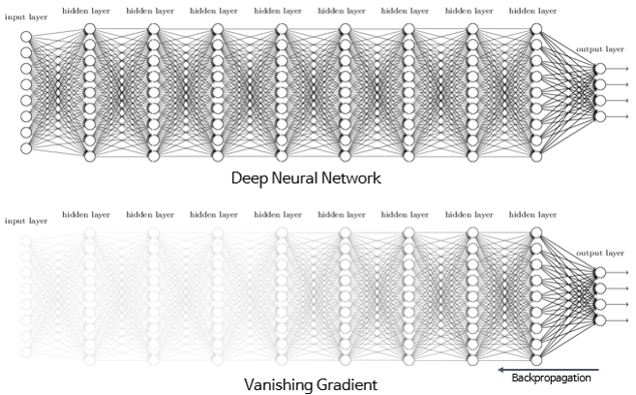
Deep Neural Networks
PipeDream: Generalized Pipeline Parallelism for DNN Training
Issues Before DNN
Vanishing Gradient Problem
As the number of hidden layers increases, the gradient tends to approach zero, making it difficult for lower layers to learn.
DNN Solutions
ReLU Activation Function
The use of ReLU (Rectified Linear Unit) solves the vanishing gradient problem, allowing for deeper networks by keeping gradients flowing during training.
Regularization Techniques
Various techniques such as dropout help prevent overfitting, making the model more robust.

Slide 4
Deep Neural Networks
PipeDream: Generalized Pipeline Parallelism for DNN Training
Forward Pass
Hidden Layer
Input Layer
Output Layer
Backward Pass

Slide 5
Deep Neural Networks Training
PipeDream: Generalized Pipeline Parallelism for DNN Training
Forward Pass
The input data moves through each layer of the network.
For each neuron, the output is calculated using
Output=(Input×Weights)+BiasOutput=(Input×Weights)+Bias
The output is passed through an activation function (e.g., ReLU, Sigmoid) to introduce non-linearity.
This process continues through all the layers until the network produces a prediction in the output layer.
Backward Pass
In the backward pass, we calculate the difference (error) between the prediction and the actual target.
This error is used to adjust the weights through a process called Gradient Descent.
The goal is to minimize the error by iteratively updating the weights and biases.
New Weights=Old Weights−𝜂×Gradient where 𝜂η is the learning rate.
This process is repeated until the model converges, reducing the error.

Slide 6
Parallelizing Optimization Algorithm Iterations
PipeDream: Generalized Pipeline Parallelism for DNN Training

Slide 7
Intra-batch, Inter-batch
PipeDream: Generalized Pipeline Parallelism for DNN Training
Intra-batch
mainly focus on how to complete the training of multiple batches faster
Data Parallelism, Model Parallelism
Inter-batch
mainly focus on how to complete a batch training faster
GPipe

Slide 8
Problems with Traditional Pipelining Techniques
PipeDream: Generalized Pipeline Parallelism for DNN Training
Inefficient Computation and Communication
Traditional pipelining techniques like GPipe perform gradient updates only after all stages have completed their computation.
This leads to a sequential process where communication occurs only after computation is finished, elongating the overall training time.
Parameter Inconsistency Due to Asynchronous Processing
In pipelined parallelism, stages operate asynchronously, causing potential mismatches between the parameters used during forward and backward passes.
This parameter inconsistency can disrupt the training process, negatively affecting the model's accuracy.
Pipeline Stalls
In GPipe, stages process sequentially, meaning the next stage must wait for the previous one to finish.
This introduces pipeline stalls where idle time is created, especially if a slower stage causes a bottleneck.

Slide 9
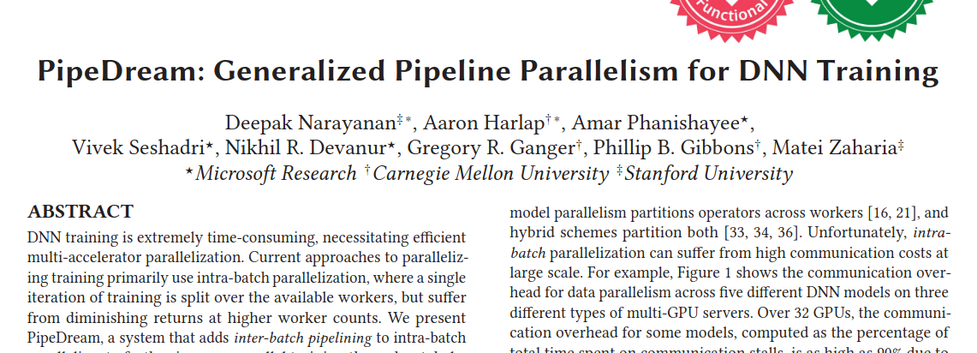
PipeDream
PipeDream: Generalized Pipeline Parallelism for DNN Training
PipeDream introduces pipeline parallelism to overcome the limitations of traditional methods.
This approach divides the model's layers into multiple stages, with each stage being processed by a separate worker.
By doing so, forward and backward computations can be performed simultaneously, which reduces communication overhead while maximizing computational efficiency.

Slide 10
Challenge Point
PipeDream: Generalized Pipeline Parallelism for DNN Training
Work Partitioning
PipeDream partitions DNN layers into stages, where each stage is assigned to a separate GPU.
This minimizes the training bottleneck by ensuring that no stage is slower than others, avoiding under-utilization of resources.
Work Scheduling
PipeDream alternates between forward and backward passes for different minibatches, ensuring all GPUs are used.
This scheduling method allows continuous computation and communication, reducing idle time and improving overall throughput.
Effective Learning
PipeDream uses weight stashing to ensure that each minibatch uses the correct weight versions during both the forward and backward passes.
This technique prevents invalid gradients from being computed, ensuring that the training process converges.

Slide 11
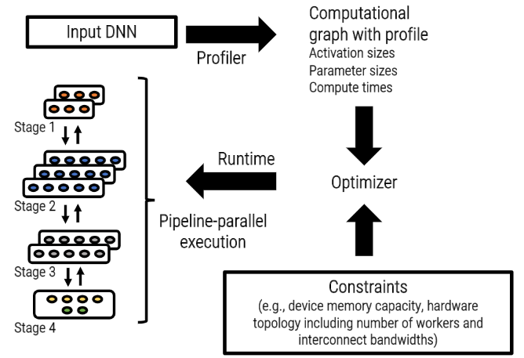
Overview
PipeDream: Generalized Pipeline Parallelism for DNN Training

Slide 12
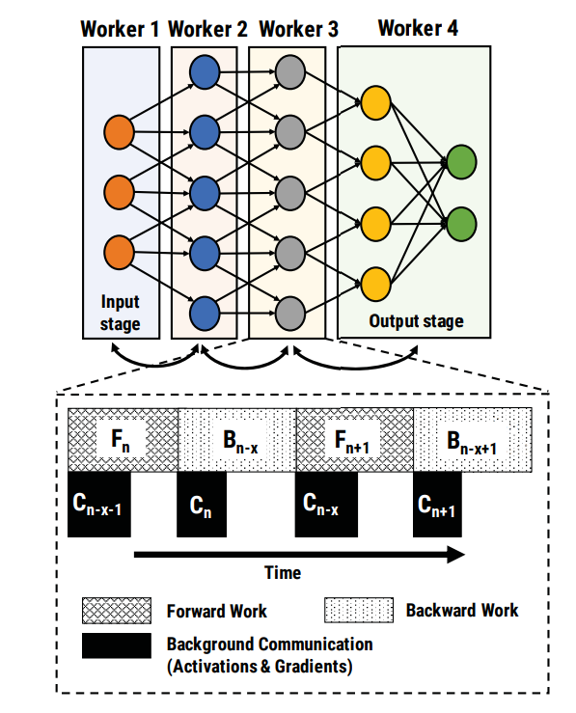
Pipeline Parallelism and Communication in DNN Training
PipeDream: Generalized Pipeline Parallelism for DNN Training
Differences of PipeDream (Compared to GPipe)
Once the gradient of a specific stage (layer) is obtained, it is updated immediately (asynchronous method).
Communication and computation are performed in parallel.
Advantages of PipeDream
PipeDream significantly reduces pipeline communication.
In PipeDream, computation and communication overlap in time, which greatly improves efficiency.

Slide 13
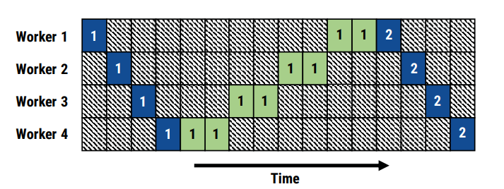
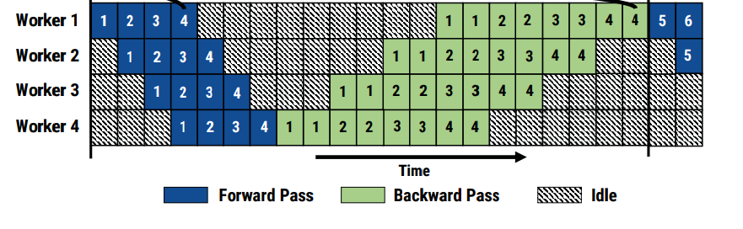
One Forward, One Backward
PipeDream: Generalized Pipeline Parallelism for DNN Training

Slide 14
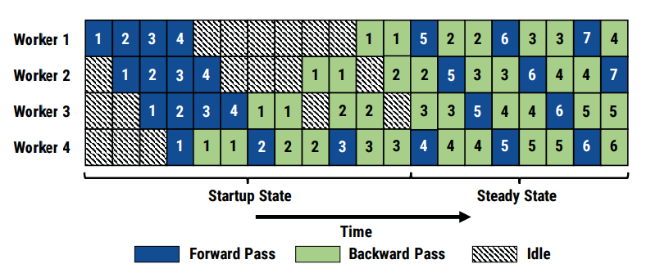
One Forward, One Backward
PipeDream: Generalized Pipeline Parallelism for DNN Training
One Forward, One Backward (1F1B)
1F1B alternates between one forward pass and one backward pass, ensuring continuous utilization of each worker's resources.
This method minimizes pipeline stalls and keeps the system in a steady processing state.
1F1B-RR (Round Robin)
1F1B-RR applies data parallelism using a round-robin method, distributing mini-batches across different workers.
This ensures consistency in data processing while maximizing parallel efficiency.

Slide 15
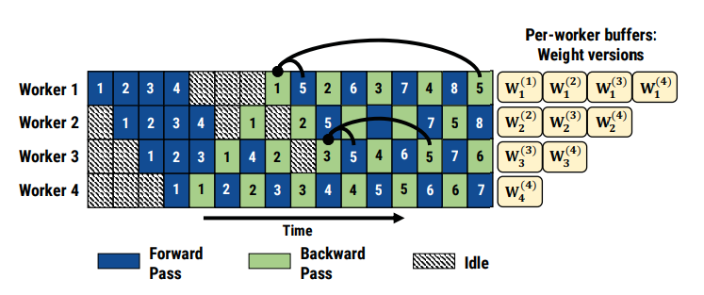
Weight stashing
PipeDream: Generalized Pipeline Parallelism for DNN Training
PipeDream uses asynchronous calculation.
It can lead to inconsistencies where different batches may use different model parameters during forward and backward propagation.
This could result in incorrect or inefficient training.
Weight Stashing is proposed to address the issue.
It caches previous versions of model weights before each update.
This approach versions the cached models, ensuring that consistent model parameters are used across different stages of pipeline processing.

Slide 16
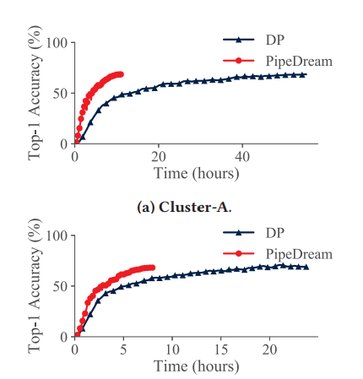
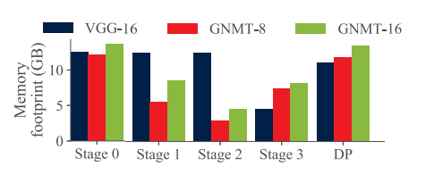
Evaluation(Time-to-Accuracy, Memory)
PipeDream: Generalized Pipeline Parallelism for DNN Training

Slide 17
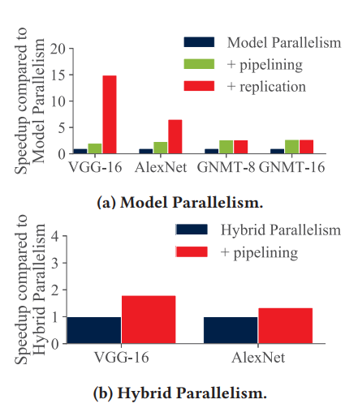
Evaluation(Intra-batch, Inter-batch)
PipeDream: Generalized Pipeline Parallelism for DNN Training
Comparison to Other Intra-batch Parallelism Schemes
Model Parallelism: Figure 14a shows pipelining boosts throughput by 2× or more, with PipeDream achieving 14.9× speedup for VGG-16 and 6.5× for AlexNet.
Hybrid Parallelism: Figure 14b shows PipeDream improves throughput by 80% and is 1.9× faster than FlexFlow on AlexNet.
Comparison to Inter-batch Parallelism
PipeDream vs. GPipe: PipeDream achieves 55-71% better throughput than GPipe by reducing pipeline stalls/flushes.
Memory Efficiency: PipeDream maintains high throughput with minimal memory overhead, even with deeper pipelines.

Slide 18
Conclusion
PipeDream: Generalized Pipeline Parallelism for DNN Training
PipeDream significantly reduces training time for DNN models.
By combining intra-batch parallelism with inter-batch pipelining, PipeDream improves hardware utilization.
It achieves up to 5.3x faster training times compared to data-parallel approaches across various models.
PipeDream minimizes communication overhead during training.
Through pipelining and optimized layer partitioning, it reduces the amount of data transferred between workers.
This approach helps limit inter-server communication, leading to faster convergence.
PipeDream maintains high statistical efficiency with weight stashing.
The system ensures numerically correct gradient updates by stashing multiple weight versions during training.
This enables high accuracy while avoiding pipeline stalls, ensuring effective learning across large-scale DNN models.

Slide 19
PipeDream-2BW
PipeDream: Generalized Pipeline Parallelism for DNN Training
PipeDream-2BW accelerates the training of large-scale DNN models through memory-efficient pipeline parallelism.
It uses a double-buffered weight update strategy to maintain high throughput without pipeline flushes.
Additionally, it automatically partitions the model across accelerators while considering memory constraints.

Slide 20
Microsoft Research's Project: Fiddle
PipeDream: Generalized Pipeline Parallelism for DNN Training
Fast and Efficient Infrastructure for Distributed Deep Learning
Efficient Distributed DNN Training
Project Fiddle focuses on building infrastructure to improve distributed DNN training efficiency by 100x.
It optimizes systems across single GPUs, multi-GPU setups, and large multi-machine clusters.
Key Innovations Across the Systems Stack
Gist: Reduces memory footprint to enable larger models on a single GPU.
PipeDream: Combines model, data parallelism, and pipelining to achieve fast, scalable training.
Blink: Accelerates inter-GPU communication, abstracting interconnect heterogeneity.

Slide 21
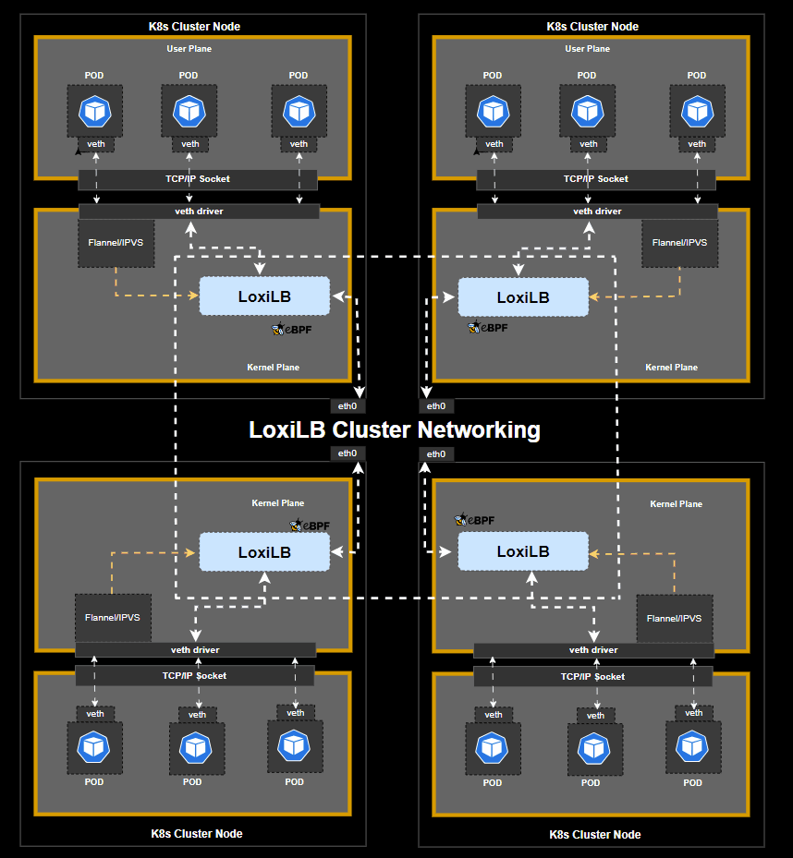
If I were to use this paper's idea, …
PipeDream: Generalized Pipeline Parallelism for DNN Training
Malicious Docker Image Classification
By utilizing PipeDream’s parallel DNN training, a system can be developed to classify malicious Docker images.
Integrated with Kubernetes’ container image scanning functionality, the model trained via PipeDream can detect malicious images in real-time.
AI-based Load Balancing
Combining Kubernetes' load balancer functionality with PipeDream enables the creation of an AI-based system that analyzes traffic.
This system then implements optimal resource allocation and scheduling for efficient load balancing.

Slide 22
Reference
PipeDream: Generalized Pipeline Parallelism for DNN Training
https://arxiv.org/abs/1806.03377(PipeDream)
https://arxiv.org/abs/1811.06965(GPipe)
https://arxiv.org/abs/2006.09503(PipeDream-2BW)
https://arxiv.org/abs/1807.05358(Intra-batch, Inter-batch)
https://www.microsoft.com/en-us/research/project/fiddle/(fiddle)

Slide 23
Thank You

