Slide 1
DiskANN: Fast Accurate Billion-point Nearest Neighbor Search on a Single Node
Suhas J. S., Devvrit, Rohan K., Ravishankar K., Harsha V. S. NeurIPS’19 Carnegie Mellon University, University of Texas at Austin and Microsoft Research India
2024. 10. 29
Presentation by Nakyeong Kim
nkkim@dankook.ac.kr

Slide 2
Preliminary
Motivation
Design
Vamana
System
Evaluation
Conclusion

Slide 3
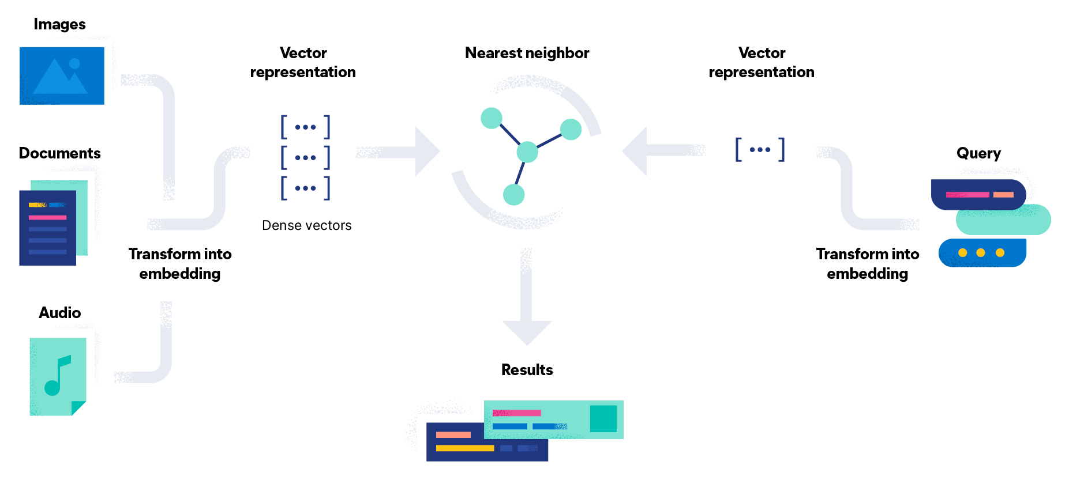
Preliminary
Vector Database
Database that store high-dimensional vectors
Vectors are usually generated by transformation or embedding
Indexing is required for fast similarity search (to get nearest neighbors)
Full fledged-system is consist of
Query processing
Indexing
Data management
Storage management
Similarity search!
https://www.elastic.co/kr/what-is/vector-embedding

Slide 4
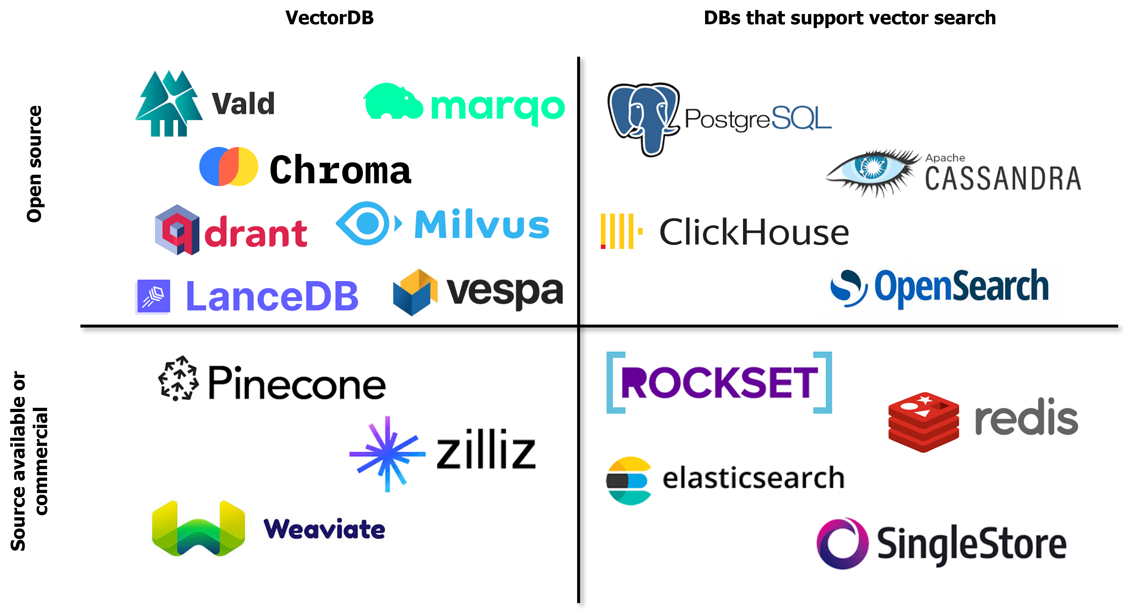
Preliminary
Vector Database
Vector Database

Slide 5
Preliminary
Approximate Nearest Neighbor Search
NNS is used in various application domains, such as information retrieval, recommendation system etc.
With explosive growth of dataset’s scale, accurate NNS cannot meet efficiency and cost
Much of literature have focused on approximate NNS
ANNS have trade-off between accuracy and performance
Query
Need to calculate
K = 3
K = 6

Slide 6
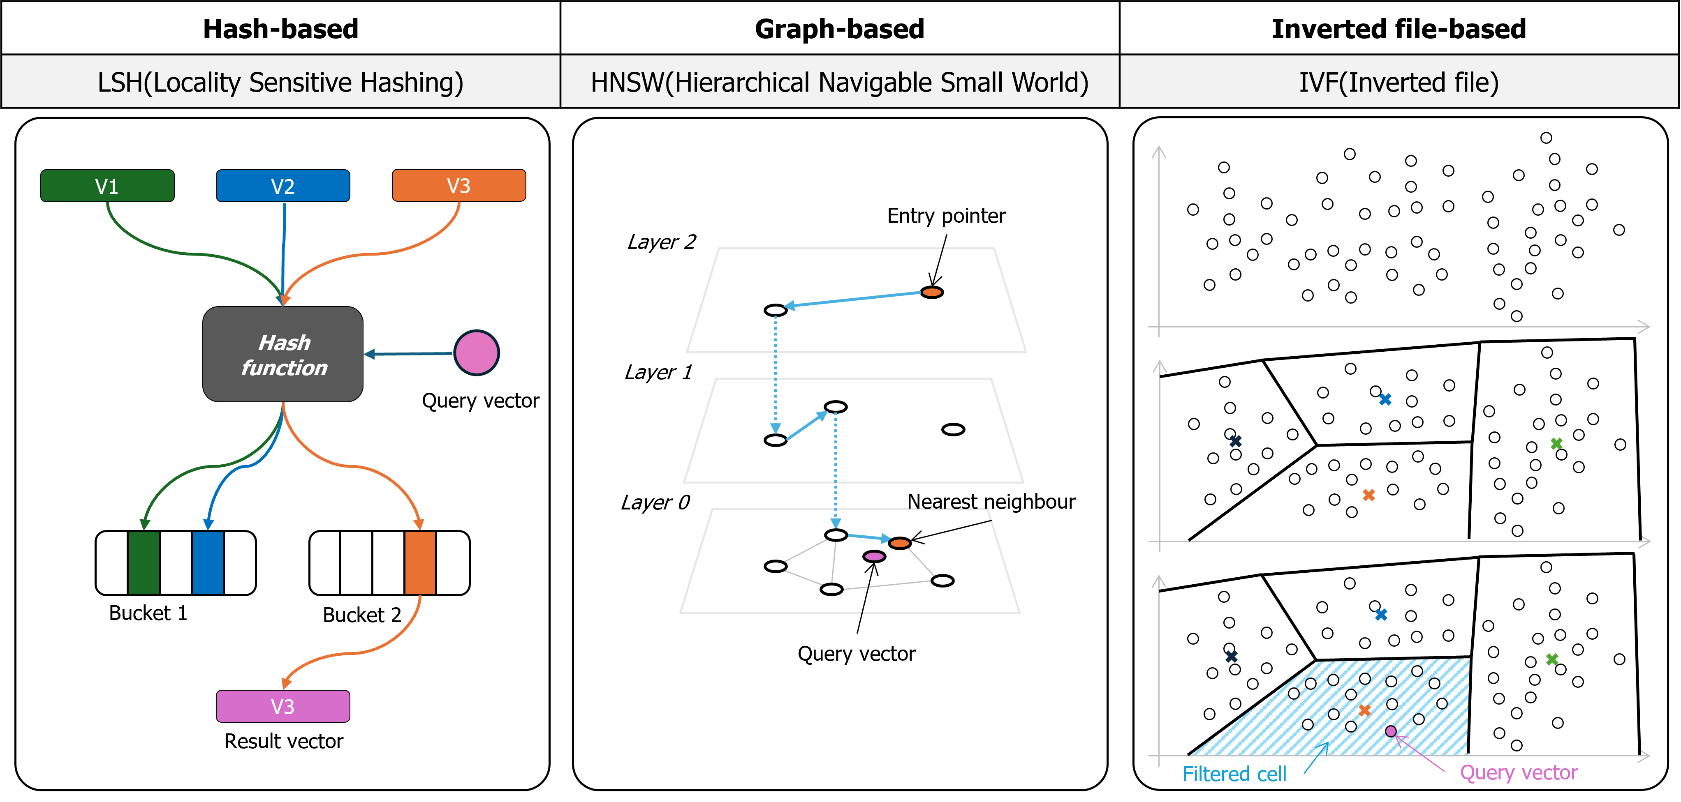
Preliminary
$k$-recall = $\frac{|X ∩ G|}{k}$
Approximate Nearest Neighbor Search

Slide 7
Motivation
State Of The Art ANNS
SOTA ANNS algorithms (e.g., HNSW, NSG) store indices in main memory for fast search
As data grow, it is impossible to store it all in memory
DiskANN serve new graph-based indexing and search system
Main challenges of SSD-resident index is reducing
# of random disk accesses
# of round-trip requests (< 10, preferably 5)

Slide 8
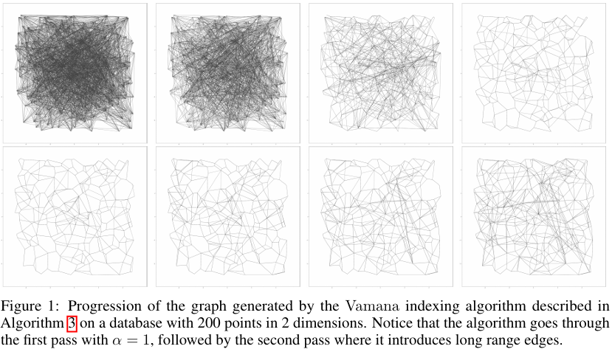
DiskANN
$$p′$$
If $d\left(p, p^{′}\right)>d\left(p^{∗}, p^{′}\right)$, remove $p↔p′$
Vamana
$$p′$$
$$p$$
$$p′$$
Index construction
Initialize graph
Randomly connected nodes (max $R$ vertices): not ensure convergence
Select entry point
Randomly chosen node (from PQ)
Get node’s neighbors
Searched greedy (Best-Fit Search)
Optimized by Robust Pruning ($α=1$)
Add backward edges
Run Robust Pruning to avoid degree violation
Optimize ($α≥1$)
Repeat 2~3 until empty candidate list
$$p^{∗}$$
$$p′$$

Slide 9
DiskANN
Vamana
Search
Select entry point
Randomly chosen node
Get neighbor nodes
In memory
In storage (fetch $W$ neighbors: Beamsearch)
Calculate distances and get closest point
Update candidate list with point’s neighbors
Repeat 2~3 until distance converged
Sort results by distance
Slice $k$ candidates and return
$$v1$$
$$v2$$
$$v6$$
$$v4$$
$$v3$$
$$v5$$

Slide 10
DiskANN
System Design
Run Vamana on dataset and store resulting graph on SSD
How to build graph over billion points? → Partition data into multiple shards → Overlapping indices
How to do distance comparison between query point and points in candidate list? → Store compressed vector for every point in memory → For overcoming PQ’s inaccurate point, store full-precision coordinates next to its neighborhood (in storage)

Slide 11
Evaluation
Setting
Machine
z840: Xeon E5-2620v4s (16 cores), 64GB DDR4 RAM, Samsung 960 EVO 1TB SSDs x2 (RAID 0)
M64-32ms: Xeon E7-8890v3s (32 vCPUs), 1792GB DDR3 RAM
Comparison and metrics
For in-memory search (NSG, HNSW): latency vs recall, # of hops
For billion point datasets(FAISS, IVF-OADC+G+P): latency vs recall
Dataset | Dimensions | Train Size | Test Size | Neighbors | Distance
SIFT1M | 128 | 1,000,000 | 10,000 | 100 | Euclidean
GIST1M | 960 | 1,000,000 | 10,000 | 100 | Euclidean
DEEP1M | 96 | 1,000,000 | 10,000 | 100 | Angular
BigANN (SIFT1B) | 128 | 1,000,000,000 | 10,000 | 100 | Euclidean

Slide 12
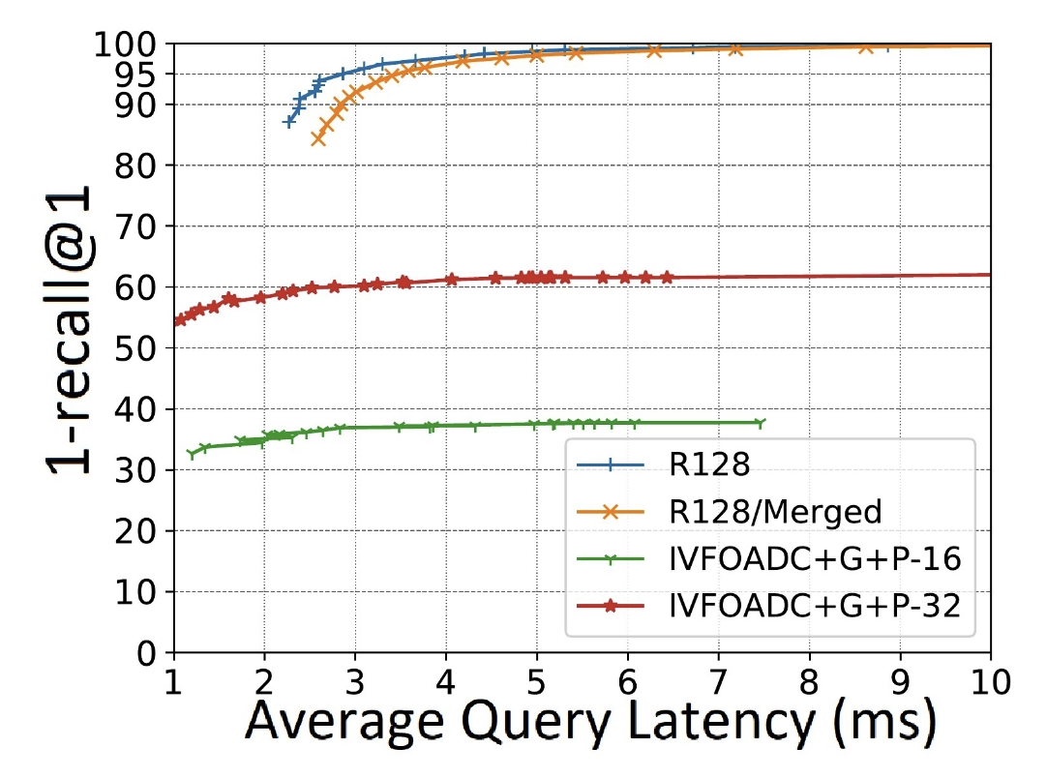
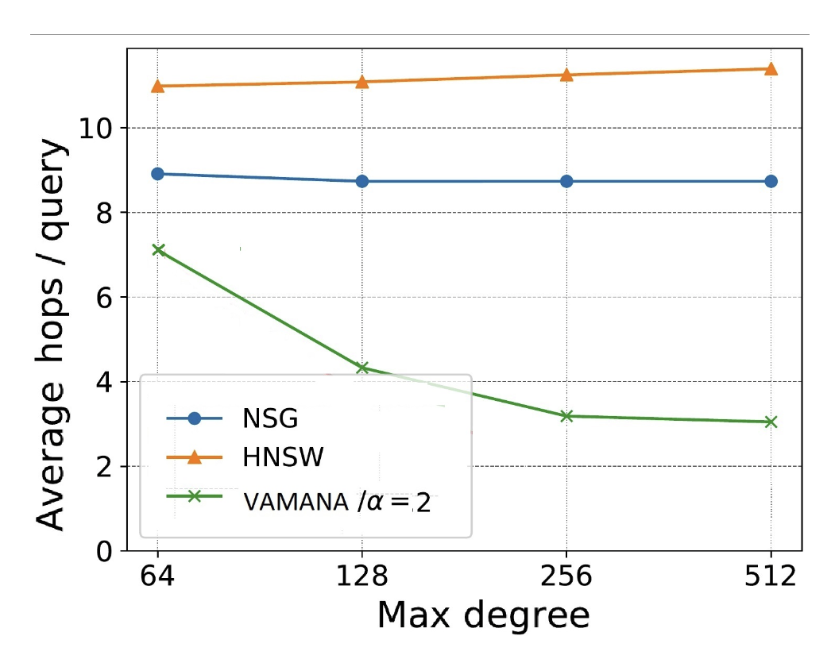
Evaluation
- R128: one-shot
- R128/Merged: merged Vamana
Recall and Performance
(a) 1-recall@1 vs latency on SIFT dataset (1M)
(b) Average # of hops vs maximum graph degree

Slide 13
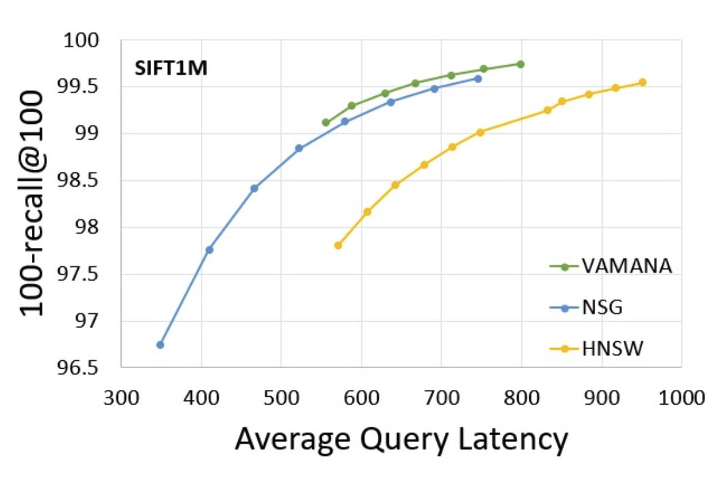
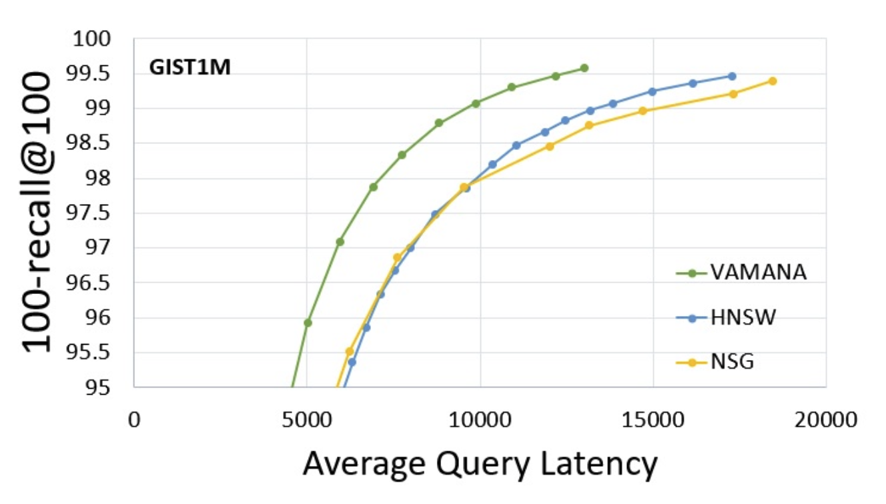
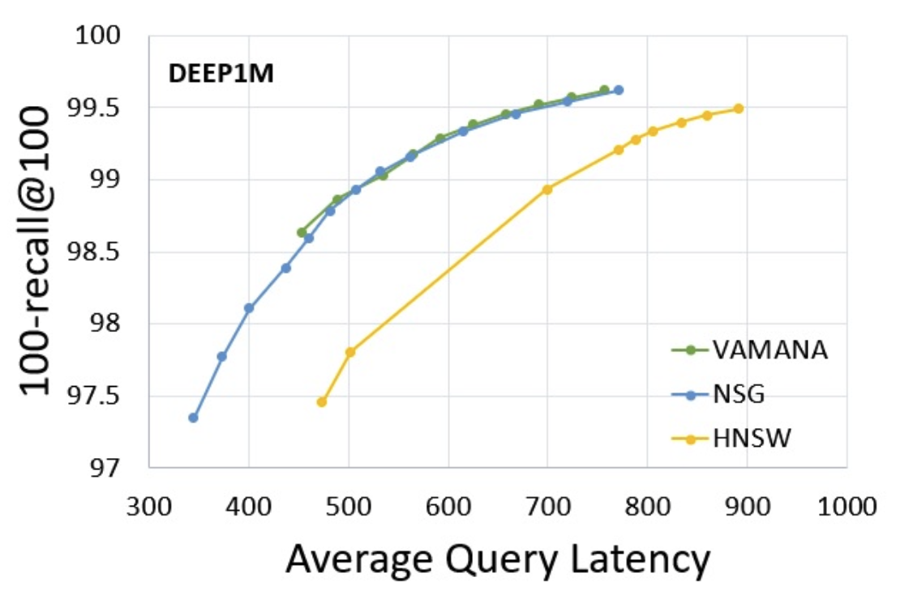
Evaluation
Comparing to Other Graph-based Indexes
Latency vs recall

Slide 14
Conclusion
Current ANNS algorithms primarily store indices in memory, limiting dataset size and making high-speed searches challenging for large datasets.
This paper introduces DiskANN, a system that uses new graph-based indexing algorithm called Vamana to efficiently store and search large-scale datasets on SSDs. Vamana enhances search efficiency by reducing memory usage and minimizing SSD access through techniques like backward edges and beam search.
Experimental results show that DiskANN achieves over 95% accuracy (1-recall@1) with average latency below 3ms on billion-point datasets using only 64GB of memory. DiskANN outperforms existing memory and SSD-based ANNS methods in both performance and scalability.

Slide 15
Thank you!
2024. 10. 29
Presentation by Nakyeong Kim
nkkim@dankook.ac.kr

