Slide 1
Cornflakes: Zero-Copy Serialization for Microsecond-Scale Networking
Deepti Raghavan, Shreya Ravi, Gina Yuan, Pratiksha Thaker, Sanjari Srivastava, Micah Murray, Pedro Henrique Penna, Amy Ousterhout, Philip Levis, Matei Zaharia, and Irene Zhang
SOSP ‘23
2024.11.26
Presentation by Suwhan Shin, Boseung Kim
sshshin@dankook.ac.kr, bskim1102@dankook.ac.kr

Slide 2
Introduction
Background
Design
Evaluation
Conclusion

Slide 3
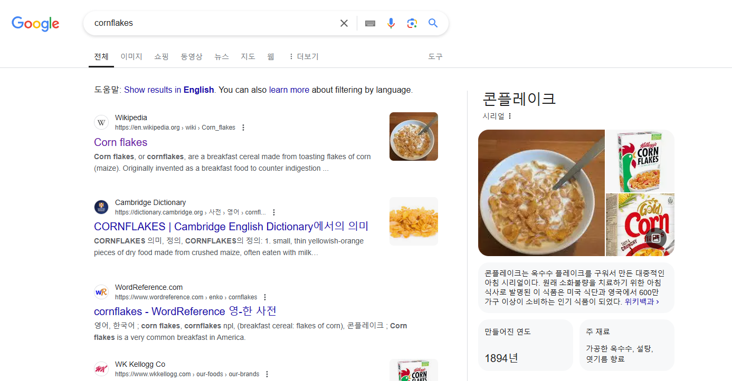
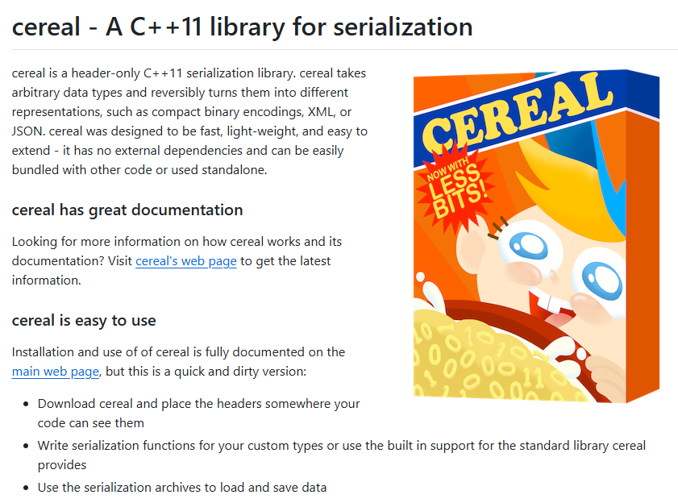
Introduction
Data serialization is a critical process in data center networking and accounts for a significant portion of CPU usage. For instance, Google and Meta report that data serialization consumes 9.6% and 6.7% of CPU cycles, respectively
The scatter-gather function of modern Network Interface Cards (NICs) have opened up the possibility of eliminating memory copying in data transmission. However, the additional memory management overhead can negatively impact performance
Cornflakes is a hybrid serialization stack that leverages scatter-gather when it improves performance and falls back to memory copying otherwise

Slide 4
Background
Serialization
Serialization is the process of converting complex data structures into a byte format for storage or transmission
It transforms data into a standard format during network communication or file storage, improving system compatibility and ensuring efficient transmission and storage
Scatter-gather
Scatter-gather I/O is a technique for processing data by handling multiple scattered data blocks in memory without copying them
Scatter: Data is distributed and stored across multiple memory buffers. For instance, a packet’s header and body can be stored in different memory locations
Gather: When transmitting data over a network or writing it to a file, these scattered data blocks are collected and processed in one go. The data is directly transferred to the network interface card (NIC) or disk
Using scatter-gather I/O eliminates the need to copy data within memory before transmission, reducing CPU overhead and improving performance

Slide 5
Background
Scatter-gather Serialization Stack
A software architecture that leverages scatter-gather I/O technology to enhance the efficiency of data serialization
Typically, serialization involves copying data structures into a contiguous memory block before sending them over the network, incurring significant copying overhead
Instead of copying data into a single contiguous block, this approach retains data in multiple scattered memory locations
The Network Interface Card (NIC) utilizes its scatter-gather capabilities to collect the scattered data, assemble it into packets, and transmit it directly
Scatter-gather Serialization Stack in Cornflakes
A hybrid stack that adapts serialization strategies based on data size
Small data: Processed through copying
Large data: Transmitted using scatter-gather I/O, avoiding copying overhead
Safety: Ensures memory safety and operates seamlessly with non-DMA-safe memory
Transparency: Designed so developers do not need to manage memory or decide whether to copy data explicitly

Slide 6
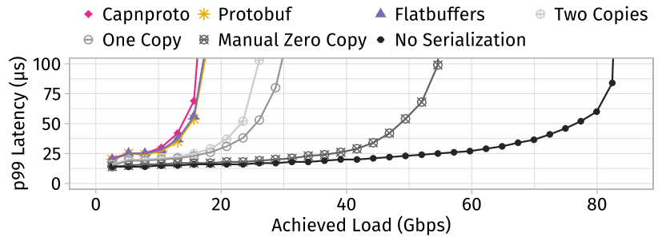
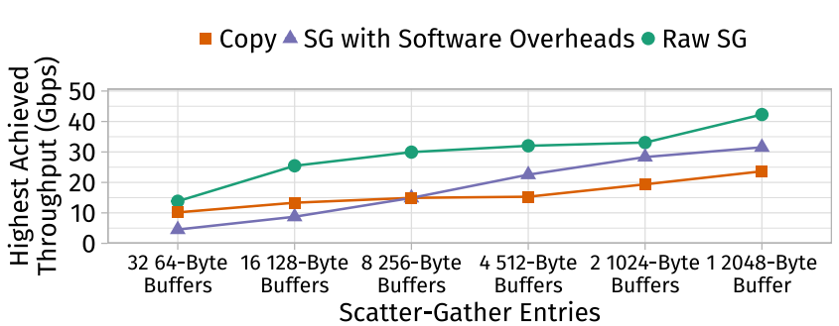
Contribution
Dynamic Selection Algorithm
Efficiently chooses between scatter-gather and copy-based approaches at runtime
A hybrid strategy was designed based on findings that processing data larger than 512 bytes with scatter-gather is more efficient
Hardware Optimization
Tightly integrated with NIC hardware, providing a serialize-and-send interface that merges serialization and networking operations for enhanced performance
Versatility
Designed for seamless integration with various applications and workloads
Demonstrated performance improvements in systems like Redis, showcasing its adaptability and effectiveness

Slide 7
Design
Cornflakes is a hybrid serialization library designed with an integrated networking stack
Supports zero-copy serialization using scatter-gather approach in application memory, ensuring safety and efficiency
Cornflakes Programming Model
Cornflakes' programming model is very similar to existing serialization libraries (Protobuf, FlatBuffers)
Data structure definition, code generation, and usage of Cornflakes objects
Uses reference counted buffers (RcBuf) and hybrid smart pointers (CFPtr)
Serialization Library Features
Scatter-Gather Heuristic
Constructing CFPtr
Serialize-and-Send API
Cornflakes Wire Format
Uses wire format similar to Cap'n Proto and FlatBuffers
Hardware compatibility & Server-to-server interoperability

Slide 8
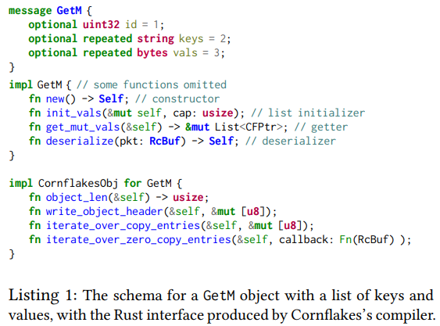
Cornflakes’s Programming Model
Cornflakes Programming Model
Cornflakes' programming model is almost identical to existing serialization libraries
Data Structure Definition
Define data structure schemas using Protobuf's existing schema language
Code Generation
Call the Cornflakes compiler to generate objects and their implementation code for messages from the schema file
Object Construction and Usage
Use the generated functions to construct Cornflakes objects in application code and populate data

Slide 9
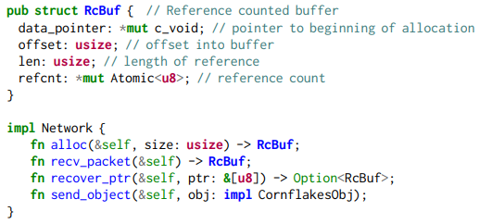
Cornflakes’s Programming Model
Ref-counted Buffers (RcBuf)
When applications, serialization libraries, and networking stacks access the same memory asynchronously, upper layers must ensure they don't deallocate or reallocate memory that lower layers are still using
Cornflakes' networking stack provides an allocator that returns reference-counted DMA-safe memory
Listing 2: RcBuf
Reference count increases when RcBuf is allocated or cloned
Reference count decreases when RcBuf is deleted
Memory is automatically freed when the last reference is deleted
While existing kernel bypass systems like Demikernel and DPDK also provide reference-counted DMA-safe buffers to applications, Cornflakes directly integrates these abstractions into the serialization library

Slide 10
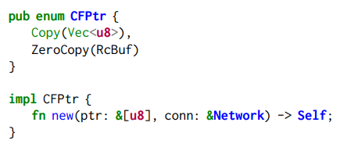
Cornflakes’s Programming Model
Hybrid Smart Pointers (CFPtr)
Cornflakes provides smart pointers to support its hybrid stack
These encapsulate either references to zero-copy data or copied data
Listing 3: CFPtr
Code generated by Cornflakes represents byte or string fields as CFPtr objects
CFPtr contains one of the following:
Vector of Bytes: Copied data that will be later copied into DMA buffers
RcBuf: Transmitted through scatter-gather entries
CFPtr constructors work regardless of the underlying memory location (e.g., stack, unpinned heap memory, middle of an RcBuf allocation)
When a pointer passed to Cornflakes is part of an RcBuf allocation, Cornflakes automatically recovers and uses it

Slide 11
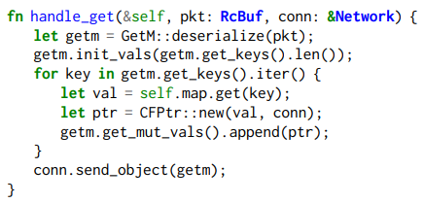
Cornflakes’s Programming Model
Example Application
Listing 4 shows a simple application implementing a key-value store using Cornflakes
Listing 4
The application deserializes incoming GetM requests
Reserves space to store values in a list within the GetM object based on the number of keys to look up (using init_vals function)
For each key:
Looks up the value and creates a CFPtr object with a raw pointer to that value
Adds the CFPtr to the vals field of GetM (using append function)
Finally, the application directly sends the GetM object to the networking stack (using send_object function)
No separate "serialize" call is needed

Slide 12
Serialization Library Features
Scatter-gather Heuristic
Constructing CFPtr
Copy
Zero-copy
Combined Serialize-and-send

Slide 13
Serialization Library Features
Scatter-gather Heuristic
Cornflakes dynamically decides whether to copy data or handle it with zero-copy (Scatter-Gather) approach
This decision is based on a quickly calculable size threshold (512 bytes)
Only byte and string fields larger than 512 bytes use the zero-copy approach
Section 5 demonstrates that this threshold is derived from hardware platform results
Cornflakes applies the heuristic on a per-field basis when creating individual CFPtr objects
Ex) In CFPtr::new (Listing 3), it verifies if the pointer is in DMA-safe memory and then increments the reference count
If a field is later copied according to the heuristic, data cache misses occur but metadata cache misses can be avoided
Cornflakes uses only simple heuristics like the data size threshold, which helps minimize either data cache misses or metadata cache misses that could occur on a per-field basis

Slide 14
Serialization Library Features
Constructing CFPtr
The CFPtr creation process varies depending on whether the data will be transmitted using scatter-gather approach
Copy (data size < threshold)
Constructor copies data into a Vector and returns the "Copy" variant of CFPtr
The networking stack later copies the data into a DMA-safe buffer
Since data is already in cache from the first copy, the cost of the second copy is low
Cornflakes uses arena allocation to reduce heap allocation costs for efficiently managing copied data
Zero-Copy (data size > threshold)
Calls the networking stack's recover_ptr function to verify if data is in DMA-safe memory (See Listing 2)
If data is in DMA-safe memory:
recover_ptr recovers and increments the reference count associated with the pointer, then creates and returns an RcBuf object
If data is not in DMA-safe memory:
Zero-copy cannot be used, so the data is copied instead

Slide 15
Serialization Library Features
Combined Serialize-and-send
Cornflakes integrates serialization and transmission APIs to eliminate additional cache misses that occur when converting data to intermediate formats
Problems with Traditional Approach
Traditional scatter-gather networking stacks (e.g., Linux's writev) take scatter-gather arrays as input and internally iterate through the array to transmit referenced buffers
If Cornflakes had been designed as an independent layer above such stacks, it would have needed to convert application objects into scatter-gather arrays
This conversion process leads to performance degradation through computational costs, memory access (potential cache misses), and additional vector allocations
Cornflakes Approach
Cornflakes is designed so that the networking stack directly accepts serialization objects (CornflakesObj) (See Listing 1)
This optimization is only possible with a co-designed networking stack, while stacks with independent serialization and networking must implement using scatter-gather arrays

Slide 16
Cornflakes Wire Format
Cornflakes' wire format is designed based on the wire formats of Cap'n Proto and FlatBuffers
This format uses pointers to encode the location and size of arbitrary-sized data fields and nested objects
The Cornflakes wire format consists of headers and field data
Headers: Index information about fields and are positioned at the front of the data structure
Field Data: Actual data is positioned after the headers

Slide 17
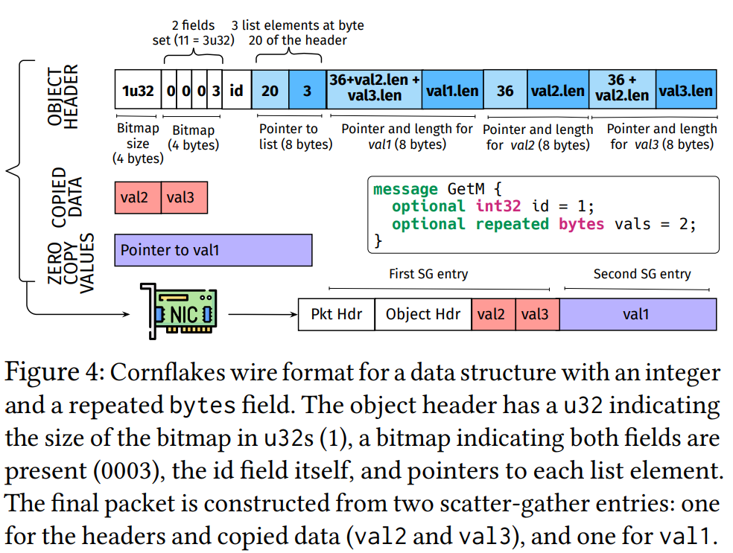
Cornflakes Wire Format
Format using a simple data structure that includes integer fields and a repeated bytes field
Header Structure
Bitmap Size (u32):
Indicates the size of the bitmap
Bitmap:
Shows whether each schema field is present
Fields can only be added, not removed or modified
This ensures deserializers are automatically compatible with previous versions
Integer Fields:
Integer field data is directly copied into the header (e.g., id field in Figure 4)
Byte/String Fields:
Header includes offset (pointer) and size
List Fields:
Header includes size indicating number of list elements and offset storing information about each element
Nested Objects:
Header includes offset of sub-header
Sub-headers contain their own bitmap and field information

Slide 18
Cornflakes Wire Format
Zero-copy & Copied Data
Zero-copy and Copied ItemsData from both top-level fields and nested (leaf) fields in the data structure is positioned after the header
Copied data is placed before zero-copy data
When transmitting objects smaller than the MTU (Maximum Transmission Unit), PCIe requests to the NIC include Z+1 PCIe entries:
Z: Number of zero-copy fields
Additional entry: Network headers, object headers, and copied data
Figure 4 illustrates this using a data structure with 3 list elements:
val2 and val3 are smaller than the size threshold, so they're handled as copied data and positioned before the zero-copy data (val1) in the wire format
This data reordering doesn't affect compatibility even when two servers use different heuristic thresholds
All leaf field references within headers are placed in a deterministic order based on the data structure schema.
However, servers using different thresholds can serialize repeated elements in different orders

Slide 19
Implementation
Implementation components of Cornflakes
Serialization code generation module
Generate RUST serialization code form data structure
Network stack interface
Pinned memory allocator
Base serialization primitive library
UDP networking stack
Based on Mellanox and Intel NIC drivers

Slide 20
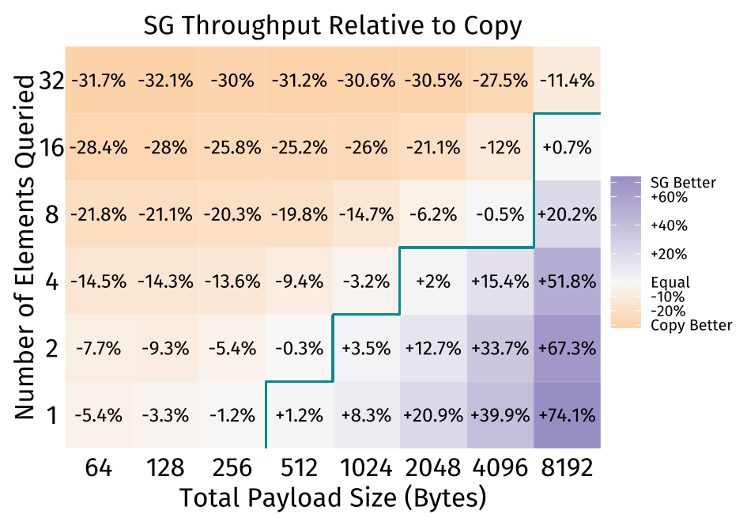
Determine Copy or Not
Tradeoff between scatter-gather and copy
Scatter-gather provides benefits when the individual field size is at least 512 bytes
Individual field size = Total Payload Size / Number of Elements Queries

Slide 21
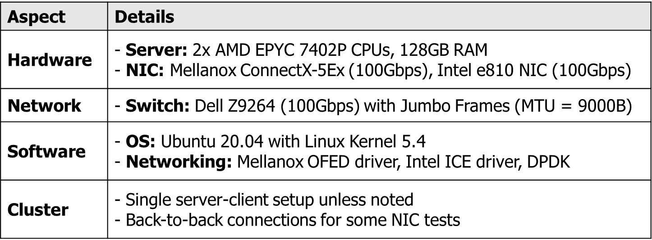
Evaluation
Methodology
- Setup
- Application

Slide 22
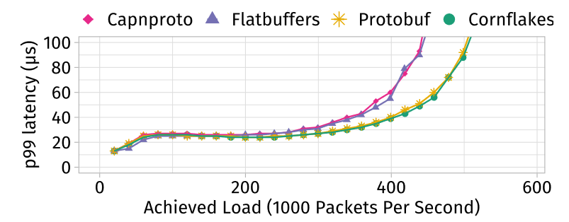
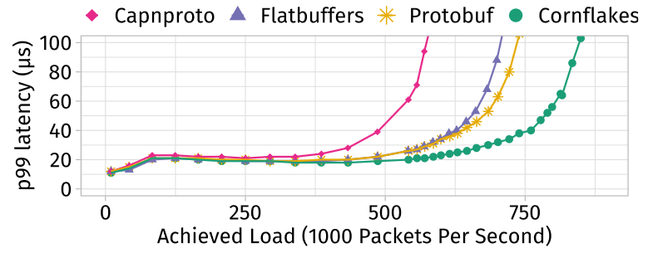
Evaluation
Comparison to software-only serialization
For small objects, Zero-copy is not useful
Cornflakes performs better on workloads with a mix of large objects
Google protobuf bytes size distribution
→ small object size
Twitter cache trace
→ large object size

Slide 23
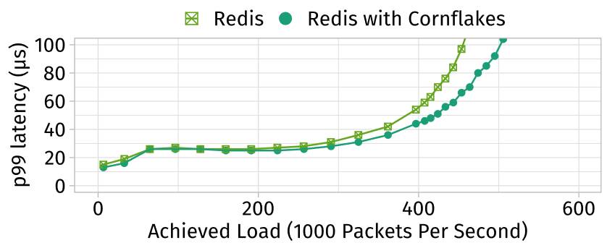
Evaluation
Redis integration
Redis is modified to use the Cornflakes UDP networking stack
Cornflakes can be integrated into existing systems to improve performance

Slide 24
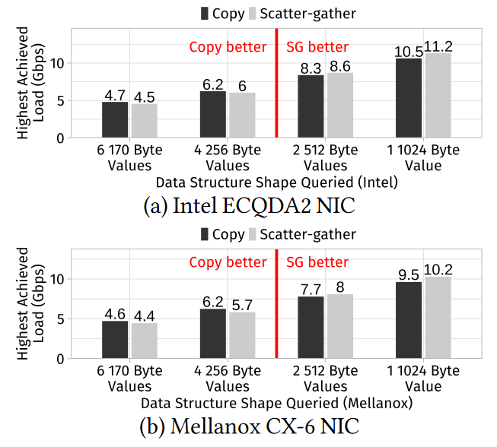
Evaluation
Generality across NICs
On both NICs, scatter-gather outperforms copy when values are 512-bytes or larger

Slide 25
Evaluation
Cornflakes overhead
Breaks down the average cycles for different parts of request handling
Cornflakes avoids a copy into the serialization data structure during “Set Value”
Average cycles
Notes:
deserialization 시간: cornflake는 키필드에 액세스 할 때까지 문자열 키 필드에대한 utf-8검증을 연기하기 때문에 더 짧다.

Slide 26
Limitation
Memory safety
Cornflakes does not prevent the application from modifying memory during sends
Static zero-copy threshold
Threshold could change dynamically based on the current memory bandwidth pressure
Allocation of pinned memory
Applications must modify all I/O allocation sites to use a specific pinned memory allocator that allocates DMAsafe memory

Slide 27
Conclusion
Cornflakes is a microsecond-scale serialization library that use NIC scatter-gather to eliminate in-memory copy
It uses thresholds to choose between copy and zero-copy, matching traditional libraries performance for small data and exceeding them for large data
Cornflakes can be efficiently integrated into existing systems and implemented for multiple NICs

Slide 28
Thank you

