Slide 1
Ginex: SSD-enabled billion-scale graph neural network training on a single machine via provably optimal in-memory caching
Yeonhong Park, Sunhong Min, and Jae W. Lee.
VLDB ’22
2024.12.03
Presentation by Suhwan Shin, Boseung Kim
sshshin@dankook.ac.kr, bskim1102@dankook.ac.kr

Slide 2
About GNNs
GNN
A neural network designed to process and analyze graph-structured data
Graph consists of nodes (entities) and edges (relationships)
GNN aim to produce a quality embedding for each node in the graph
Embeddings capture structural and relational information in the graph.
Key tasks: Node classification, recommendation system, link prediction
Nodes
Edges
Graph structured data
Notes:
Each node has its own feature

Slide 3
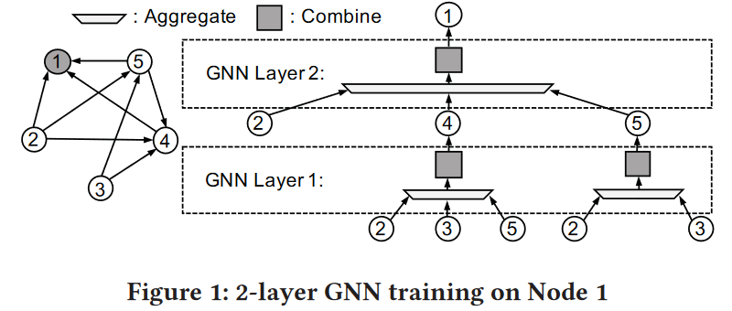
About GNNs
GNN Training
Each GNN layer synthesizes the features of neighboring nodes to update the seed node
Two main steps in each layer
Aggregate: Collects features from neighboring nodes to capture local graph information
Combine: Applies non-linear transformations and updates the node embedding
Seed node of layer2

Slide 4
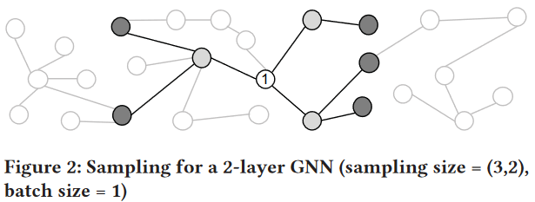
About GNNs
Neighborhood Sampling
Collecting neighborhood leads to exponential growth of memory footprint
→ Selecting subset of neighborhood

Slide 5
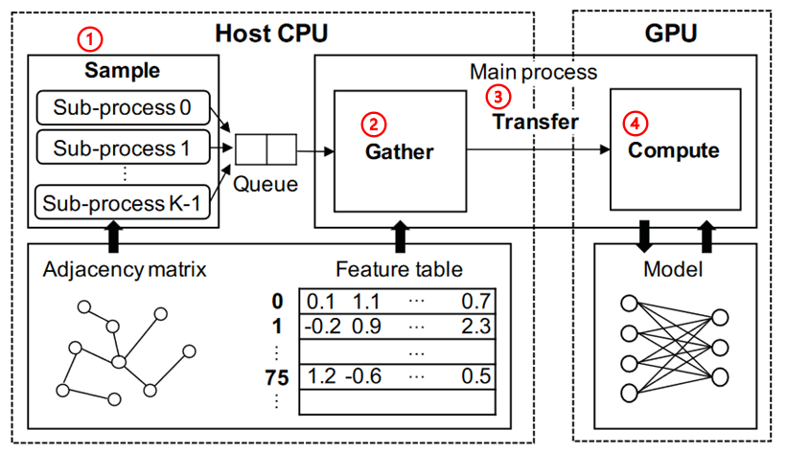
About GNNs
GNN Training System
Sample: Sampling seed nodes and neighbors based on a graph structure
Gather: Collect feature vectors of sampled nodes into a buffer
Transfer: Sending collected data to the GPU
Compute: Perform operations including aggregate and combine

Slide 6
Challenges for Large-Scale Graphs
GNN training
During training, the target node and its neighboring nodes are both involved in the learning process
While loading the entire graph into memory can improve training efficiency, it is often impractical
➔ As graph sizes grow to hundreds of GB, memory limitations cause significant bottlenecks

Slide 7
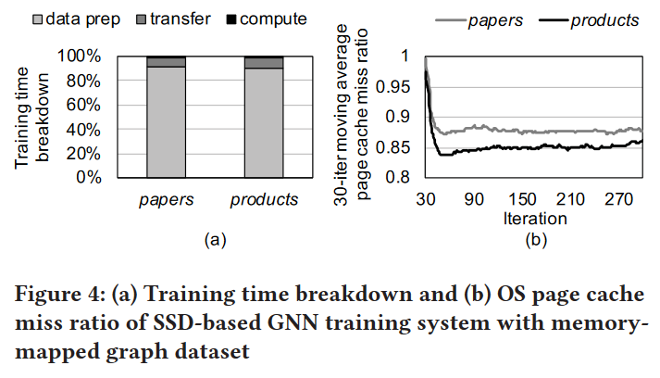
Challenges in Disk-based GNN Training
Disk-based GNN training
Disk-based GNN training has emerged to handle the limitations of large-scale graphs
However, solely relying on disk storage introduces inefficiencies, particularly in the sample and gather stages
High percentage of data prep

Slide 8
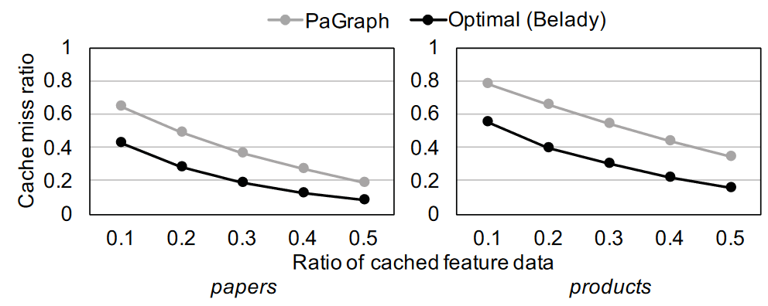
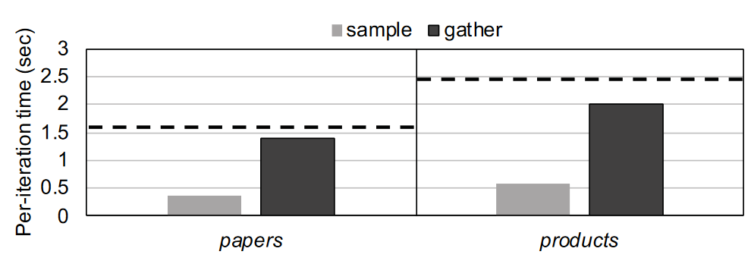
Challenges in Disk-based GNN Training
Disk-based GNN training
Challenge 1: Sub-optimal In-memory Cache
Challenge 2: Sub-optimal Pipeline
Notes:
Sub-optimal In-memory Cache
Problem: Inefficient caching leads to high cache miss ratios.
Observation: Optimal caching (Belady) significantly outperforms current methods (PaGraph).
Sub-optimal Pipeline
Problem: Inefficiencies in sample and gather stages dominate iteration time.
Observation: Per-iteration time is significantly longer than optimal, especially for larger datasets.

Slide 9
Ginex Design
Ginex (Graph inspector-executor)
System for efficient training large scale GNN by using SSD
For sample and gather operation, reduce I/O traffic by utilizing main memory as application-specific in-memory cache
Rearrangement of the training pipeline for optimal caching

Slide 10
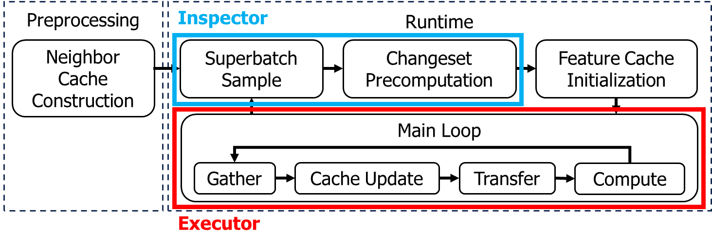
Ginex Design
Ginex
Inspector-Executor Execution Model
Inspector: Collect information that is available only at runtime
Executor: Utilizes this runtime information to optimize data layout
Enabling optimal management of the feature cache

Slide 11
Ginex Training Pipeline
Neighbor Cache Construction
Ginex uses a static neighbor cache
To make neighbor cache, Ginex examines the graph structure and picks out important nodes
This neighbor cache is saved to SSD and would be loaded at the next step
→ Avoid the repeated cost of constructing the neighbor cache

Slide 12
Ginex Training Pipeline
Superbatch Sample
Load the neighbor cache from preprocessing
Sampling is started for as many as the superbatch size S
Two-types of sampling results are written to SSD, ids and adj
ids: all the sampled nodes’ IDs
adj: Data structure that describes the connectivity among the sampled node
Notes:
superbatch: Ginex performs sampling for a predefined number of batches

Slide 13
Ginex Training Pipeline
Changeset Precomputation
Instead of computing chageset in gather(main loop), Ginex precomputes changeset by examining ids
Two-types of precomputation results are written to SSD, init and update
init: cache initialization status
update: cache update for every S iteration
Notes:
Changeset: which feature vectors to insert and which ones to evict from the feature cache

Slide 14
Ginex Training Pipeline
Feature Cache Initialization
Ginex reads the previously created init files and constructs the feature cache
Building an address table that will be used for cache look-up

Slide 15
Ginex Training Pipeline
Main Loop
All remaining GNN training operations(gather, transfer, compute) are performed iteratively
Cache Update
Ginex reads a set of ids, adj and update file
Using the ids file, Ginex gathers feature vectors and updates the cache based on the update file
Ginex sends the prepared batch input and adj to the GPU for training

Slide 16
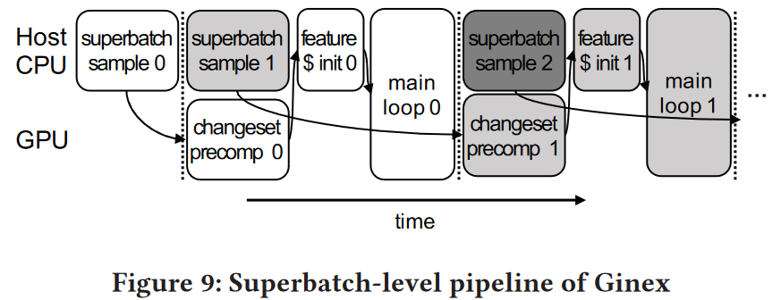
Ginex Training Pipeline
Superbatch-level Pipeline
Jobs for different superbatches can be pipelined
Changeset precomputation and superbatch sample of next superbatch are executed in parallel
Successfully hides most of the changeset precomputation overhead

Slide 17
Ginex Design
Neighbor Cache
By caching part of neighbor in memory, Ginex reduces the number of I/O
Neighbor cache takes node ID as input and return list of neighbors of target node

Slide 18
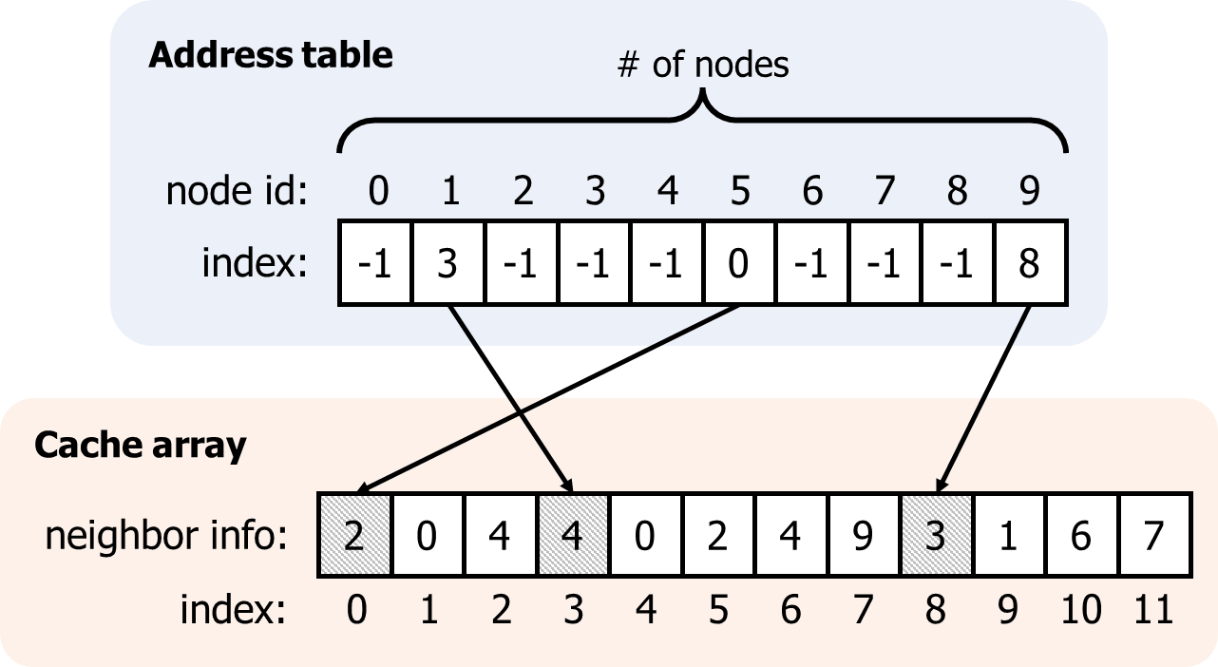
Ginex Design
Neighbor cache structure
Address table: Contains indexes to look up in the cache array
Cache array: Contains number of neighbors and neighbor nodes’ ID

Slide 19
Ginex Design
Feature Cache
Adopts the optimal Belady’s algorithm
Belady’s algorithm evicts data with the longest reuse distance at every timestep
The whole superbatch are available at the time of gather, Ginex has the knowledge of future data access
Changeset precomputation result
in_ids : IDs of inserted nodes for each iteration
out_ids : IDs of evicted nodes for each iteration
in_positions : Positions of the nodes in in_ids

Slide 20
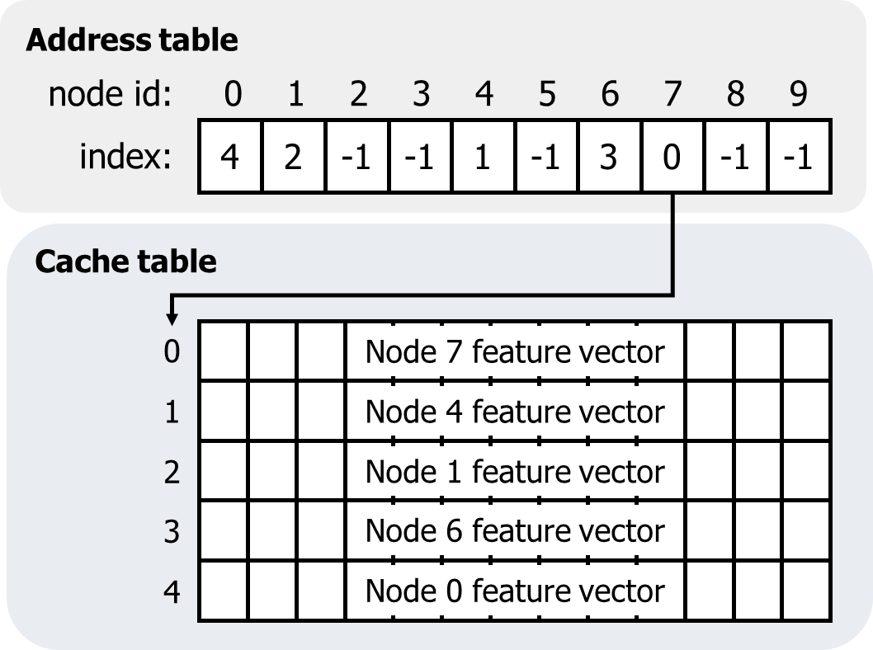
Ginex Design
Feature Cache Structure
2-D array whose row length equals the feature vector size
Elements in the address table contain the row index of the cache array

Slide 21
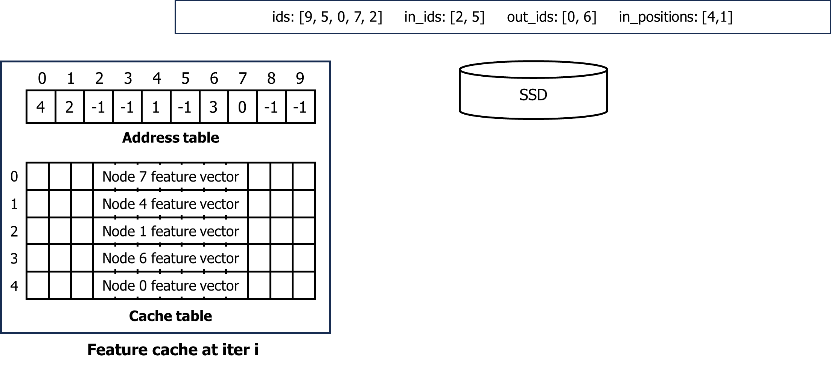
Ginex Design
Feature Cache
The process of cache update followed by gather using an example
The total number of nodes are 10, and five of them are cached

Slide 22
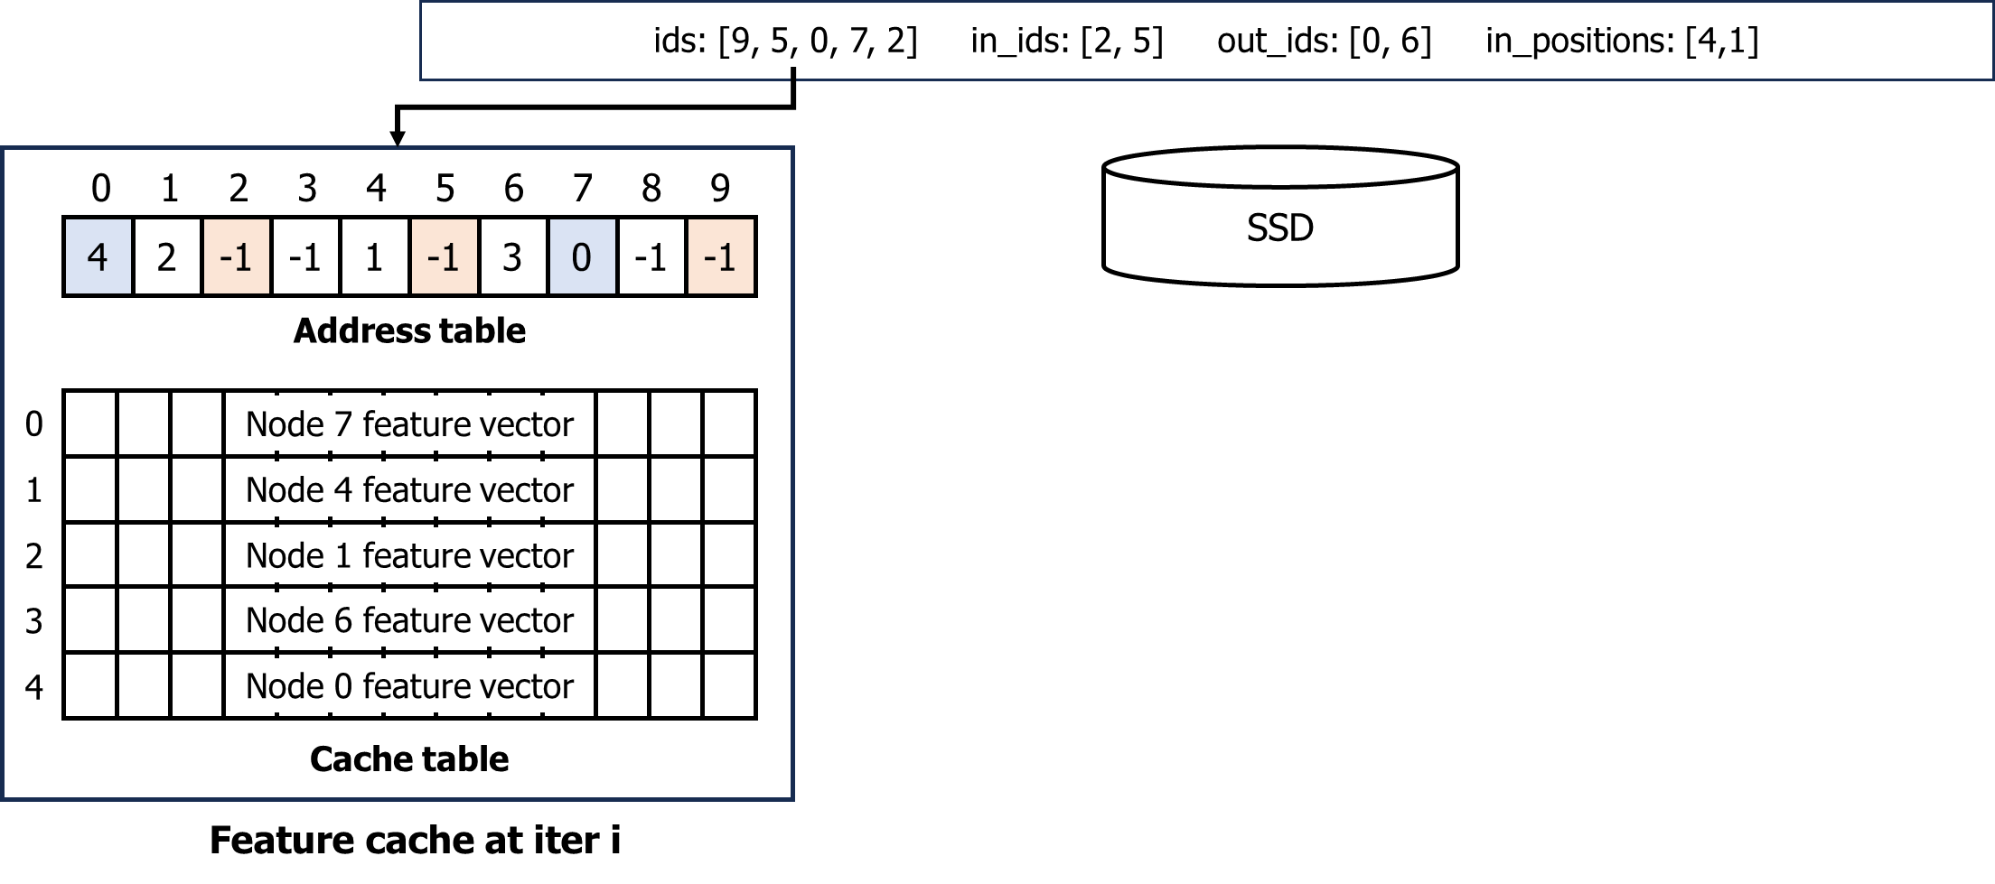
Ginex Design
Feature Cache
1. Check address table for nodes in ids

Slide 23
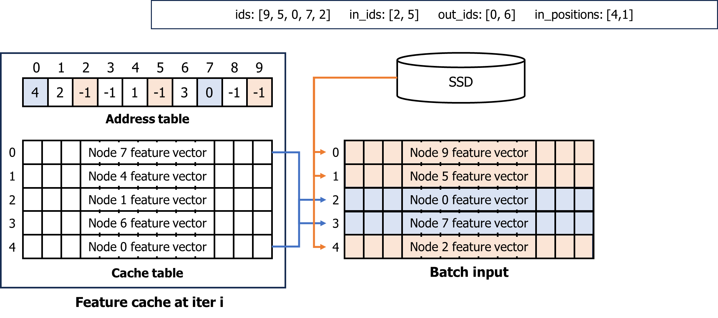
Ginex Design
Feature Cache
2. The feature vectors of the nodes present in the cache (0 and 7) are fetched from the cache, while the others (2, 5 and 9) are read from SSD

Slide 24
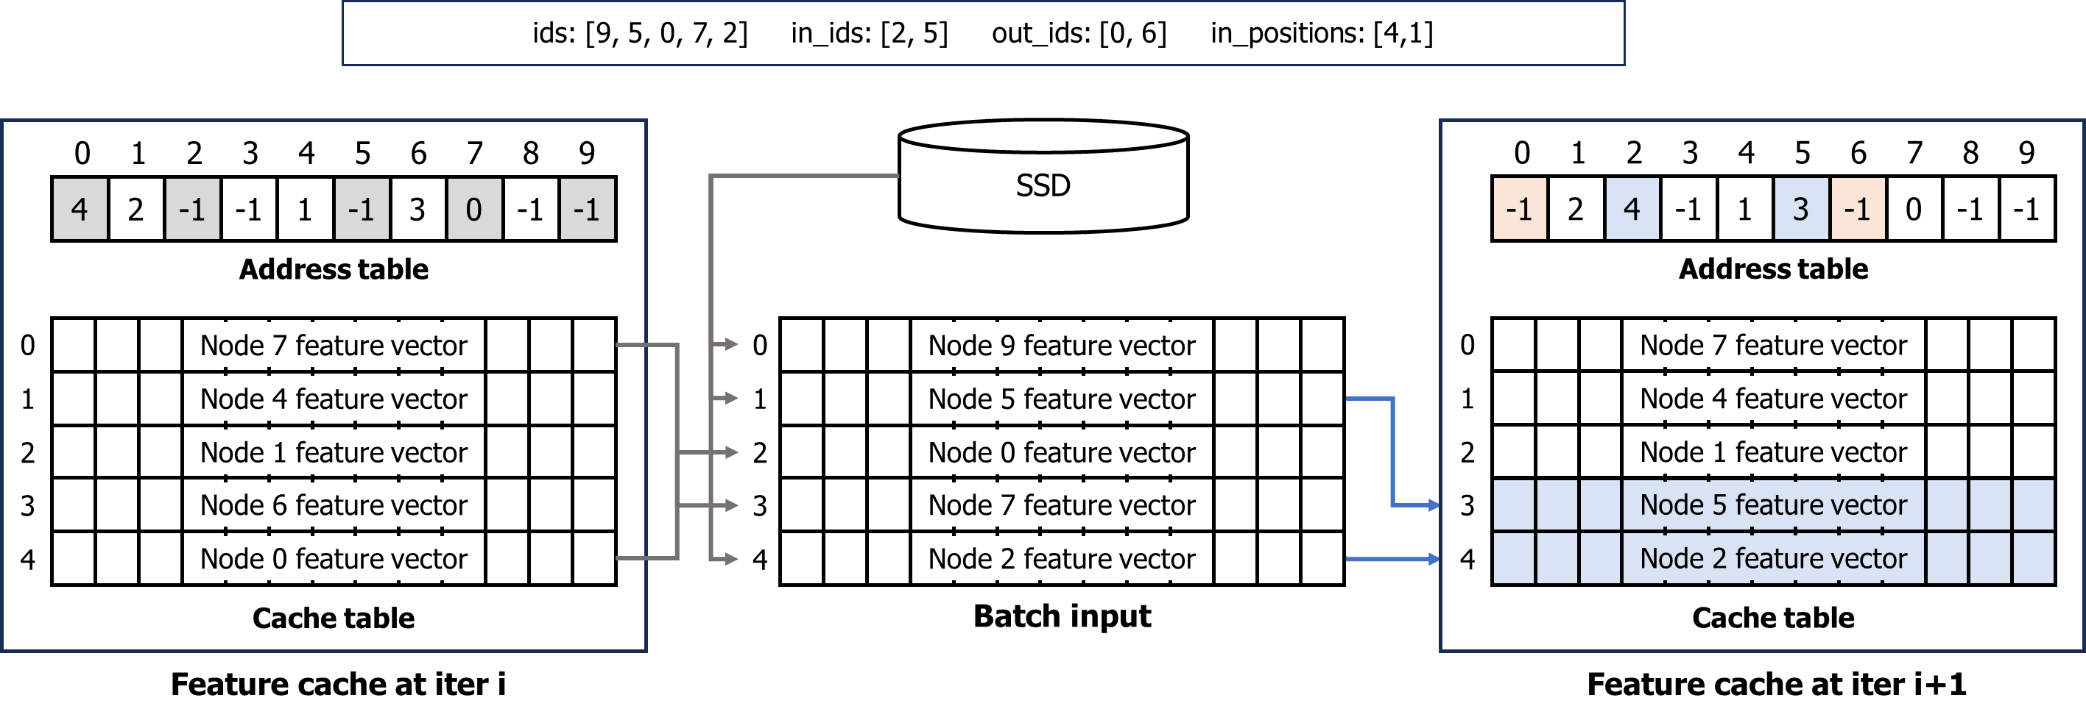
Ginex Design
Feature Cache
3. Ginex performs cache update by referring to in_ids, out_ids and in_positions

Slide 25
Ginex Design
Changeset Precomputation Algorithm
Changeset can be obtained by comparing the difference between the two consecutive cache status
$C_{i}$: Cache state at iteration $i$, $union(C_{i},ids_i)$: potential candidates to be included in $C_{i+1}$
$f_{Belady}$: Selects the elements in the given list, prioritizing those that are to be accessed earlier than others

Slide 26
Ginex Design
Changeset Precomputation Algorithm
Data structure for tracking next access iterations
ids_0
[3,4]
ids_1
[4,2]
ids_2
[0,3]
ids_3
[0,4]
ids_4
[3,0]
Access trace:
iteration
0
1
2
3
4
0
0 | 0 | 1 | 1 | 1
0 | 0 | 0 | 0 | 0
0 | 1 | 0 | 0 | 0
1 | 0 | 1 | 0 | 1
1 | 1 | 0 | 1 | 0
1
node ID
2
3
4

Slide 27
Ginex Design
Changeset Precomputation Algorithm
Data structure for tracking next access iterations
ids_0
[3,4]
ids_1
[4,2]
ids_2
[0,3]
ids_3
[0,4]
ids_4
[3,0]
Access trace:
iteration
0
1
2
3
4
0
0 | 0 | 1 | 1 | 1
0 | 0 | 0 | 0 | 0
0 | 1 | 0 | 0 | 0
1 | 0 | 1 | 0 | 1
1 | 1 | 0 | 1 | 0
1
node ID
2
3
4

Slide 28
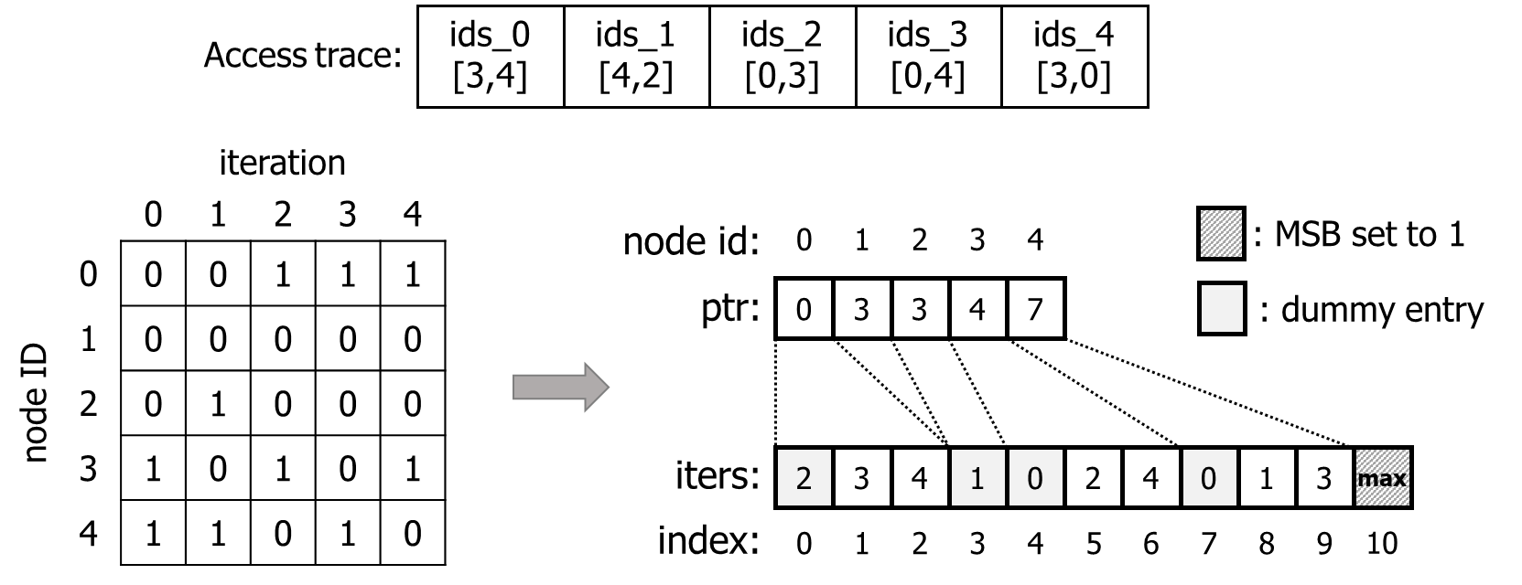
Ginex Design
Changeset Precomputation Algorithm
Data structure for tracking next access iterations

Slide 29
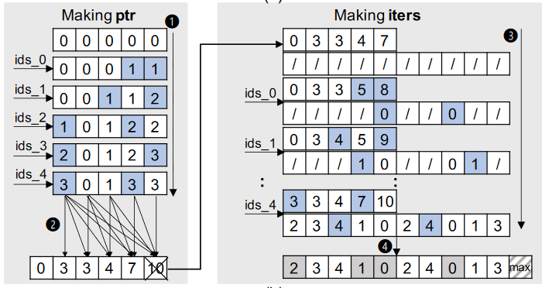
Ginex Design
Changeset Precomputation Algorithm
Construction of data structure(ptr, iters) requires two passes over the access traces

Slide 30
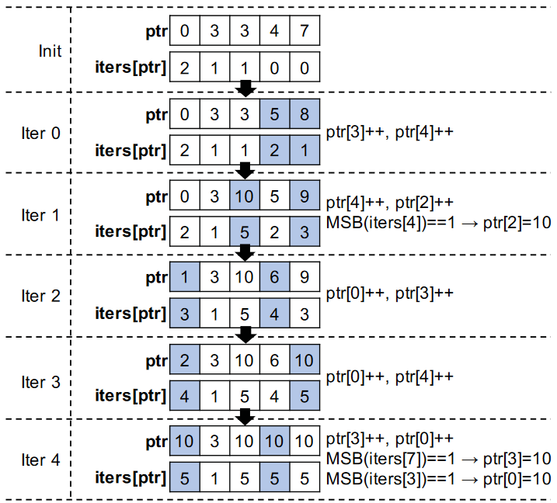
Ginex Design
Changeset Precomputation Algorithm
Ginex updates ptr for each iteration in a way that it can always find out the next accessed iterations of all nodes by looking at the elements in iters pointed by ptr.

Slide 31
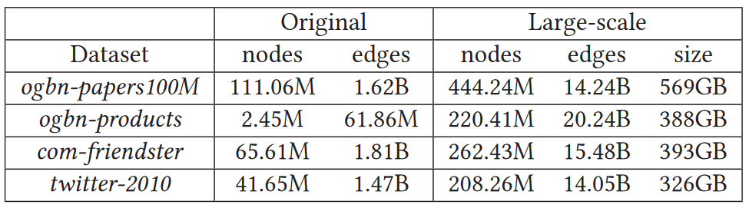
Evaluation
Model: 3-layer GraphSAGE, 2-layer GCN
Comparison baseline
PyG+
Ali+PG
Methodology
System Configuration
Dataset
Using graph expansion technique

Slide 32
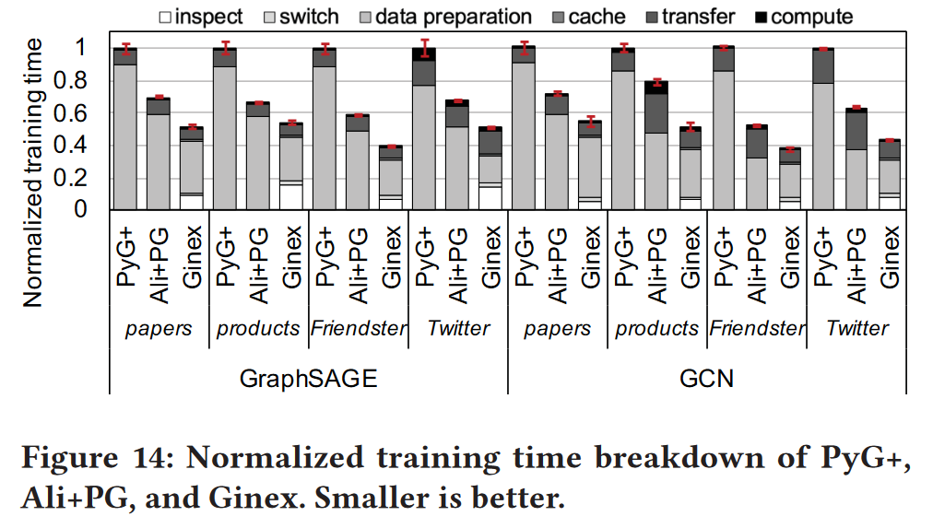
Evaluation
Overall Performance
PyG+, Ali+PG can be breakdown into data preparation, transfer, compute
Ginex has three more components: inspect, switch, cache
Ginex is 1.8-2.6× and 1.2-1.5× faster than PyG+ and Ali+PG

Slide 33
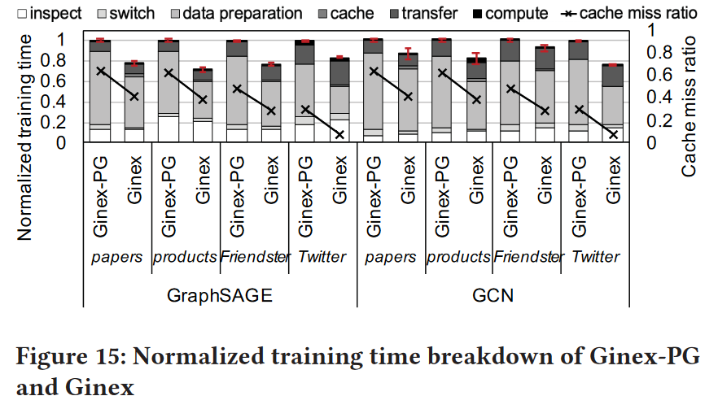
Evaluation
Impact of Cache Policy
Ginex-PG: Cache policy replaced by PaGraph
Ginex consistently demonstrates significantly lower miss ratio

Slide 34
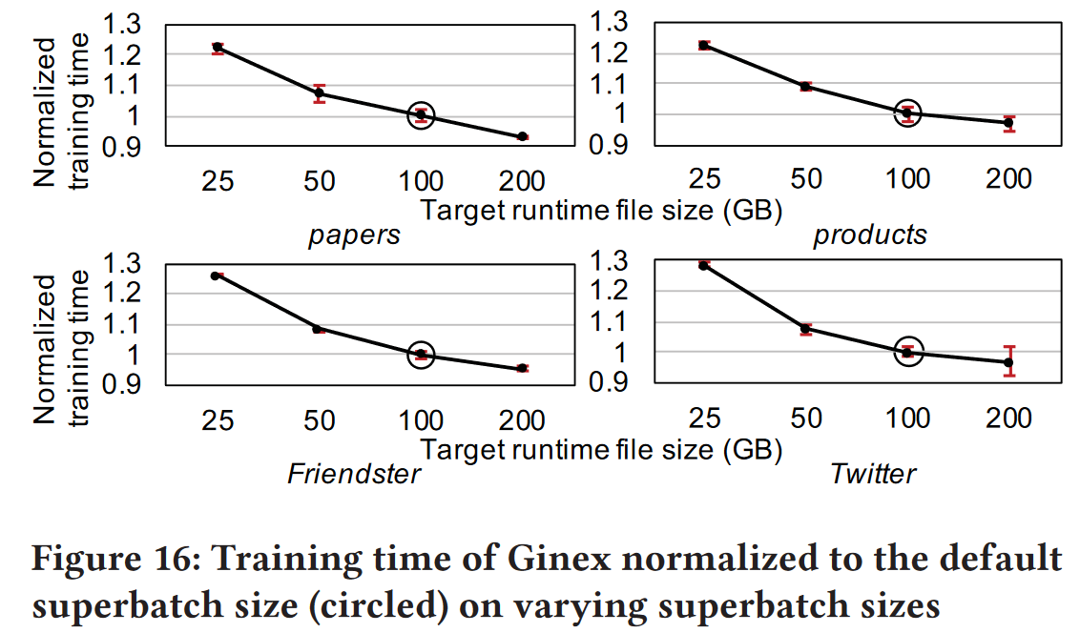
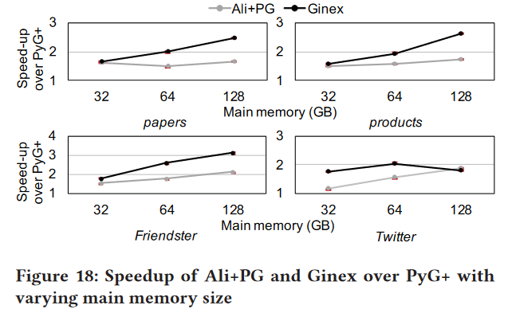
Evaluation
Sensitivity Study
Impact of Superbatch Size
Impact of Memory Size

Slide 35
Conclusion
Key Challenges
Training GNNs is challenging due to the large size of real-world graph datasets, which often exceed main memory capacity
Proposed
This paper introduces Ginex, an SSD-based GNN training system capable of handling billion-scale graph datasets on a single machine
Ginex reconstructs the training pipeline to implement an optimal caching system for feature vectors, effectively mitigating the I/O bottleneck
Results
Ginex enables scalable GNN training while achieving significant speedups compared to existing state-of-the-art methods

Slide 36
Thank you! Q&A?

