Slide 1
Storage Abstractions for SSDs: The Past, Present, and Future
X. Zhang., J. Bhimani., S. Pei., E.J. Lee., S.J. Lee., Y.J. Yoon., E.J. Kim., C.H. Choi., E.H. Nam., J.M. Choi., B.S. Kim. ATC’23 Syracuse University, Florida International University, Samsung Semiconductor Inc, Soongsil University, DGIST, FADU Inc, Dankook University
2024. 12. 17
Presentation by Yeojin Oh and Nakyeong Kim
oyj5420@dankook.ac.kr nkkim@dankook.ac.kr

Slide 2
Introduction
Background
Block Layer
Communication Protocol
SSD
Abstraction Enhancement (4)
Future
Conclusion

Slide 3
Introduction
Storage Abstraction
Modern computers use abstractions for interoperability between host and peripherals
SSD different from HDD
Not mechanical device, but electrical
Out-of-place updates (garbage collection necessity)
Internal parallelism
High internal bandwidth
SSD need new enhancement abstraction
Not provide method to reduce GC overhead with host-SSD coord
Data transfer between host and SSD pose limitation of utilization
Tr. storage abstraction see storage in units of sectors
Host
2. Issue request
1. Expose address range
4. Return result
bottleneck
Storage
3. Execute operation

Slide 4
Introduction
Categories
Extending block abstraction with host-SSD hints
TRIM
Multi-stream
Flexible Data Placement
Enhancing host-level control over SSDs
Open-channel SSD
Zoned Namespaces SSD
Offloading host-level management to SSDs
Key-value SSD
Computational storage
Making SSDs byte-addressable
Use in CXL

Slide 5
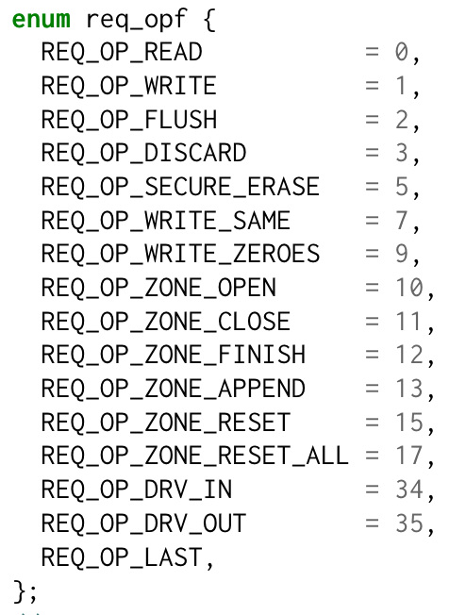
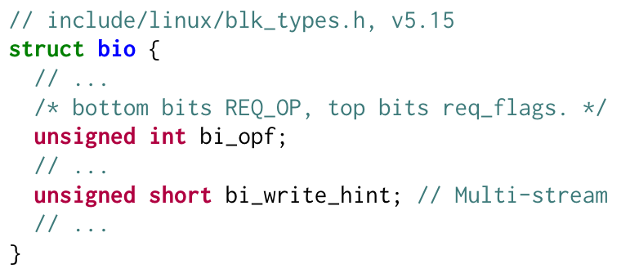
Background
OS
Communication
Block Layer
SSD
Most storage expose their capacity to OS and support 2 operations: read & write
Bio serve unifying interface between OS and various types of storage device
From first version(only two read/write tasks in 2001), many improvements were made by 2021
To provide optional hint for improved I/O, introduced discard operation (TRIM)
Added Multi-stream and Zoned Namespaces enhancements
Allowed multi-queue design (blk-mq), scaling with # of host CPU cores
v6.12.4 (latest)

Slide 6
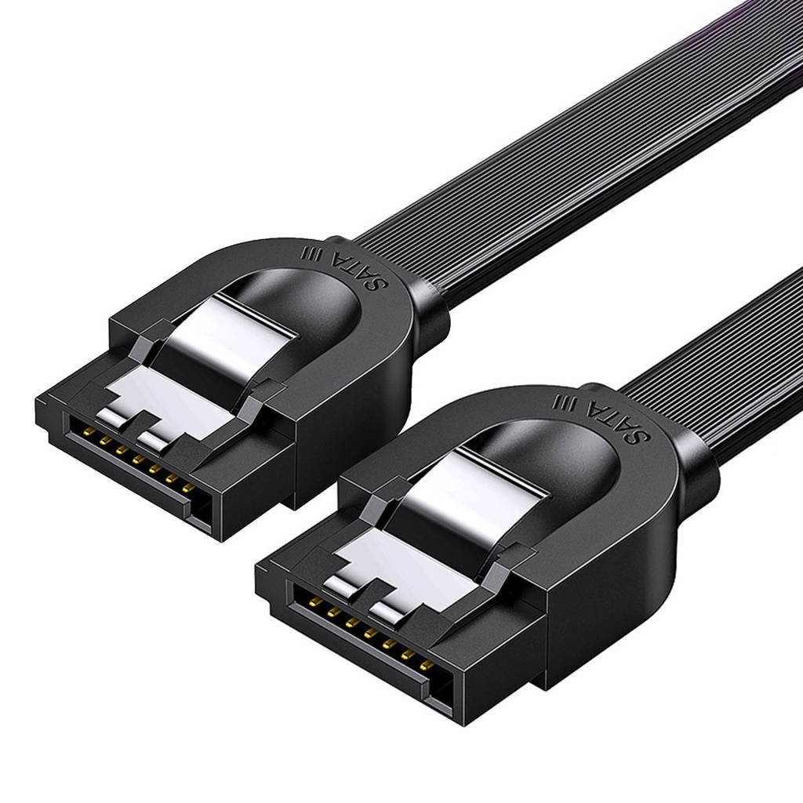
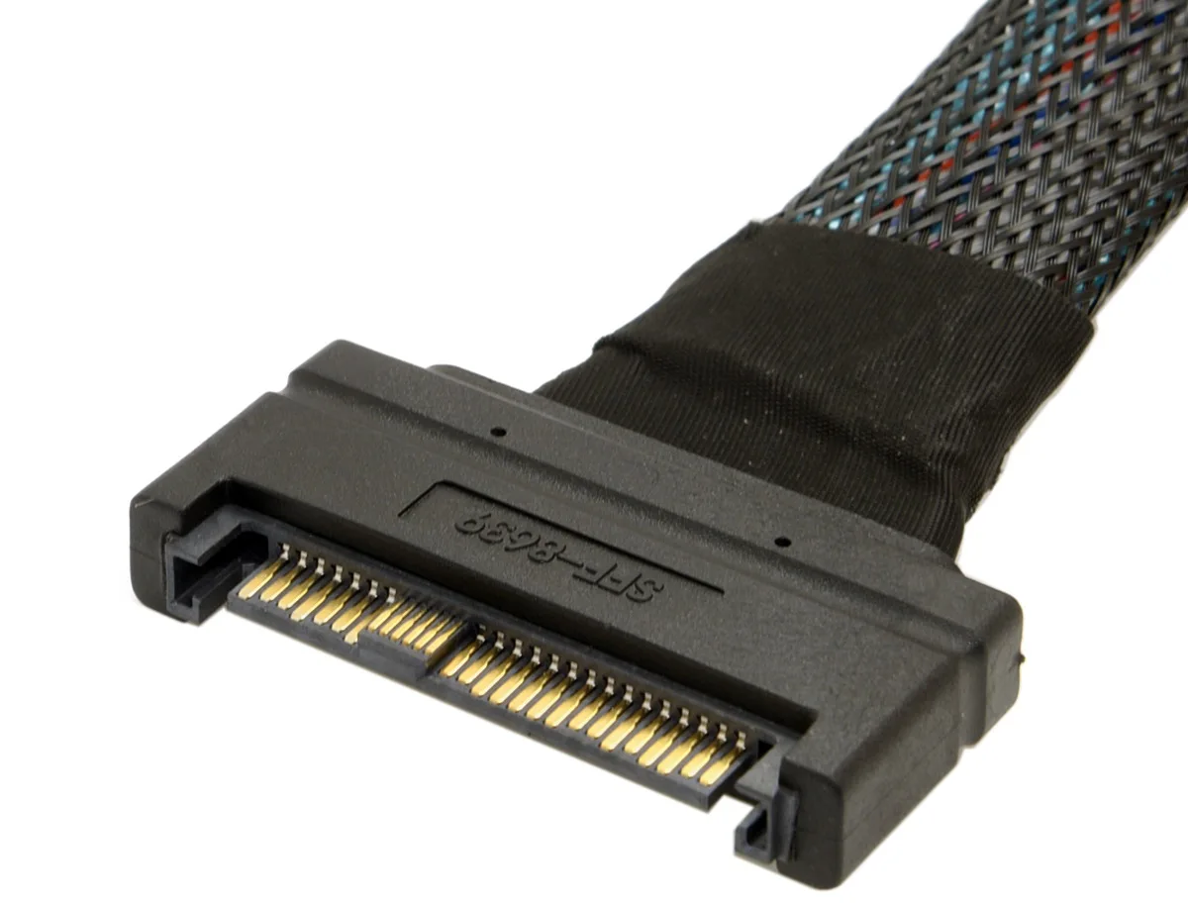
Background
OS
Communication
Communication Protocols
SSD
Host and SSD must communicate in same language
SATA (Serial AT Attachment, 2001)
Serve as high-speed serial link replacement for PATA of storage devices
3 major versions: 1.0, 2.0 and 3.0 (improved transfer speed)
SATA 3 is bounded with maximum transfer speed of 6GB/s
NVMe (NVM Express, 2011)
Utilize PCIe as underlying bus interface
Achieve about 1GB/s with one single PCIe 3.0 lane (~ 16GB/s with 16 lanes)
De facto standard for SSDs, at present time

Slide 7
Background
OS
Communication
SSD
SSD
The smallest unit of read/write is page, while reclaim(erase) unit is block
Exploit internal parallelism by grouping erase blocks from each chip into superblock
Any valid data in victim block will be relocated → write amplification
Internal data movement (via GC) cause long tail latency
Reducing GC overhead is main goal of SSD research
Chip
Host
Interface
Logic
Die0
Block
Processor
Flash
Controller
Ch0
A
Die1
…
Superblock 0
Superblock 15
Buffer Manager
Die6
Ch3
Die7

Slide 8
Background
OS
Communication
SSD
SSD
The smallest unit of read/write is page, while reclaim(erase) unit is block
Exploit internal parallelism by grouping erase blocks from each chip into superblock
Any valid data in victim block will be relocated → write amplification
Internal data movement (via GC) cause long tail latency
Reducing GC overhead is main goal of SSD research
Chip
Host
Interface
Logic
Die0
Block
Processor
Flash
Controller
Ch0
A
B
Die1
…
Superblock 0
Superblock 15
Buffer Manager
Die6
Ch3
Die7

Slide 9
Background
OS
Communication
SSD
SSD
The smallest unit of read/write is page, while reclaim(erase) unit is block
Exploit internal parallelism by grouping erase blocks from each chip into superblock
Any valid data in victim block will be relocated → write amplification
Internal data movement (via GC) cause long tail latency
Reducing GC overhead is main goal of SSD research
Chip
Host
Interface
Logic
Die0
Block
Processor
Flash
Controller
Ch0
A
B
A
Die1
…
Superblock 0
Superblock 15
Buffer Manager
Die6
Ch3
Die7

Slide 10
Background
OS
Communication
SSD
SSD
The smallest unit of read/write is page, while reclaim(erase) unit is block
Exploit internal parallelism by grouping erase blocks from each chip into superblock
Any valid data in victim block will be relocated → write amplification
Internal data movement (via GC) cause long tail latency
Reducing GC overhead is main goal of SSD research
Chip
Host
Interface
Logic
Die0
Block
Processor
Flash
Controller
Ch0
X
B
A
Die1
…
Superblock 0
Superblock 15
Buffer Manager
Die6
Ch3
Die7

Slide 11
Background
OS
Communication
SSD
SSD
The smallest unit of read/write is page, while reclaim(erase) unit is block
Exploit internal parallelism by grouping erase blocks from each chip into superblock
Any valid data in victim block will be relocated → write amplification
Internal data movement (via GC) cause long tail latency
Reducing GC overhead is main goal of SSD research
Chip
Host
Interface
Logic
Die0
Victim Block
Processor
Flash
Controller
Ch0
X
X
A
B
X
X
X
C
Die1
…
Superblock 0
Superblock 15
Buffer Manager
Die6
Ch3
Die7

Slide 12
Background
OS
Communication
SSD
SSD
The smallest unit of read/write is page, while reclaim(erase) unit is block
Exploit internal parallelism by grouping erase blocks from each chip into superblock
Any valid data in victim block will be relocated → write amplification
Internal data movement (via GC) cause long tail latency
Reducing GC overhead is main goal of SSD research
Chip
Erase
Host
Interface
Logic
Die0
Victim Block
Processor
Flash
Controller
Ch0
X
X
A
B
X
X
X
C
A
B
C
Die1
…
Superblock 0
Superblock 15
Buffer Manager
Die6
Ch3
Die7
Copy valid pages to new block

Slide 13
Background
OS
Communication
SSD
SSD
The smallest unit of read/write is page, while reclaim(erase) unit is block
Exploit internal parallelism by grouping erase blocks from each chip into superblock
Any valid data in victim block will be relocated → write amplification
Internal data movement (via GC) cause long tail latency
Reducing GC overhead is main goal of SSD research
Chip
Host
Interface
Logic
Die0
Processor
Flash
Controller
Ch0
A
B
C
Die1
…
Superblock 0
Superblock 15
Buffer Manager
Die6
Ch3
Die7

Slide 14
Abstraction Enhancement
1) Extending Block Abstraction with Host-SSD Hints
Provide hints to SSD from host
Define hints as optional data entry field that SSD can utilize or ignore
Discard / TRIM
Multi-Stream
Flexible Data Placement

Slide 15
Abstraction Enhancement
1) Extending Block Abstraction with Host-SSD Hints
Discard / TRIM
When user delete data, FS mark logical page as invalid → remain in SSD
Host notice SSD which logical address contains invalid data due to overwrites
Reduce # of relocated valid pages in GC
Simple but effective → Most modern OS and storage protocols adopt
Filled | Filled | Filled
Filled | Filled | Filled
Filled | Filled | Filled
Free | Free | Free
Filled | Filled | Filled
Filled | Filled | Filled
Filled | Filled | Filled
Free | Free | Free
OS Logical Page Table
SSD Physical Page Table

Slide 16
Abstraction Enhancement
1) Extending Block Abstraction with Host-SSD Hints
Discard / TRIM
When user delete data, FS mark logical page as invalid → remain in SSD
Host notice SSD which logical address contains invalid data due to overwrites
Reduce # of relocated valid pages in GC
Simple but effective → Most modern OS and storage protocols adopt
Just mark as tombstone
Filled | Filled | Filled
Filled | Filled | Filled
Filled | Deleted | Deleted
Free | Free | Free
Filled | Filled | Filled
Filled | Filled | Filled
Filled | Filled | Filled
Free | Free | Free
OS Logical Page Table
SSD Physical Page Table

Slide 17
Abstraction Enhancement
1) Extending Block Abstraction with Host-SSD Hints
Discard / TRIM
When user delete data, FS mark logical page as invalid → remain in SSD
Host notice SSD which logical address contains invalid data due to overwrites
Reduce # of relocated valid pages in GC
Simple but effective → Most modern OS and storage protocols adopt
Filled | Filled | Filled
Filled | Filled | Filled
Filled | Deleted | Deleted
Free | Free | Free
Filled | Filled | Filled
Filled | Filled | Filled
Filled | Invalid | Invalid
Free | Free | Free
TRIM
OS Logical Page Table
SSD Physical Page Table

Slide 18
Abstraction Enhancement
1) Extending Block Abstraction with Host-SSD Hints
Multi-Stream
Allow hosts to inform SSD physical placement preference of different data
Similar characteristics may be invalidated at the same time → decrease WAF
Different stream hints ensure different superblocks
Supported by Linux kernel since v4.13-rc and NVMe 1.3
Require manual assignment of stream IDs → need to rewrite application
Stream 0 (Hot)
Stream 1 (Warm)
Stream 2 (Cold)
Mixed
A1
A1
B1
B2
B2
C1
C2
C3
C4
A1
A1
B1
B2
B2
B1
C1
C2
C3
C4
Need to copy valid pages (WA!)

Slide 19
Abstraction Enhancement
1) Extending Block Abstraction with Host-SSD Hints
Multi-Stream
AutoStream provide ability to automatically assign stream IDs
vStream propose virtual streams that different sources can have their own stream
StoneNeedle and ML-DT apply ML algorithms on assigning stream IDs
Linux kernel(v5.18-rc1) removed Multi-stream support in bio layer and NVMe driver due to low adoption of vendor
It is possible to see some schemes built for Multi-stream SSDs appear in ZNS

Slide 20
Abstraction Enhancement
- RU: Reclaim Unit
- RUH: Reclaim Unit Handle
1) Extending Block Abstraction with Host-SSD Hints
Namespace
FDP
Considered an enhanced version of Multi-stream, but more flexible
Provide ability for hosts configure GC unit based on capability of SSD by providing list of possible FDP configuration
GC unit granularity can be as small as single erase block or as big as superblock
Provide statistics and events related to GC to host → learn about SSD internal states
New NVMe version support FDP formally
Index | RU Handle ID
0 | 0
1 | 2
2 | 3
RUH0 | RUH1 | RUH2 | RUH3
Reclaim Group
RU0
RU0
RU1
RU2
RU2
RU3
RU3

Slide 21
Abstraction Enhancement
1) Extending Block Abstraction with Host-SSD Hints
FDP
WARCIP provide feedback about GC to host; host dynamically merge and split streams
PLAN improve performance by dynamically assigning superblocks with different sizes based on write characteristics

Slide 22
Abstraction Enhancement
2) Enhancing Host Control Over SSD
Host has more control over SSD
Host take over responsibilities of SSD, like metadata management, write buffering and wear-leveling
Not compatible to tr. SSDs → code change required (in app, fs, or driver)
Open-Channel SSD
Zoned Namespaces SSD

Slide 23
Abstraction Enhancement
2) Enhancing Host Control Over SSD
Open Channel SSD
Created to provide transparent SSD from host point of view
Users can directly control placement onto desired channels
Place too much responsibility on developers
Applications have to be aware of existence of OC SSD
Developers have to manage most SSD responsibilities
Not adopted by industry and replaced by Zoned Namespaces

Slide 24
Abstraction Enhancement
2) Enhancing Host Control Over SSD
ZNS SSD
Expose superblocks as zones to host (limited compared to OC-SSD)
When handling write request, host have to choose zone to write to
Incoming data have to be sequentially appended to zone
Host have to manage GC
App0
App1
App2
ZNS Controller
Zone0
Zone1
Zone2

Slide 25
Abstraction Enhancement
2) Enhancing Host Control Over SSD
ZNS SSD
ZoneKV, CAZA and WALTZ combine KV store and ZNS SSD
DFZNSP identify zones mapped to same chips to prevent duplicate writes
eZNS assign zones into non-conflictable logical zones(v-zone), which can shrink or expand depanding on workload requirement
Persimmon implement ZNS native by modifying F2FS

Slide 26
Abstraction Enhancement
3) Offloading Host Responsibility to SSD
Reduce latency caused by I/O stack in OS (reducing number and sizes of I/O requests)
Prevent stacking logs on another layer of logs (integrating KV store with SSD)
Computational Storage on SSDs
Key-Value SSD

Slide 27
Abstraction Enhancement
3) Offloading Host Responsibility to SSD
Computational Storage on SSDs
SSD allow series of functions(tasklet) to be run on SSD and return result data to host
Tasklet can only be loaded to SSD internals offline
No industry standardization effort for tasklet disregarding of storage device
SmartSSD allow SSD to be programmed for different computational tasks
Target Hadoop MapReduce type of workload
YourSQL based on SmartSSD provide early filtering of SQL query results, which reduce # of I/O
Biscuit enhance ability of SmartSSD with dynamic task loading
GLIST and GenStore can be used in graph learning and genome sequence analysis in each

Slide 28
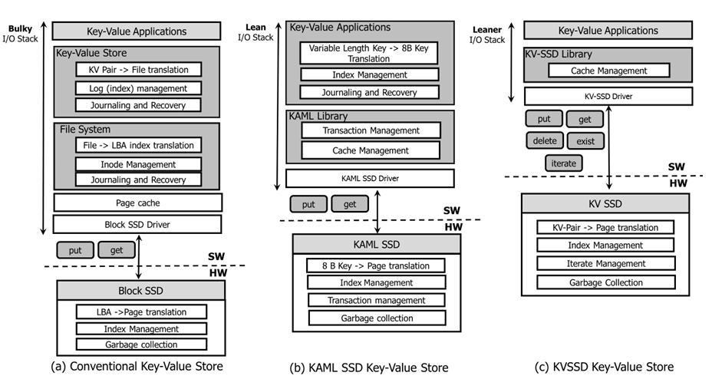
Abstraction Enhancement
3) Offloading Host Responsibility to SSD
Key-Value SSD
Provide key-value interface instead of block interface
KAML provide new key-value interface for SSD for removing semantic gaps: between kv-store, VFS and FTL
PinK improve performance by pinning to levels of LSM-trees
GPUKV allow direct access between GPU and KV-SSD for reducing I/O overhead
Semantic gap!
SYSTOR’19 Towards Building a High-Performance, Scale-In Key-Value Storage System

Slide 29
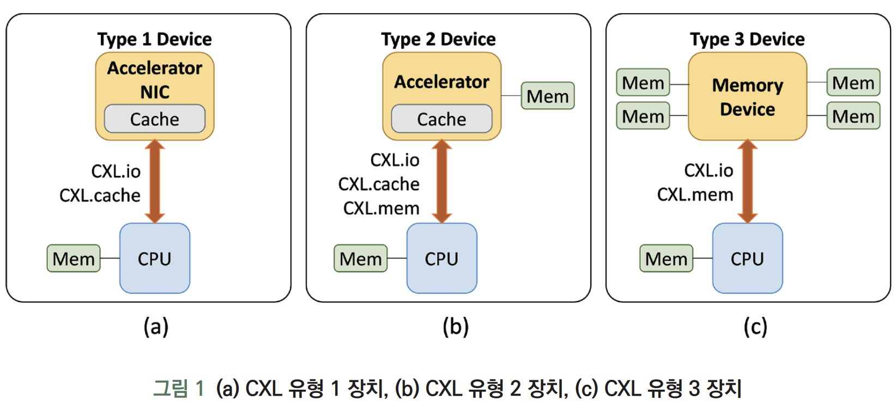
Abstraction Enhancement
https://ettrends.etri.re.kr/ettrends/206/0905206006
4) Byte-Addressable SSD
Use in CXL
CPU can directly use SSDs as part of memory system by accessing PCIe-attached SSDs
Mismatch of granularity can cause traffic amplification (memory: byte, SSD: block)
2B-SSD allow 2 different access granularities

Slide 30
Future
Storage abstraction should achieve balance of simplicity and configurability

Slide 31
Conclusion
Traditional storage abstractions have limitations that hinder performance and adaptability for modern storage systems like SSDs.
This survey categorizes and analyzes storage abstraction enhancements into four philosophical approaches, examining their history, relationships, and ecosystem impacts.
By comparing design concepts and implementation, it highlights key insights from industry and academia, addressing partially failed enhancements.
The study identifies future directions for research and development in storage abstraction, aiming to inspire advancements in SSD-focused storage systems.

Slide 32
Thank you!
2024. 12. 17
Presentation by Yeojin Oh and Nakyeong Kim
oyj5420@dankook.ac.kr nkkim@dankook.ac.kr

