Slide 1
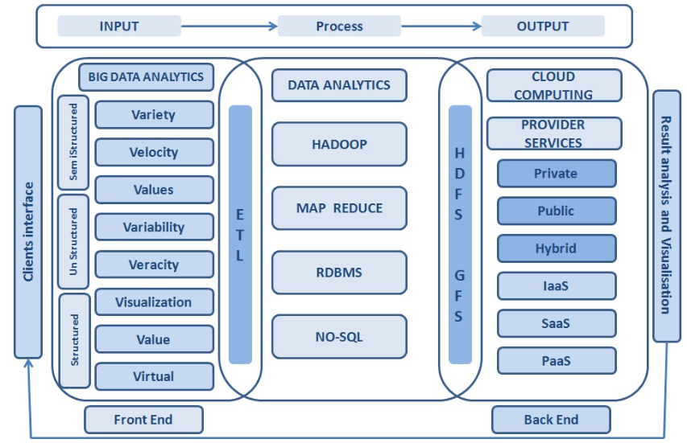
빅데이터 플랫폼과 클라우드 서비스 (Bigdata Platform and Cloud Service)
September 3, 2024
Jongmoo Choi
http://embedded.dankook.ac.kr/~choijm
Notes:
ETL: Extract, Transform, Load

Slide 2
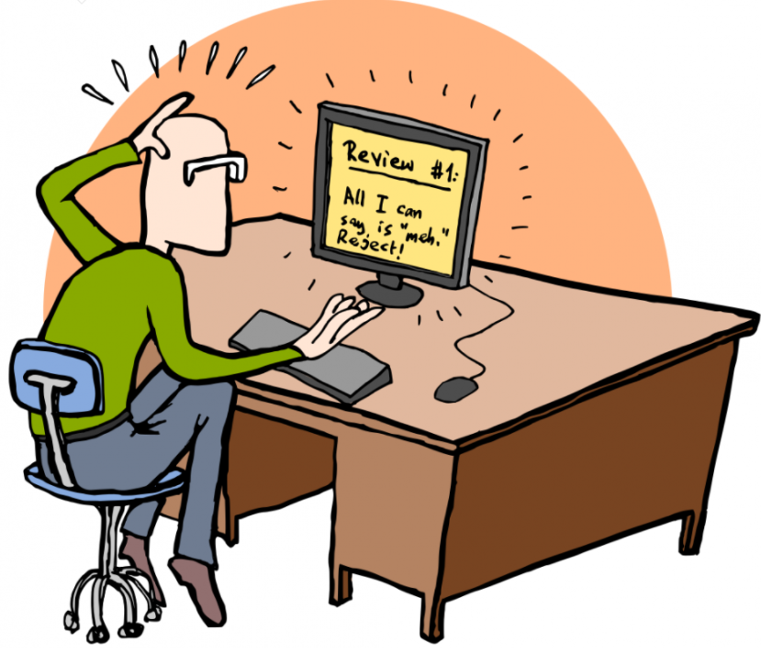
Course Objective
Understanding key concepts about Bigdata and Cloud
Bigdata: Unstructured, MapReduce, NoSQL, Next generation SSD, In-storage processing, Learned Index, …
Cloud: *aaS, Virtualization, Container, DNN pipeline, AI service, Disaggregation, Serverless, Sustainable, …
Based on research papers
Get accustomed to papers written in English
Grasp the general structure of a paper
How to review a paper?
Enhance presentation skill
Practice via actual presentations
How to discuss or argue?
Make our own paper
How to write a good paper?
Submit to a conference/journal (or mandatory?)
2

Slide 3
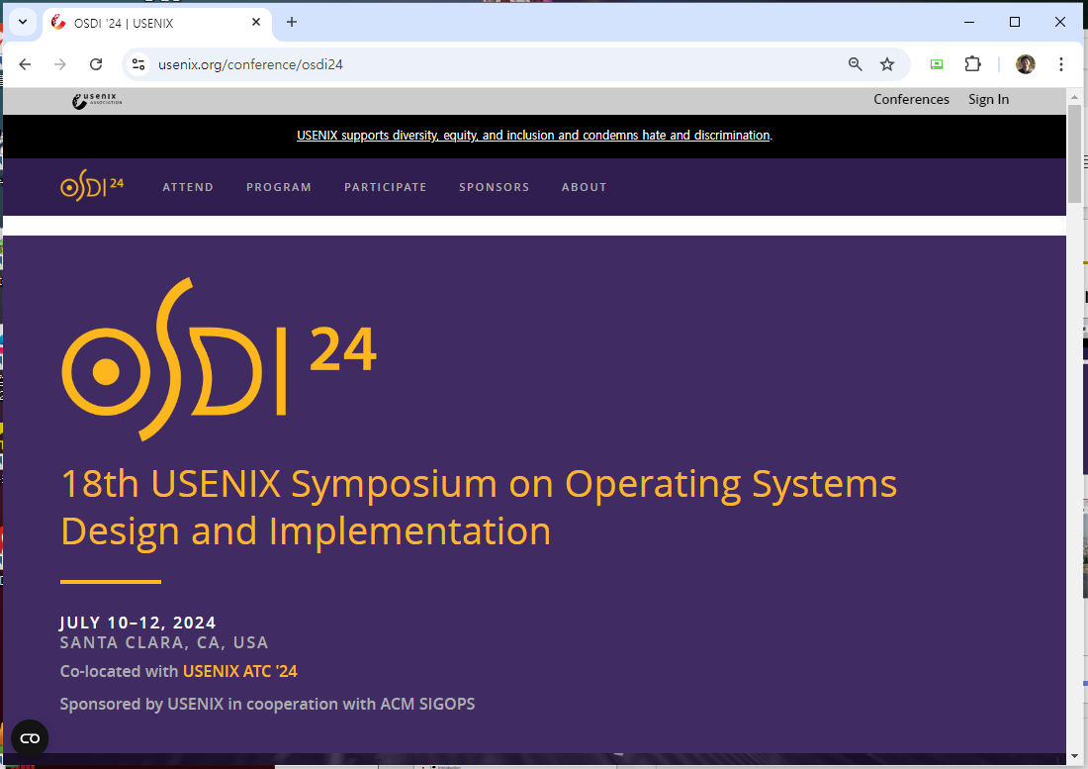
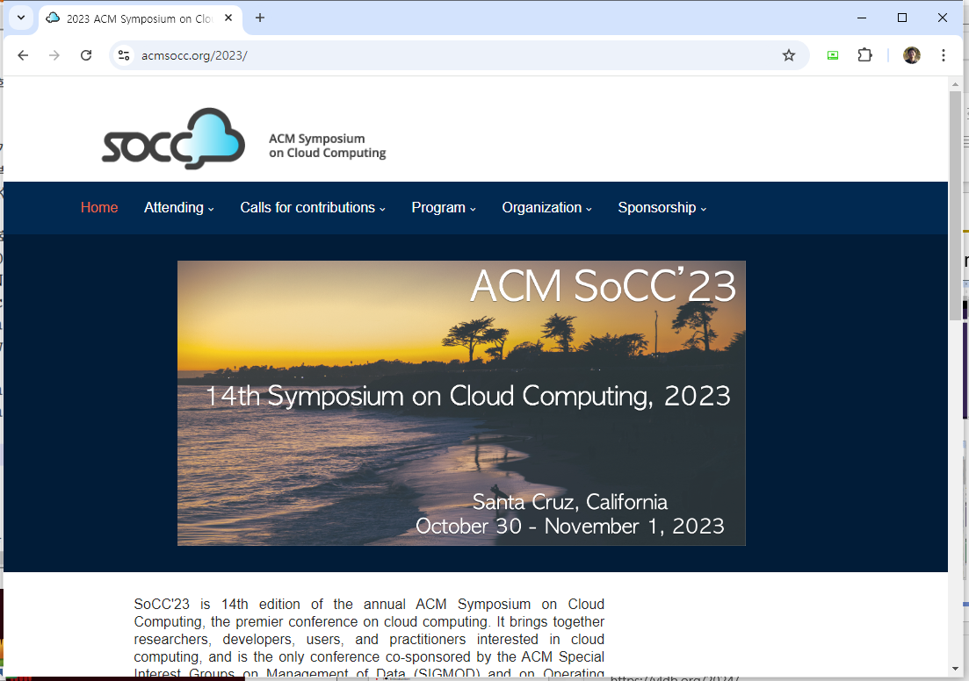
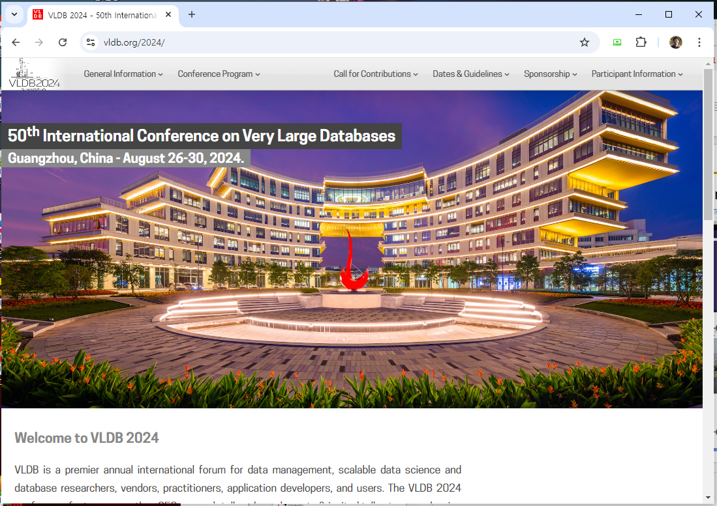
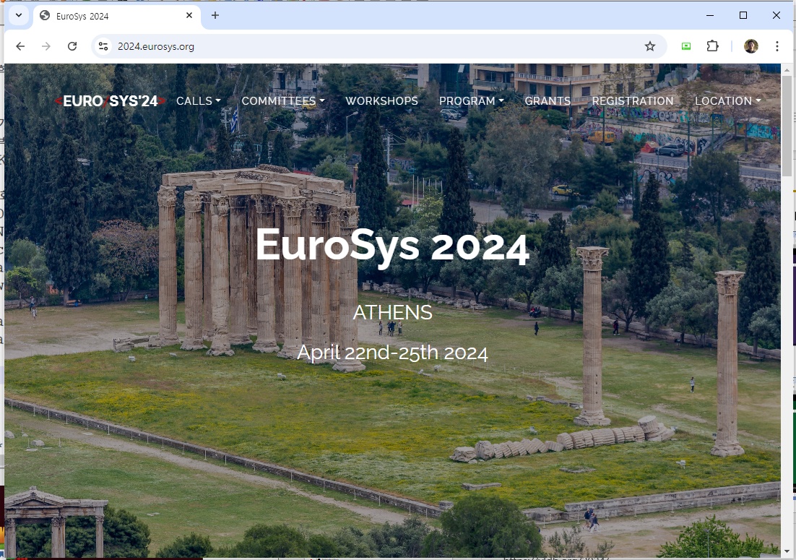
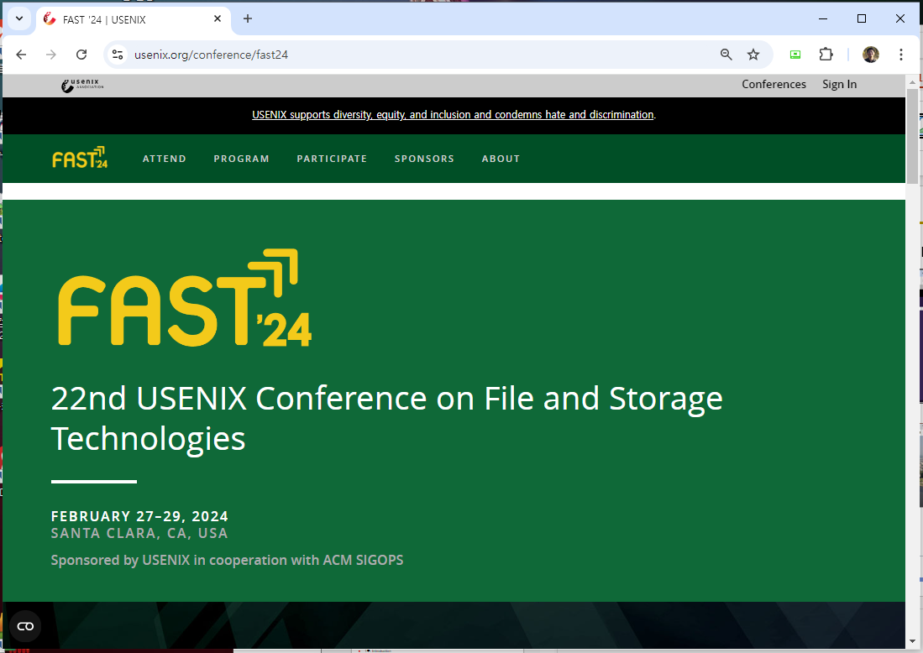
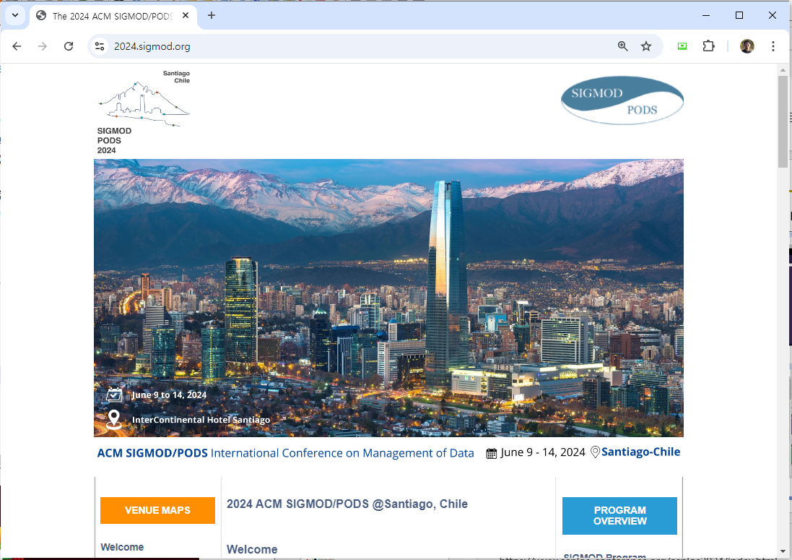
Course text
Where can you find papers?
From well-known journals and conferences
<OSDI>
<SoCC>
<VLDB>
<Eurosys>
<FAST>
<SIGMOD>
3
Notes:
https://www.usenix.org/conference/osdi24
https://acmsocc.org/2023/
https://www.asplos-conference.org/asplos2024/index.html
https://vldb.org/2024/
https://2024.eurosys.org/
https://2024.sigmod.org/

Slide 4
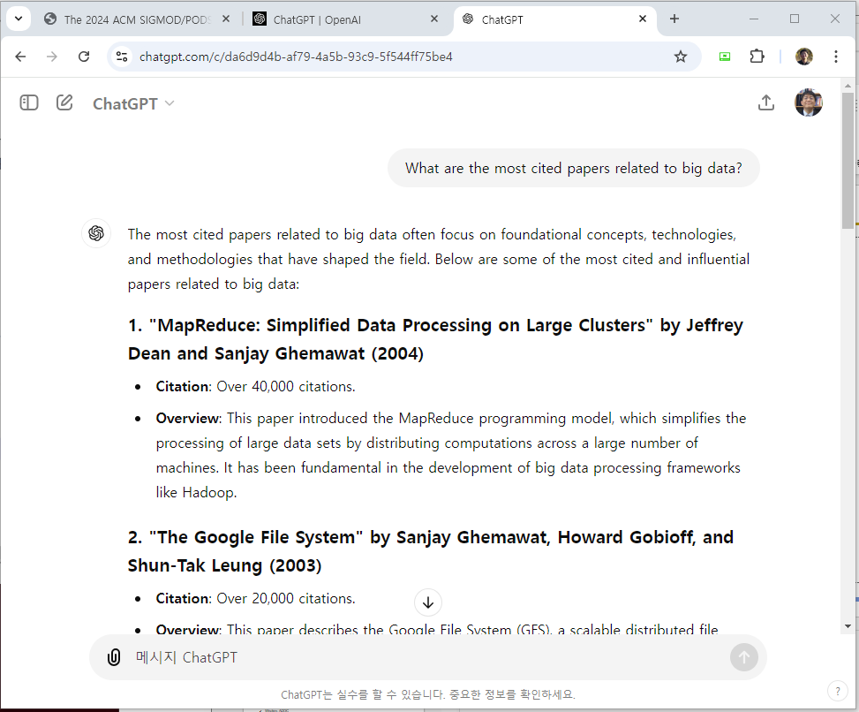
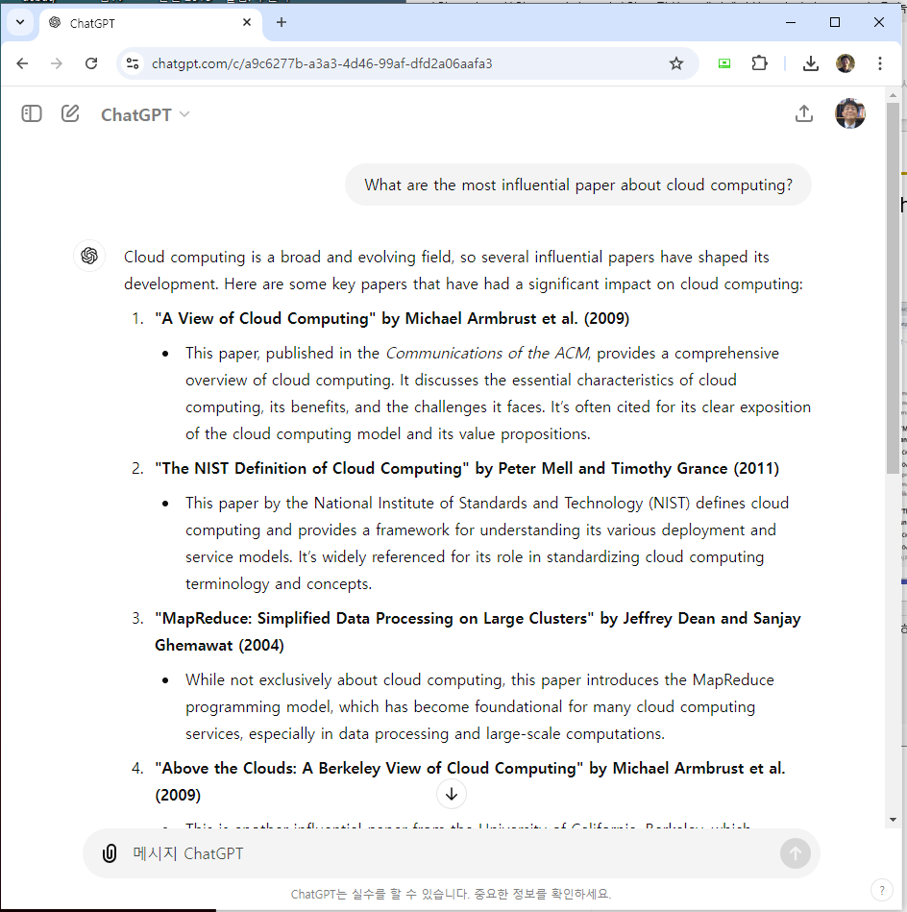
Course text
Where can you find papers?
From Experts
In this course: two selection criteria, either 1) most cited papers (more than 1000) or 2) recent published (after 2020 in Major Conf.)

Slide 5
Paper lists (Suggested)
1주. Introduction
강의 내용, 방법 소개, 팀 구성 (2인), 논문 선택 (5개 선택, 3개 발표)
2주. 빅데이터 기본
J. Dean et al., “MapReduce: Simplified Data Processing on Large Clusters”, OSDI’04.
S. Weil et al., “Ceph: A Scalable, High-Performance Distributed File System”, OSDI’06.
3주. 클라우드 기본
P. Barham et al., “Xen and the Art of Virtualization,” SOSP’03.
A. Verma et al., “Large-scale cluster management at Google with Borg”, Eurosys’15.
4주. DNN 프레임워크
M. Abadi et al., “TensorFlow: A System for Large-Scale Machine Learning”, OSDI’16.
D. Narayanan et al., “PipeDream: Generalized Pipeline Parallelism for DNN Training”, SOSP’19.
5주. Personal presentation + Feature embedding
Y. Jia et al., “Caffe: Convolutional Architecture for Fast Feature Embedding”, ACM MM’14.
ICE break (자기 소개) + Idea (연구 주제 아이디어 발표)
5
Notes:
17명 ➔ 연규 빼면 16/2 = 8팀, 매주 2번이면 2*12 = 24. 결국 8팀이 3번 발표하면 24번이 나옴

Slide 6
Paper lists (Suggested)
6주. 비정형 데이터를 위한 DB: 키-밸류 스토어
L. Lu et al., “WiscKey: Separating Keys from Values in SSD-conscious Storage”, FAST’16.
G. DeCandia et al, “Dynamo: Amazon’s Highly Available KVS”, SOSP’07.
7주. LLN
Ashish Vaswani et al., “Attention is All You Need”, NeurIPS’17.
Jacob Devlin et al.,“BERT: Pre-training of Deep Bidirectional Transformers for Language Understanding”, NAACL’19.
8주. 벡터 DB
J. Pan et al., “Survey of Vector Database Management Systems”, arxiv.org.
S.J. Subramanya et al., “DiskANN: Fast accurate billion-point nearest neighbor search on a single node”, NeurIPS’19.
9주. 클라우드 서비스 for AI
M. Chow et al., “ServiceLab: Preventing Tiny Performance Regressions at Hyperscale through Pre-Production Testing”, OSDI’24.
Y. Xiong et al., “SuperBench: Improving Cloud AI Infrastructure Reliability with Proactive Validation”, ATC’24.
10주. Personal presentation + Serialization
J. Jang et al., “A specialized architecture for object serialization with applications to big data analytics”, ISCA’20.
Related work (연구 주제에 대한 관련 연구) + Design (설계 내용)
6
Notes:
논문 배정: 2개씩: 12명 * 2개 = 24 = 2개*11주 + 1개*2주 + 0개*2주 (1주/15주)
논문 배정: 3개씩: 12명 * 3개 = 36 = 3개*11주 + 1개*2주 ➔ 한 학생은 2개가 되는군.

Slide 7
Paper lists (Suggested)
11주. 학습된 인덱스
M. Choi et al., “Can Learned Indexes be Built Efficiently? A Deep Dive into Sampling Trade-offs”, SIGMOD’24.
J. Wu et al., “Updatable Learned Index with Precise Positions”, VLDB’21.
12주. 학습된 인덱스 응용
S. Wang et al., “LearnedFTL: A Learning-Based Page-Level FTL for Reducing Double Reads in Flash-Based SSDs.”, HPCA’24.
Y. Dai et al., “From WiscKey to Bourbon: A Learned Index for Log-Structured Merge Trees”, OSDI’20.
13주. GNN
Y. Park et al., “Ginex: SSD-enabled Billion-scale Graph Neural Network Training on a Single Machine via Provably Optimal In-memory Caching”, VLDB’21.
F. Niu et al., “FlashGNN: An In-SSD Accelerator for GNN Training”, HPCA’24.
14주. New architecture
X. Zhang et al., “Storage Abstractions for SSDs: The Past, Present, and Future”, ACM ToS’24.
X. Luo et al., “SMART: A High-Performance Adaptive Radix Tree for Disaggregated Memory”, OSDI’23.
15주. Personal presentation
Evaluation (연구 주제에 대한 실험 내용) + Documentation (논문 형식. 예를 들어 정보과학회)
현재로는 시험 또는 과제 계획 없음 (논문 발표 및 개별 연구 발표에 집중)
7
Notes:
논문 배정: 2개씩: 12명 * 2개 = 24 = 2개*11주 + 1개*2주 + 0개*2주 (1주/15주)
논문 배정: 3개씩: 12명 * 3개 = 36 = 3개*11주 + 1개*2주 ➔ 한 학생은 2개가 되는군.

Slide 8
Paper lists (Candidates)
Recommended for reading
How to do research
Butler W. Lampson, “Hints for Computer System Design,” SOSP’83.
Research paper alternatives
W. Zhang et al., “What's the Story in EBS Glory: Evolutions and Lessons in Building Cloud Block Store”, FAST’24.
J. Mohan et al., “Analyzing and Mitigating Data Stalls in DNN Training”, VLDB’21.
Y. Kwon et al., "Coordinated and Efficient Huge Page Management with Ingens", OSDI'16.
S. Yang et al., "Overcoming the Memory Wall with CXL-Enabled SSDs, ATC'23.
F. Manco et al., "My VM is Lighter (and Safer) than your Container, SOSP'17.
S. Ghemawat et al., “The Google File System,” SOSP'03.
S. Choi et al., "EnvPipe: Performance-preserving DNN Training Framework for Saving Energy", ATC’23.
C. Wang et al., "SEPH: Scalable, Efficient, and Predictable Hashing on Persistent Memory", OSDI'23.
Yang et al., "GL-Cache: Group-level learning for efficient and high-performance caching", FAST’23.
B. Kim et al., "Design Tradeoffs for SSD Reliability", FAST'19.
Zhong et al., "MadFS: Per-File Virtualization for Userspace Persistent Memory Filesystems", FAST'23.
M. Abdi et al. "Palette Load Balancing: Locality Hints for Serverless Functions", Eurosys'23.
O. Balmau et al, “SILK: Preventing Latency Spikes in Log-Structured Merge Key-Value Stores”, ATC'19.
Please let me know if you want to present other papers (major conf. & 2020 or later)
8

Slide 9
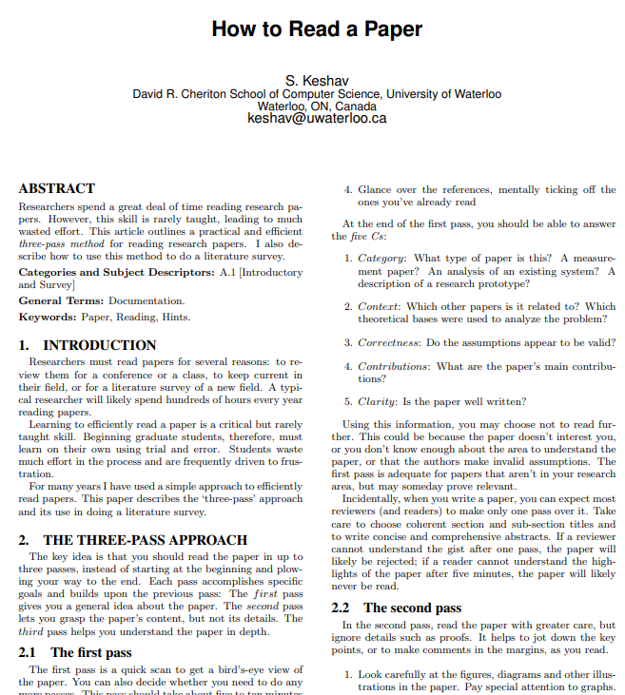
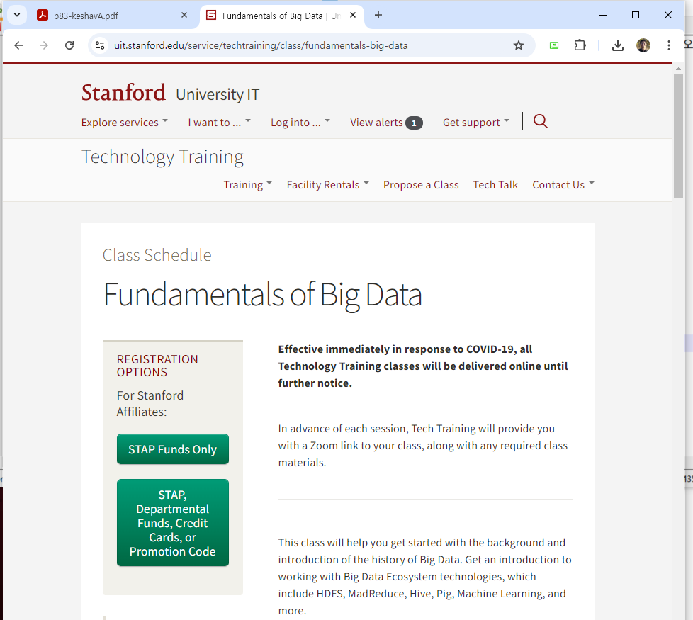
Papers about how to read/write a paper?
How to read a paper.
J. Eisner, “How to Read a Technical Paper”, https://www.cs.jhu.edu/~jason/advice/how-to-read-a-paper.html.
Roy Levin and David D. Redell, “How (and How Not) to Write a Good Systems Paper”, ACM Operating Systems Review, 1983.
J. Maletic, “How to Read and Evaluate Technical Papers”, http://www.cs.kent.edu/~jmaletic/howtoread.html.
S. Keshav, “How to read a paper”, http://ccr.sigcomm.org/online/files/p83-keshavA.pdf
Papers used in other universities
Advanced Cloud Computing, https://www.cs.cmu.edu/~15719/
Stanford Tech. Training for Big data, https://uit.stanford.edu/service/techtraining/class/fundamentals-big-data
Big data analytics, https://www.ee.columbia.edu/~cylin/course/bigdata/
Bigdata papers reading, https://github.com/thuva4/Bigdata-Papers-Reading
Advanced Topics in Cloud Computing, https://mobitec.ie.cuhk.edu.hk/cmsc5735/
9

Slide 10
Lecture details
Consists of three core components
1. Presentation
Per team (2 persons per a team)
3 times per a team
Less than 25 minutes
Q & A are quite important
2. Paper Review
Per person
Every week
3. Personal project
Per person
Write a paper
No examination
10

Slide 11
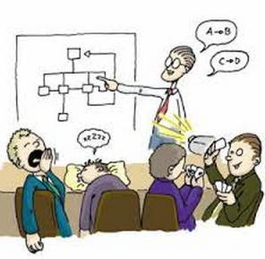
How to present
Presentation
Time
Presentation: 25 min, Q&A: 20 min
Slide
Less than 15 lines per each page
More than half pages must contain figures
Must include humor slides (if not, less points)
Must include references (if not, less points)
Each slide must be put in the lecture site (send it to choijm@dankook.ac.kr by Monday (previous day), 6pm)
Audience
Obligation of audience: at least one question per person a day
Without questions, you can not get a good grade.
Count the number of questions
11

Slide 12
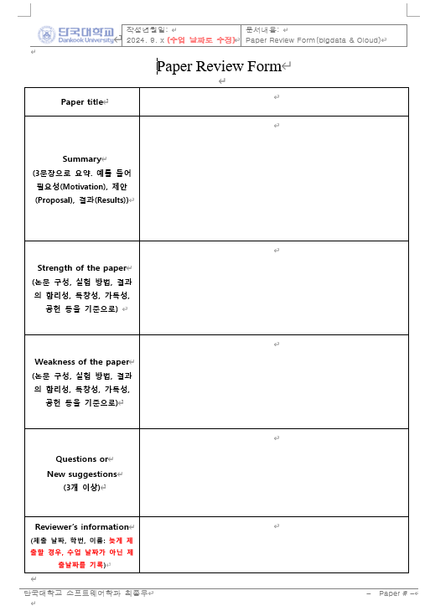
How to review a paper
Paper Review
All student must submit reviews about papers assigned to the corresponding week.
Format
Summary
3 sentences
Motivation, Proposal, Evaluation
Strength
What are positive things in this paper?
Weakness
What are the down sides of this paper?
Questions or Suggestions
At least 3
12

Slide 13
How to make a proposal
Personal project
1. Idea presentation (5 minutes)
Personnel introduction, Ice break
Research Idea (or Brainstorming)
2. Survey presentation and design (5 minutes)
Related work (prepare references in advance)
Design: 1) why, 2) how, 3) what are expected results
3. Final presentation (10 minutes)
Idea, Related work, Design, Evaluation results
Apply the idea learnt from your presentation
1) presentation (ppt), 2) paper (tex, hwp, word)
I strongly recommend to submit KCC or KSC or any conferences/workshops
13

Slide 14
Evaluation
Evaluation
Presentation(30%)
Questions and Answers (20%)
Paper review (30%)
Final proposal (20%)
14

Slide 15
Discussion
Make a team (recommend 2 persons)
Choose 5 papers in the suggested list and send your choices to me via email (choijm@dankook.ac.kr) until this Friday Monday (6th, September).
Need volunteers for next week (Bigdata basic papers).

