Slide 1

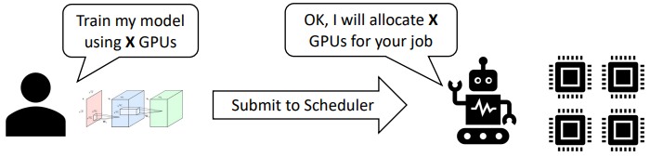
고급 운영체제론
(Advanced Operating Systems)
Dept. of Software
Dankook University
September 1, 2026
Jongmoo Choi
http://embedded.dankook.ac.kr/~choijm

Slide 2
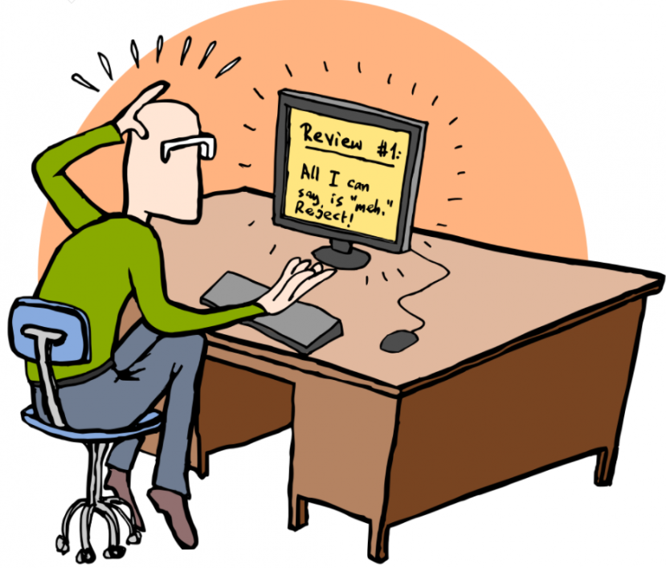
Course Objective
Understanding key concepts about advanced operating system, especially focusing on System SW for Bigdata.
  OS basic (scheduling, memory, file system) and advanced topics
  Fundamental Framework, Key-value store, SSD, LLM, VectorDB survey, …
  Vector Search, Learned index, Disaggregated, New Indexing, …
Get accustomed to papers written in English
  Grasp the general structure of a paper
  How to review a paper?
Enhance presentation skill
  Practice via actual presentations
  How to discuss or argue?
Make our own paper
  How to write a good paper?
  Submit to a conference/journal (or mandatory?)
2

Slide 3
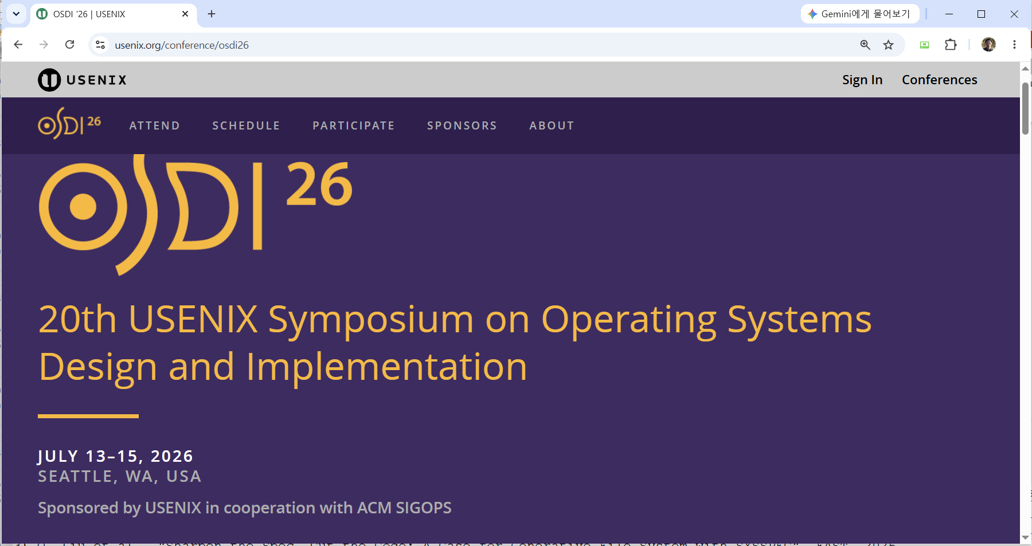
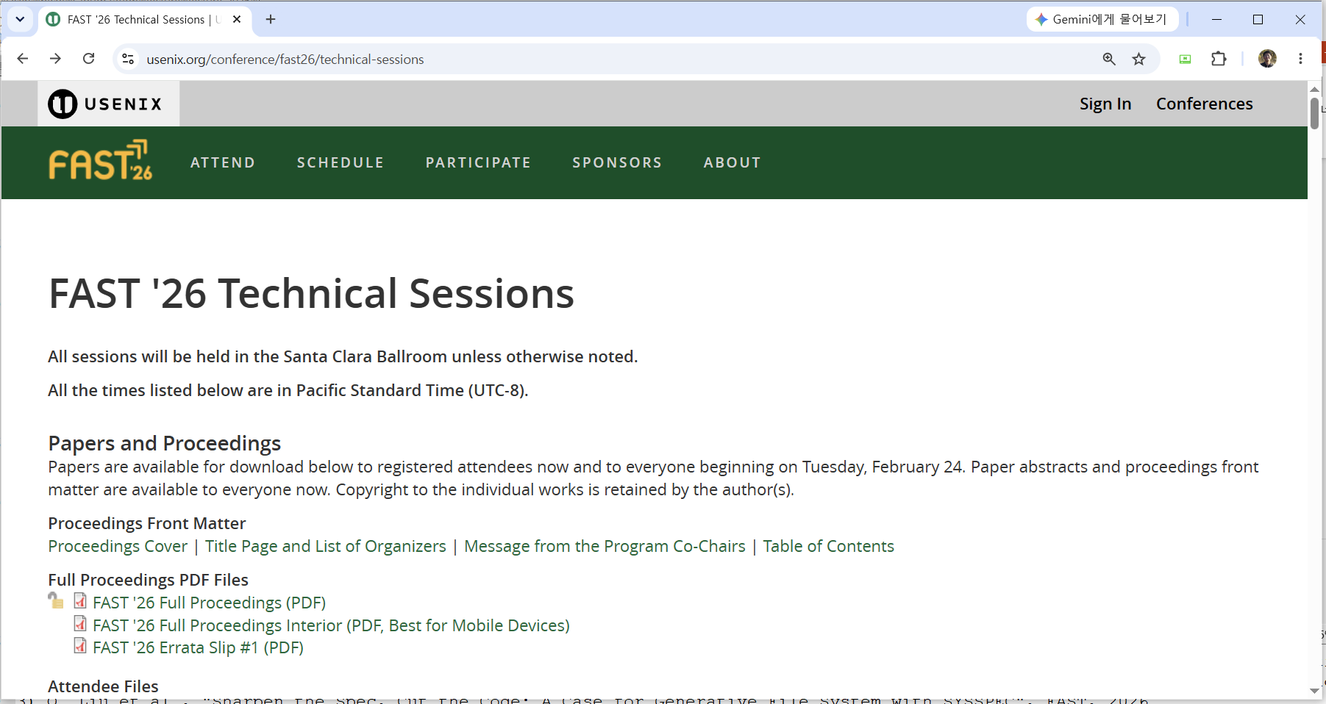
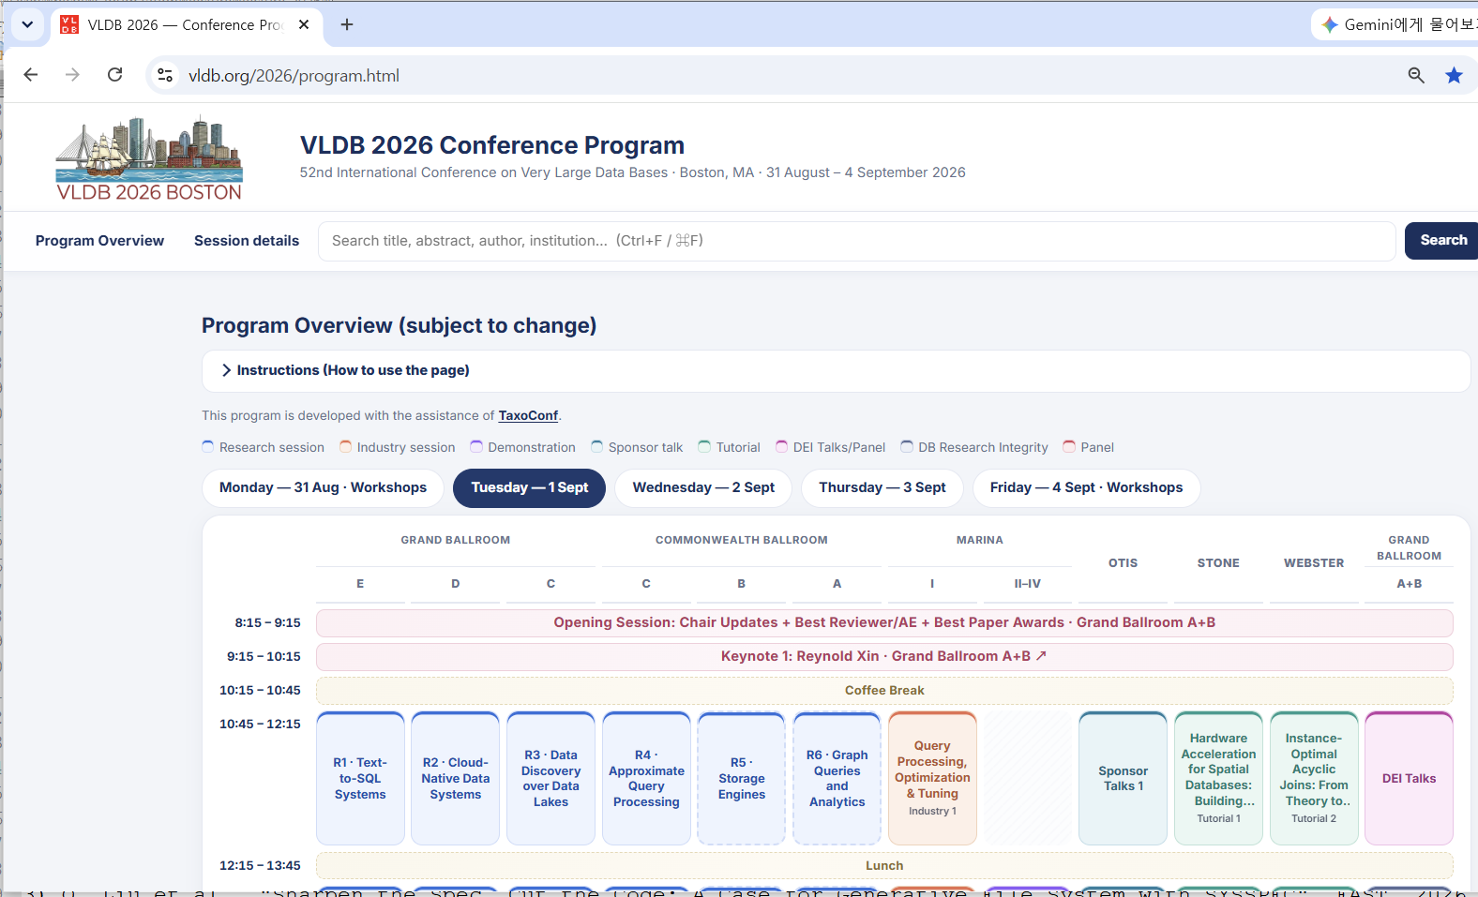
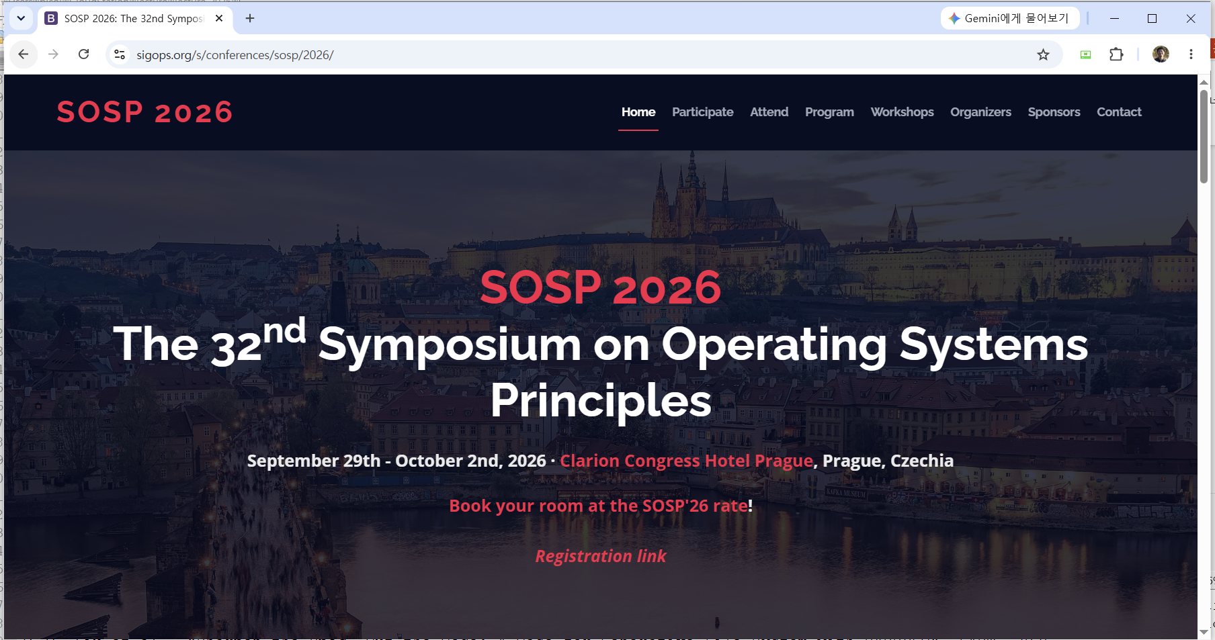
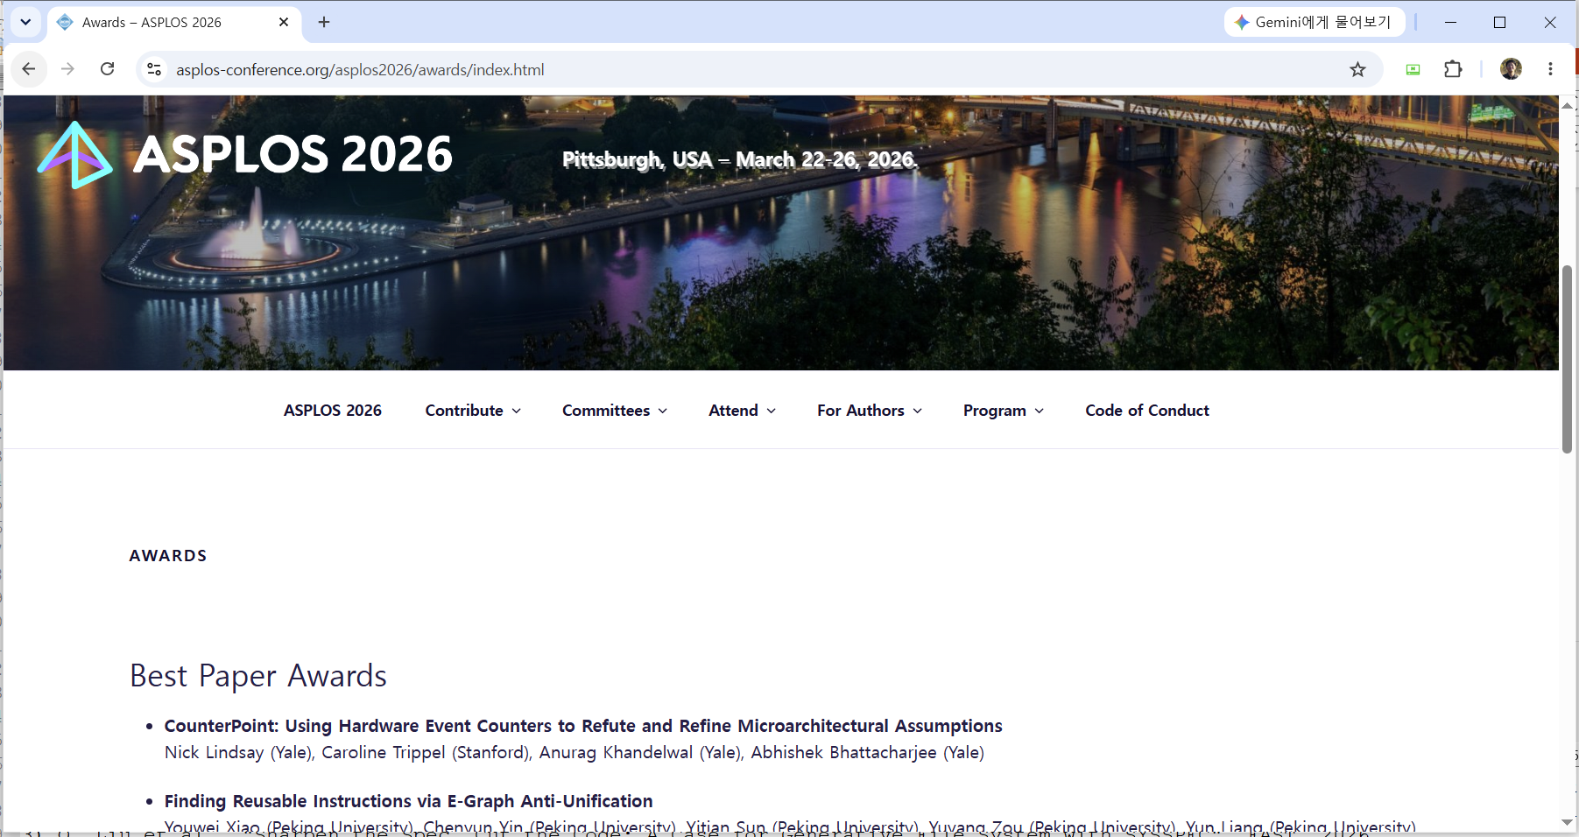
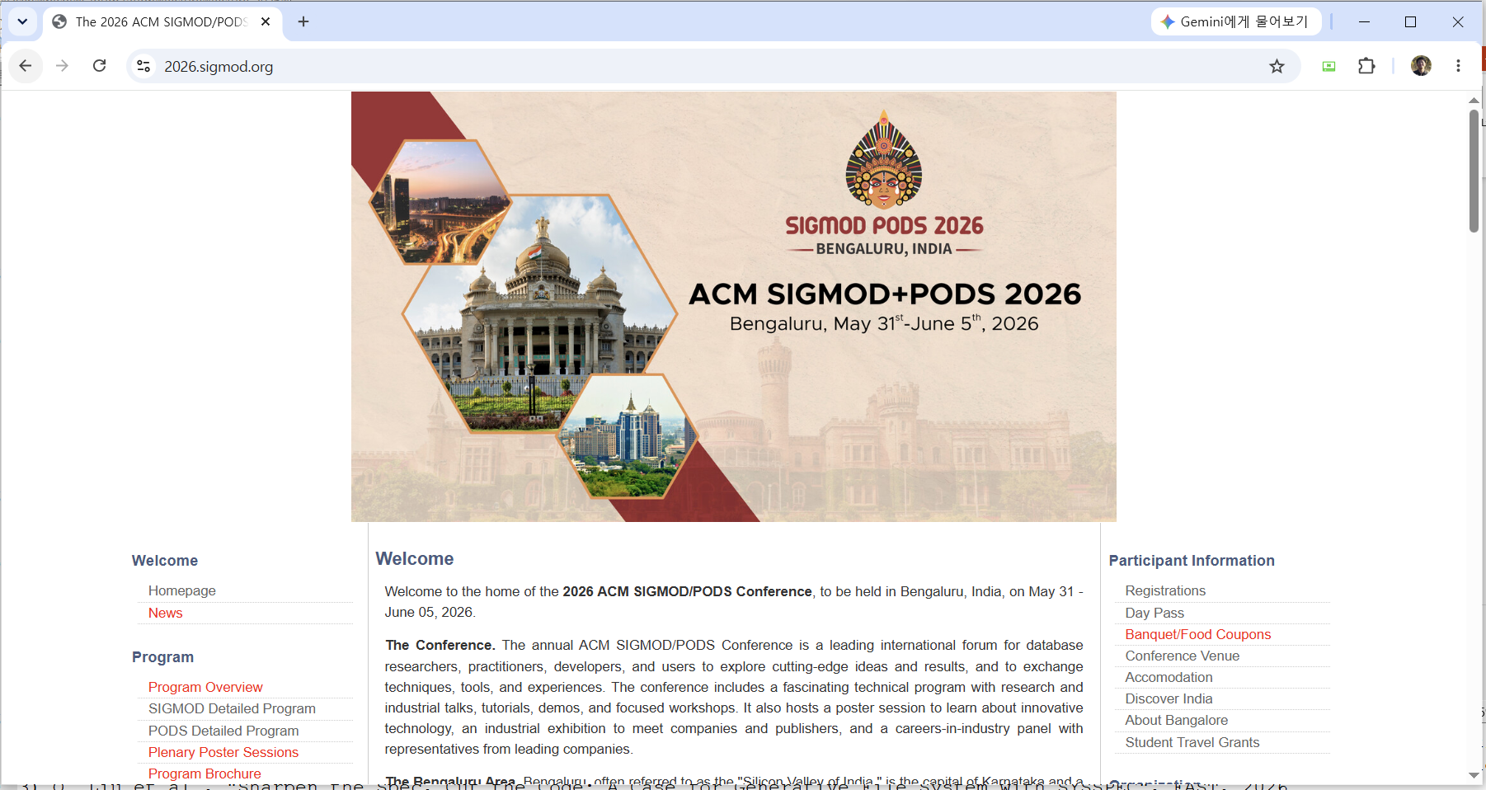
Course text
Where can you find papers?
  From various top-tier conferences and journals
<OSDI>
<FAST>
<VLDB>
<SOSP>
<ASPLOS>
<SIGMOD>
3

Slide 4
Paper lists (Suggested)
1주. Introduction
  강의 내용, 방법 소개 ➔ 논문 선택 (5개 선택, 그 중에 3 or 4개 발표)
2주. OS basic
  C. Waldspurger and W. Weihl, "Lottery Scheduling: Flexible Proportional-Share Resource Management", OSDI, 1994.
  D. Lee et al., "LRFU: A Spectrum of Policies that Subsumes the Least Recently Used and Least Frequently Used Policies", IEEE Transactions on Computers, 2001.
  M. Rosenblum and J. Ousterhout, "The design and implementation of a log-structured file system", ACM Transactions on Computer Systems, 1992.
3주. Fundamental Framework
  P. Barham et al., "Xen and the Art of Virtualization", SOSP, 2003.
  J. Dean et al., "MapReduce: Simplified Data Processing on Large Clusters", OSDI, 2004.
  S. Weil et al., "Ceph: A Scalable, High-Performance Distributed File System", OSDI, 2006.
4주. Key-Value Stores
  L. Lu et al., "WiscKey: Separating Keys from Values in SSD-conscious Storage", FAST, 2016.
  N. Dayan and S. Idreos, "Dostoevsky: Better Space-Time Trade-Offs for LSM-Tree Based Key-Value Stores via Adaptive Removal of Superfluous Merging", SIGMOD, 2016.
  K. Kanellis., "From FASTER to F2: Evolving Concurrent Key-Value Store Designs for Large Skewed Workloads", VLDB, 2025.
5주. SSD
  Aayush Gupta et al., "DFTL: A flash translation layer employing demand-based caching of page-level address mappings", ASPLOS, 2009.
  B. Kim, "Design Tradeoffs for SSD Reliability", FAST, 2019
  Y. Jun et al., "We Ain't Afraid of No File Fragmentation: Causes and Prevention of Its Performance Impact on Modern Flash SSDs", 2024.
4
Notes:
논문 배정: 2개씩: 12명 * 2개 = 24 = 2개*11주 + 1개*2주 + 0개*2주 (1주/15주)
논문 배정: 3개씩: 12명 * 3개 = 36 = 3개*11주 + 1개*2주 ➔ 한 학생은 2개가 되는군.

Slide 5
Paper lists (Suggested)
6주. System for LLM
  G. Yu et al., "Orca: A Distributed Serving System for Transformer-Based Generative Models", OSDI, 2022.
  W. Kwon et al. "Efficient Memory Management for Large Language Model Serving with PagedAttention", SOSP, 2023.
  N. Wadlom et al., "Efficient LLM Serving for Agentic Workflows: A Data Systems Perspective", SIGMOD, 2026.
7주. VectorDB Survey
  J. Pan et al., "Survey of Vector Database Management Systems", VLDB, 2024.
  L. Ma et al., "A Comprehensive Survey on Vector Database: Storage and Retrieval Technique, Challenge", arxiv
  J. Wang et al., "Milvus: A purpose-built vector data management system", SIGMOD, 2021
8주. Personal presentation
  Idea (연구 주제 아이디어 발표)+ Related work (연구 주제에 대한 관련 연구) + Design (설계 내용)
9주. Vector Search
  I. Azizi et al., "Graph-Based Vector Search: An Experimental Evaluation of Twenty-Four State-of-the-Art Methods", SIGMOD, 2025.
  J. Luo et al., "CGIF: Combining Proximity Graphs and Inverted Files for Efficient Filtered Vector Search over Arbitrary Predicates", VLDB, 2026.
  Y. Malkov et al., "Efficient and robust approximate nearest neighbor search using Hierarchical Navigable Small World graphs", IEEE Transactions on Pattern Analysis and Machine Intelligence, 2016
10주. Disk-based ANN
  S. Subramanya et al., "DiskANN: Fast Accurate Billion-point Nearest Neighbor Search on a Single Node", NeurIPS, 2019
  X. Chen et al., "Disk-Resident Graph ANN Search: An Experimental Evaluation", arXiv.
  M. Wang et al., "Starling: An I/O-Efficient Disk-Resident Graph Index Framework for High-Dimensional Vector Similarity Search on Data Segment", SIGMOD, 2024.
5

Slide 6
Paper lists (Suggested)
11주. Learned index
  Tim Kraska et al., "The Case for Learned Index Structures", SIGMOD 2018.
  Y. Dai et al., "From WiscKey to Bourbon: A Learned Index for Log-Structured Merge Trees", OSDI, 2020.
  S. Wang et al., "LearnedFTL: A Learning-Based Page-Level FTL for Reducing Double Reads in Flash-Based SSDs", HPCA, 2024.
12주, Distributed and Disaggregated System
  C. Wang et al., "Semeru: A Memory-Disaggregated Managed Runtime", OSDI, 2020.
  J. Yu et al., "FalconFS: Distributed File System for Large-Scale Deep Learning Pipeline", NSDI, 2026.
  J. Liu et al., "Structural Designs Meet Optimality: Exploring Optimized LSM-tree Structures in a Colossal Configuration Space", SIGMOD, 2024
13주. New concept
  Y. Huang et al., "The Clustering Strikes Back: Building Cost-Effective and High-Performance ANNS at Scale with Helmsman", OSDI, 2026.
  F. Turchenko et al., "Matryoshka: Uncovering Relevant Features in Data Lakes to Enhance Machine Learning Applications", VLDB, 2026.
  A. Kusupati et al., "Matryoshka Representation Learning", NeurIPS, 2022.
14주. Best papers
  Q. Liu et al., "Sharpen the Spec, Cut the Code: A Case for Generative File System with SYSSPEC", FAST, 2026.
  L. Chen et al., "Teaching the Old Dog New Tricks: Building Efficient Data Pipelines for Large-Scale LLM Pre-Training (Operational Systems)", OSDI, 2026.
  Y. Liu et al., "PropertyGPT: LLM-driven Formal Verification of Smart Contracts through Retrieval-Augmented Property Generation ", NDSS, 2025.
15주. Personal presentation
  Evaluation (연구 주제에 대한 실험 내용) + Documentation (논문 형식. 예를 들어 정보과학회)
6

Slide 7
Paper lists (Candidates)
Recommended for reading
  General
    Butler W. Lampson, “Hints for Computer System Design,” SOSP’83.
  OS
    J. Hwang et al., “Rearchitecting Linux Storage stack”, OSDI’21.
    S. R. Dulloor et al., “System Software for Persistent Memory”, Eurosys’14.
    M. Marty Set al., “Snap: a Microkernel Approach to Host Networking”, SOSP’19.
    H. Park et al., "Regularities considered harmful: forcing randomness to memory accesses to reduce row buffer conflicts for multi-core, multi-bank systems", ASPLOS, 2013.
  Storage
    H. Guo and Y. Lu, "Achieving Low-Latency Graph-Based Vector Search via Aligning Best-First Search Algorithm with SSD", OSDI, 2025.
    F. Chen et al., “CAFTL: A Content-Aware Flash Translation Layer Enhancing the Lifespan of Flash Memory based Solid State Drives”, FAST’11.
    M. Bjørling et al., “ZNS: Avoiding the Block Interface Tax for Flash-based SSDs“, ATC’21.
  AI systems
    V. Reddi et al., “MLPerf Inference Benchmark”, ISCA’20.
    L. Zheng et al., “Ansor: Generating High-Performance Tensor Programs for Deep Learning”, OSDI’20.
    X. Wan wt al. "The Shadow Price of Reasoning: Economic Perspective on Optimal Budget Allocation for LLMs", ICML, 2026.
    F. Turchenko et al., "Matryoshka: Uncovering Relevant Features in Data Lakes to Enhance Machine Learning Applications", VLDB, 2026.
  KVS and VectorDB
    G. DeCandia et al., “Dynamo: Amazon’s Highly Available Key-value Store”, SOSP’07.
    S. Dong et al., “Evolution of Development Priorities in Key-value Stores Serving Large-scale Applications: The RocksDB Experience”, FAST’21.
    R. Guo et al., "Manu: a cloud native vector database management system", VLDB, 2022.
  …
Please let me know if you want to present other papers (major conf. & 2024 or later)
7

Slide 8
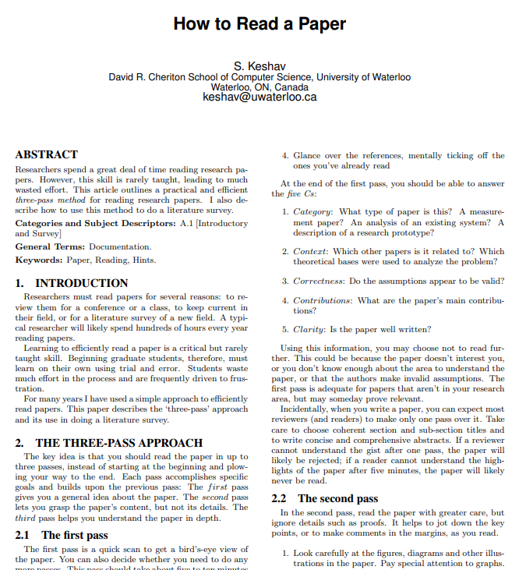
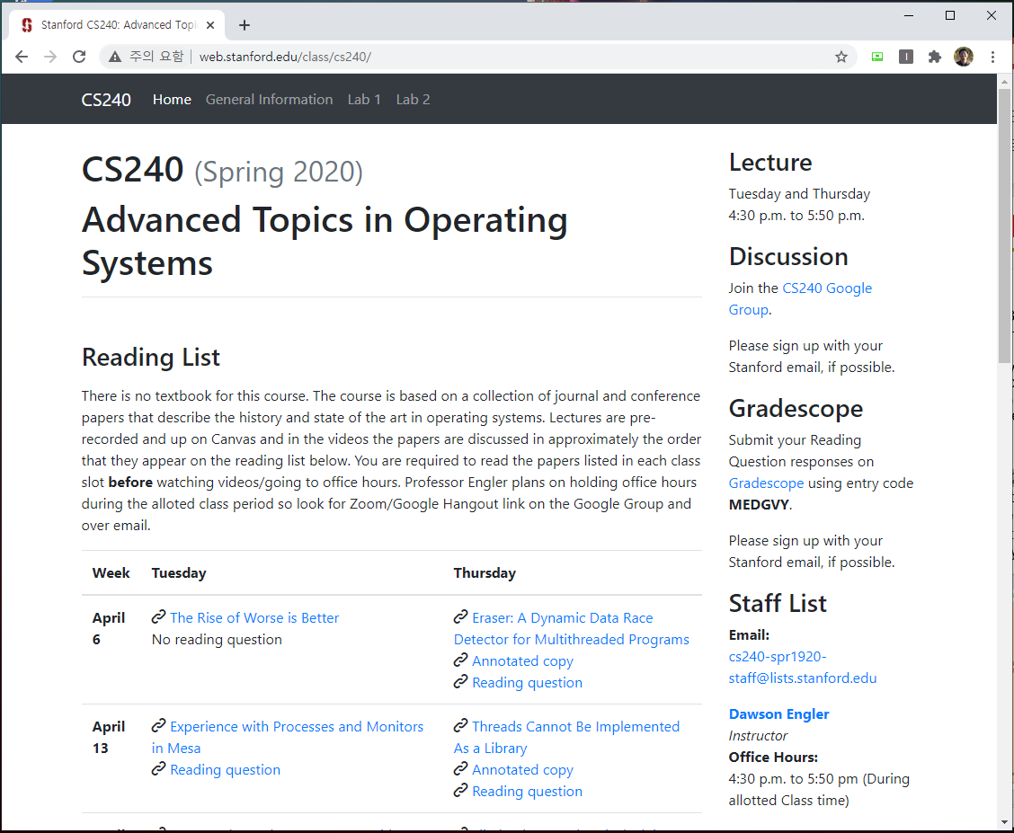
Documents about how to read/write a paper?
How to read a paper.
  J. Eisner, “How to Read a Technical Paper”, https://www.cs.jhu.edu/~jason/advice/how-to-read-a-paper.html.
  Roy Levin and David D. Redell, “How (and How Not) to Write a Good Systems Paper”, ACM Operating Systems Review, 1983.
  J. Maletic, “How to Read and Evaluate Technical Papers”, http://www.cs.kent.edu/~jmaletic/howtoread.html.
  S. Keshav, “How to read a paper”, https://web.stanford.edu/class/ee384m/Handouts/HowtoReadPaper.pdf.
Papers used in other universities
  http://web.stanford.edu/class/cs240/
  https://www.seltzer.com/margo/teaching/CS508.19/syllabus.html
  http://pages.cs.wisc.edu/~dusseau/Classes/CS736/CS736-F13/papers.html
  http://csl.snu.ac.kr/courses/4190.568/2019-1/#readings
8

Slide 9
Lecture details
Presentation (roughly 3~4 times per person)
  Less than 25 minutes
  Q & A are quite important
Paper Review
Personal project
  Write a paper
No examination
9

Slide 10
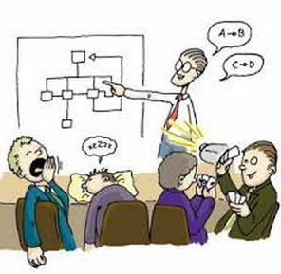
How to present
Presentation
  Time
    Presentation: 25 min, Q&A: 10 min
  Slide
    Less than 15 lines per each page
    More than half pages must contain figures
    Must include humor slides (if not, less points)
    Must include references (if not, less points)
    Each slide must be put in the lecture site (send it to choijm@dankook.ac.kr by Monday (previous day), 6pm)
Audience
  Obligation of audience: at least one question per person a day
    Without questions, you can not get a good grade.
    Count the number of questions
10

Slide 11
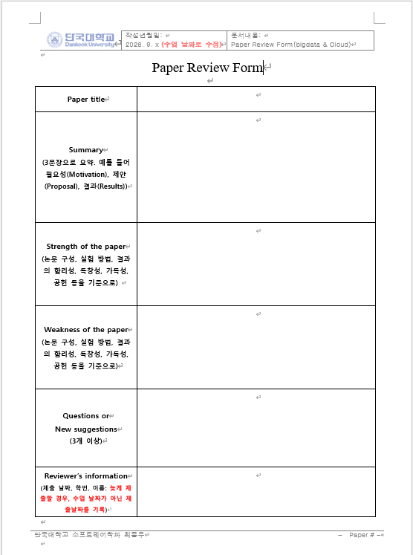
How to review a paper
Paper Review
  All student must submit reviews about papers assigned to the corresponding week.
  Format
    Summary
      3 sentences
      Motivation, Proposal, Evaluation
    Strength
      What are positive things in this paper?
    Weakness
      What are the down sides of this paper?
    Questions or Suggestions
      At least 3
11

Slide 12
How to make a proposal
Personal project
  1. Idea, Related work and Initial design presentation (15 minutes)
    Personnel introduction, Ice break
    Research Idea (or Brainstorming)
    Related work (prepare references in advance)
    Design: 1) why, 2) how, 3) what are expected results
  2. Final presentation (12 minutes)
    Idea, Related work, Design, Evaluation results
      Apply the idea learnt from your presentation
    1) presentation (ppt), 2) paper (tex, hwp, word)
      I strongly recommend to submit KCC or KSC or any conferences/workshops
12

Slide 13

Evaluation
Evaluation
  Presentation(25%)
  Questions and Answers (25%)
  Paper review (25%)
  Final proposal (25%)
Choose 5 papers in the suggested list and send your choices to me via email (choijm@dankook.ac.kr) until this Friday (4th, September).
Need volunteers for next week (OS basic papers).
13

Slide 14

Discussion

